Slide 1
MARINE STRATEGY FRAMEWORK DIRECTIVE (MSFD) COMMON IMPLEMENTATION STRATEGY
MSFD Metadata Catalogue 19.3 reporting analysis
Document: DIKE TSG1 WP3 follow-up on art 19.3 data reporting

Slide 2
Article 19.3 Overview
Data collected through monitoring programmes under Article 11
Metadata catalogue under Article 19(3)
Assessments under Article 8
Progress towards achieving GES under Article 9
Progress towards targets under Article 10

Slide 3
Metadata reporting options for the Member Countries
Existing metadata fields for Art. 8 electronic reporting including a web link
Where data sets have been prepared specifically for use in the Initial Assessment, MS should list these and list how they can be accessed.
Directly to the Commission and EEA or by posting on the MS web site
Using the “metadata catalogue” option.
MS may use a mixture of both

Slide 4
Overview of the submitted metadata
Option a. followed by 10 MS (BE, CY, DK, FI, FR, EL, IE, LV, SE, UK)
Option c. followed by 6 MS (DE, IT, LT, RO, SL, ES)
Option b.i followed by NL
PL did not report

Slide 5
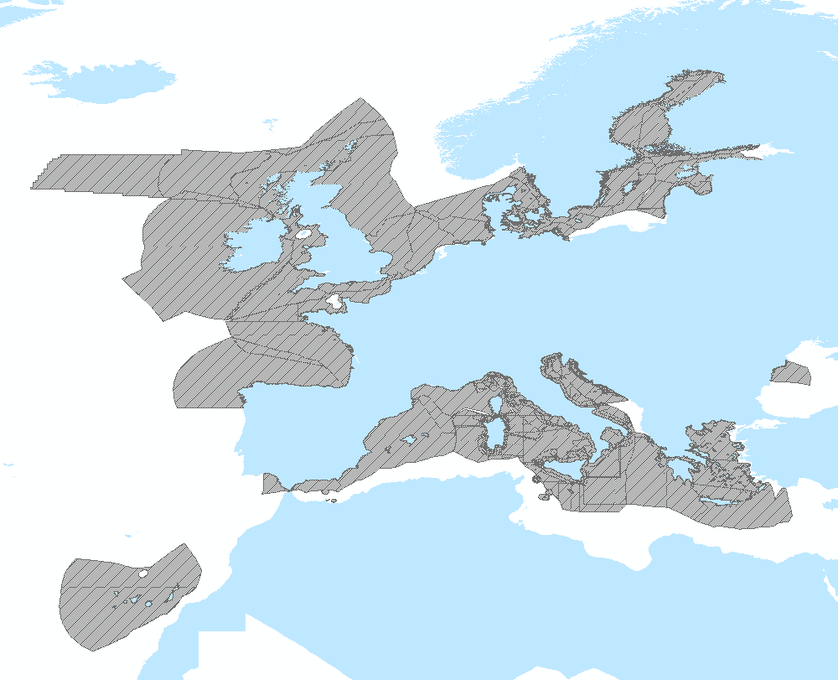
Geographical Coverage

Slide 6
Evaluation/Usability of the submitted metadata
Formats used: nonISO, INSPIRE, CDI, EDMED, DB records, .doc
Languages used: links to reports written in English by UK, IE, IT, RO and partly by EL, FI, DK, CY
Linkage to data source issue. Not enough information to locate the datasets/reports

Slide 7
Summary
Increasing the variability of the metadata sources adds extra complexity as far as the information extraction is concerned; and the usability of the information provided is negatively affected by the disparate sources/methods. While moving towards the 2018 deadline it becomes more and more clear that simple, standardised and harmonised reporting workflows are the key to success.

