Slide 1
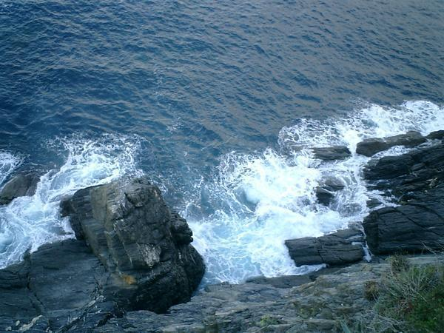
A roadmap for art 19.3
Trine Christiansen
March 19, 2013

Slide 2
Four long term objectives
To have defined a prioritized list of data sets directly linked to all GES indicators, monitoring programmes, and future MSFD assessments;
To have agreed the thematic content and format of each data set, according to the needs of MSFD for use in assessments, such that the data sets can be readily aggregated;
To have established effective and efficient data management mechanisms at national and EU levels which allow ready access to the data for the EEA and the EC according to the requirements of MSFD Article 19(3);
To have established public access to the data and data products via web portals, preferably via a single portal (WISE-Marine)

Slide 3
Marine information
Map and explain progress towards good environmental status across Europe
Starts with initial assessment reporting in 2012
With focus on status, pressures, and human activities
Will become elaborated through
Data related to initial assessments
Monitoring programmes and data from them
Criteria and indicators for good environmental status
Programmes of measures
2018 reporting
Most of this does not exist (yet) but information sharing can be based on WISE technology

Slide 4
WG-GES
with JRC, RSC’s, ICES, and TGs
High level objectives for GES definition (Art 3.5)
D1
D2
D3
D4
D5
D6
D7
D8
D9
D10
D11
Criteria
5.1
5.2
5.3
Indicators
5.2.1
5.2.2
5.2.3
5.3.4
Datasets
e.g. Chl-a
WG-DIKE and Art 19.3 with EEA
Specification
Data sharing mechanisms
Application of INSPIRE
Monitoring
Common methods
Monitoring programmes
Reporting

Slide 5
Indicators and data products
Data and observations
Monitoring programme reporting
Art 11
WISE-Marine
Art 19.3
WISE-marine

Slide 6
DIKE TSG1 objectives
To obtain a better understanding of how we can work together to assemble an adequate information system:
How are things working today
What came out of the 2012 art 19.3 reporting
What can we take from INSPIRE?
A model for organising working arrangements that also allows us to understand the roles of Emodnet and Copernicus.
Feedback to DIKE on a preferred model for working based on workshop discussions.

