Slide 1
Wrap-Up: Intro & Round Table
Setting the agenda

Slide 2
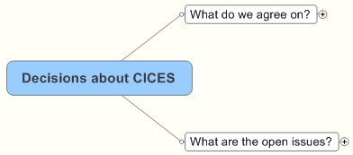
Agenda

Slide 3
Accommodates past and future
Process involves broadening/expanding interest groups
We are observing an 'evolutionary' process
Need a road map...it may take sometime.
Classifications are necessary but are part of the process
Do not use different classifications for the same purpose
What do we agree on?
Classifications must serve multiple purposes
One classification will not serve all purposes
What are the strengths/weakness of existing attempts?
Experience counts!
Examples of best practice are useful

Slide 4
Need
Do we need a classification/classification system?
Mandate
Valuation
Awareness
What are the purposes of CICES?
Policy/Planning
etc.
Who are the audiences for this?
Core set of definitions categories?
What are the open issues?
How can we ensure flexibility
Flexible just translation between ideas
Terminology (Dolf's paper)
MA+ or New approach?
Who are they?
If we need a road map - what are the steps?
Stakeholder involvement
How can they be involved?
CICES platform/champions
Process (Alessandra/Mark)
Synchronisation with other initiatives
Content
End-points
Post 2010 (Jan)

