Slide 1
Fast track implementation of ecosystem capital accounts in Europe
Landscape/biodiversity capacity accounts preliminary results 2000-2006-2010, version 2
Jean-Louis Weber, Emil D. Ivanov,
Rania Syropoulou, Oscar G. Prieto
4 June 2012

Slide 2
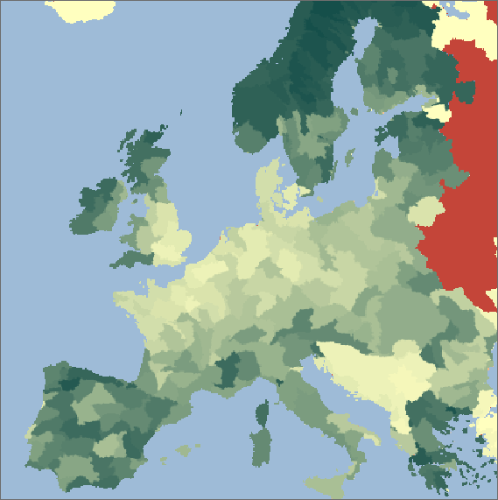
Net landscape ecological potential, nlep 2000 (observed)

Slide 3

Net landscape ecological potential, nlep 2010 (nowcast)

Slide 4
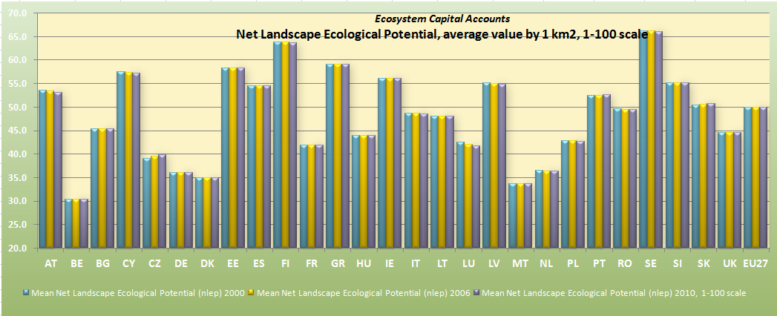
Ecosystem Capital Accounts: Landscape/Biodiversity Capacity Account

Slide 5
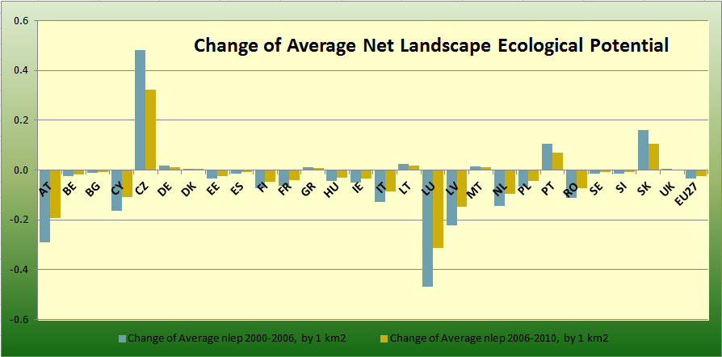
Ecosystem Capital Accounts: Landscape/Biodiversity Capacity Account

Slide 6
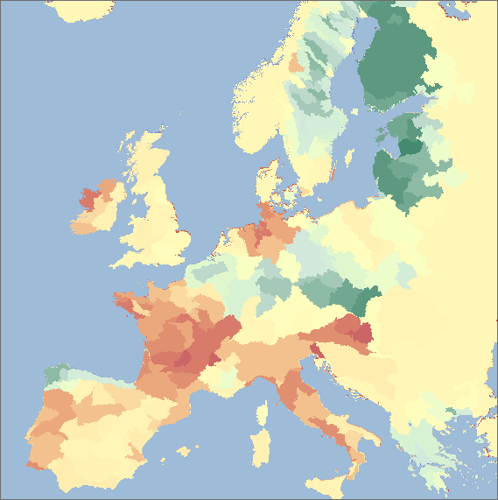
Art17 “Populations trend” biodiversity index, by sub-basins

Slide 7
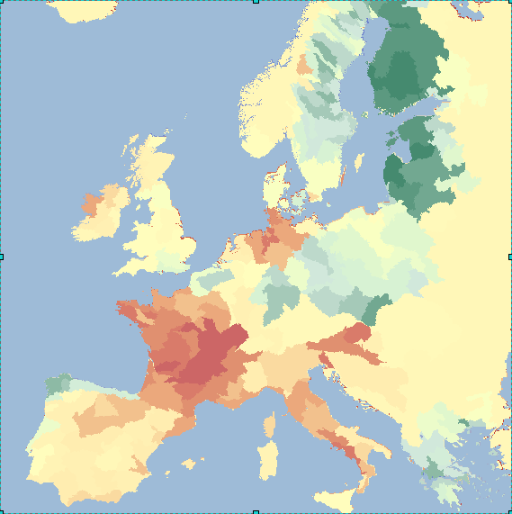
Art17 “Future prospect” biodiversity index, by sub-basins

Slide 8
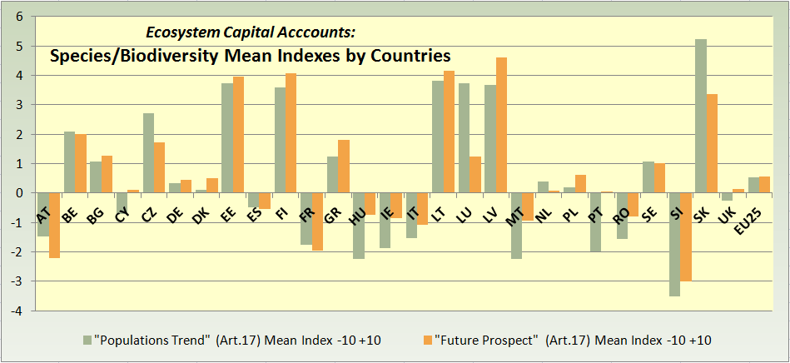
Ecosystem Capital Accounts: Landscape/Biodiversity Capacity Account

Slide 9
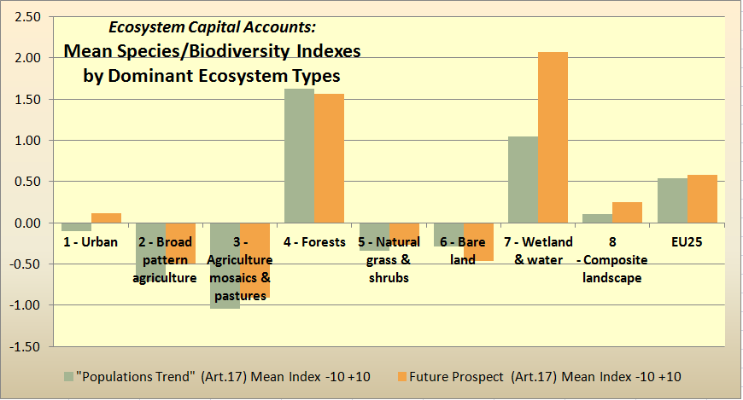
Ecosystem Capital Accounts: Landscape/Biodiversity Capacity Account

Slide 10
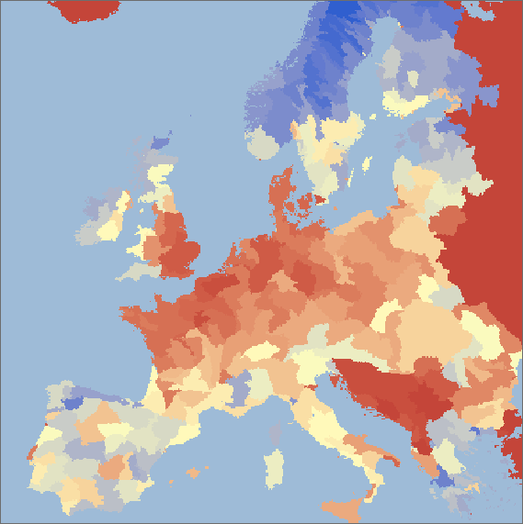
Landscape bio-capacity 2000 by sub-basins

Slide 11
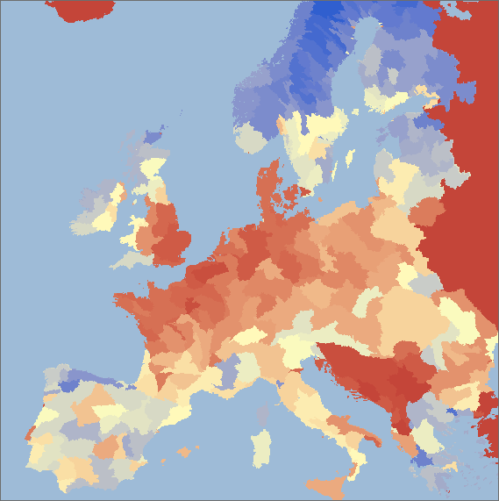
Landscape bio-capacity 2006 by sub-basins

Slide 12

Landscape bio-capacity 2010 by sub-basins

Slide 13
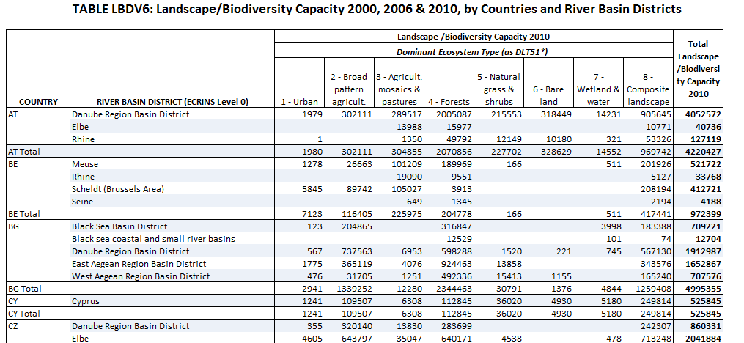
Ecosystem Capital Accounts: Landscape/Biodiversity Capacity Account

Slide 14
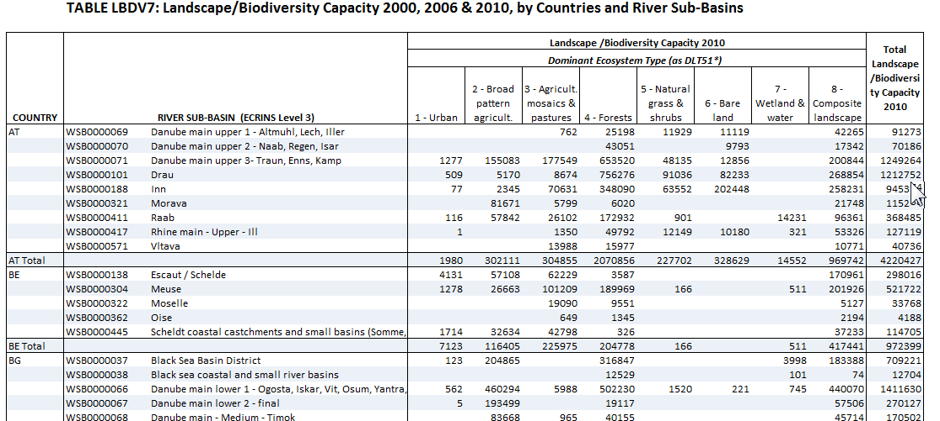
Ecosystem Capital Accounts: Landscape/Biodiversity Capacity Account

Slide 15
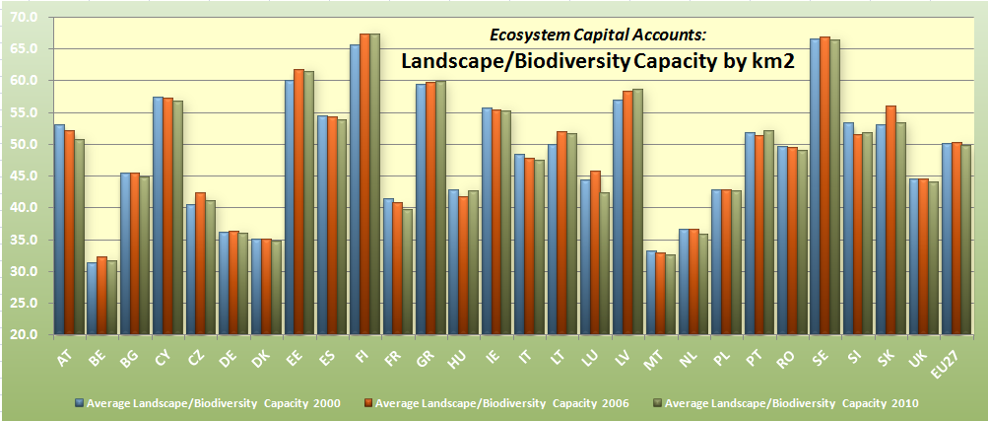
Ecosystem Capital Accounts: Landscape/Biodiversity Capacity Account

Slide 16
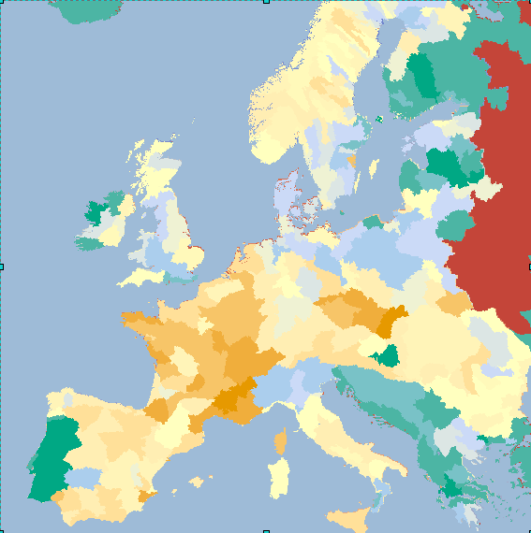
Change in landscape bio-capacity 2000-2006, by sub-basins

Slide 17
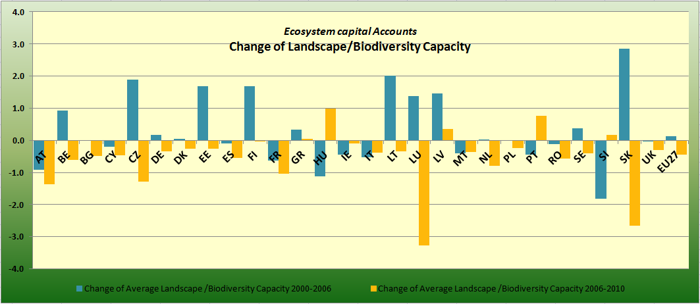
Ecosystem Capital Accounts: Landscape/Biodiversity Capacity Account

Slide 18
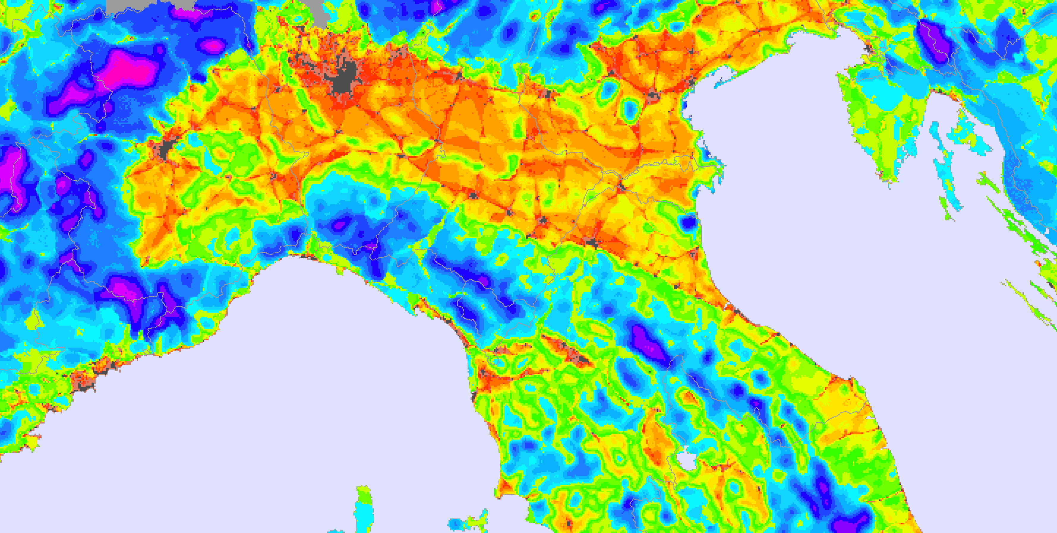

Landscape ecosystem potential (integrity): the EEA nlep indicator – 2000 (observed)

Slide 19
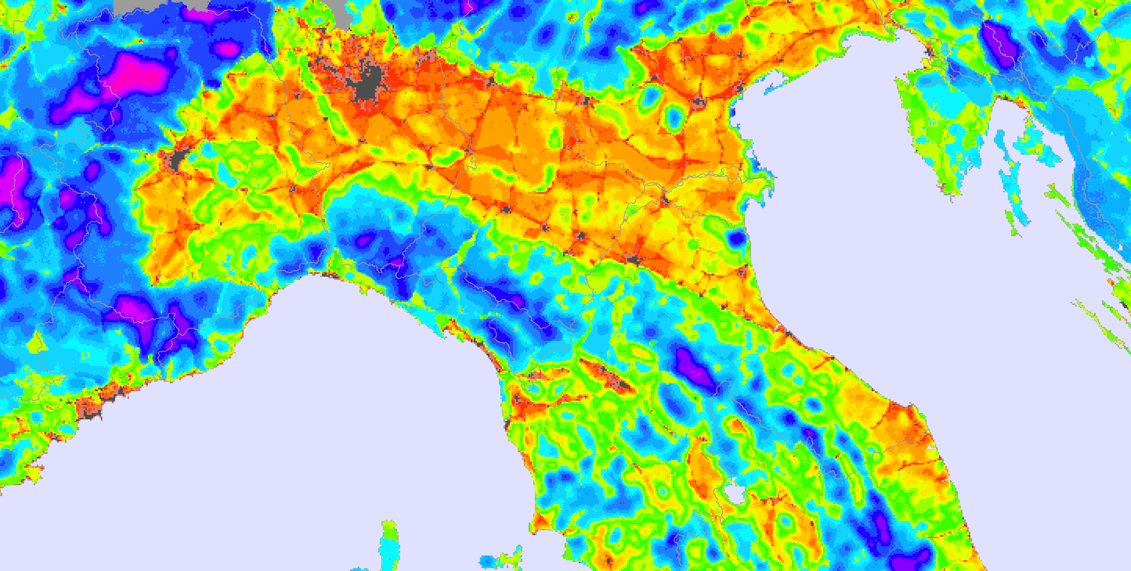
Landscape ecosystem potential: the EEA nlep indicator – 2010 (now-casting)

Slide 20
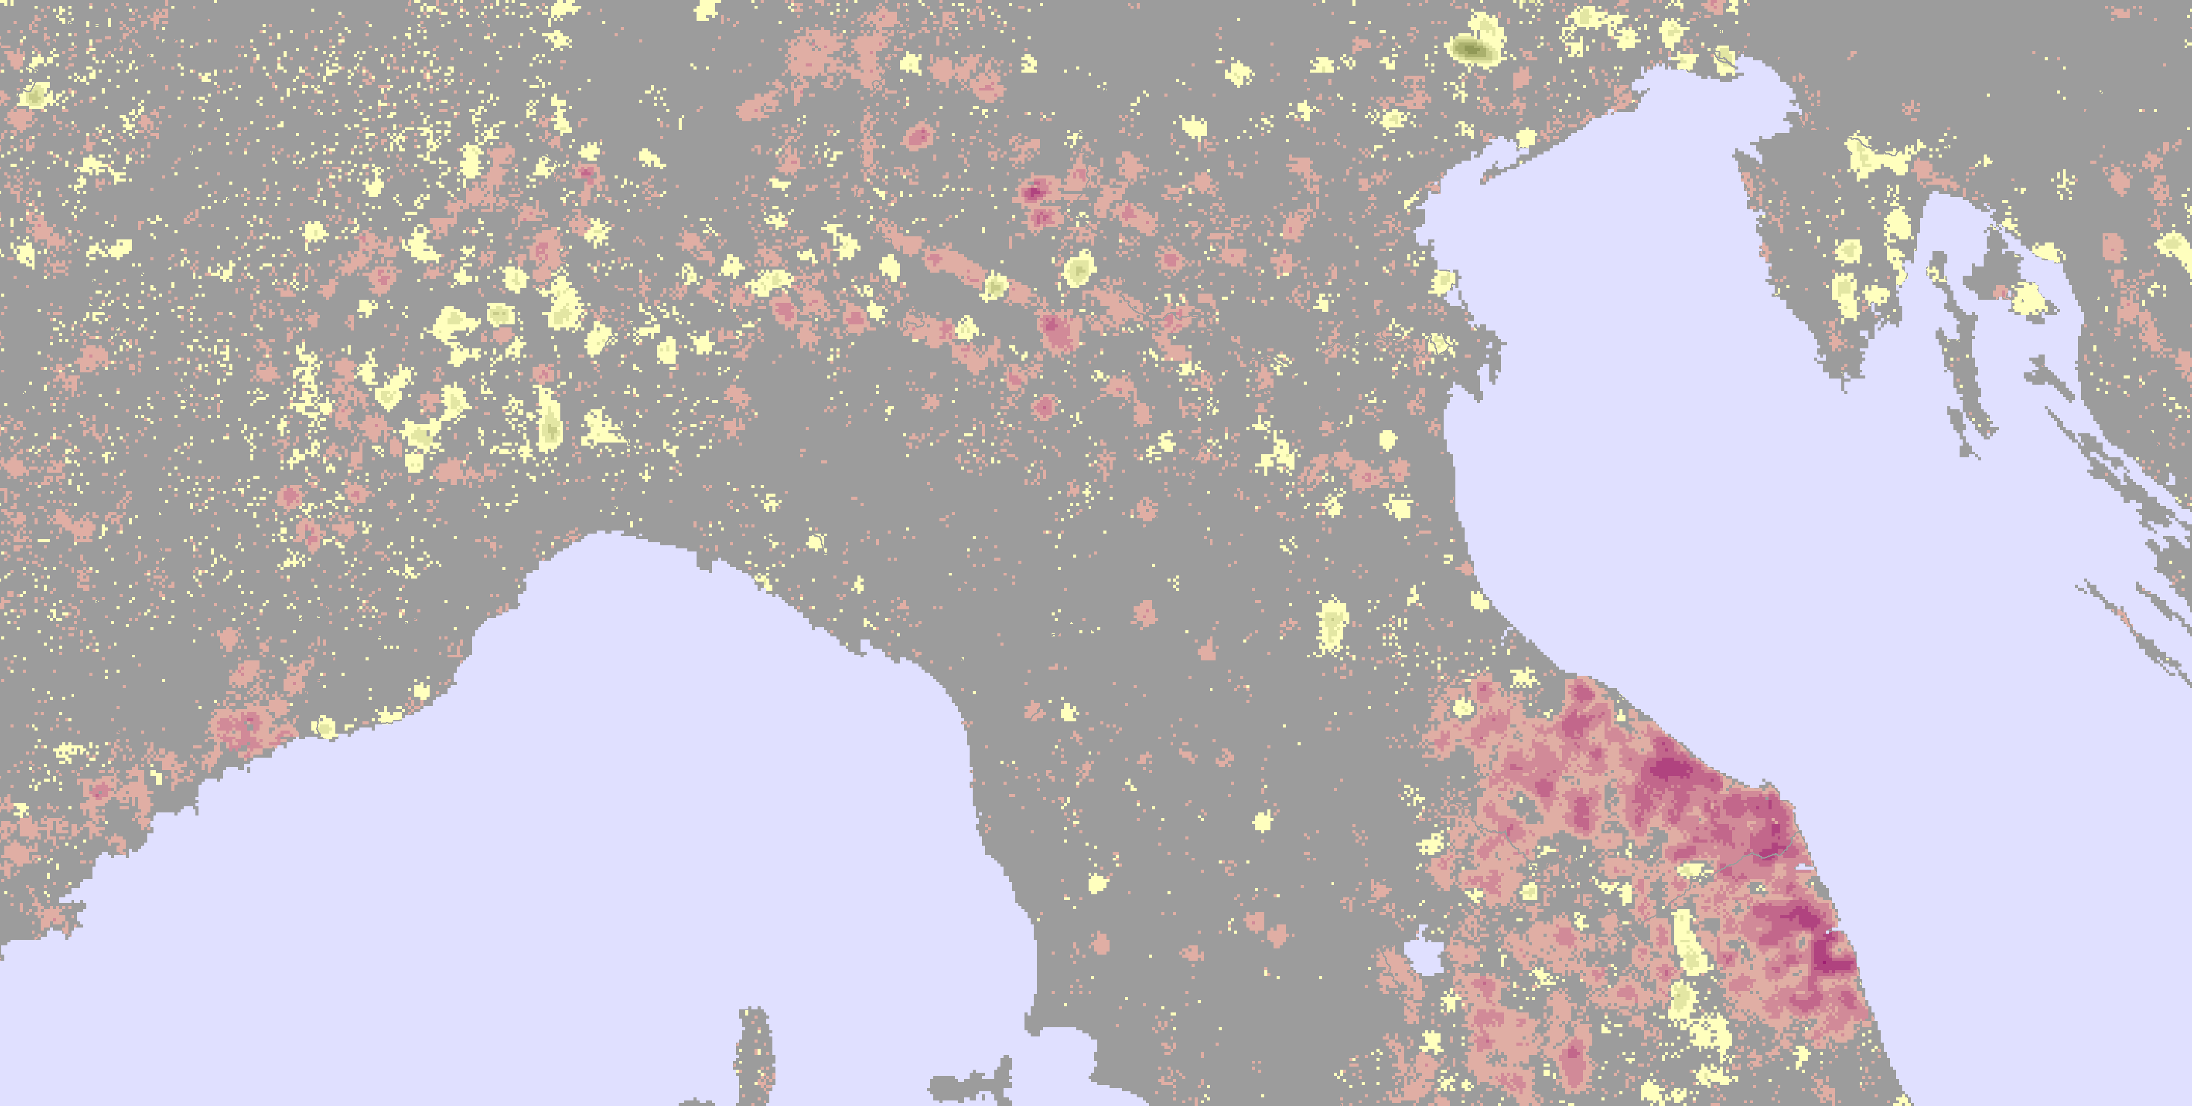

Change in nlep, 2000 – 2010, 0-100 scale

Slide 21
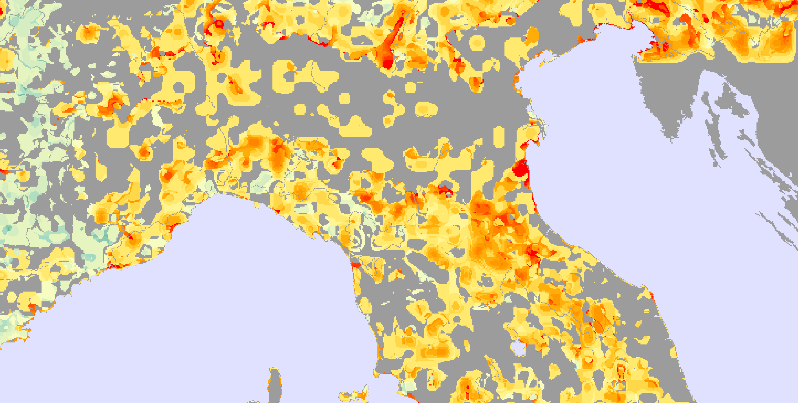

Species biodiversity index: “Art.17” reporting to the EC on Populations past/present trends (up to 2006)

Slide 22
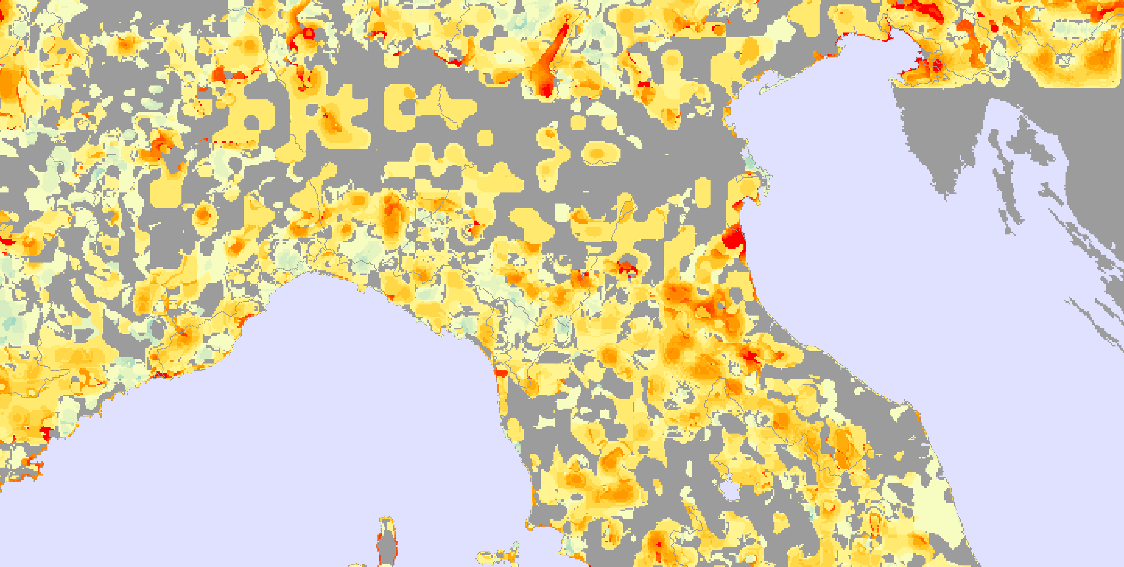
Species biodiversity index: “Art.17” reporting to the EC on Future prospects (after 2006)

Slide 23
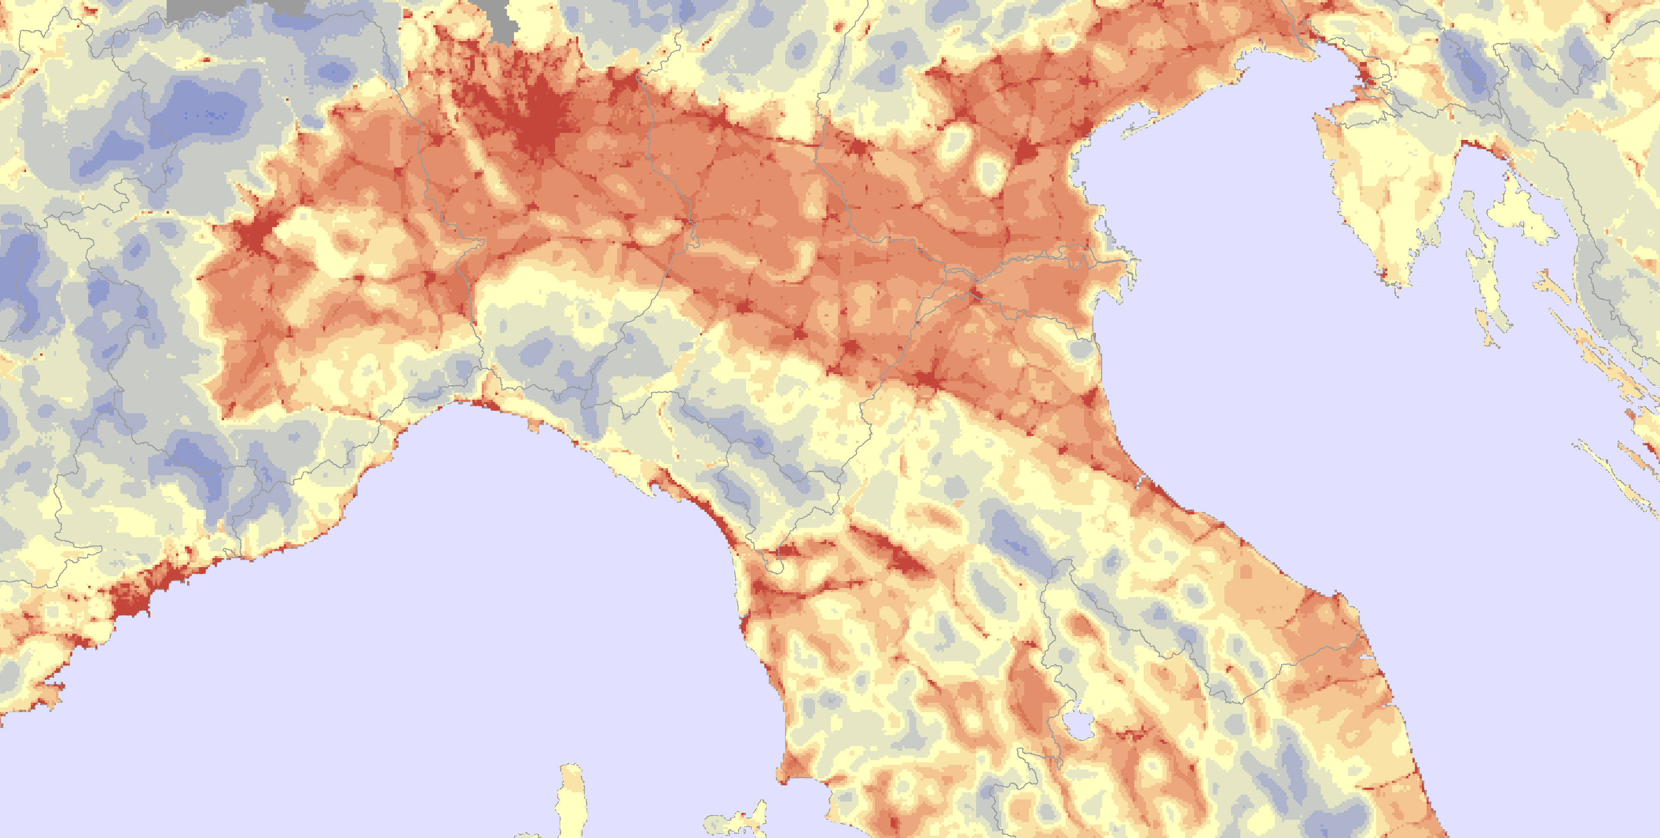

Landscape bio-capacity 2000

Slide 24
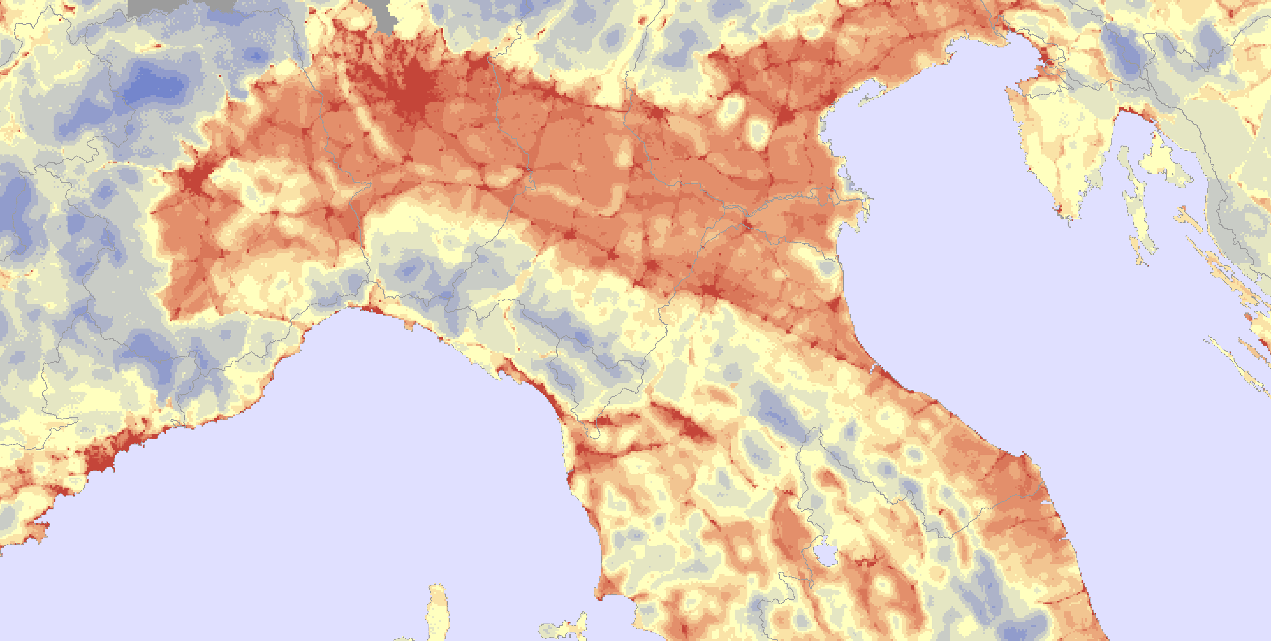
Lansdcape bio-capacity 2010

Slide 25
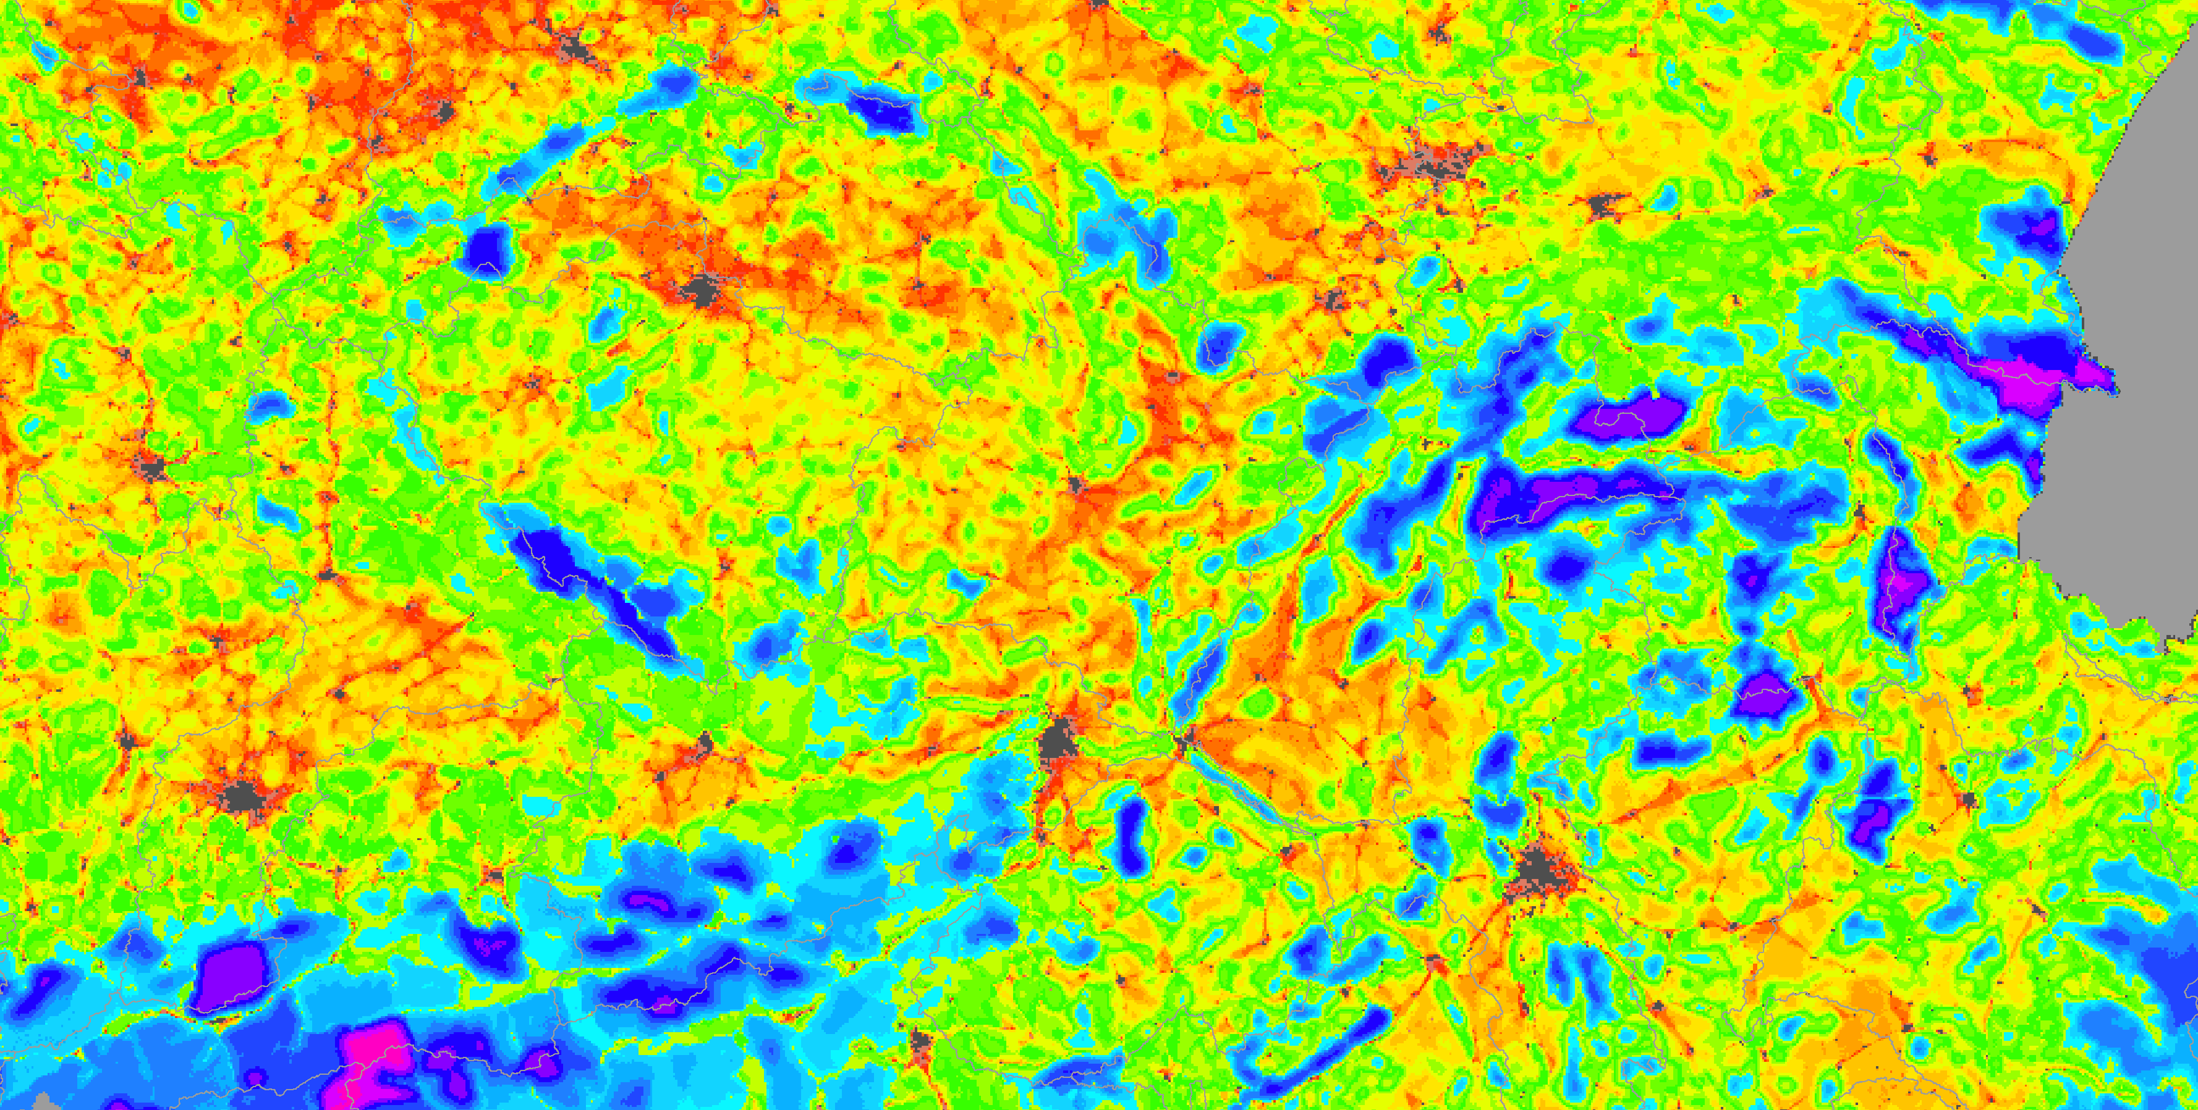
Landscape ecosystem potential (integrity): the EEA nlep indicator – 2000 (observed)

Slide 26
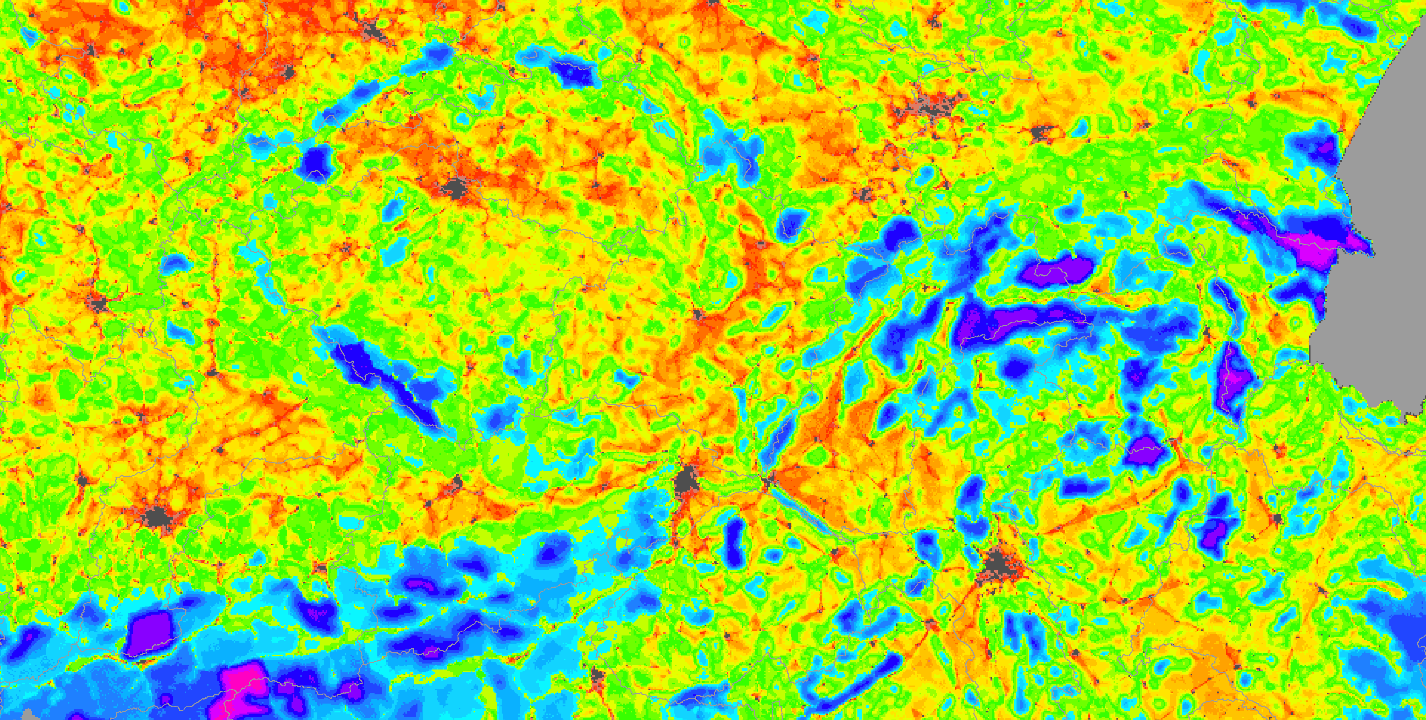
Landscape ecosystem potential (integrity): the EEA nlep indicator – 2010 (now-casting)

Slide 27

Change in nlep, 2000 – 2010, 0-100 scale

Slide 28
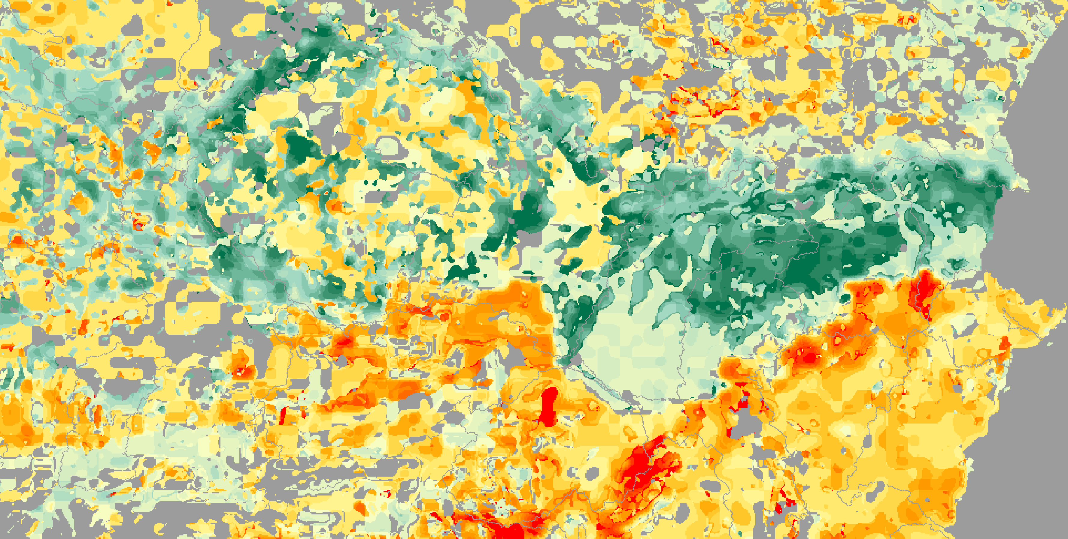
Species biodiversity index: “Art.17” reporting to the EC on Populations past/present trends (up to 2006)

Slide 29
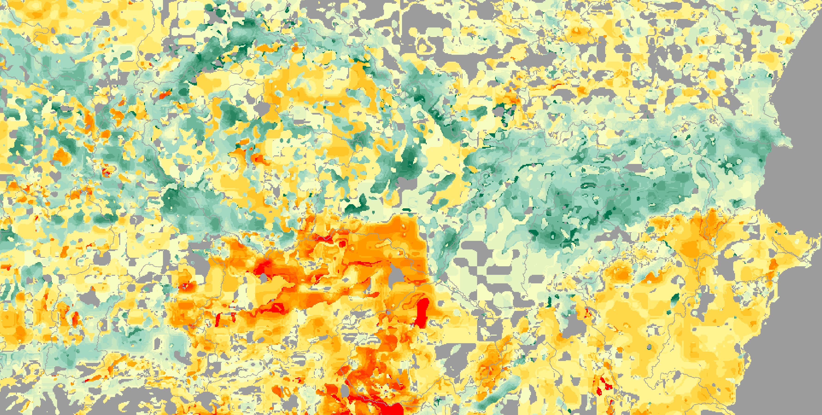
Species biodiversity index: “Art.17” reporting to the EC on Future prospects (after 2006)

Slide 30
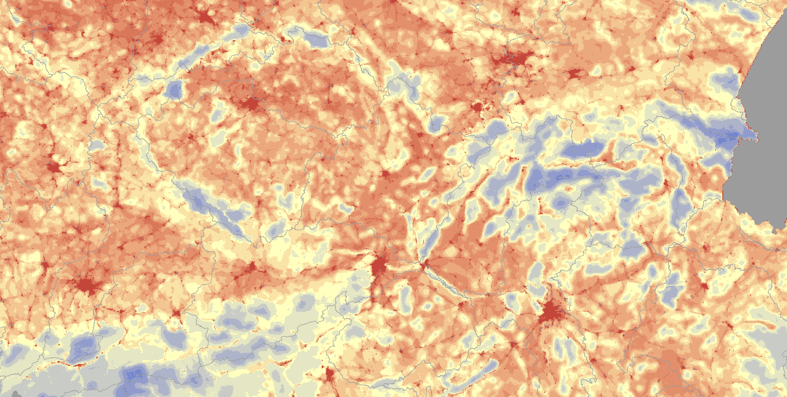
Landscape bio-capacity 2000

Slide 31
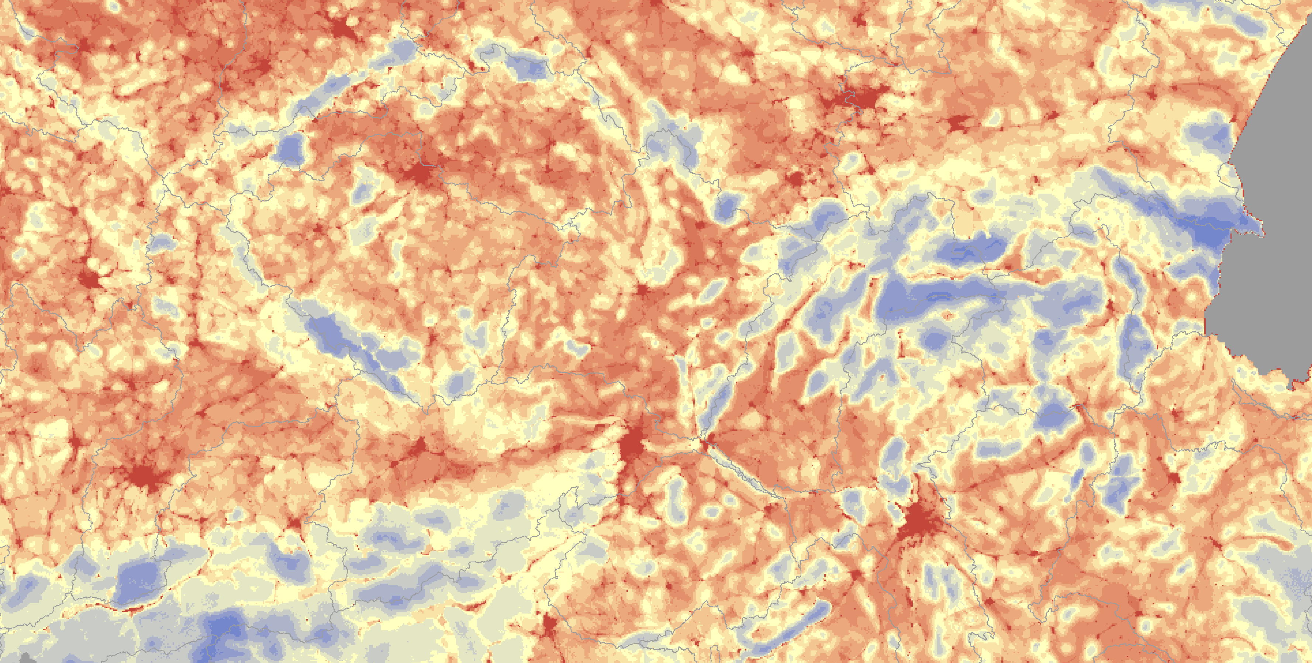
Lansdcape bio-capacity 2010

