Slide 1
European Example
Based on land use, current biodiversity trends, and future biodiversity prospects
Spatial resolution = 1 km, aggregated into various coarser units
Temporal resolution determined by frequency of evaluations
However, this example is based on a very well-known region in terms of biodiversity … can examples be developed for regions with less information infrastructure?

Slide 2
Biodiversity Metrics (From Jane McDonald Yesterday)
Measures relevant aspect of biodiversity
Measures change
Is scalable and comparable
Is based on obtainable data

Slide 3
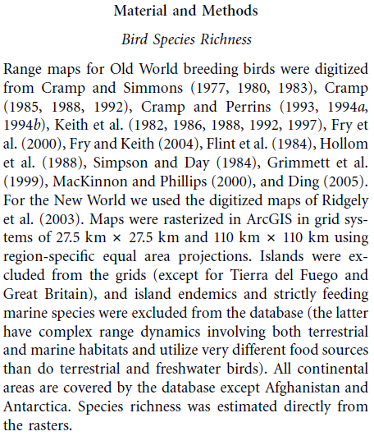
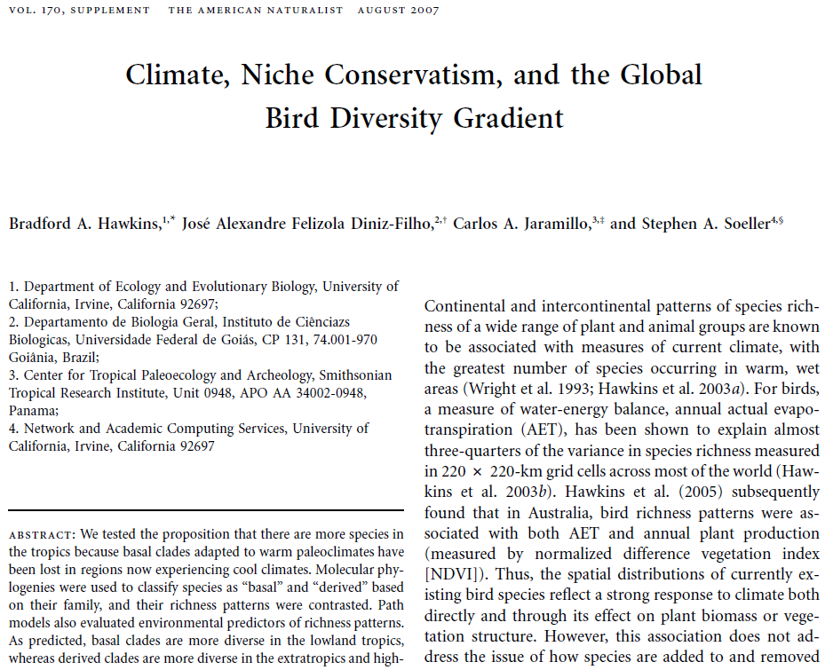
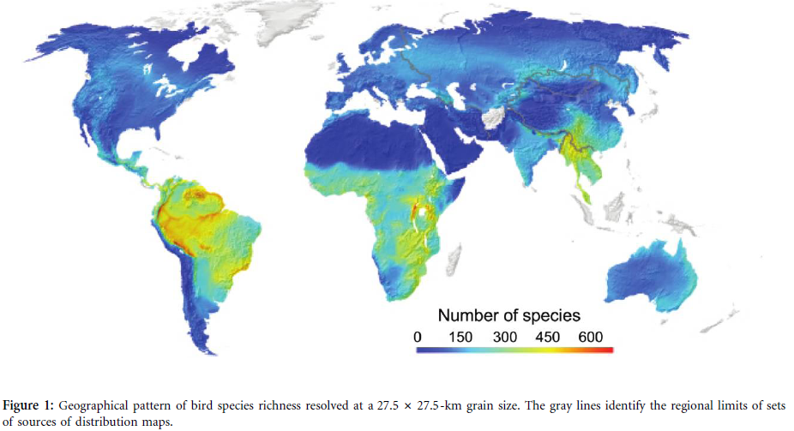

Slide 4
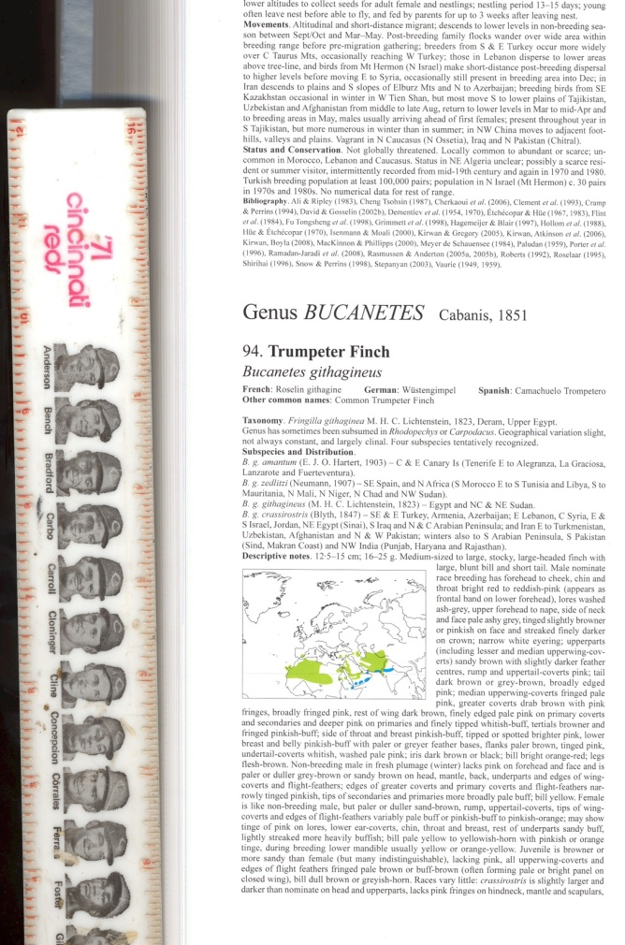
Southern tip of Greenland to southern tip of India
On published map: 1.625”
On the Earth: 431,637,049”
Effective map scale: 1:265,622,799

Slide 5
Point-based Distributional Data
Primary data – this is the basis of all other distributional data
Abundant – millions of specimens, probably billions of observations are ‘out there’
Major initiatives – ORNIS, eBird, GBIF, etc.
Dimensionless – a point has no area; biodiversity ‘points’ have only a basement level of uncertainty
Useful at any resolution above the basement level of uncertainty

Slide 6
Opinion: Biodiversity Data are abundant, but are much underutilized for lack of effective methodologies

Slide 7
Brazilian Plants – 3.5M Records

Slide 8
Birds of the World – 75M Records

Slide 9
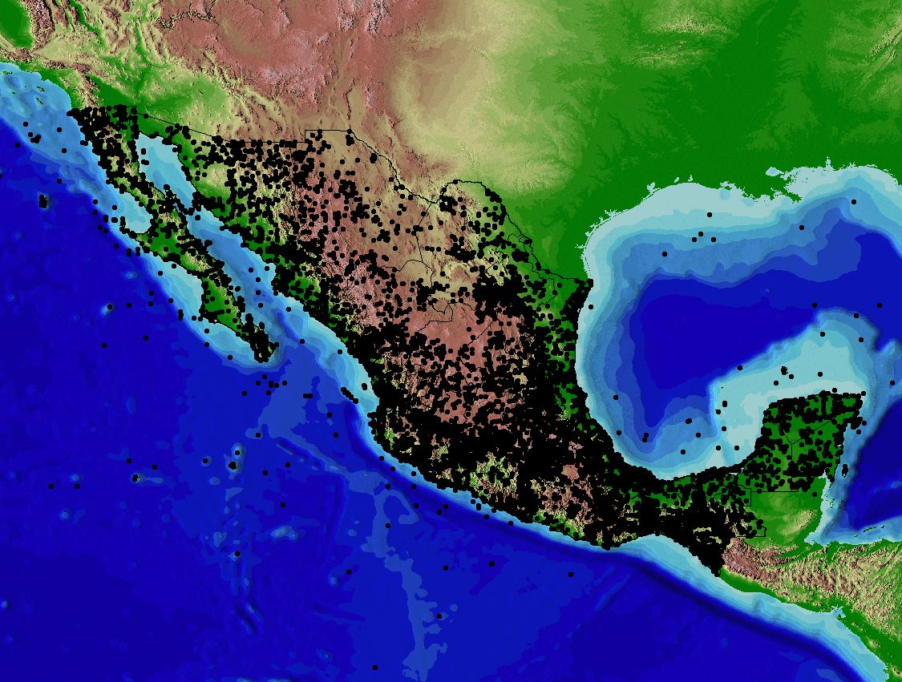
Birds of Mexico
0.42M Records

Slide 10
Biodiversity “Intactness”
Akin to the “current trends” in European example
Based on measuring loss of species that “should be” at a site
Requires historical data on occurrences for model building
Ecological niche models built based on climatic requirements
Requires new data on occurrences for measuring species losses
Coarsen resolution to suit data available
Compare present reality with expected set of species

Slide 11
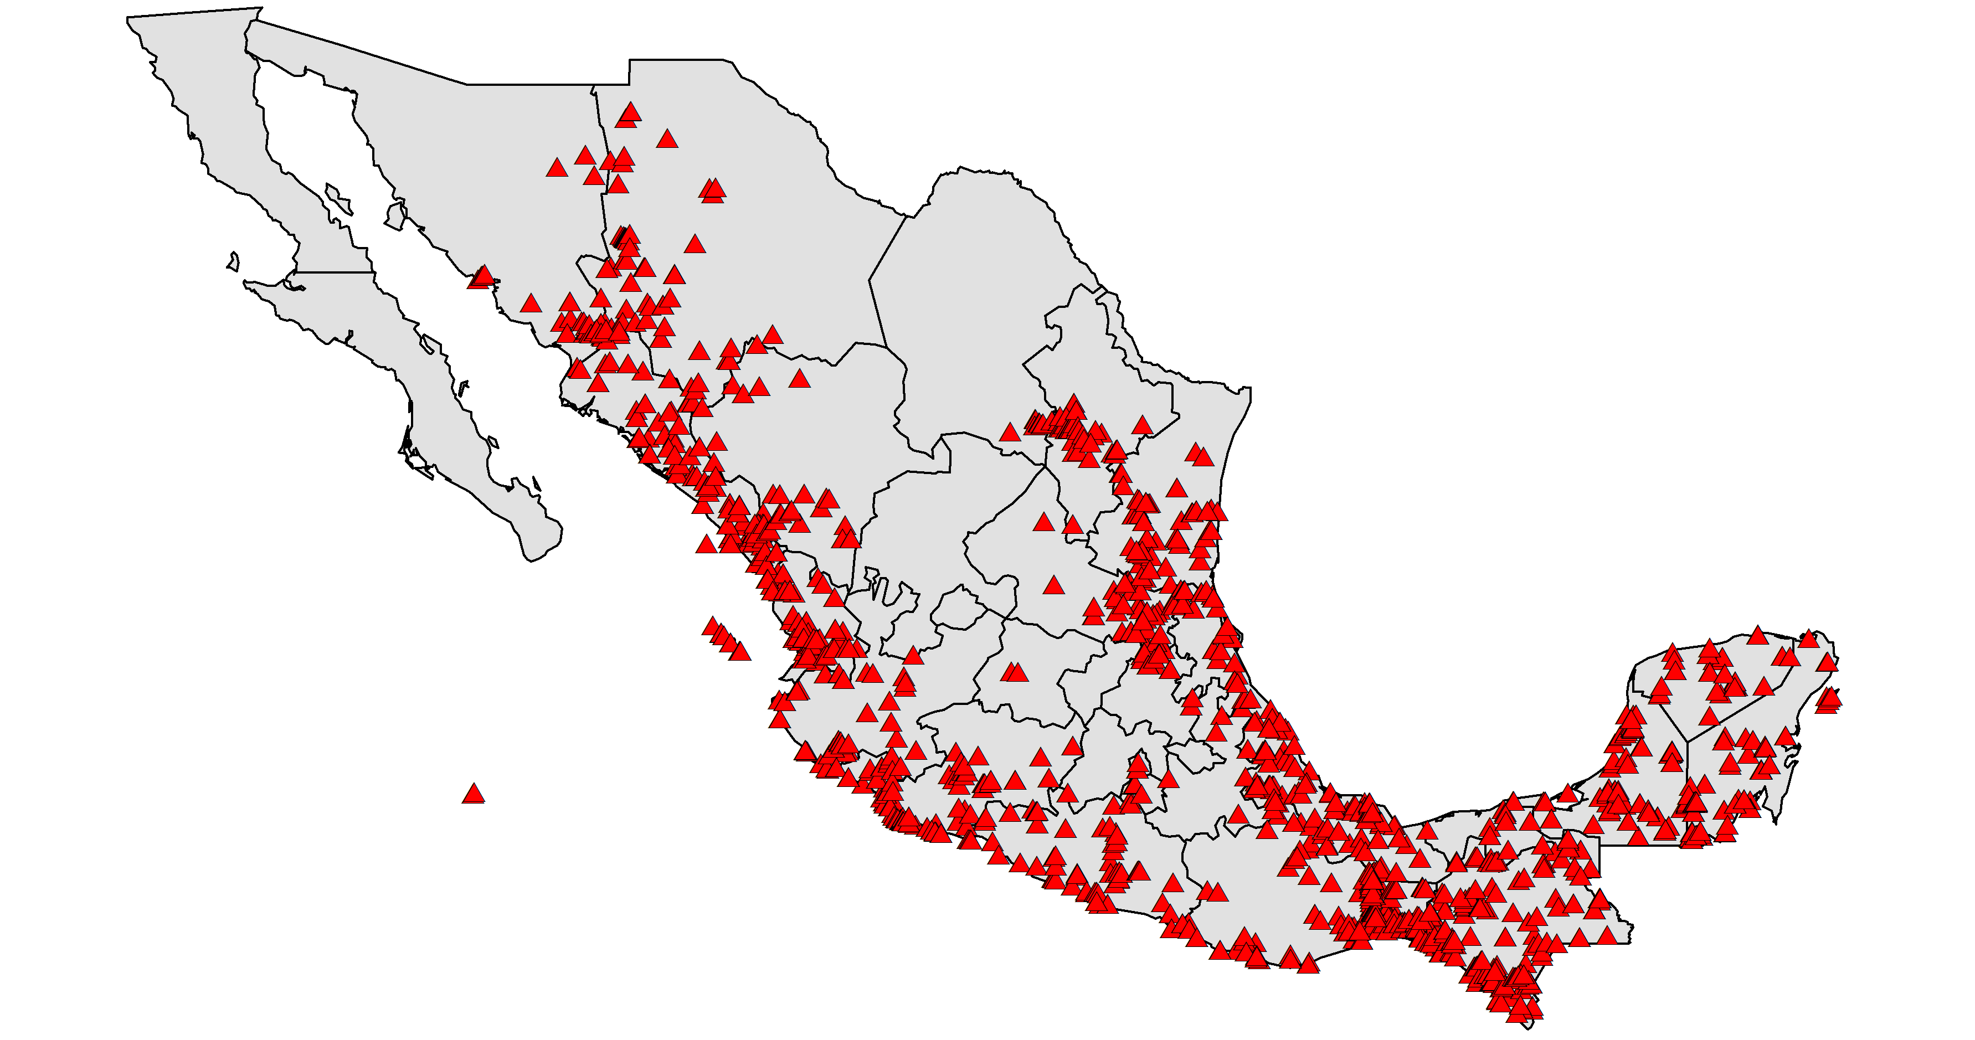
Mapping Biodiversity Loss
Historical parrot records in Mexico (from Mexican bird atlas database)

Slide 12
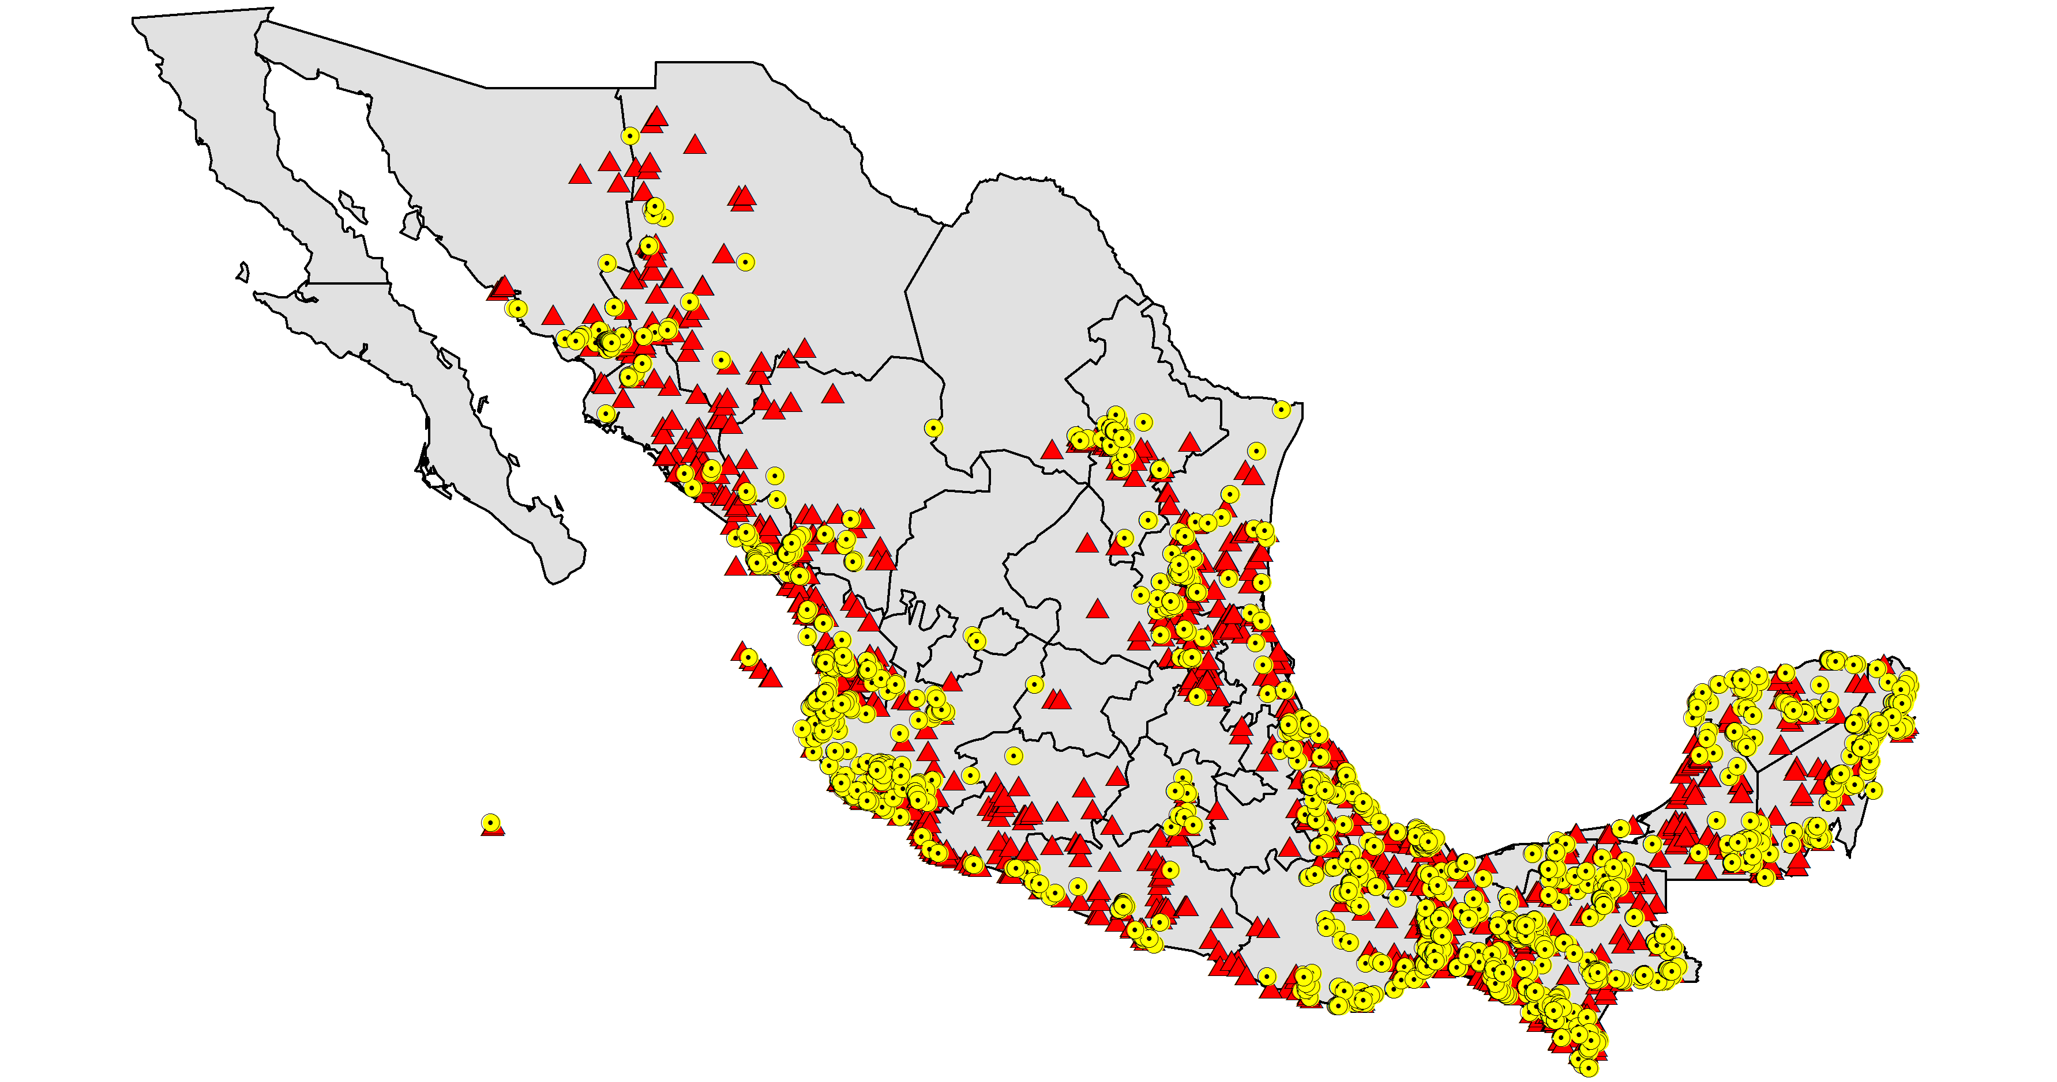
Mapping Biodiversity Loss
Historical and recent (2000-present) parrot records in Mexico
(recent records from GBIF data portal, mainly from AVerAves)

Slide 13
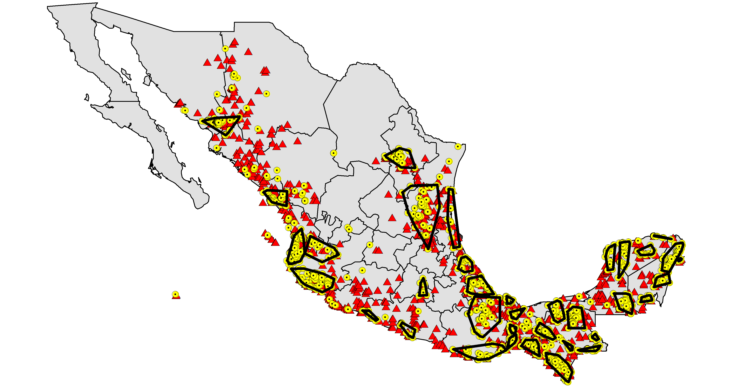
Mapping Biodiversity Loss
Units of analysis of recent data

Slide 14
Intactness Index

Slide 15
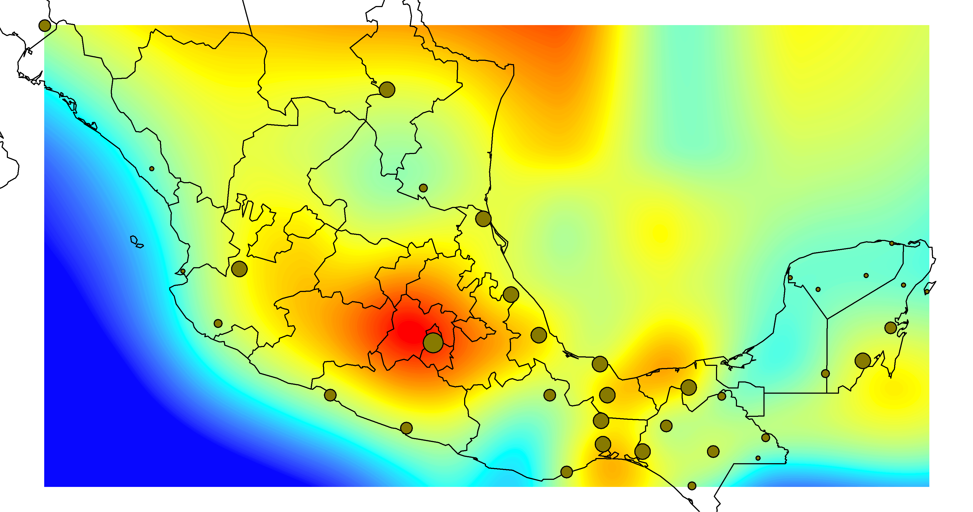
Mapping Biodiversity Loss
Intactness index based on turnover = 100*(gains and losses)/total pool of species
Note: Mexico City and Monterrey both have multiple species introductions

Slide 16
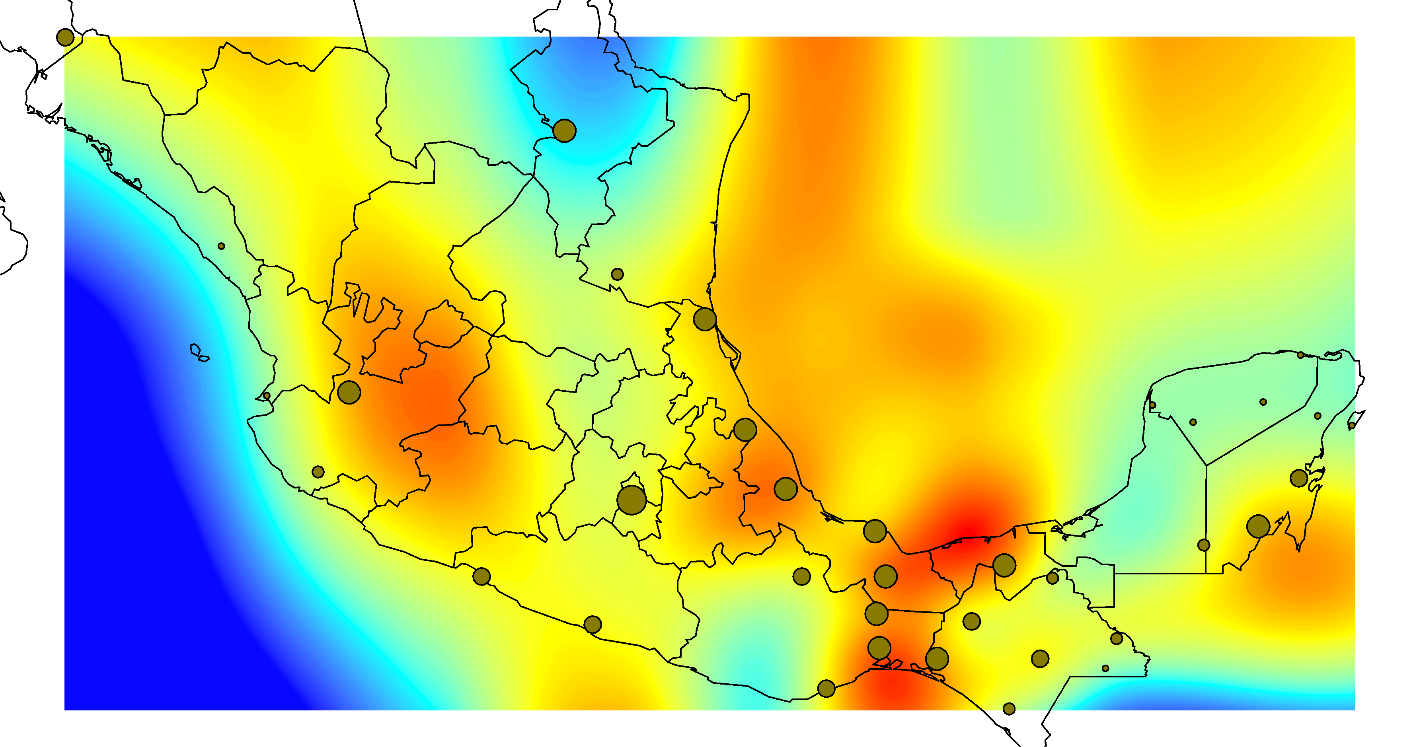
Mapping Biodiversity Loss
Intactness index based on turnover = 100*(gains and losses)/total pool of species
Cities removed from consideration

Slide 17
How Feasible?
GBIF – 173M bird records, drawn from many sources worldwide
ORNIS – NSF-funded portal to North American data sources (mostly), including almost all major museum collections in the USA
CONABIO – Mexico’s national biodiversity portal
Atlas of Living Australia – Australia’s national biodiversity portal
SpeciesLink – Brazilian collections data portal

Slide 18
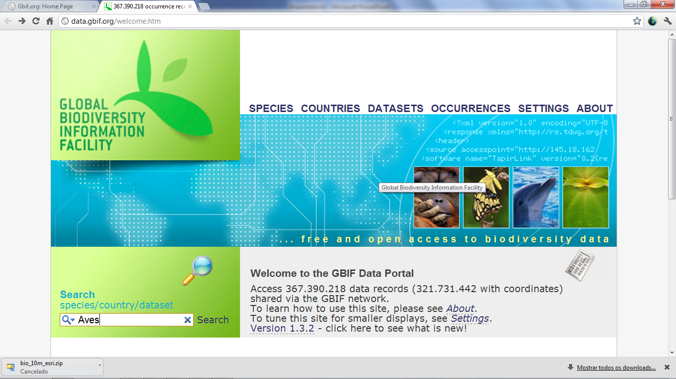
Biodiversity Information

Slide 19
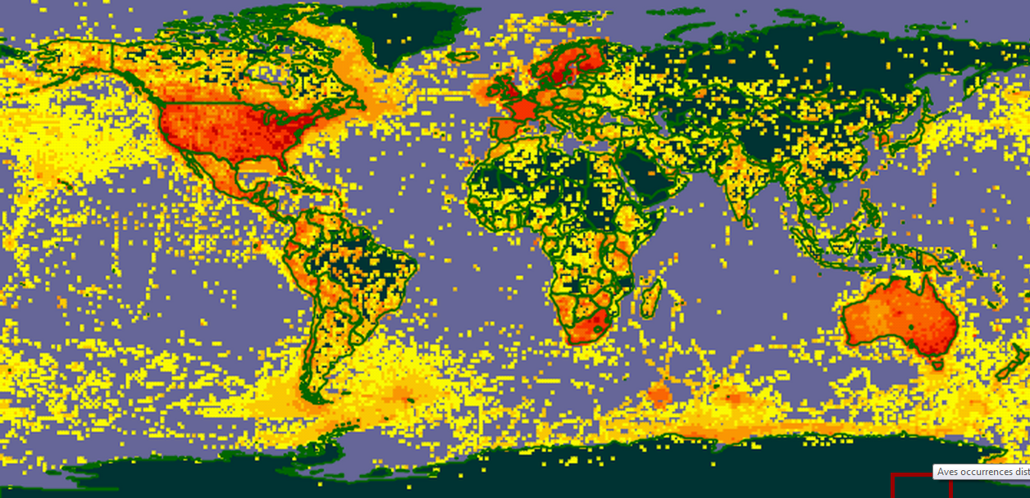
Bird Data: 173,080,459 Records

Slide 20
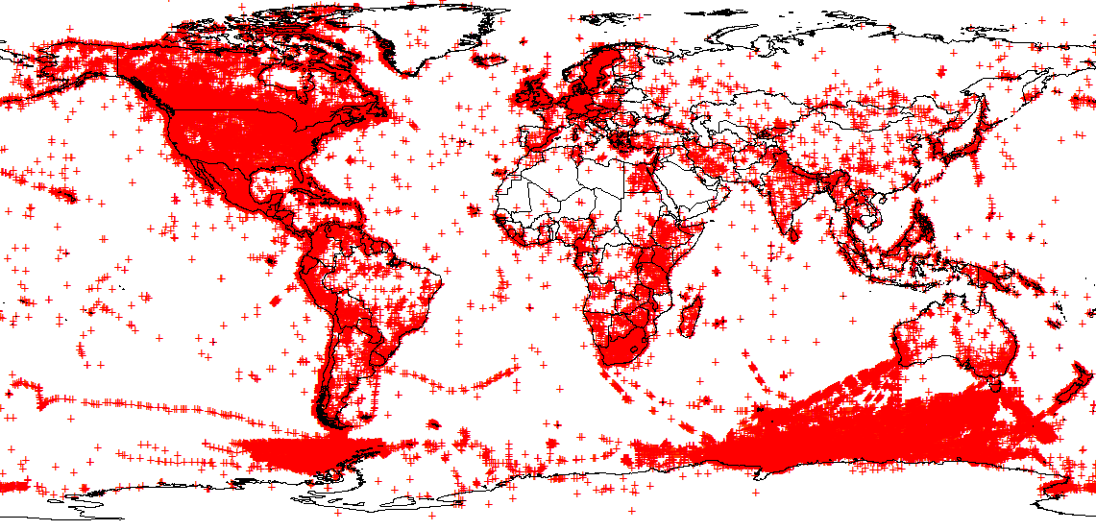
Raw Occurrence Data – Oct 2010

Slide 21
Completeness Calculations
a and b are the numbers of species observed one and two times, respectively, in the site inventory; Chao2 equation

Slide 22
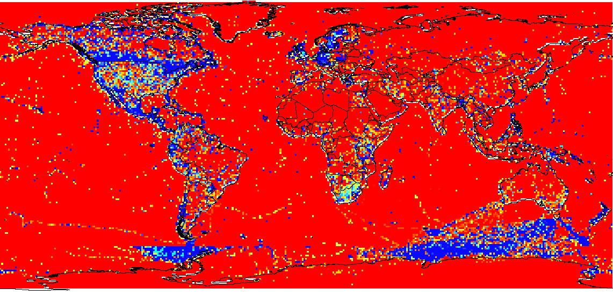
Global Knowledge (C)

Slide 23
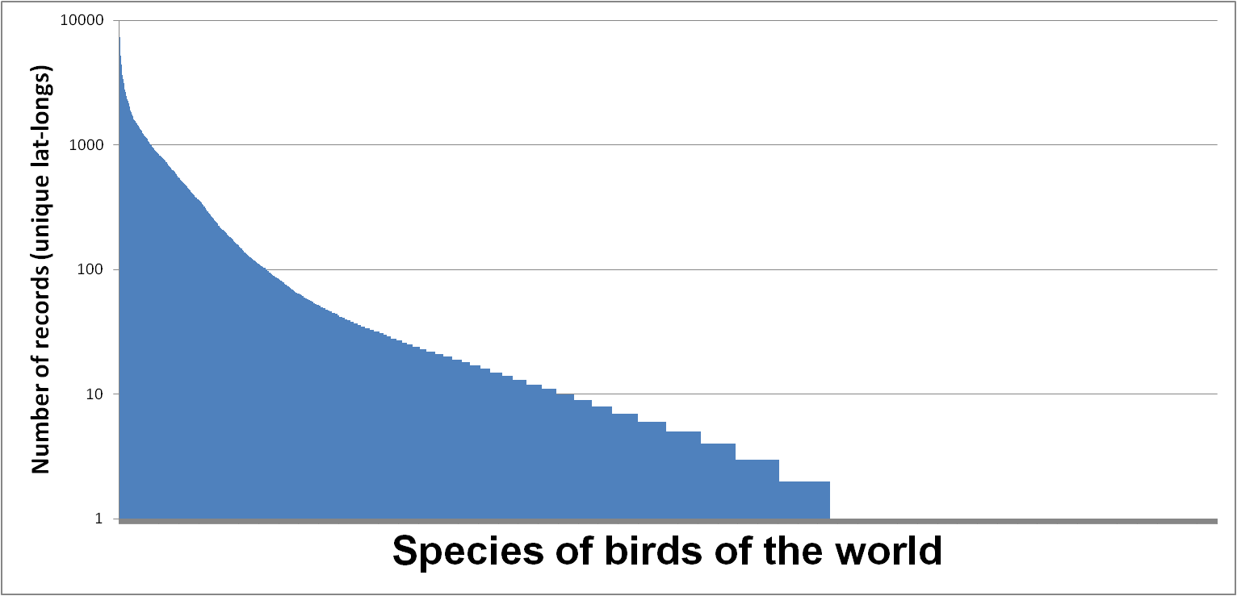
Current Digital Geographic Documentation of Birds of the World
Available for modeling
Poorly known
Virtually unknown

Slide 24
Brazilian Plant Example

Slide 25
OPINION/CONCLUSION: land use and biodiversity considerations can be summarized on global scales

Slide 26
What is Needed for Full Implementation?
Refine the tools … how best to calculate intactness and range loss can be improved
Improve the data:
Capture of historical ‘legacy’ data sets
Citizen science capture of large amounts of observational data worldwide
Continue science-based exploration of biodiversity
“Balance” global coverage, at least for example groups
Develop case studies and trial implementations
Here parrots of Mexico, next all birds of Mexico …

Slide 27
Jean-Louis Weber Jean-Louis.Weber@eea.europa.eu Rania Spyropoulou Rania.Spyropoulou@eea.europa.eu Town Peterson town@ku.edu

