Slide 1



The Natural Capital/Ecosystem Capital Accounting (ECA) project for Mauritius
Implementation of SEEA-Ecosystem Capital Accounts in Mauritius
Methodology and data processing
Jean-Louis WEBER
Consultant
European Environment Agency Scientific Committee
Honorary Professor, School of Geography, University of Nottingham
jlweber45@gmail.com

Slide 2




National Accounts: SNA and SEEA
The System of Environmental-Economic Accounts adopted by the UN Statistical Commission in 2012 (SEEA 2012) has been supplemented in 2013 by a volume on “Experimental Ecosystem Accounting”. The “Ecosystem Capital Accounts” (SEEA-ECA) under implementation in Europe are one of these experimentations.
SEEA-EEA XXX
SEEA Part 2
“Experimental Ecosystem
Accounting”
SNA
SEEA Part 1
“Central Framework”
SEEA-EEA YYY
SEEA-ECA
Ecosystem
Capital
Accounts
Jean-Louis Weber, 19 July 2013

Slide 3
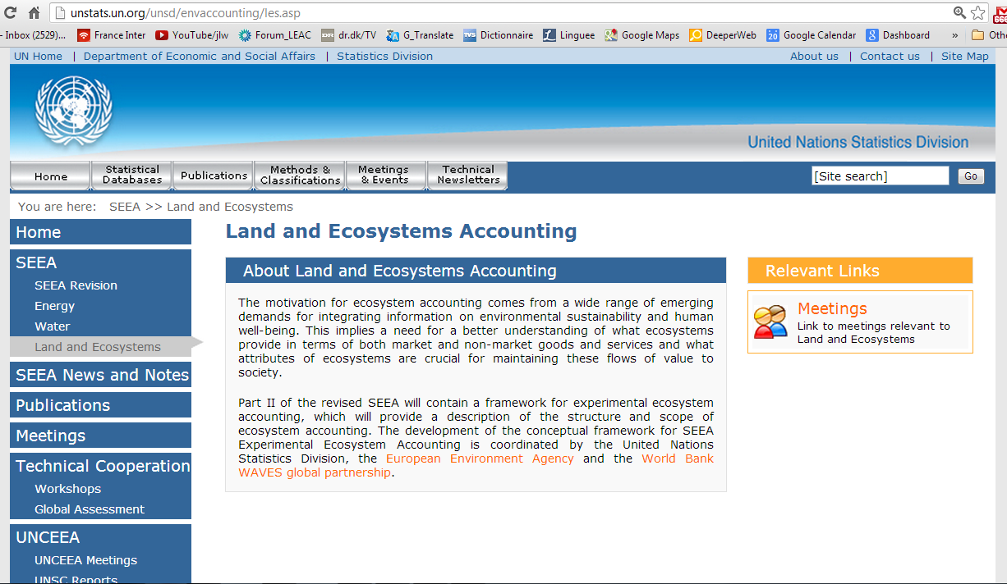
Land and Ecosystem Accounting

Slide 4
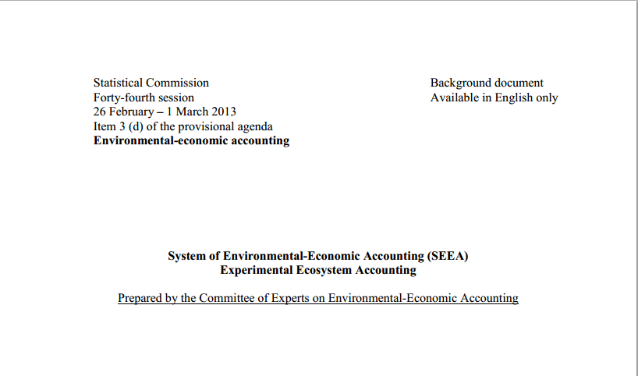
SEEA Experimental Ecosystem Accounting

Slide 5


Ecosystem accounts are based on spatial information (1)

Slide 6
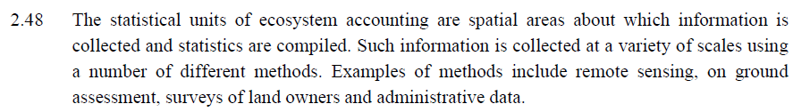
Ecosystem accounts are based on spatial information (2)

Slide 7
Four specificities of SEEA-ECA
Economy and Ecosystem are taken as two interacting and co-evolving systems.
  There are two basic approaches to environmental accounting. The first one is the “extension of the production boundaries” where natural resources are defined according to their usefulness to the economy and their economic value, using real market prices or estimated by “shadow prices”.
  The second approach acknowledges that the interaction of the economy and Nature creates a liability for the economy to maintain the renewable natural capital in the same way it maintains the produced capital. The amount of this maintenance and restoration when needed cannot be limited to monetary values but must meet the physical needs of ecosystem.
SEEA-ECA aims at recording the resource which is accessible without ecosystem degradation, at measuring the degradation or the enhancement of the ecosystem capital due to human activities and at establishing an ecological balance-sheet to summarize the accountability
SEEA-ECA is an integrated framework which follows the general accounting rules of double-entry and quadruple-entry (SNA) accounting. It integrates various ecosystems (inland, sea and atmosphere/climate ecosystems) and ecosystems to the economy.
A common measurement unit or currency is defined to allow integration of the accounting framework
  The physical units presently used in environmental accounting are not fully additive and are limited to the quantitative dimension of natural resources.
  There is a need to create a composite unit to measure ecological values in the way the money measures the ecological values. In ECA, this unit is called “Ecosystem Capability Unit” (ECU)
Jean-Louis Weber, 20July 2013

Slide 8

ECU: a composite currency to measure ecological value
Economic value: Quantity x Price (in money)
Ecological Value: Quantity x Price-equivalent (in ECU)
In physical accounts, measurements are made in basic units (tons, joules, m³ or ha) which cannot be aggregated. These measurements have to converted to a special composite currency named ECU for ‘Ecosystem Capability Unit’.
The price of one physical unit (e.g. 1 ton of biomass) in ECU expresses at the same time the intensity of use of the resource in terms of maximum sustainable yield and the direct and indirect impacts on ecosystem condition (e.g. water contamination or biodiversity loss, inversely ecosystem restoration).
François 1st (1515-1547), Ecu d'or au soleil du Dauphiné, Source : Münzen & Medaillen GmbH (DE)
1 ECU =
1 unit of accessible
ecosystem resource
Jean-Louis Weber, 19 July 2013

Slide 9

Region
Ecosystem
Indexes of Accessible Carbon/ Biomass
Calculation of Ecological Values in ECU
& Total Ecosystem Potential (TEC)
Indexes of Accessible Water
Indexes of Accessible Landscape/ Biodiversity Services
SUM / 3
X
=
SUM
Basic resource
(e.g. tons of Carbon/ Biomass)
ECU-Prices
ECU values per 1 km2 grid-cells
TEC: Total Ecosystem Capability (ECU)
Jean-Louis Weber, 20July 2013
Notes:
Finally, he presented Experimental implementation of ecosystem accounts in Europe.
First, define 1 square km grids and assign land cover class for each grid.
Then calculate total capital of each grid maybe by adding each component of ecosystem services such as accessible water surplus and carbon surplus and systemic services.
9

Slide 10
Change in Total Ecosystem Potential (TEC):
ecosystem capital degradation or enhancement
t
X
=
SUM
Basic resource year t
(e.g. tons of Carbon/ Biomass)
ECU-Prices year t
ECU values per 1 km2 grid-cells, year t
TEC: Total Ecosystem Capability (ECU, year t)
TEC change
(TEC t+1)
–
(TEC t)
t+1
X
=
SUM
Basic rerource year t+1
(e.g. tons of Carbon/ Biomass)
ECU-Prices year t+1
ECU values per 1 km2 grid-cells, year t+1
TEC: Total Ecosystem Capability (ECU, year t+1)
In this case, there is degradation
Jean-Louis Weber, 20July 2013
Notes:
Finally, he presented Experimental implementation of ecosystem accounts in Europe.
First, define 1 square km grids and assign land cover class for each grid.
Then calculate total capital of each grid maybe by adding each component of ecosystem services such as accessible water surplus and carbon surplus and systemic services.
10

Slide 11
Sketch of Ecosystem Capital Accounts for a country with 3 ecosystems
REST OF THE WORLD
Flows embedded into trade
Domestic economy’s global impacts
Ecological Balance Sheet in €
Adjustment of Final Demand (Full Cost)
Consumption of Ecosystem Capital
Ecosystem economic benefits of projects, policies and plans
Ecological Balance Sheet (assets & debts) in ECU
Sectors’ liability to ecosystem degradation
Estimation
of Restoration Costs (€)
============
Use of natural resource by SNA economic sectors
(physical units)
Social demand for ecosystem services
Total Ecosystem Capital Capability in ECU
Valuation
of Ecosystem Services (€)
Biomass
Biomass
Biomass
Water
Water
Water
Systemic services/ biodiversity
Systemic services/ biodiversity
Systemic services/ biodiversity
Land cover change accounts
Geographical & statistical data infrastructure
Jean-Louis Weber, 20July 2013

Slide 12
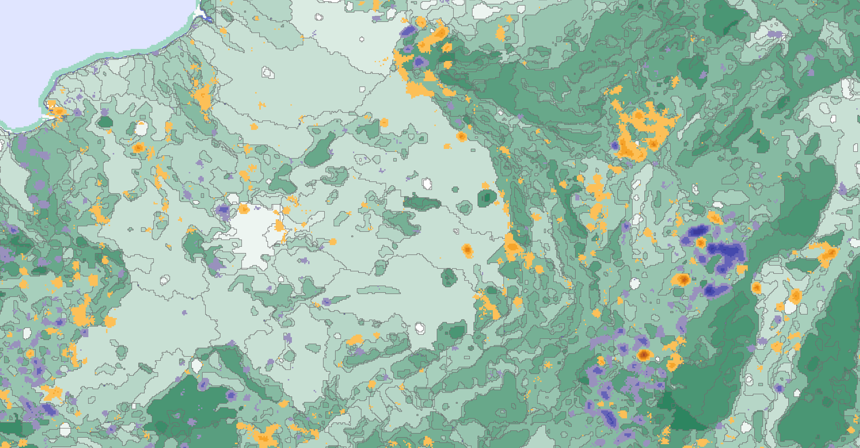


National Accounts & Ecosystem Capital Accounts
Total Ecosystem Capital Capability in ECU
Consumption of ecosystem capital
(unpaid costs) & Adjustment of Final Demand (Full Price)
Degradation
Balance sheet of ecological debts & credits in ECU
Enhancement
Restoration costs
Stocks 1990
National Accounts:
GDP, Final Demand, Balance Sheet
Change 1990-2006
Sustainability coefficients
Ecological sustainability of
Value Added supported by ecosystem services
Landscape Ecological Potential change 1990-2006, by ecosystem landscape units
Jean-Louis Weber, 20July 2013

Slide 13
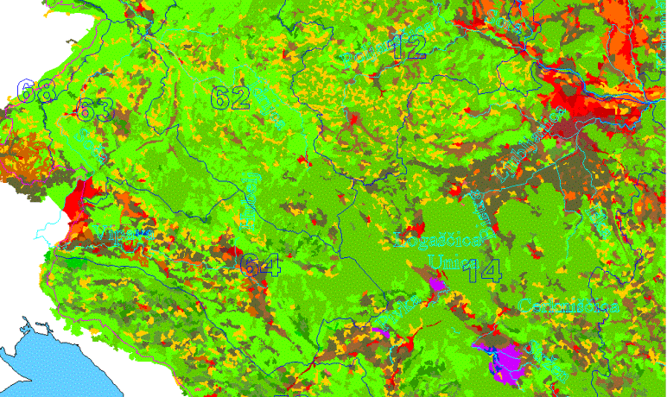
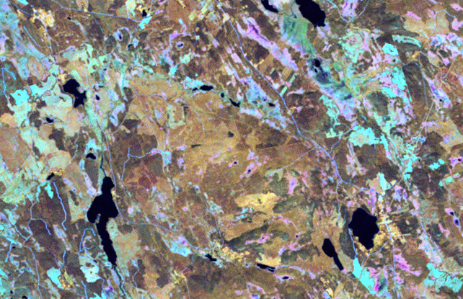
Spatial Integration of Environmental & Socio-Economic Data
Mapping
Socio-Economic
Statistics
Sampling
Individual Sites Monitoring
Notes:
Earth Observation
Land cover continuous mapping as well as censuses, registers or exhaustive surveys: main features & spatial distribution
Sampling: detailed information representative for an area, a type, a group
Complete investigation of important or rare ecosystems, protected areas, case studies, long term ecological monitoring

Slide 14
Main data flows to compile ecosystem capital accounts
Data assimilation
(1 ha or 1 km2 grid)
Accounts integration, analysis and reporting
Data input
Socio-economic statistics by regions
Disaggregate& map
Monitoring data. rasters
Aggregate
& map
Monitoring data, samples
Extrapolate
Standard coefficients
Multiply

Slide 15
Production of the urban areas land cover layer from high resolution data on buildings, using smoothing (gaussian blur) techniques

Slide 16
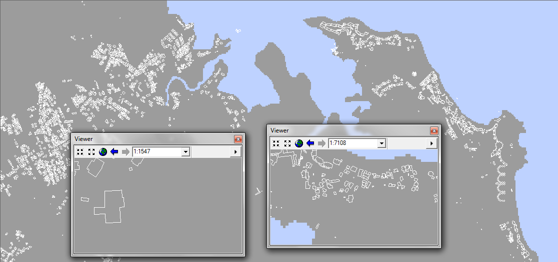
The buildings Shapefile

Slide 17
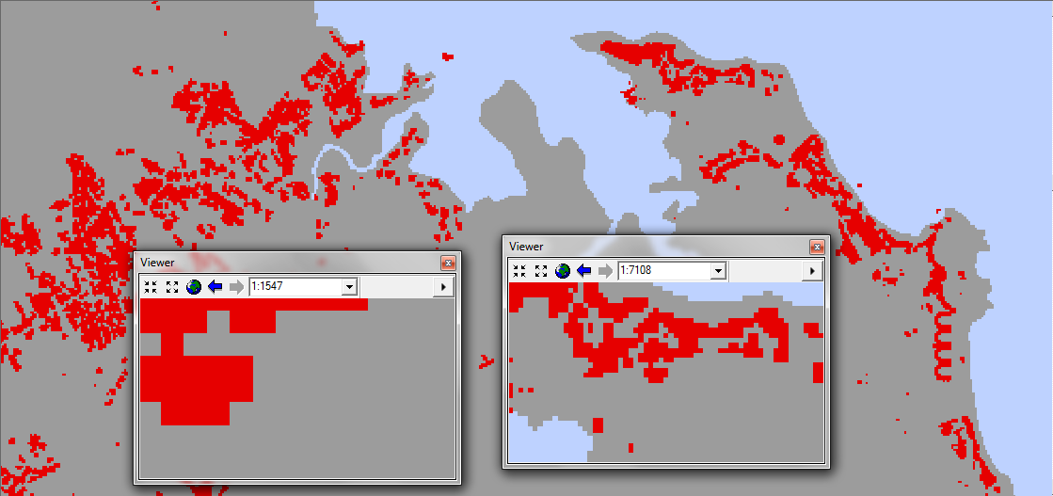
The buildings raster (tif) 10 meters x 10 meters

Slide 18
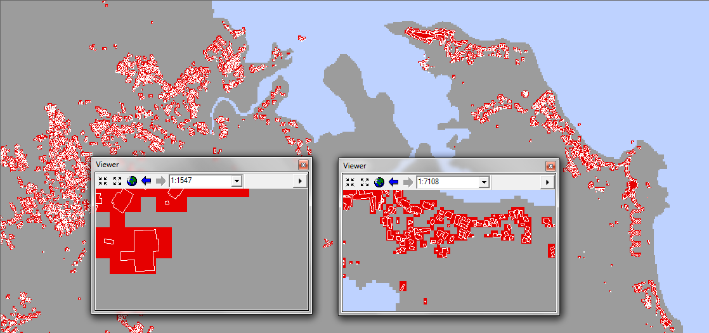
The buildings Shp and Raster 10 m

Slide 19
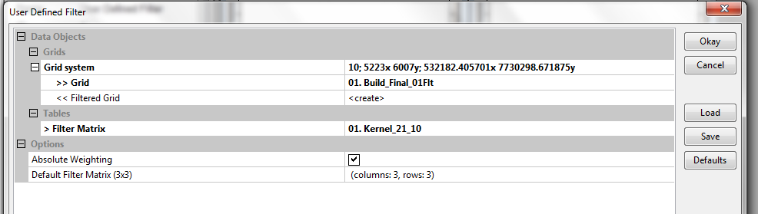
Smoothing (blurring) with SAGA Gis/ Grid Filters/ User Defined Filter
Input: raster 10 m, values 1 to 101
Filter Matrix (for gaussian blur at 10 pixels radius or 100 m, using a kernel of 21 x 21 cells): here Kernel_21_10

Slide 20
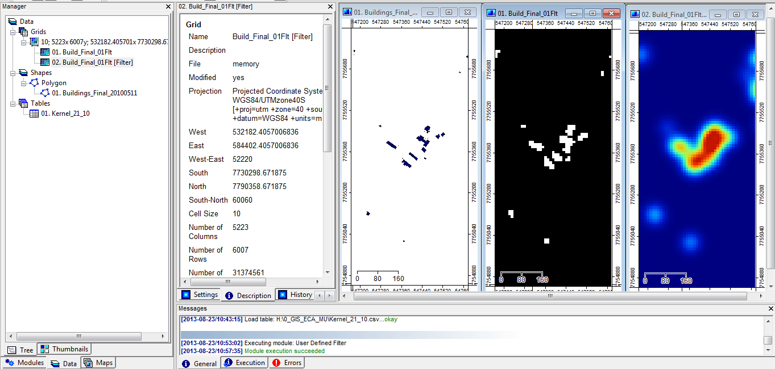
Sequence of treatments with SAGA GIS:
Smoothed (Gaussian blur) raster, radius of 100 meters (kernel = 21)
Input: shapefile, scale circa 1/5000 or finer
Raster (tif) at 10 meters

Slide 21
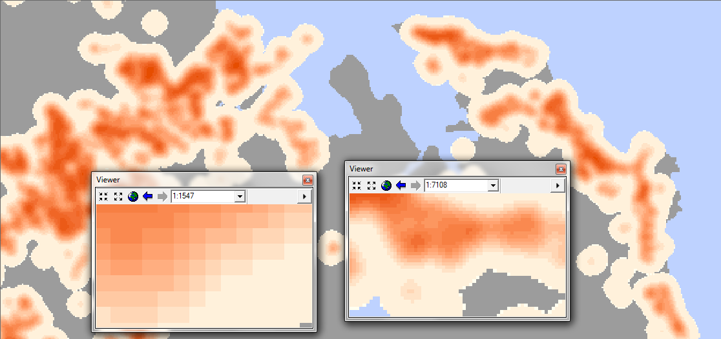
The buildings raster smoothed at 100m (values in the neighbourhood)

Slide 22
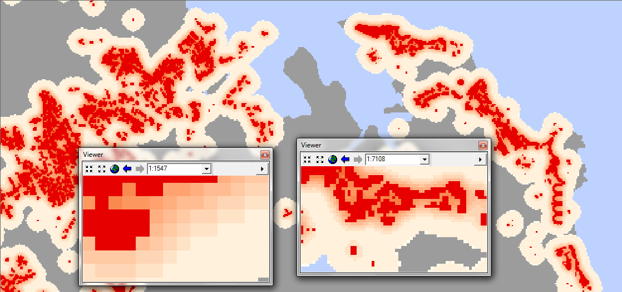
Building raster, 10 m and smoothed at 100m (values in the neighbourhood)

Slide 23
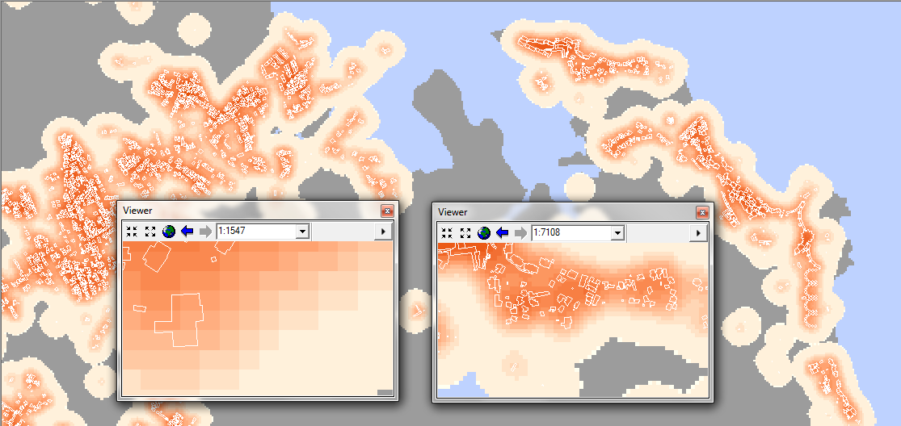
Building Shp and smoothed tif (values in the neighbourhood)

Slide 24
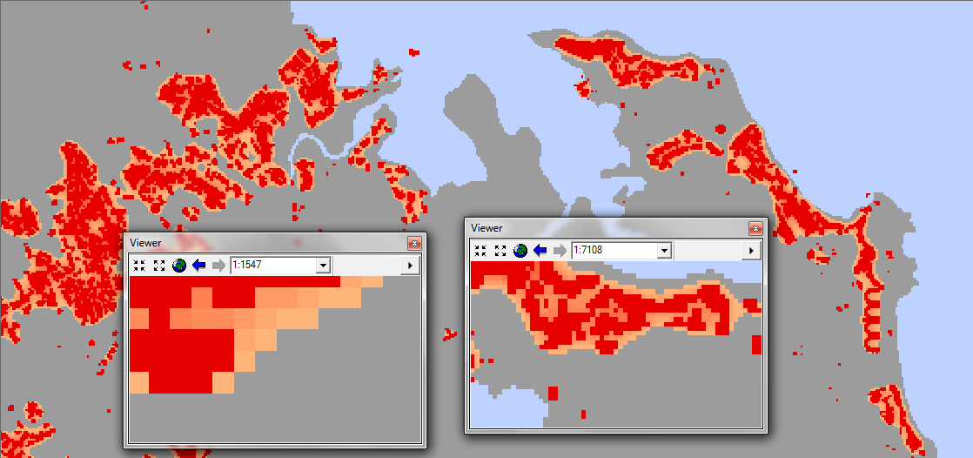
Agglomeration/generalisation: cells > 20% of the smoothed value
NB: cells are of 10 x 10 meters

Slide 25
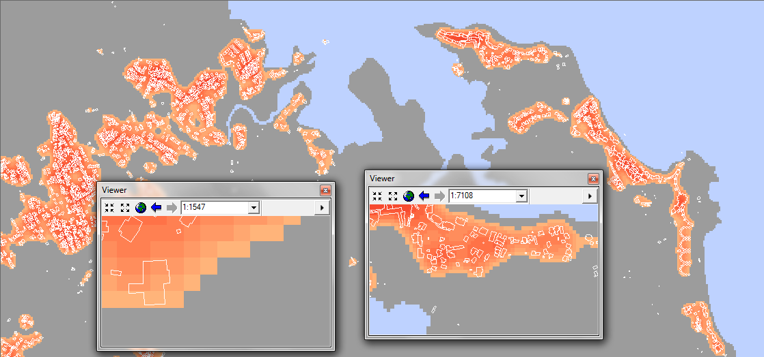
Agglomeration/generalisation: shp and cells > 25% of the smoothed value
NB: cells are of 10 x 10 meters – here, the threshold captures dispersed urban

Slide 26
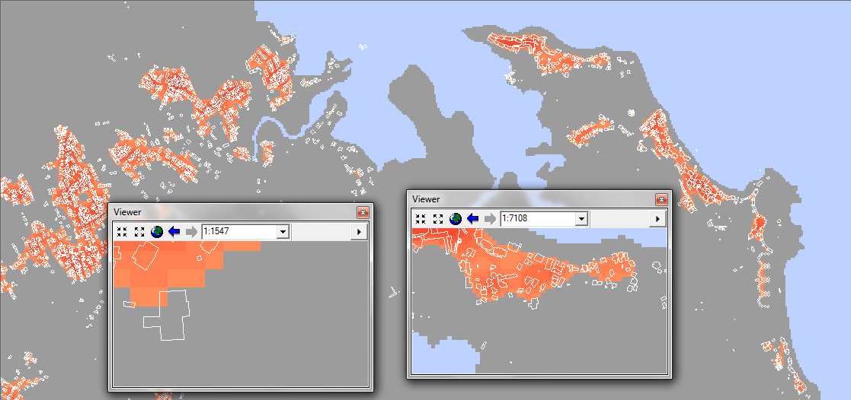
Agglomeration/generalisation: shp and cells > 50% of the smoothed value
NB: cells are of 10 x 10 meters – here, the threshold eliminates dispersed urban…

Slide 27
Provisional conclusion
The 20% threshold seems a priori more appropriate for urban areas mapping. The same or different thresholds can be chosen for different classes (e.g. forêts, wetlands…) and in differnt geographical contexts.
The urban layer will be overlaid and combined with the other layers on agriculture, forêts, natural zones.
Smaller themes will be given priority to the larger ones in order to minimise the relative errors. Adjustments will be done accordingly.
The method is to some extent a simulation of visual photo-interpretation.

Slide 28
Thank You !
Jean-Louis WEBER
jlweber45@gmail.com

