Slide 1

Ecosystem services and the social value of Nature 2
Ecosystem Natural Capital Accounts: towards an Ecological Balance-Sheet
Biological Resources and Biodiversity 2014
Tuesday 3 June 2014: Ecosystems and economy
Legal, social & economic aspects /
Jean-Louis Weber
Member of the European Environment Agency Scientific Committee
Honorary Professor, University of Nottingham
jlweber45@gmail.com

Slide 2
Recurrent demands for improved macro-economic indicators and aggregates
Historical pioneer projects after Stockholm 1972 (Norway, Canada, France, The Netherlands, Philippines, Indonesia, WRI…)
Rio 1992, Agenda 21
UN SEEA1993 to “adjust” the UN SNA (‘green GDP’), revised in 2003, then in 2012/2013
Multiplication of initiatives:
  Material flows analysis (Ayres, Wuppertal Institute, NIES-Japan, OECD, Eurostat…)
  Beyond GDP Conference followed Stiglitz/ Sen/ Fitoussi report on the measurement of economic performance (EU, OECD…)
  Potsdam 2008 G8+5 initiative and TEEB to value ecosystem services (now hosted by UNEP)
  Ecological Footprint Accounting (Wakernagel, WWF…)
  Water Footprint (Twente U. , UNESCO)
  HANPP (Vitousek, Haberl…)
  WAVES (World Bank)
  A second volume to the SEEA on “experimental ecosystem accounting”
  new Aichi-Nagoya CBD Strategy: demand for the inclusion of biodiversity and ecosystem value into national accounts
Initiatives in Europe:
  Eurostat (the economy side) and the EEA and JRC (the ecosystem side)
Country initiatives all around the World

Slide 3
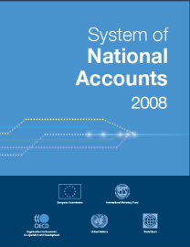
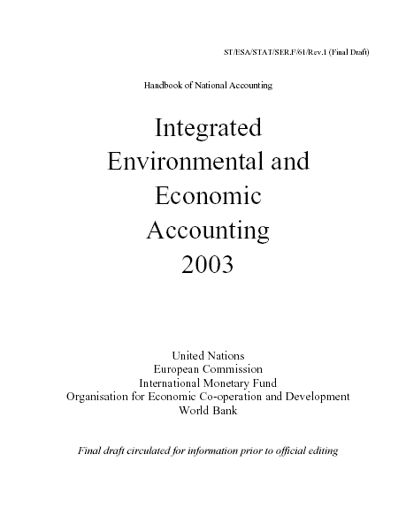
UN manual for environmental-economic accounting: SEEA2012/13
On par with the System of National Accounts (SNA) since February 2012
Revision of the SEEA2003 ➔ SEEA2012/13, steered by the UNCEEA
Impacts on ecosystem capacity of delivering services/benefits
Part 1
“Central framework” and SNA satellite accounts for the environment
Expenditures, taxes,
hybrid accounts,
physical flows,
sub-soil, energy, water, land,
economic assets depletion
Part 2
Ecosystem accounts
Ecosystem capital (stocks and
Quality), ecosystem services, benefits and maintenance costs…
RM HASSAN - UN The System of Environmental and Economic Accounting (UN 2003) -
RANESA Workshop June 12-16, 2005 Maputo
Negative feedbacks of ecosystem degradation on production and wellbeing

Slide 4
Figure 1: SNA and SEEA Part 1 and Part 2

Slide 5
Ecosystem, economy & finance, two quotations and a few remarks…
Bertrand de Jouvenel, 1968: “Because National Accounts are based on financial transactions, they account nothing for Nature, to which we don’t owe anything in terms of payments but to which we owe everything in terms of livelihood.”
Wikipedia: “Finance aims to price assets based on their risk level, and expected rate of return.”
We certainly owe nothing (in terms of payments) to Nature, but by degrading biodiversity and the ecosystem capability to produce ecosystem services, we create debts to Nature which are debts towards future generations who lose services or/and will have to restore the ecosystem…
We create as well debts to the present (and future) generations of those who supply us with commodities obtained by degrading their ecosystem (altogether as the capability of their human capital; see the “fair trade” paradigm…).
Unlike debts between human which can be repaid or cancelled by mutual agreement, debts to Nature can only be extinct or offset (if possible) by restoration of equivalent ecosystem functions, whatever the monetary cost...
Ecosystem capital degradation is an unpaid depreciation cost = we don’t pay the full cost of our consumption.
Ecological debts increase the risk level of debtors, public and private; they should be part altogether with private and public conventional debts, of the overall portfolio…
Ecological debts should be taken into account(s) in the international financial and monetary system
The ultimate goal of ecosystem capital accounts (ENCA) is to measure ecological debts (and credits, when ecosystems are enhanced) so that they can be taken into operational mechanisms…

Slide 6
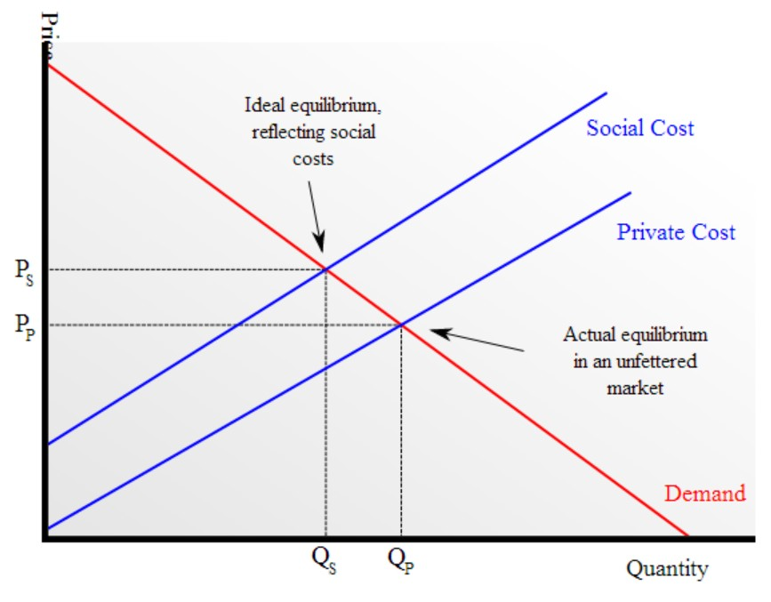
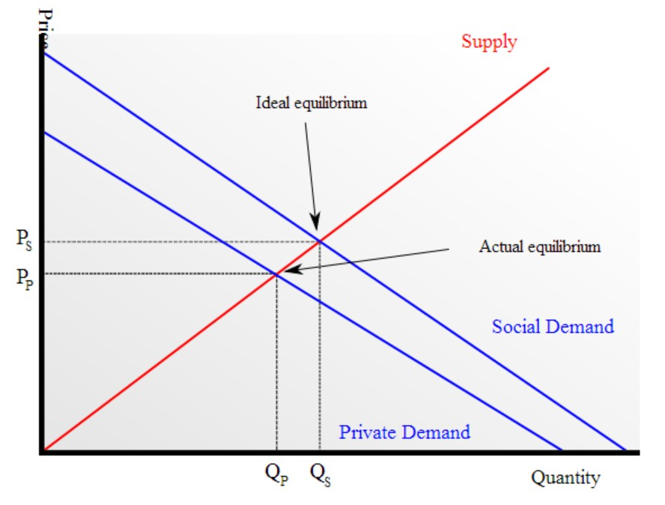
About externalities in economy (from Wikipedia)
In economics, an externality is the cost or benefit that affects a party who did not choose to incur that cost or benefit
Negative externalities
Positive externalities
Demand curve with external costs; if social costs are not accounted for price is too low to cover all costs and hence quantity produced is unnecessarily high (because the producers of the good and their customers are essentially underpaying the total, real factors of production.)
Supply curve with external benefits; when the market does not account for additional social benefits of a good both the price for the good and the quantity produced are lower than the market could bear.

Slide 7
Remarks
Responses (Wikipedia): Normally governments pass laws and regulations to address pollution and other types of environmental harm. These laws and regulations can take the form of "command and control" regulation (such as setting standards, targets, or process requirements), or environmental pricing reform (such as ecotaxes or other Pigovian taxes, tradable pollution permits or the creation of markets for ecological services). The second type of resolution is a purely private agreement between the parties involved (“Coase” theorem…)”.
NB: legal obligation to buy an insurance to cover risks of damges to the environment is another response…
Some externalities are paid by others (not a burden to the ecosystem)
Some externality are paid by nobody and born by the community (as loss of ecosystem present and future services)

Slide 8
Accountability of the Economy to the Ecosystem Capital is an emerging concept...[1]
The Clean Development Mechanism of the UN Convention on Climate Change is based on accounting for global warming units called CO₂-equivalents. The target is of “maximum temperature increase of 2 degrees” and refers to the degradation of the atmosphere ecosystem. The cost for reaching this target is the cost of an ecosystem capital consumption.
The European Environmental Liability Directive of 2004 shifts the Polluter Pay Principle from pressures to ecosystem impacts. The remediation costs of these impacts are ecosystem capital consumption. The Directive defines "environmental damage" as damage to protected species and natural habitats, damage to water and damage to soil.
The European Water Framework Directive has overarching targets of “good ecological quality of the river basins” and “full recovery of costs” in water pricing…
The financial mechanism of the Water Agencies in France gives another example, although partial at this stage. In each watershed, users of water are bounded by “solidarity” links regarding the use of water: if one actor pollutes or proceed to excessive abstractions, it degrades the service to other actors downstream and has to pay for compensation. This payment can be a special tax used to finance works in the basins or a direct expenditure by the economic actor.

Slide 9
Accountability of the Economy to the Ecosystem Capital is an emerging concept...[2]
The Wetlands Mitigation Banking in the US is another example where “accounts” are established for “ecosystem service areas” defined as "the designated geographic area in which a bank can reasonably be expected to provide appropriate compensation for unavoidable impacts to wetlands." The “determination of credits” in a “wetland bank” is based on accounts of physical characteristics and capacity of delivering services which “include acreage, category type, and/or function”. The need of credits for mitigating damages is assessed by a certification process based on a symmetric accounting of the amount to be replaced regarding expected damages. This is the basis of a market mechanism where credit values are established .
In France, CDC Biodiversity implements the principle that there will be no net loss of biodiversity at land development projects and the principle of full coverage for the repair of environmental impacts by those who are the project owners (based on the compensation of residual impacts under the Act on the Protection of Nature, 1976)
+ several other experiments in “mitigation banking” in and out of Europe…
Incorporation of environmental degradation in corporate accounts

Slide 10
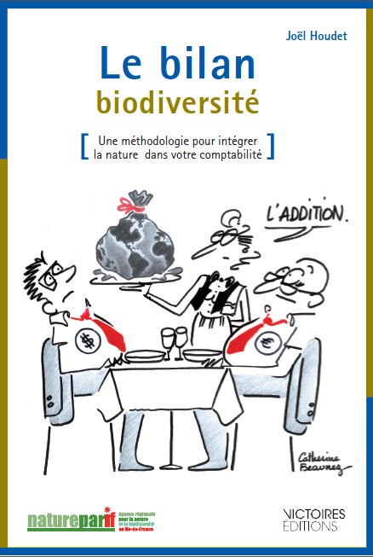
An ecological balance sheet at the company level
INTRODUCTION
“In his latest book, Professor Jacques Richard explains that the financial management of companies, only targeting the shareholder remuneration, is unable to meet the current needs of humankind, including regarding the triple economic ecological and social crisis that we are experiencing.
According to him, to ensure humans well-being and the maintenance and renewal of natural capital, it is urgent to develop a new form of accounting in which the depreciation of human and natural capital would be mandatory. In other words, this means that any company should follow an "environmental covenant" that forces to bear the costs of its impacts on the social and ecological grounds.”

Slide 11
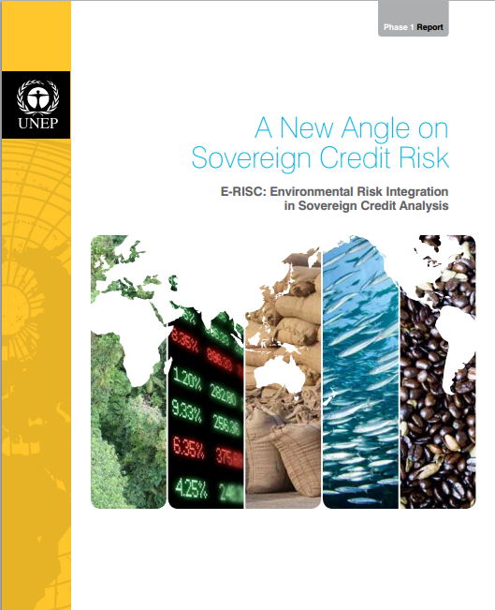
The 2012 E-RISC report by UNEP Finance Initiative
Emerging Risk Drivers: Demand for renewable, biological natural resources and services now exceed the planet’s ability to provide them by one and a half times and rising. As many countries grow more dependent on resources and services they cannot provide from within their own borders, their import bills for both biological and nonrenewable resources rise. This signals more competition for the planet’s limited resource capacity, with potentially negative consequences for economic performance and ﬁscal revenue. The result is that resource constraints and associated prices will become an ever more signiﬁcant determinant of economic performance, and therefore,
credit risk.
E-RISC:The consequences of natural resource depletion and environmental degradation have accompanied a growing awareness of the limitations of traditional ﬁnancial risk frameworks. The recent ﬁnancial crisis and government debt crisis has provided a window of opportunity for projects such as E-RISC (Environmental Risk in Sovereign Credit analysis) to question former assumptions on the adequacy of conventional rating and risk assessment methodologies. E-RISC attempts to demonstrate the materiality of environmental risk, making the connections between environmental risk and core economic or ﬁnancial indicators quantiﬁable. The overall aim is to allow for the incorporation of these factors into bond risk analysis, thereby allowing for the improvement of assessment tools and ratings.

Slide 12
An accounting framework for measuring accountability of the economy to the ecosystem

Slide 13
Ecosystem Capital Account attempt to respond to basic questions when accounting…
What is the amount/value of the net resource flow?
Quantities
Net resource flow
Do gains compensate
for
losses?
Stock at time 1
Stock at time 2
Stock carried over
Gain of stock
e.g. by afforestation
Loss of stock
e.g. by deforestation
Has the quality of the stock been maintained?
Adapted from Roy Haines-Young

Slide 14
Ecosystems, economic assets, services and values: 3 dimensions
2 - Non produced assets/ non priced services: mostly common goods, could be traded
1 – SNA produced & non produced assets:
mostly for commodities
(private goods & govt services)
Provisioning
Regulating
Recreating
3 – Ecosystem healthy state: public good, non-rival, non-exclusive use, non-transferable ownership rights (green taxes as general source for maintenance, but offset certificates could be traded or leased)

Slide 15
Current deregulated governance model
Public/
Wellbeing
Business/
Private
Benefits
Government/
Regulation
Parliament/
Public Good
Source: Jacqueline McGlade

Slide 16
State control governance model ??
Public/
Wellbeing
Business/
Private
Benefits
Government/
Regulation
Parliament/
Public Good
Source: Jacqueline McGlade

Slide 17
Green Economy governance model
Public Participation and Protection of the Public Good at the Core
Public/
Wellbeing
Business/
Private
Benefits
Government/
Regulation
Parliament/
Public Good
Source: Jacqueline McGlade

Slide 18

About the representation of the relation economy-nature
The current representation of the relation economy-nature in the SEEA and a possible mis-interpretation
natural inputs
Economy
Economy
products
products
Environment
residuals
Notes:
SEEA central accounts model of the relationship between the environment and the economy

Slide 19
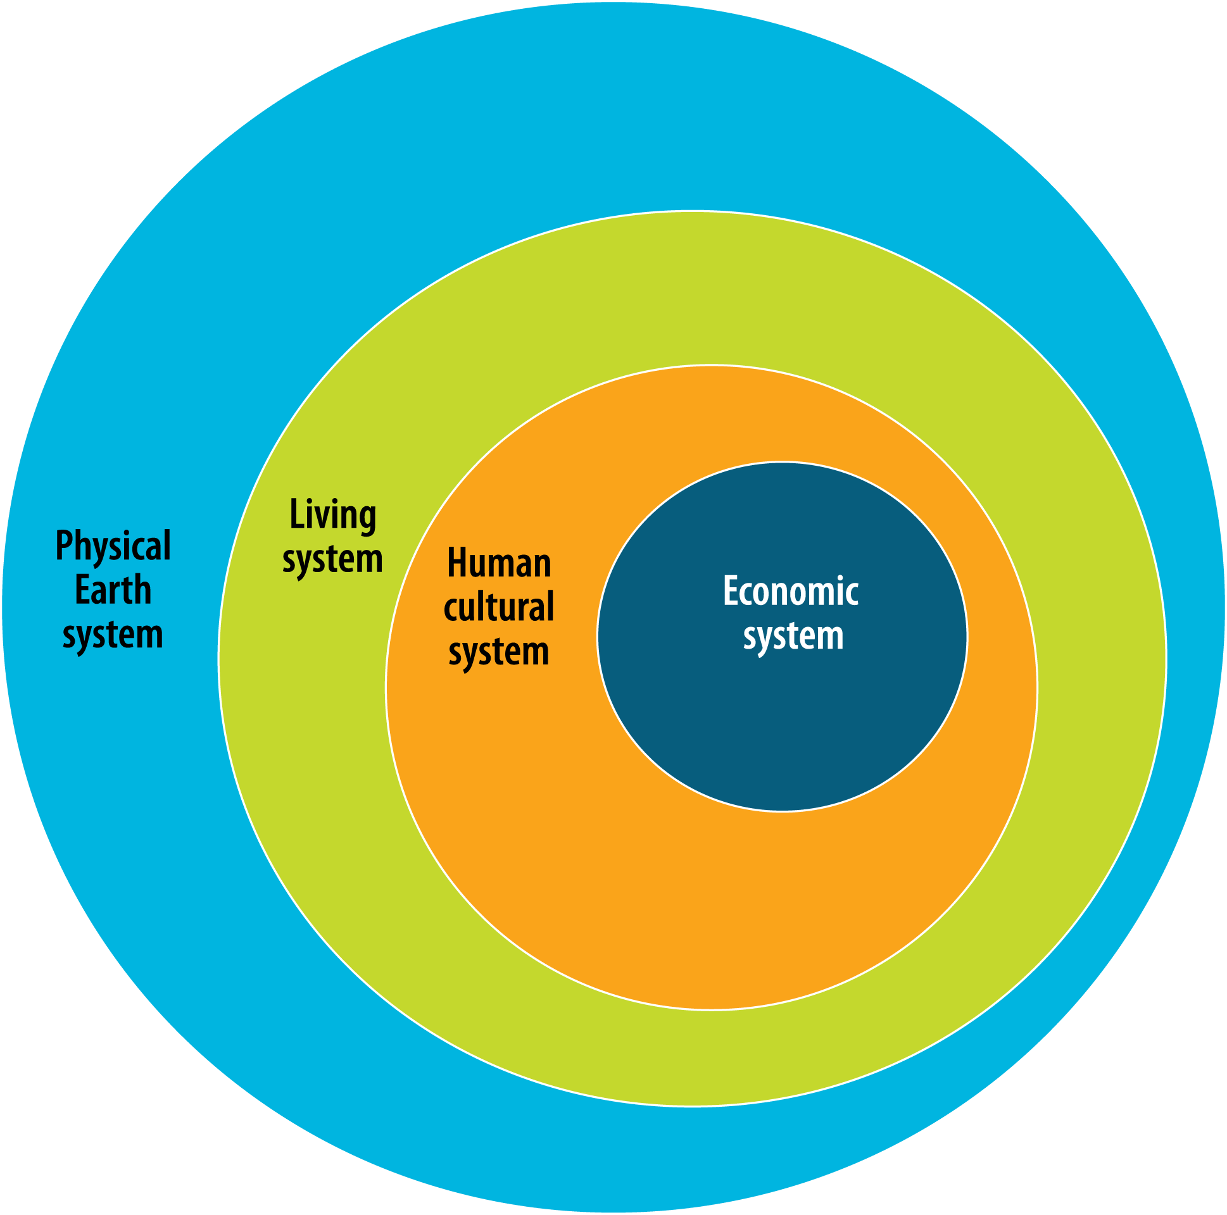
The “Joint perspective model” of BoM in 2D
Source: Richard Mount, Australian Bureau of Meteorology, 2012
Notes:
The Joint Perspectives model of the Bureau of Meteorology Environmental Accounts project. This model is unpacked in the following presentation.

Slide 20
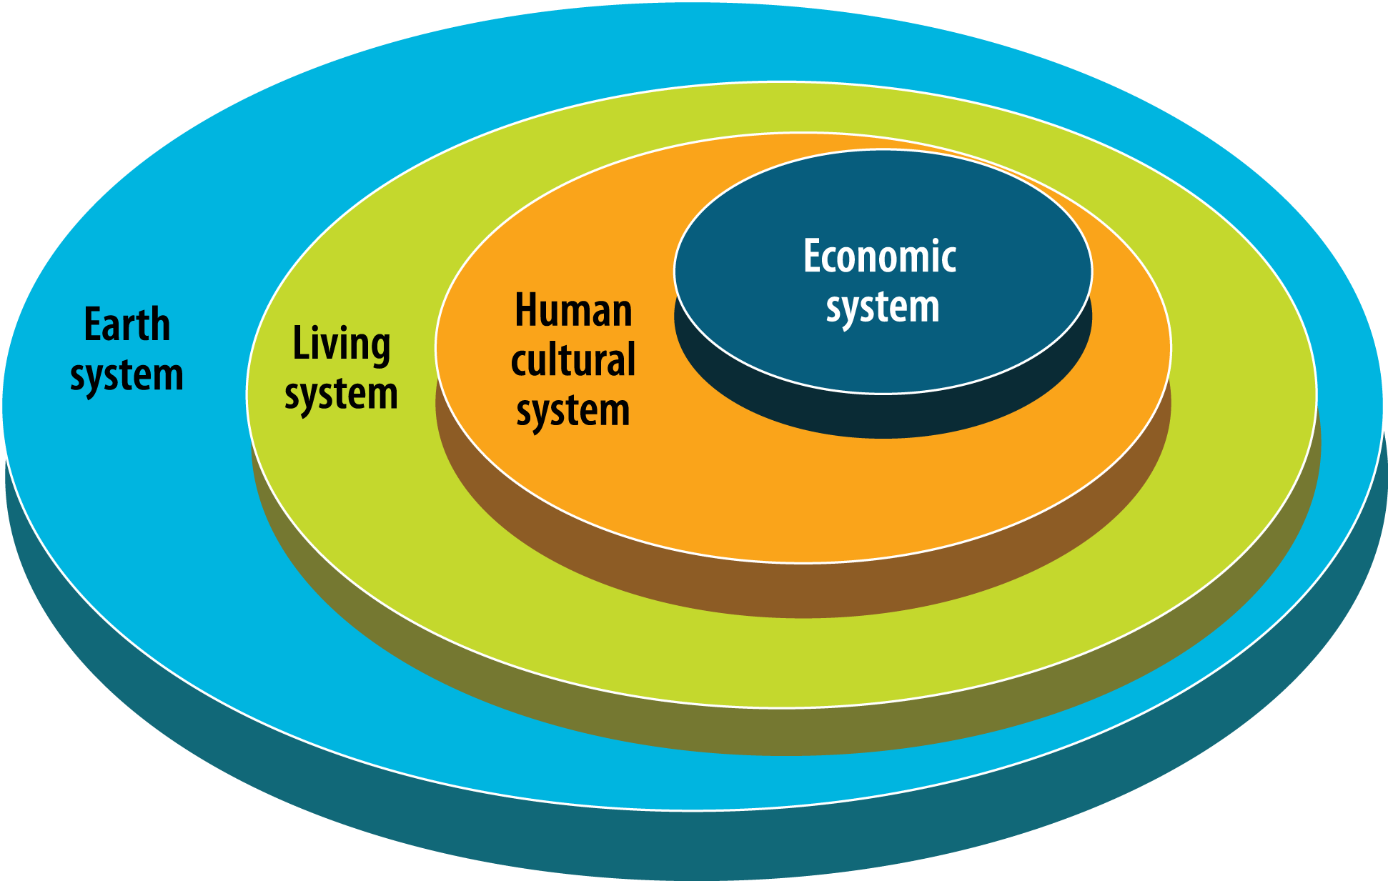
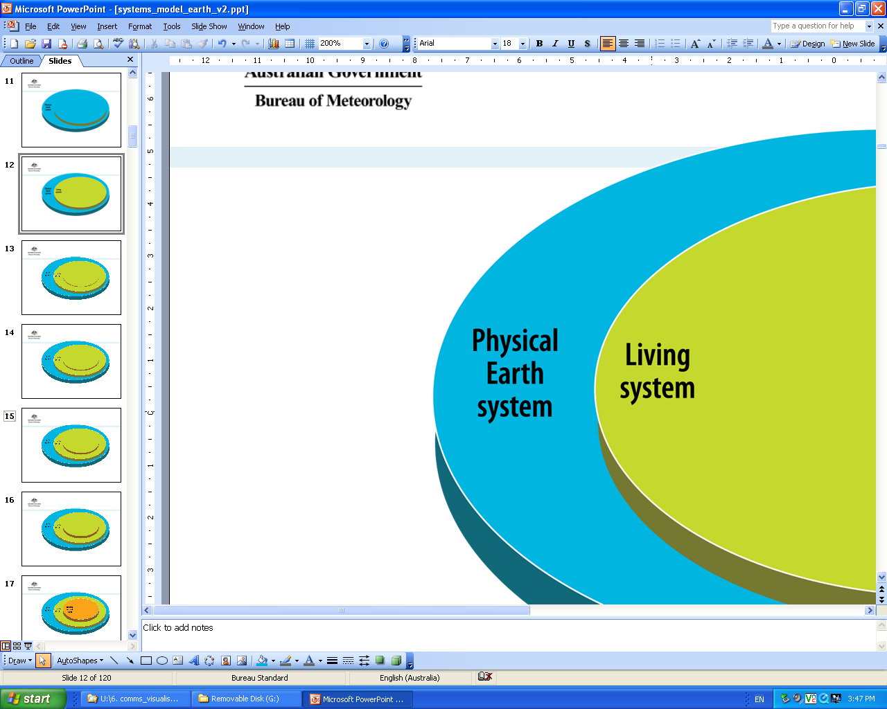
The “Joint perspective model” of BoM
in 3D
Source: Richard Mount, Australian Bureau of Meteorology, 2012
emergent systems

Slide 21

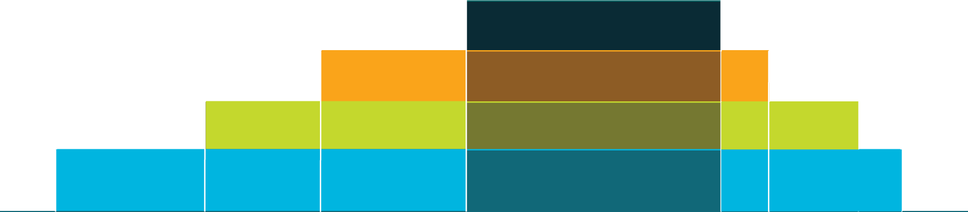
Flows of
ecosystem
services
to economy
production boundary
economic
human cultural
living
physical earth
Positive externalities
Negative externalities
Source: Richard Mount, Australian Bureau of Meteorology, 2012
Notes:
This is how it looks from above – what should the currency be for these flows?

Slide 22
Ecosystem capital accounts and main policy applications

Slide 23
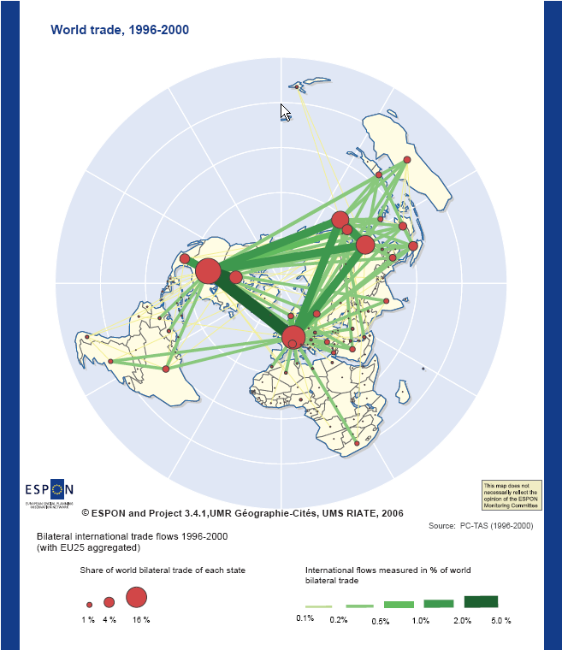
Accounting for ecosystem capital consumption embedded into trade
Because ecosystem capital depreciation is not recorded, the commodities based on ecosystem services are often underpriced, which contributes to smaller South-North flows.
Global trade: the picture in US$

Slide 24
2 approaches to ecosystem economics: maximisation of benefits (the financial value of nature) vs. maintenance of options (the quantity*quality of nature)
Maximisation of benefits from nature ➔ measurement of benefits & losses (e.g. TEEB’s COPI study) or of ecosystem services value entangled into commodities or real estates (WB current proposal for SEEA revision). Requires measurement and valuation of ecosystem services & ecosystem assets. Ecosystem depreciation calculated as the difference in ecosystem asset values at two dates. Accounting prices: depends on services and purposes (market prices, production functions, contingent values, assets as NPV of future benefits = financial approach) ➔ relevant for planning, project impacts assessments (CBA).
Maintenance of options (ecosystems potential of delivering services) ➔ measurement of ecosystem capital degradation in physical units (quantity*quality) & valuation limited to (non-paid) remediation costs. Equivalent to the calculation of capital maintenance cost (Consumption of Fixed Capital). No valuation of ecosystem services nor of ecosystem assets. Accounting prices: derived from observed remediation costs (statistics) ➔ relevant for National Accounts, as well as for business accounting (options and risks)… and for CBA in addition.

Slide 25

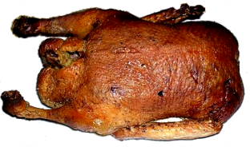
“Economic Theory”: asset value = financial value = NPV of expected future benefits
Financial value of natural assets = “Net Present Value” of expected future benefits
= NPV
If surveys or econometric models tell how much homo economicus is willing to pay for ecosystem services, there is no need to monitor Nature!

Slide 26



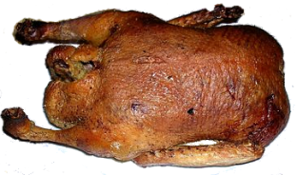
Ecosystem capital account: asset “quantity*quality”
Degradation
Restoration
Final Consumption at the full cost
Purchaser price
+
Remediation cost
=

Slide 27
Ecosystem capital: systems & services, benefits, degradation & costs
Non paid =
Ecological debt
Expenditures for
environmental protection & resource management
Ecosystem biophysical structures & processes
[landscapes, biodiversity, Net Primary Production...]
Degradation
Maintenance & restoration costs non paid by the economy
Non-sustainable use of ES
Ecosystem functions
[nutrient cycling, water regulation, habitats, biomass...]
Ecosystem services [provision, regulation, socio-cultural services]
Non valued private and collective benefits
(mostly public goods)
Socio-economic benefits from ES
[private & collective
well being]
Physical flows
Sustainability of economic benefits (sector ‘s direct & indirect income depending on ES)
Monetary benefits
Monetary costs
Primary benefits, externalities & rents (mostly private)
Weber, J.-L., 2010,
adapted from Haines-Young, R. & Potschin, M.
Notes:
27

Slide 28
Estimation of ecosystem capital degradation: 2 ways
t1
t2
t2 − t1
Account of pressures responsible of degradation
ϕ
ϕ
Degradation of ecosystem capital
ϕ
Assets ϕ
(−)
Physical accounts of E-services
Physical accounts of E-services
ϕ
ϕ
Assessment of remediation costs
Flows
Valuation of E-services
Valuation of E-services
€
€
€
NPV & (+)
NPV & (+)
Estimation of ecosystem capital depreciation…
(+)
€
Assets €
€
(−)
…based on mitigation costs
€
…based on assets values
t2 − t1
€

Slide 29
The narrative behind Ecosystem Capital Accounts:
1 - Accounting for the performance(s) of 2 co-evolving systems: resources, productivity and health
Economic system
Fossil energy & materials
Biomass/carbon
Water
Land systemic services
Use of natural resources
Products & economic assets
Economy performance
Economic growth
Trade
Value-added, income, profit…
Consumption
Investment
Wealth (non-financial and financial assets)
Economic health
(net savings, assets and debt quality, accountability, prices, well-being, knowledge)
Ecosystem
Ecosystem capability to deliver services in sustainable way
Ecosystem productivity
Flows
Accumulation
Stocks
Ecosystem health (condition)
(biodiversity, integrity, resilience, interdependence)
Performance (income, savings) better measured NET of capital maintenance costs
(needed to remediate degradation)

Slide 30
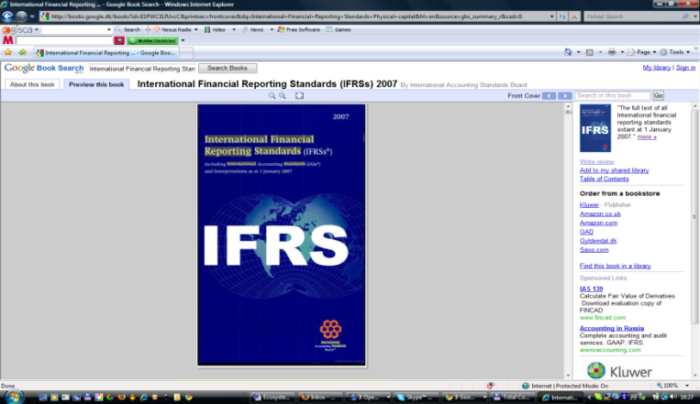
Consumption (Depreciation) of Ecosystem Capital & the measurement of economic performance
Consumption of Ecosystem Capital (CEC) is the monetary estimation of ecosystem depreciation resulting from physical degradation
  alike “fixed capital consumption” (UN System of National Accounts/ SNA2008)
  alike “capital depreciation” in financial corporate accounts (International Financial Reporting Standard)
CEC measures altogether the depletion of the private or common good (the economic resource, such as timber or managed fish stocks) and the degradation of the public good (such as forest or fisheries)
    International Financial Reporting Standards of the International Accounting Standards Board:
    “To be reliable, the information in financial statements must be complete within the bounds of materiality and cost. An omission can cause information to be false or misleading and thus unreliable and deficient in terms of its relevance”
    http://www.ifrs-portal.com/Texte_englisch/Framework/index.htm
Therefore, capital depreciation must be estimated and deducted when calculating profit. This is of highest importance for shareholders (dividends, stocks value…) as well as for the fiscal authority…
However, neither IFRS nor SNA record complete Consumption of Ecosystem Capital: IFRS economic natural resource only (timber and fish stocks) and the SNA, nothing…
CEC is an unpaid cost. An unpaid cost is a debt. CEC is the measurement of the increase in ecological debts (to future generations) and should be recorded accordingly. CEC can be calculated on the basis of physical degradation and restauration costs.

Slide 31
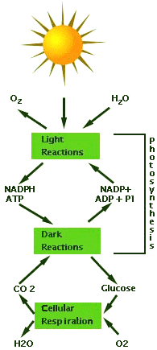
The narrative behind Ecosystem Capital Accounts:
2 - Only a surplus is accessible for human use
Ecoproduct (of cycling and reproductive systems/ capital) are produced by means of other ecoproducts. The ecosystem production function includes a surplus ecoproduct that can be used by the economy. (from Anthony Friend 2004)
Non-basic eco-product
Surplus accessible for harvest/abstraction
Economy
Basic eco-product
Necessary for ecosystem reproduction (conservation of ecosystem health, integrity, functions & services)
Sources: Kling/U Michigan_2005 & Friend/ISEE_2004

Slide 32
The narrative behind Ecosystem Capital Accounts:
3 - Only a surplus is accessible for human use
Challenge = maximise yields while maintaining natural functions and biodiversity
Possible compensation = artificial input (irrigation, energy, fertilizers, infrastructures…)
Non-basic eco-product
Surplus accessible for harvest/abstraction
Economy
Basic eco-product
Non-sustainable
harvest/abstraction
Necessary for ecosystem reproduction (conservation of ecosystem health, integrity, functions & services)
Sources: Kling/U Michigan_2005 & Friend/ISEE_2004

Slide 33
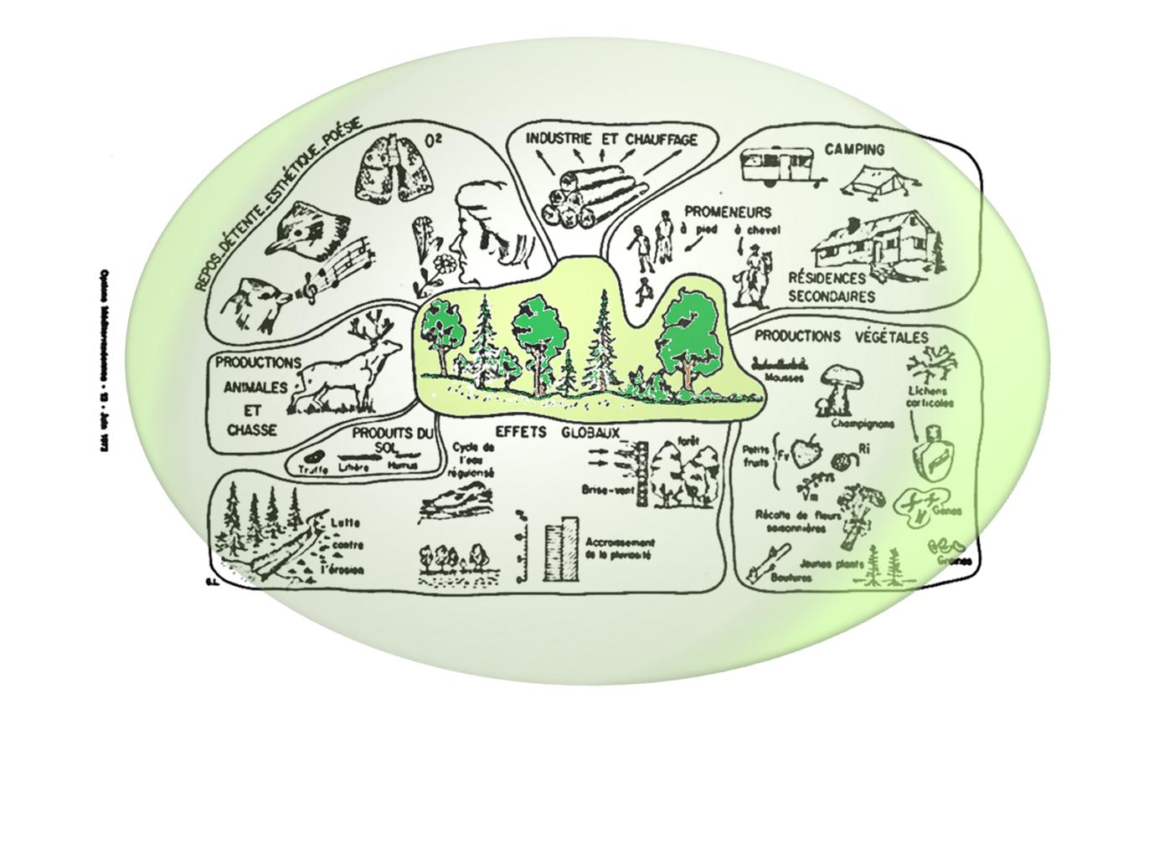
The narrative behind Ecosystem Capital Accounts:
4 - Ecosystems deliver altogether multiple services
NOTE: Excessive extraction of 1 service (here wood removal) can ruin all the others
Source: Gilbert Long, 1972
A propos du diagnostic écologique appliqué au milieu de vie de l'homme.
Options Méditerranéennes, 13 , CHIEAM, Montpellier, Juin 1972

Slide 34
The narrative behind Ecosystem Capital Accounts:
Physical vs. Monetary accounts
Maintenance/restoration costs,
Collective Preferences,
Consumption of Ecosystem Capital,
Final Consumption at Full Price
Ecological Debts (2)
Physical accounts, assets
Monetary accounts
Ecosystem extent & health as public good
Ecological Taxes or/and Tradable Offset Certificates
Ecosystem Stocks & Flows
Ecosystem Health
Ecological Balance Sheet,
in physical units
Land cover,
Biomass/carbon,
Water,
Systems & species biodiversity
Vigour
Organisation
Resilience
Autonomy
Support to healthy populations
Natural & modified inland socio-ecosystems. Sea, Atmosphere
Ecosystem Capability,
Resource use, Degradation / Enhancement,
Ecological Debts / Credits (1)
Service f: e.g. non-use value
Service f $ value
Service e: e.g. symbolic value
Service e $ value
Service d: e.g. water regulation
Service d $ value
Service c: e.g. eco-tourism
Service c $ value
Service b: e.g. fish provision
Service b $ value
Service a: e.g. timber provision
Service a $ value
Ecosystem services values,
Individual Preferences,
Market and shadow prices,
Costs-Benefits analysis
Physical accounts, services
Monetary accounts

Slide 35

Ecosystem Capital Accounts (ENCA) – A simplified integrated model: the ecosystem capital supplies altogether 3 broad types of services between which there is little possible compensation or tradeoff: biomass/carbon AND freshwater AND systemic services. Ecosystem capital potential (& degradation) can be measured by combining measurements of these 3 broad services (accessible resources).
1 - Accessible carbon surplus
Measurement with a new physical currency: ECU
for
Ecosystem Capability Unit
3 - Accessible
ecosystem systemic services
Total
Ecosystem Capital
Capability
&
Ecosystem Capital
Degradation
2 - Accessible water surplus

Slide 36
Moving from Quantities to Values: Economic value vs. Ecological value
Economic value = quantity x price
Financial & national accounts: values are established by the market; prices are decided by the transactors, they relate to production costs, to the capacity for the seller to make profit, to the quality for the buyer, to its capacity to negotiate discounts…
Ecological value = quantity x “price-equivalent”
Ecosystem capital accounts: values need to be calculated, knowing quantity and defining an overall “quality” index equivalent to market price
General equivalency, measurement of stores of various ecosystem capabilities and their change (degradation, improvement), useable for offset transactions…
Conventional but transparent and verifiable measurement to be used to record ecological credits (ecosystem enhancement) and debts (degradation)

Slide 37

ECU: a composite currency to measure ecosystem capability, degradation and improvement, ecological debts and credits…
In physical accounts, measurements are made in basic units (tons, joules, m³ or ha) which cannot be aggregated. These measurements are converted to a special composite currency named ECU for ‘Ecosystem Capability Unit’.
The price of one physical unit (e.g. 1 ton of biomass) in ECU expresses at the same time the intensity of use of the resource in terms of maximum sustainable yield and the direct and indirect impacts on ecosystem condition (e.g. water contamination or biodiversity loss). The loss of ecosystem capability resulting from human activity is a measurement of ecological debt (in ECU).
1 ECU = the ecological value of 1 unit of accessible ecosystem resource
François 1st (1515-1547), Ecu d'or au soleil du Dauphiné, Source : Münzen & Medaillen GmbH (DE)

Slide 38
Examples of equivalent-units and composite indicators
Tonne (Ayres): Material Flows Accounts (MFA); all tonnes are equivalent…
Tonne of Oil Equivalent (TOE) (International Energy Agency, OECD…): energy released by burning one tonne of crude oil
Livestock Unit (LU) (FAO, …): all grazing livestock animals measured in “adult cow”…
Environmentally weighted tonne: EWMF, tonnes adjusted for potential environmental impacts (toxicity, life cycle…)
CO₂-Equivalent (IPCC): CO₂-Equivalents converts all GHG gazes into regarding their Global warming capacity
Global Hectare (Wackernagel): Ecological Footprint Accounts, “biocapacity” of 1 hectare
EMERGY (Odum): embedded renewable energy is universal equivalent
Ecointegrador (Naredo/Valero): total exergy (energy available for uses) of water systems integrating quantity and quality, with reference to environmental targets
Econd (Cosier, WGCS/Australia): ecosystem condition unit (a currency) to measure ecosystem biodiversity comparing historical and present condition (extent and health)
ECU (Weber, EEA): ecosystem capability (or potential) equivalent-unit (a currency) integrating quantity (productivity) and quality (ecosystem health)
GDP at constant price (SNA) where the aggregate is adjusted with prices of a previous year; this composite is the most used version of GDP because it allows better comparison of values.

Slide 39
The Integrated Framework of Ecosystem Natural Capital Accounts
REST OF THE WORLD
Flows embedded into trade
Domestic economy’s global impacts
Adjustment of Final Demand (Full Cost)
Consumption of Ecosystem Capital
Ecosystem economic benefits of projects, policies and plans
Ecological Balance Sheet (credits & debts) in ECU
Sectors’ liability to ecosystem degradation
Estimation
of Restoration Costs (€)
============
Use of natural resource
(physical units)
Social demand for ecosystem services
Valuation
of Ecosystem Services (€)
===========
Ecosystem Services & Well Being
(physical units)
Total Ecosystem Capital Capability in ECU
Land cover change accounts
Geographical & statistical data infrastructure
Jean-Louis Weber, 2013

Slide 40
Implementation of (Integrated) Ecosystem Capital Accounts

Slide 41
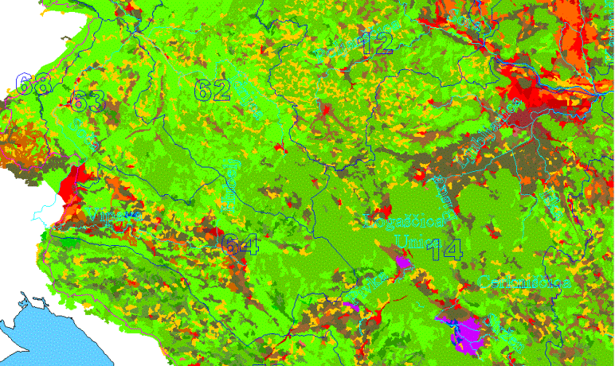
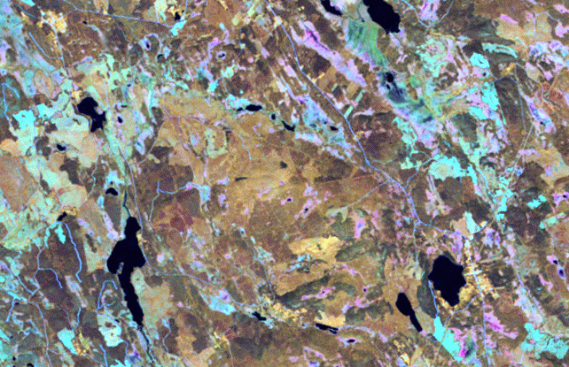
Spatial Integration of Environmental & Socio-Economic Data
Mapping
Socio-Economic
Statistics
Sampling
Individual Sites Monitoring
Notes:
Earth Observation
Land cover continuous mapping as well as censuses, registers or exhaustive surveys: main features & spatial distribution
Sampling: detailed information representative for an area, a type, a group
Complete investigation of important or rare ecosystems, protected areas, case studies, long term ecological monitoring

Slide 42
Main data flows to compile ecosystem capital accounts
Data assimilation
(1 ha or 1 km2 grid)
Accounts integration, analysis and reporting
Data input
Socio-economic statistics by regions
Disaggregate& map
Monitoring data. rasters
Aggregate
& map
Monitoring data, samples
Extrapolate
Standard coefficients
Multiply

Slide 43
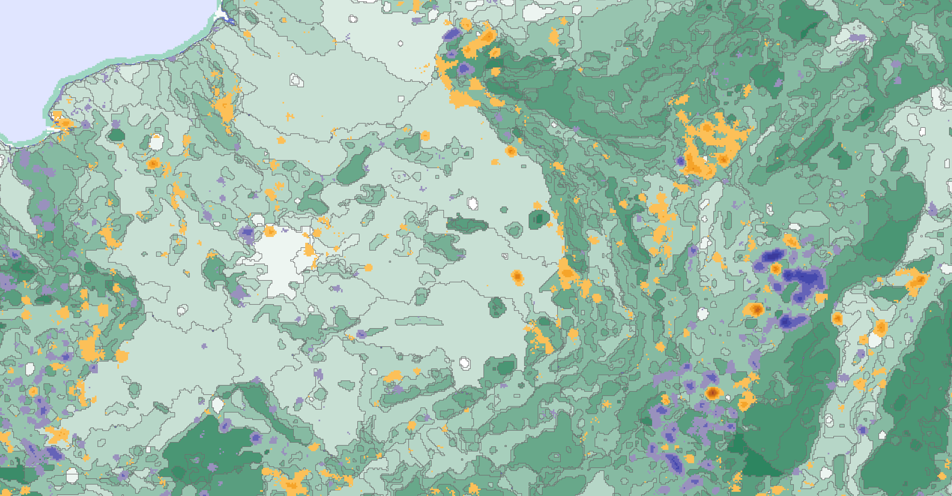


From ecosystem physical degradation to capital consumption, ecological debts and sustainable benefits
Consumption of ecosystem capital
(unpaid costs) & ecological debts (in $)
Degradation
Balance sheet of ecological debts & credits (ECU)
Enhancement
Remediation costs
Economic statistics
&
national accounts
Sustainable use coefficients
Ecological sustainability of
Value Added supported by ecosystem services
Landscape Ecological Potential change 1990-2006, by ecosystem landscape units
(J-L Weber and E. Ivanov, 2011)

Slide 44
Presentation of the ENCA core integrated accounting framework
A “distribution” of the SEEA part 2 on experimental ecosystem accounting
Based on experiences at the European Environment Agency and in Mauritius
In line with the forthcoming SCBD Technical report on ENCA, A Quick Start Package

Slide 45
SEEA-ENCA land cover account structure

Slide 46
Classifications used for land cover accounts
Land cover flows
(formation and consumption of land cover)

Slide 47
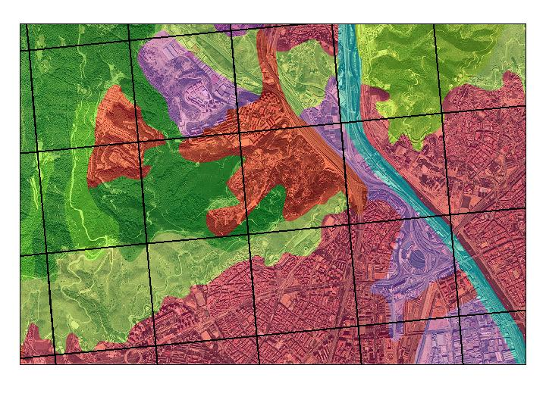
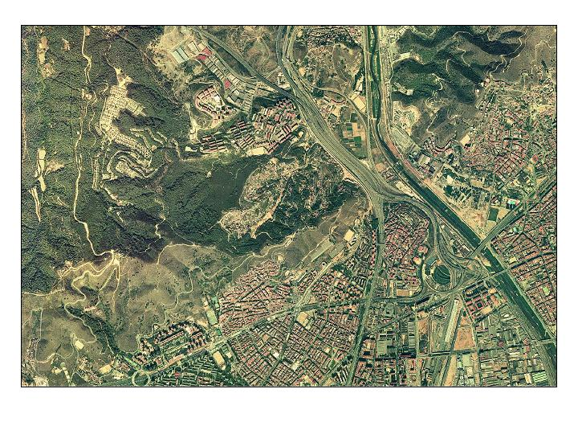
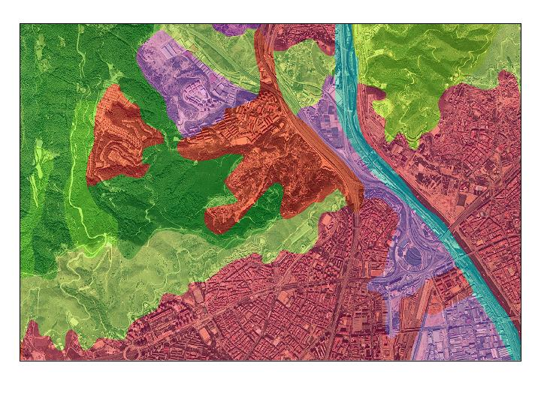
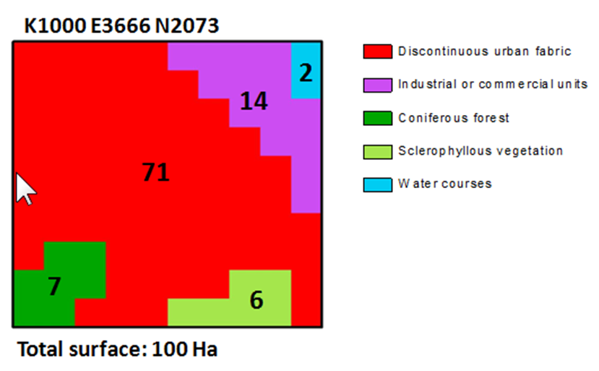
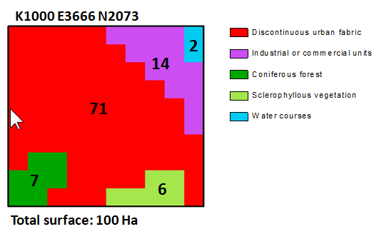
Land cover accounts for Europe
1990-2000 (26 countries)
2006 update (35 countries)
Land cover accounting: statistics based on gridded data
Land cover accounts are produced for 1 km² grid cells
European Reference Grid 1x1 Km
Satellite image (Image 2000)
CORINE Land Cover
===
72
==
6
2
4
Jean-Louis Weber, CBD Conférence, Libreville, 16 Septembre 2010

Slide 48
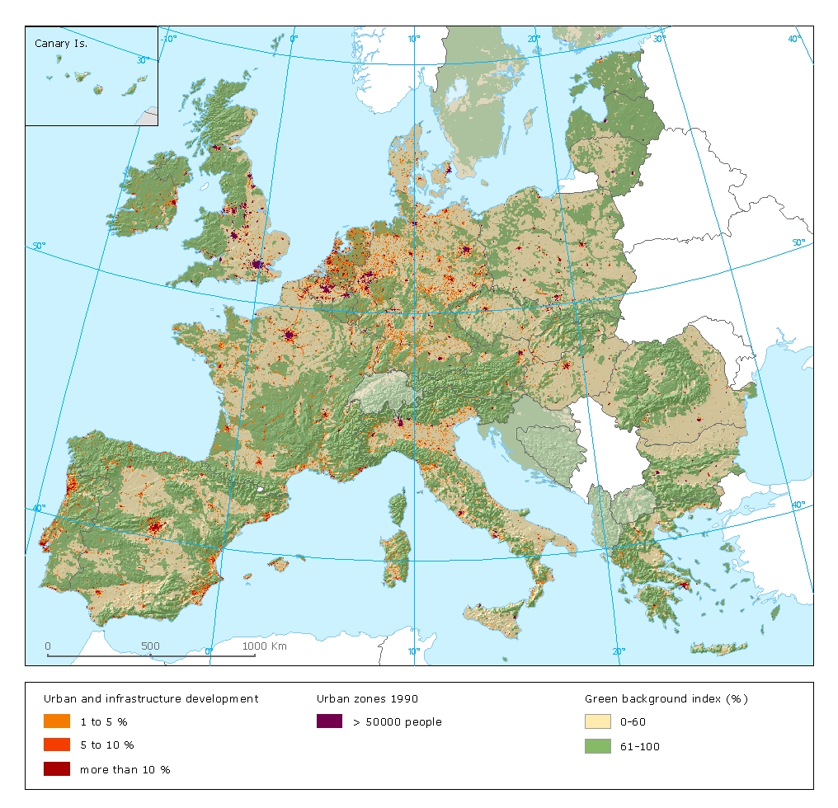
Sprawl of artificial areas 1990-2000
Jean-Louis Weber, CBD Conférence, Libreville, 16 Septembre 2010

Slide 49
Urban sprawl in the province of Venice, 1990-2000, cells of 1 km² , impact on wetlands
Wetlands
Despite possible threats from sea level rise and the permanent ecological problems of the lagoon due to agriculture eutrophicating surpluses, urban and infrastructures development has continued in the province of Venice.
Jean-Louis Weber, CBD Conférence, Libreville, 16 Septembre 2010

Slide 50
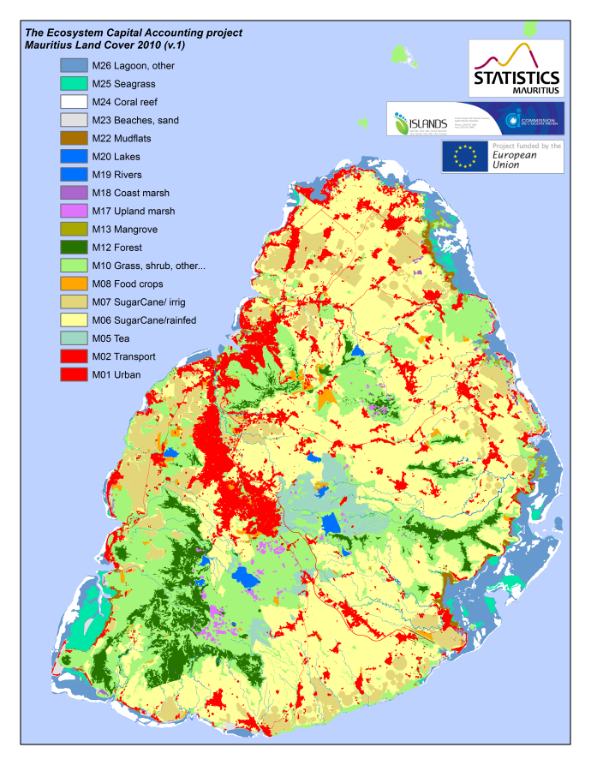
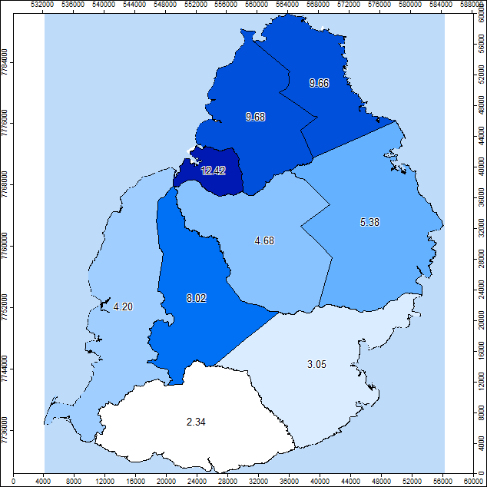
SEEA-ENCA Mauritius preliminary results :
Land cover and change from 2000 to 2010
The land cover data are stored using geographical datasets which use grids (10m x 10m and 100m x 100m) at the most detailed level.
These grids allow computing statistics and producing ecosystems/natural capital accounts for various statistical units such as municipal and village council areas, districts, coastal zones, river basins, socio-ecological landscape units and any relevant zoning.
Urban land cover 2000 & 2010
Urban sprawl 2000-2010 by Districts
Provisional

Slide 51
SEEA-ENCA ecosystem carbon account structure
Accounts Variables Indicators

Slide 52
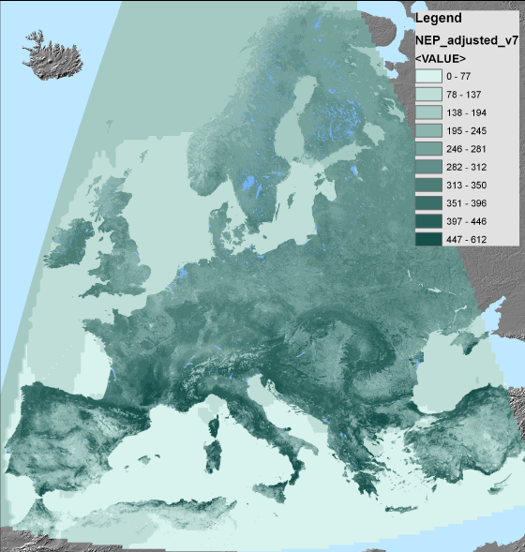
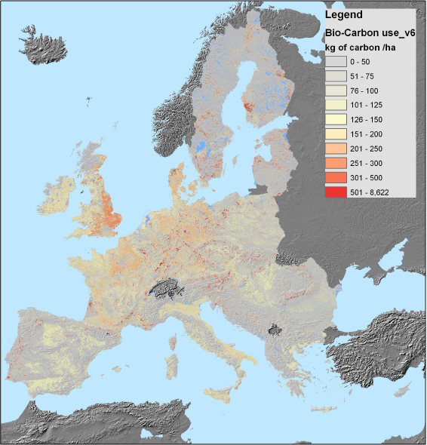
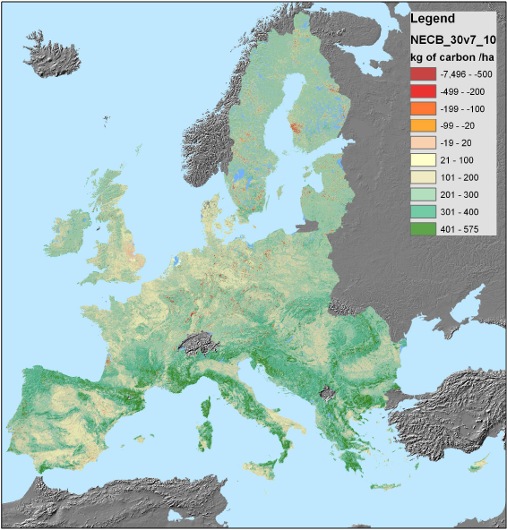
The carbon/biomass account
_
=
Net Primary Production of biomass:
satellite images (NDVI) and modeling,
accessible bio-C surplus
Uses:
agriculture and forestry statistics by regions/countries resampled to the1km2 or 1 ha grid
f(land cover, NDVI)
Net Ecosystem Carbon Balance:
soil and vegetation (trees, shrubs, grass)

Slide 53
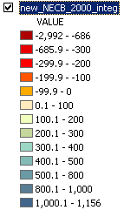
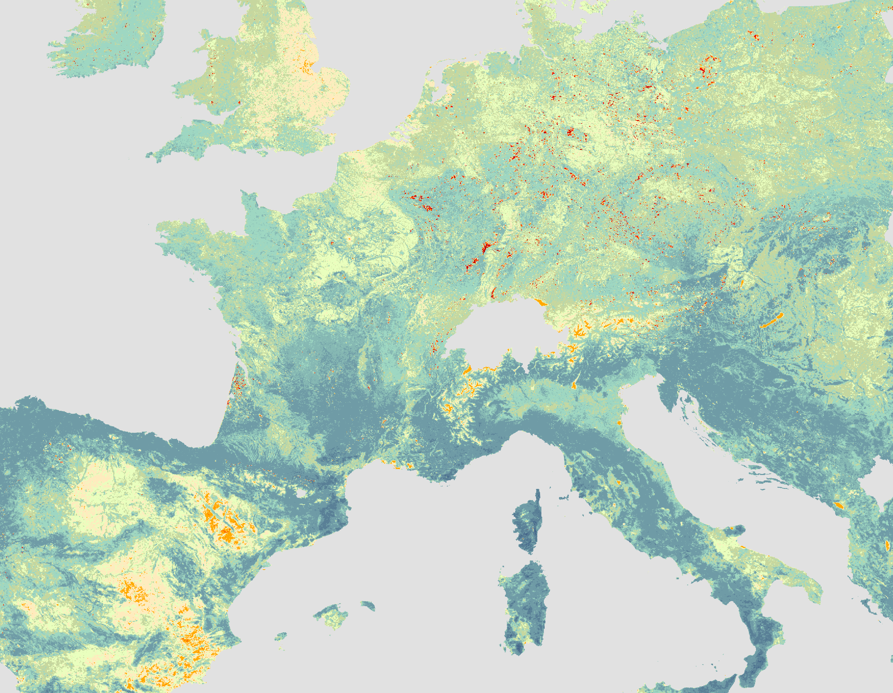
The biomass/carbon account
Tree felling, 1999 Xmas storm
Greenhouses, plastic sheets
Intensive agriculture
Mixed agriculture
Forest
NB: over-estimation of NPP in the South

Slide 54
SEEA-ENCA Mauritius preliminary results :
The biomass-carbon account
Woody biomass/ tons of C
Carbon Accounts show the capacity of the ecosystems to produce biomass and the way it is used by crops harvests and trees removal or sometimes sterilised by artificial developments or destroyed by soil erosion or forest fires (in line with IPCC guidelines).
Accounts are compiled using various sources such as products based on earth observation by satellite (e.g. MODIS NPP), on in situ monitoring (for IPCC-LULUCF, FAO/soil, FRA2010) and official statistics .
Change in NPP/ tons of C
Provisional
Sugar cane harvest/ tons of C

Slide 55
SEEA-ENCA ecosystem water account structure
Accounts Variables Indicators

Slide 56
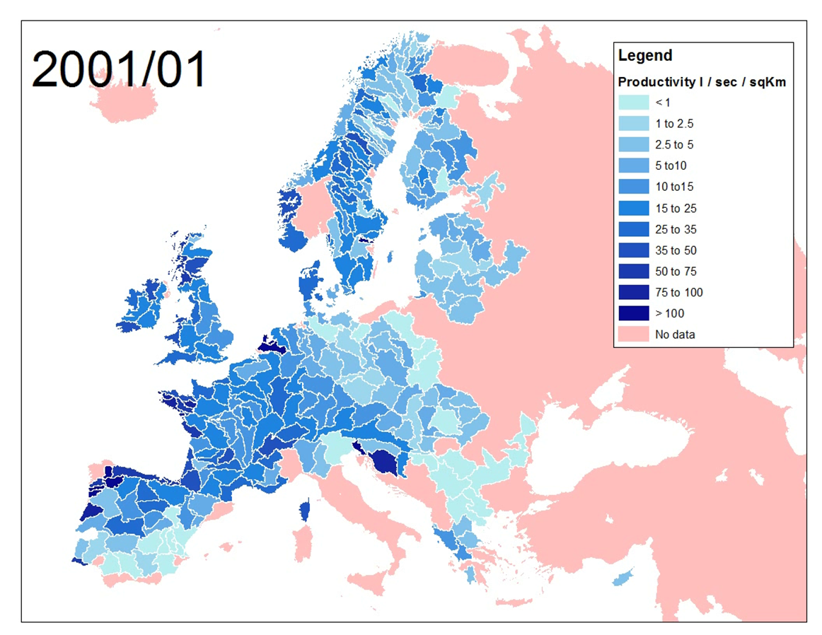
Water Account ( preliminary results):
Monthly productivity at sub-catchment level

Slide 57
SEEA-ENCA Mauritius preliminary results :
The ecosystem water account
The ecosystem water accounts follows the SEEA Water methodology and use preliminary results of the national water accounts. They are detailed by river basins and sub-basins where the hydrological system can be described consistently. Stocks of water are mainly aquifers and lakes/reservoirs, which play important role in Mauritius. Data have provided by the meteorological and water agencies. Water use by sub-basins is estimated from population census data and irrigation map. Satellite products have been used for evapotranspiration. The outcome is the calculation of the water really accessible for use and of an index of stress from water use intensity.
Accessible water, mean amount by ha, 10^3 m3
Provisional
Water use intensity stress index (stress when <100)

Slide 58
SEEA-ENCA biodiversity functional services account structure
Accounts Variables Indicators

Slide 59
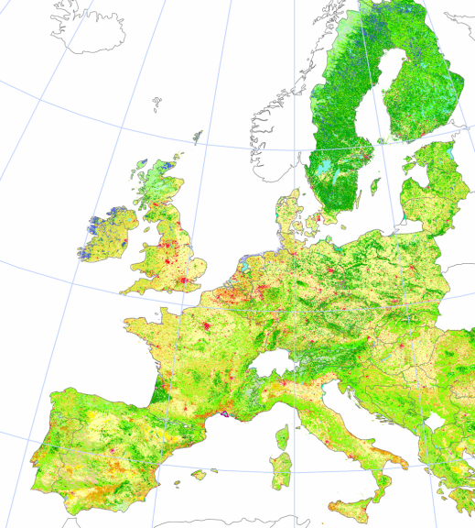
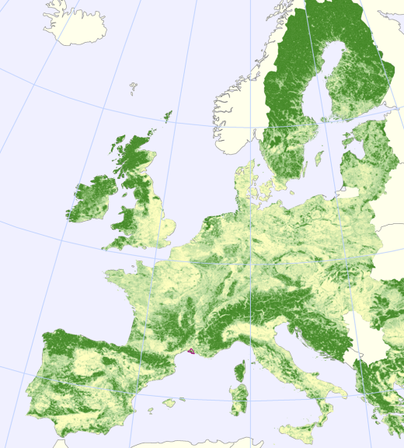
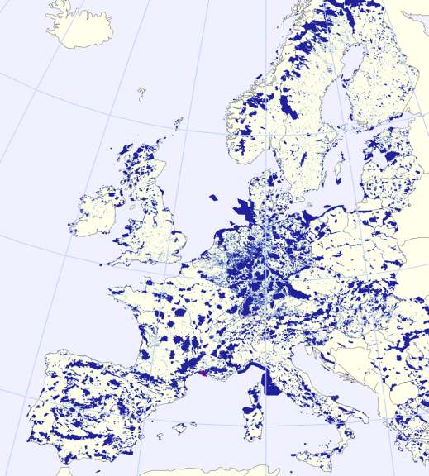
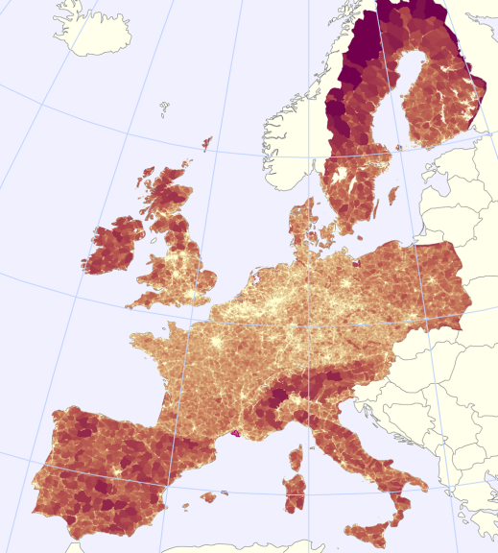

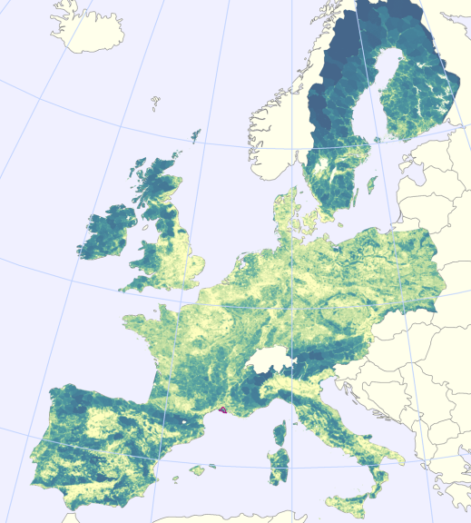
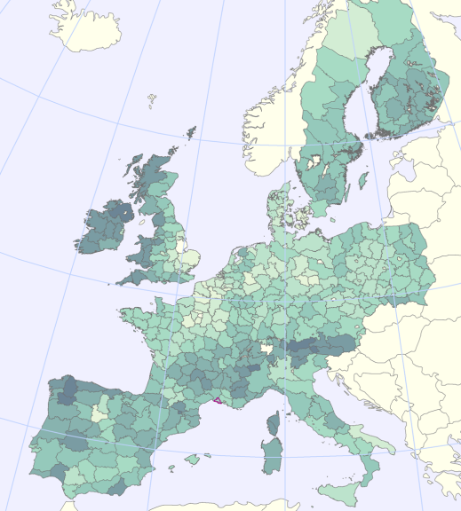
Landscape Integrity & Systemic Services: Landscape Ecological Potential
Corine land cover map (CLC is derived from satellite images)
Green Landscape Index (derived from CLC)
Nature Value (Naturilis, derived from Natura2000 designated areas)
Fragmentation (Effective Mesh Size (MEFF) derived from TeleAtlas Roads and CLC)
➔
and
Landscape Ecological Potential (LEP) 2000, by 1km² grid cell
LEP 2000 by NUTS 2/3

Slide 60
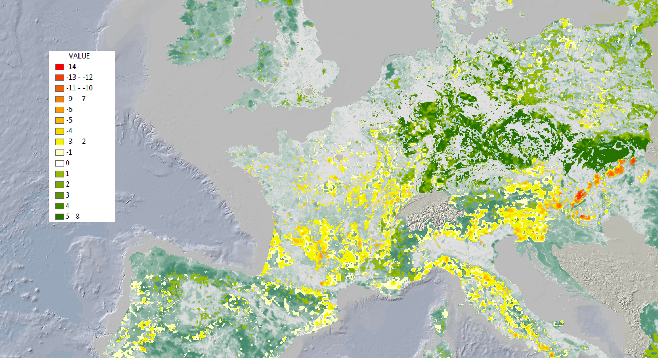
Species biodiversity change account
Index for forest species population trend before 2006: Number of species with population “increase” and “stable” minus “population decrease” (based on the 2006 countries’ reporting to the EC (Art. 17) on status of threatened species)
Jean-Louis Weber , Rania Spyropoulou, Emil Ivanov & Oscar Gomez

Slide 61
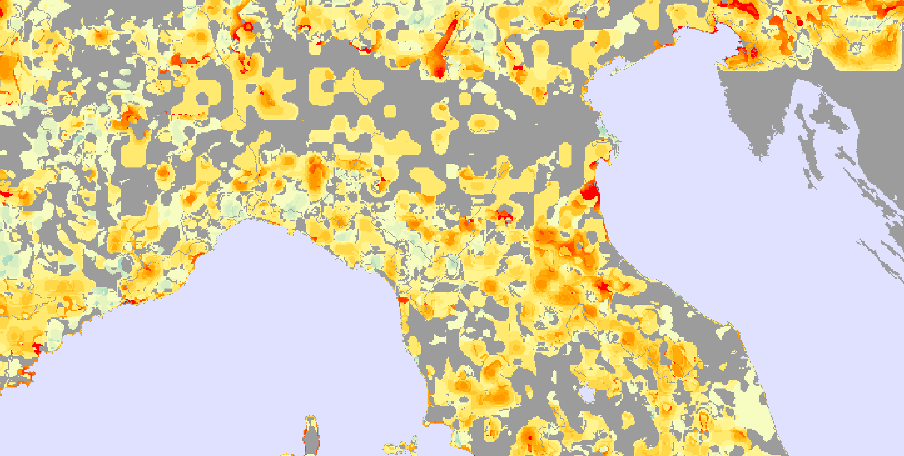

Species biodiversity change account
Index for all ecosystem types: future prospects (after 2006) measured as “good” status minus “poor+bad” (based on the 2006 countries’ reporting to the EC (Art. 17) on status of threatened species)
+10
-10
Jean-Louis Weber , Rania Spyropoulou, Emil Ivanov & Oscar Gomez

Slide 62
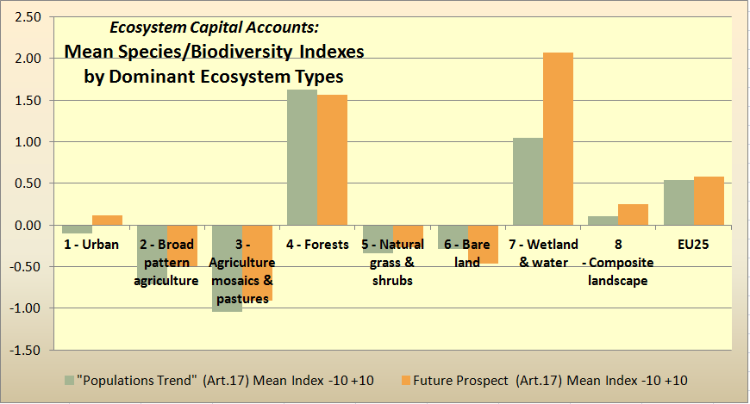
Preliminary results:
Ecosystem Capital Accounts: Landscape/Biodiversity Capacity Account
Species/biodiversity change mean indexes pre- and post 2006, by ecosystems
Jean-Louis Weber , Rania Spyropoulou, Emil Ivanov & Oscar Gomez

Slide 63
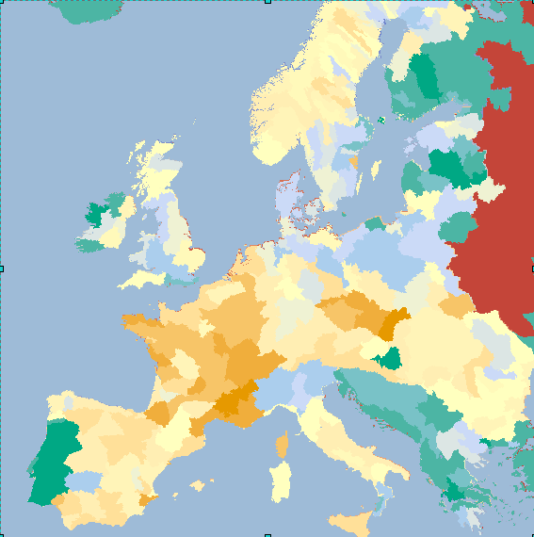
Change in landscape/biodiversity capacity 2000-2006, by sub-basins

Slide 64
SEEA-ENCA Mauritius preliminary results :
The functional services account (depending from integrity and biodiversity)
The biodiversity of systems and species account is made of two accounts which describe the state of ecosystems green infrastructure (landscapes, rivers and sea coastal zones) on the one hand and changes in species biodiversity on the other hand.
Provisional
The NLEP index combines the green character of ecosystems and their fragmentation by roads which may alter their good functioning. Land cover is then weighted with NLEP.
Highest NLEP values can be found where forests, shrubs, grass and natural habitats are predominant, in particular in mountainous and land coastal areas. Low NLEP values correspond to urbanised areas and intermediate score reflect agriculture dominated catchments.
Net Landscape Ecosystem Potential (NLEP) 2010 by
River basins [a], Districts [b] and Municipalities [c]
[a]
[b]
[c]

Slide 65
Calculation of ecosystem’s ecological value in ECU
Stocks,
Supply & Use
Accessible Basic Resource
(tons, joules)
Sustainable
use
index
Change in health index (incl. stability of carbon pools)
Biomass/ Carbon
*
Stocks,
Supply & Use
Accessible Basic Resource
(m3, joules)
Sustainable use index
Change in health index
(incl. pollution)
Composite index of ecosystem capability (ECU-Price)
Water
*
Stocks,
Formation & Consumption,
Accessible Basic Resource
(weighted ha or km)
Sustainable use
index
Change in health index
(incl. biodiversity, diseases…)
Biodiversity
Functional
Services
Hydro
systems, Sea
-
*
Ecosystem Capital Capability
=
One resource (e.g. biocarbon) x ECU-price
NON
ADDITIVE
Jean-Louis Weber – 22 Nov. 2013
Notes:
, 22 Nov. 2013

Slide 66
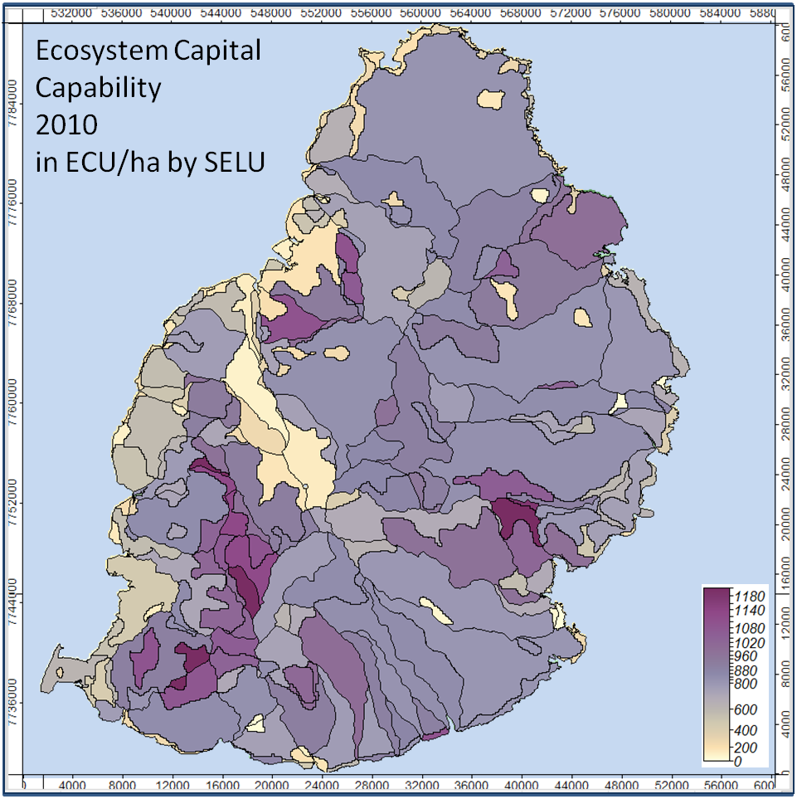
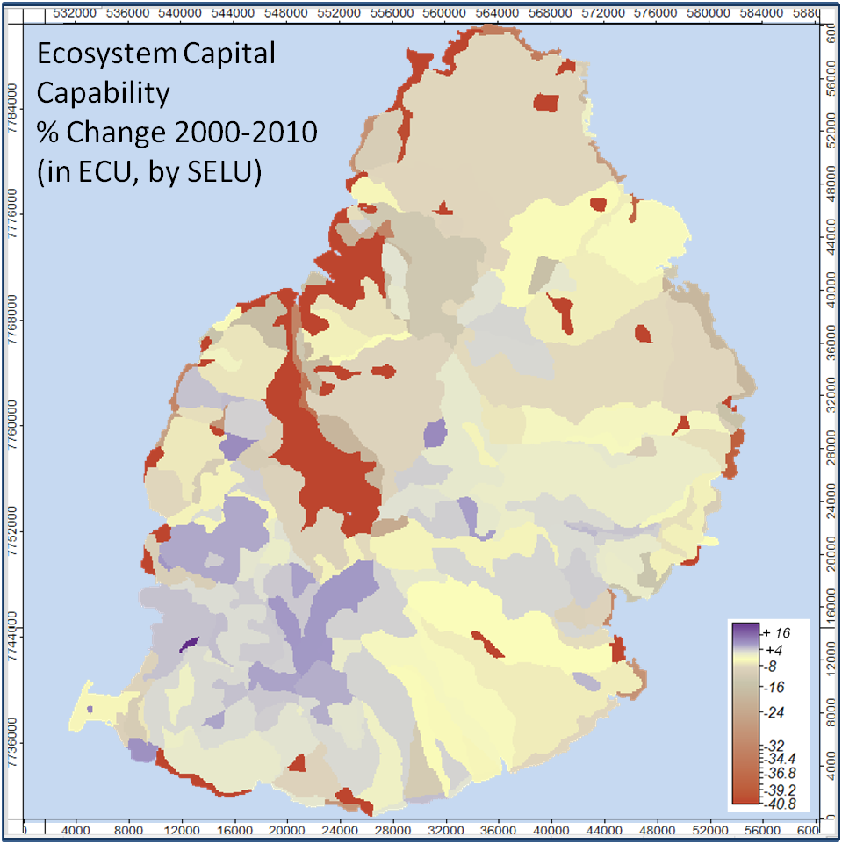
Ecosystem capital capability and change (in ECU)
Ecosystem Capital Capability:
ECU value by Socio-Ecological Landscape Units, 2010
Ecosystem Capital Capability (inland):
Change in ECU value, % by Socio-Ecological Landscape Units, 2000-2010
Provisional

Slide 67
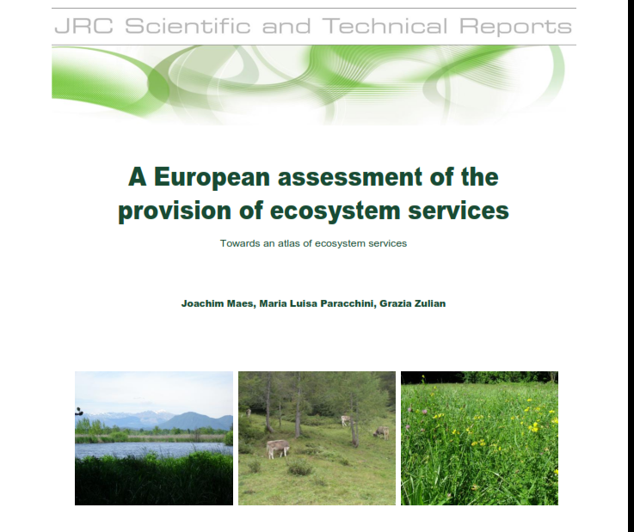
Functional analysis of (selected) Ecosystem Services
Example of MAES in Europe
MAES: Mapping and Assessing Ecosystem Services

Slide 69
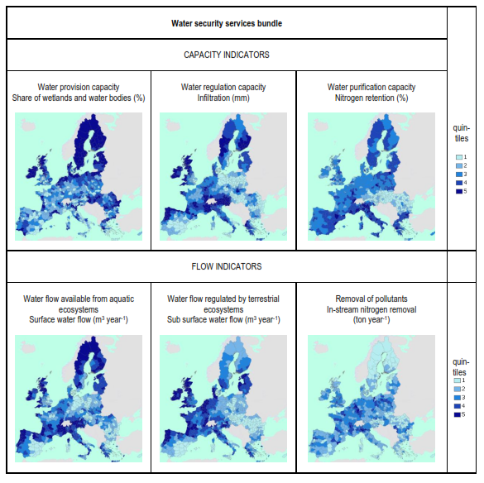

Slide 70
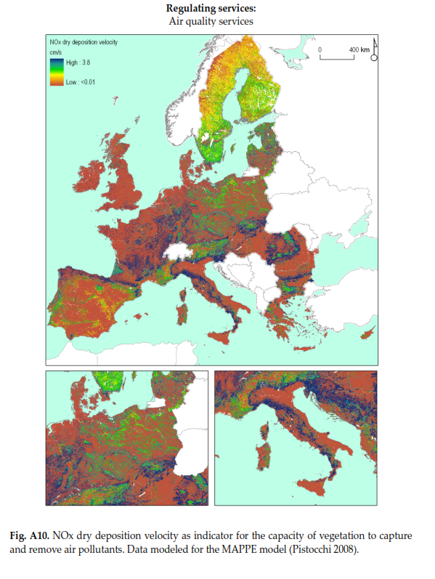

Slide 71
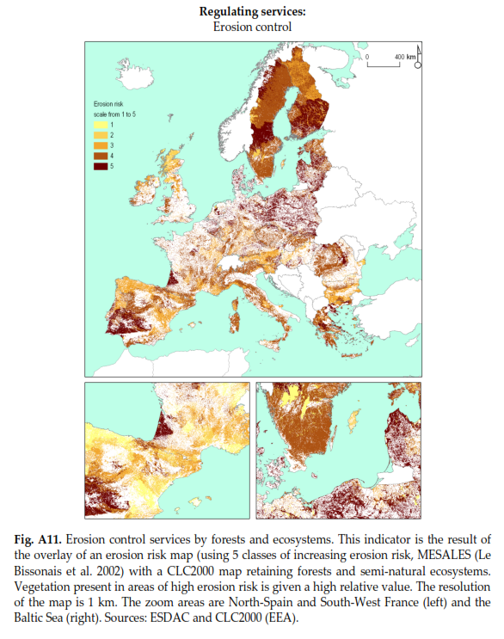

Slide 72
Jean-Louis Weber
jlweber45@gmail.com
Skype: jean-louis.weber

Slide 73
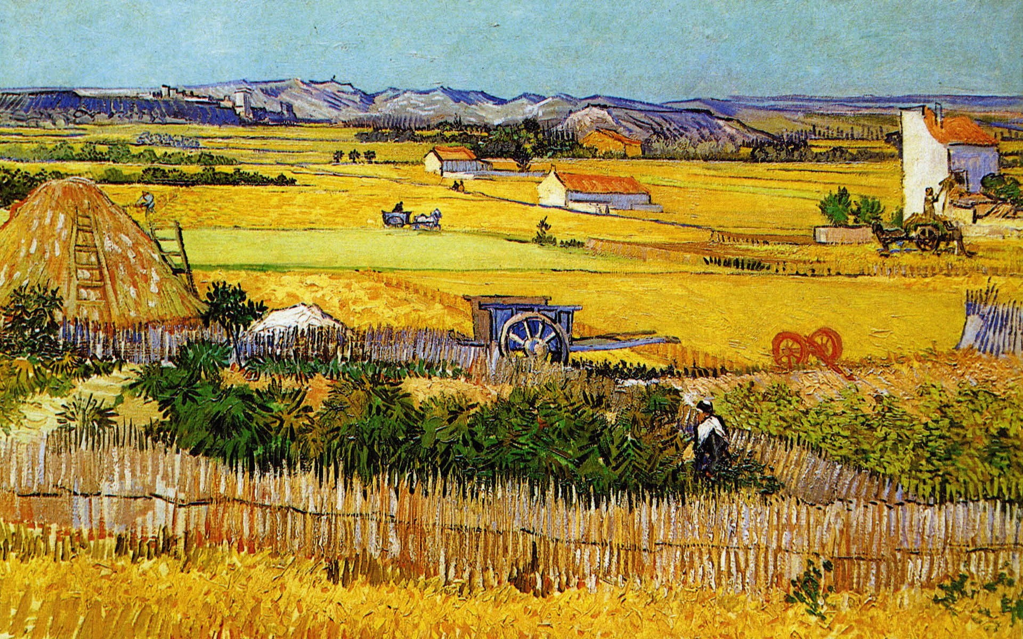
Thank you! Jean-Louis Weber jlweber45@gmail.com
Vincent Van Gogh: La plaine de la Crau avec la ruine de Montmajour (wallpaper hd art artwork painting)

