Slide 1
Forest Information System for Europe
Miruna Bădescu, Adriana Baciu – Eau de Web
Koldo Goñi Iza - Tracasa

Slide 2
Plan for FISE developments
Short presentation of FISE milestones
Meaning to start humble and build the system bottom up
Start with user stories for each target group, important to meet the demand
Milestone | Planned date
Development of the first portal prototype, to present at the meeting with the National Forest Directors | September 2018
Development of second portal prototype, approximatively one year after the start of the contract | February 2019 – delivered iteratively from Oct 2018
Final prototype ready and operational | December 2019

Slide 3
Main components of FISE
Portal
Main entry point for retrieval of FISE information and content. Main section of the portal: Topics, Countries and Regions, Indicators
National Forest Inventory Search functionality
Tool that will assist the users in easy retrieval of National Forestry Inventory datasets and information, along with other datasets and information available on forestry
Maps and Graphs
Visualization tool for GIS data relevant to the forest field
Visualization tool for existing tabular data, time series for such datasets etc.
All technologies used will follow EEA Standards

Slide 4
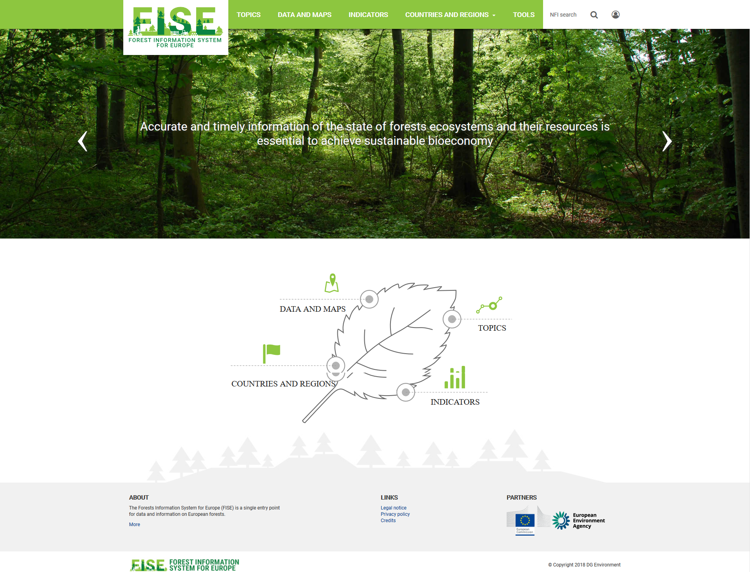
Portal design

Slide 5
Portal structure
Homepage structure:
Menu area: logo, easy navigation from the portal menu
Rolling banner – presenting short welcome messages for the visitor, announcements, conferences, reporting news
Navigation area, emphasis on main sections
Stories area – to be implemented – will advertise the relevant stories of the moment
Footer area: Contact, About, Partners etc.
Main sections:
Topics
Data and maps
Indicators
Countries and regions
Tools

Slide 6
Portal main sections and pages

Slide 7
Country pages, Indicators
The country pages will show the information available now:
Art 17 forest data
NFI search per country
LULUCF data
Etc.
Ideally, specific information will be filled in and maintained by countries
Indicators
EEA is compiling forest condition indicators as part of a forest pilot project carried with the Commission
Other indicators, compiled for other processes and related to different policy relevant topics

Slide 8
Search through the National Forest Inventories
Data has been collected by JRC from NFIs and international organisations:
FAO/FRA, UNECE, Forest Europe, ICP-Forests, EUFORGEN, Global Forest Watch, etc.
Commission Services: JRC, DG ENV, DG AGRI, DG CLIMA, etc.
National Forest Inventories
Copernicus layers (HRL Forests, tree cover density)
Currently more than 1600 resources (datasets, maps, reports, documents etc.) and counting…
The search looks in the resources’ metadata (country/region, resource type, topic, keywords etc. )
Manually associated by the JRC, i.e. common nomenclatures
Meaningful results

Slide 9
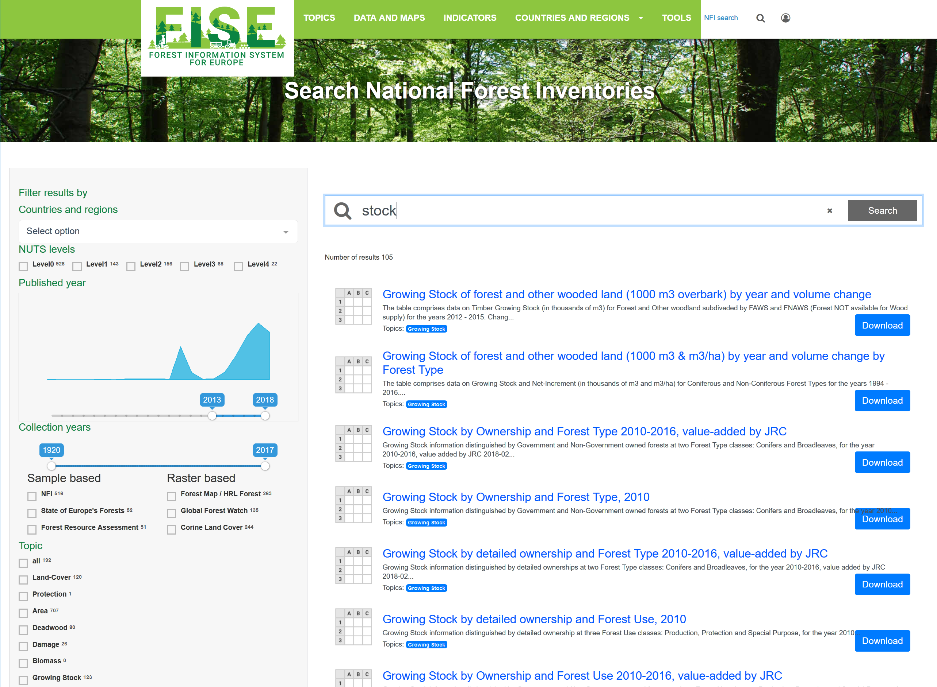
Search National Forest Inventories

Slide 10
Forest maps in progress
Many data sources to consider - JRC, EEA, FAO, UNECE, EFI, EFFIS, EUFORGEN, NFIs, COPERNICUS, ICP-Forests, …
There is a lot of tabular information suitable to represent at country level
We have to select under some criteria
Relevance
Unpublished
Geographic component

Slide 11
Planned activities
Maps in progress
Forest density and forest types combined Wood production
Forested areas in Protected sites (Natura2k & CDDA)
Cover density & forest type statistics by nuts(0-3)
Copernicus & fragmentation
EFFIS wildfires by nuts
Maps in the stack
Forest and fresh water resources
Wood production
Forest and recreation

Slide 12
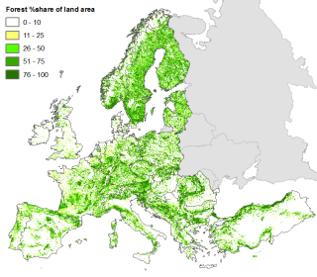
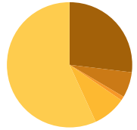
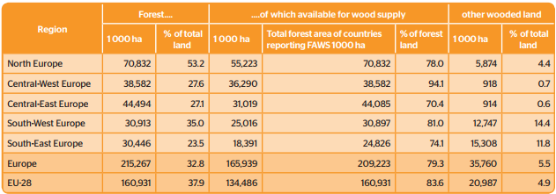
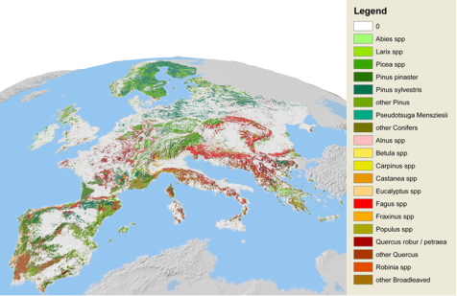
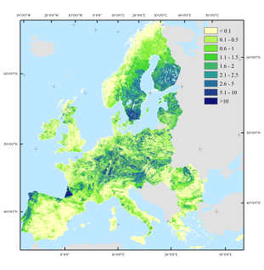
How to get Forest information?
Two main data types ↔ complementary information
Remote sensors (satellite)
Homogeneous assessment across Europe
Single forest definition
Forest: Land cover (incl. agro-forestry)
Data in non-accessible at region level
Data can be summarized in indices
Reproducible & efficient analysis
NFI: plot sample data
High thematic detail at plot location (tree species, age, deadwood, etc.)
Forest: Land use (excl. agro-forestry)
Long history & continuous approach
Expert knowledge
Official, national forest data
Mix data sources & technics

Slide 13
Tree cover density and forest types
http://wab.discomap.eea.europa.eu/webappbuilder/apps/144/

Slide 14
Data from EFFIS (European Forest Fires Information System)
http://wab.discomap.eea.europa.eu/webappbuilder/apps/146/

Slide 15
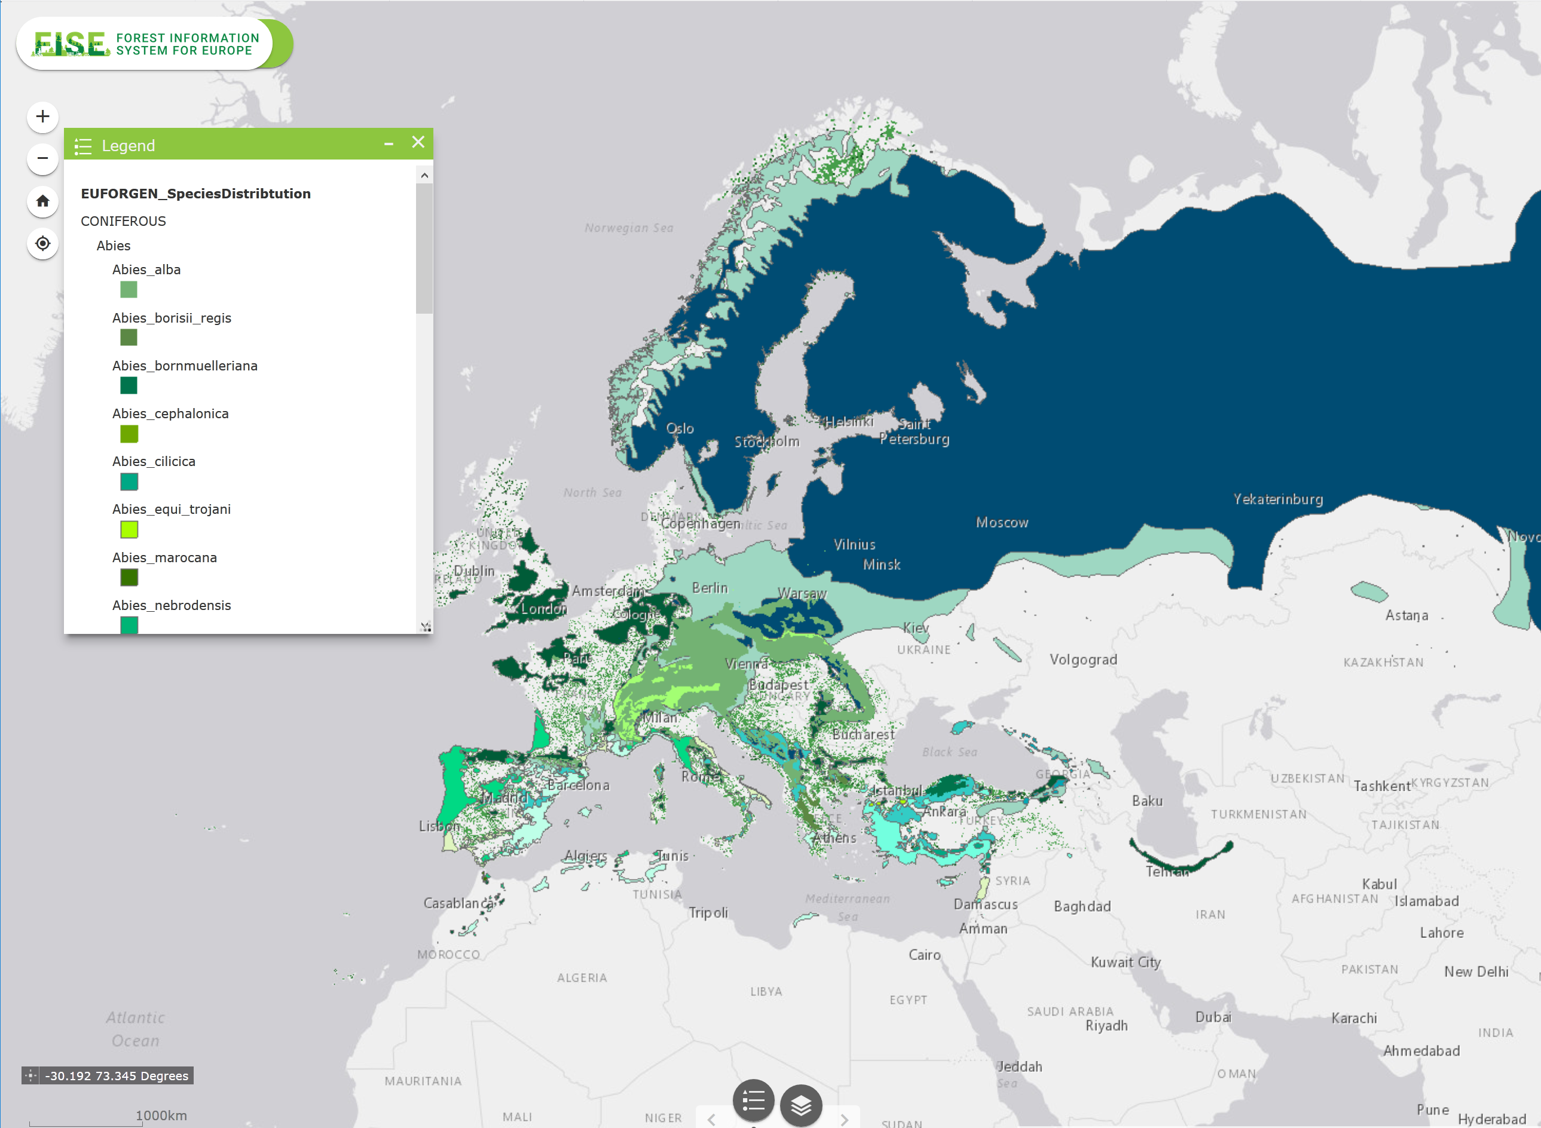
EUFORGEN
http://wab.discomap.eea.europa.eu/webappbuilder/apps/149/

