Slide 1
Building the Information System for Forests in Europe
Miruna Bădescu, Adriana Baciu – Eau de Web
Photos by Annemarie Bastrup-Birk

Slide 2
Project objectives – April 2018
In short:
Inform policy making and decision-taking
Support monitoring and assessments, potentially support reporting
Facilitate expert knowledge sharing, research and innovation
Improve public awareness and knowledge
More detailed:
Provide enhanced forest information to gather vital information on forest ecosystems conditions and monitor the relevant trends for informed policy decisions, funding and management.
Sustainable forest management, to encourage forest management practices which preserve and enhance all forest ecosystem functions and services. Main actions include work on criteria and indicators for sustainable forest management and sustainable biomass; promote the wider use of forest management plans and the integration therein of ecosystem approaches and biodiversity concerns.
Valuing forests to help identify, value and include the full value of forests into statistics, accounts, decision-making and payments to forest owners. Main actions include MAES-Forests, payment for ecosystem services in forests.
Integration of the forest environmental needs in the various policy objectives and initiatives of DG ENV and the Commission at large. Forests are affected by a number of policies and decisions, and their main tasks are achievable only if our objectives are sufficiently reflected across all relevant policies.

Slide 3
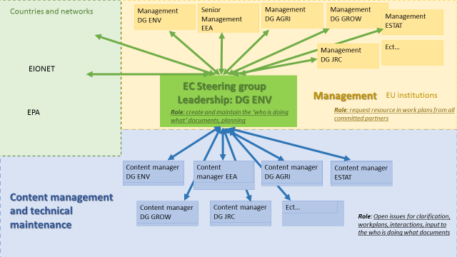
Actors and stakeholders

Slide 4
Resources for contractors
Eau de Web – 354K €
Tracasa – 200K €
Type of activity | Person-days
Business analysis, system architecture | 60
Web development, testing and documentation | 899
Training | 0
Meetings, discussions, travel (6 meetings in the EU envisaged) | 70 md + travel expenses
Project management | 100
Total | 1129
Type of activity | Person-days
Mapping | 240
Charting | 200
Business analysis | 30
QA/QC | 30
Meetings, discussions, travel | 30
Total | 530
Consumption: ~360 person-days, ~30%
Consumption: ~135, < 25%

Slide 5
Useful links
Project documents https://projects.eionet.europa.eu/fise-project/library/
Concept paper, containing Business Cases
Project Charter
Project Handbook
Project Workplan
Datasets received from the JRC https://projects.eionet.europa.eu/fise-project/library/datasets-jrc
Ticketing system https://taskman.eionet.europa.eu/projects/fise-dev
Demo system https://demo-forests.eea.europa.eu/

Slide 6
Plan for FISE developments
FISE milestones, as foreseen in April 2018
Meaning to start humble and build the system bottom up
Start with user stories for each target group, important to meet the demand
Milestone | Planned date
Development of the first portal prototype, to present at the meeting with the National Forest Directors | September 2018
Development of second portal prototype, approximatively one year after the start of the contract (postponed, to reschedule) | February 2019 – delivered iteratively from Oct 2018
Final prototype ready and operational | December 2019

Slide 7
Timeline
Apr 2018 Sep 2018 Dec 2018 May 2019 ? Dec 2019 Feb 2020 Apr 2020
Start
First prototype
Improvements / on hold
Now
Interim deliveries
Launch
Eau de Web EOC
Tracasa EOC
Should establish interim releases between now and December
Need to link releases with explicit features and outputs
Consider prolonging the contract(s) in 2020

Slide 8
Main components of FISE
Portal
Main entry point for retrieval of FISE information and content. Main section of the portal: Topics, Countries and Regions, Indicators
National Forest Inventory Search functionality
Tool that will assist the users in easy retrieval of National Forestry Inventory datasets and information, along with other datasets and information available on forestry
Maps and Graphs
Visualization tool for GIS data relevant to the forest field
Visualization tool for existing tabular data, time series for such datasets etc.
All technologies used will follow EEA Standards

Slide 9
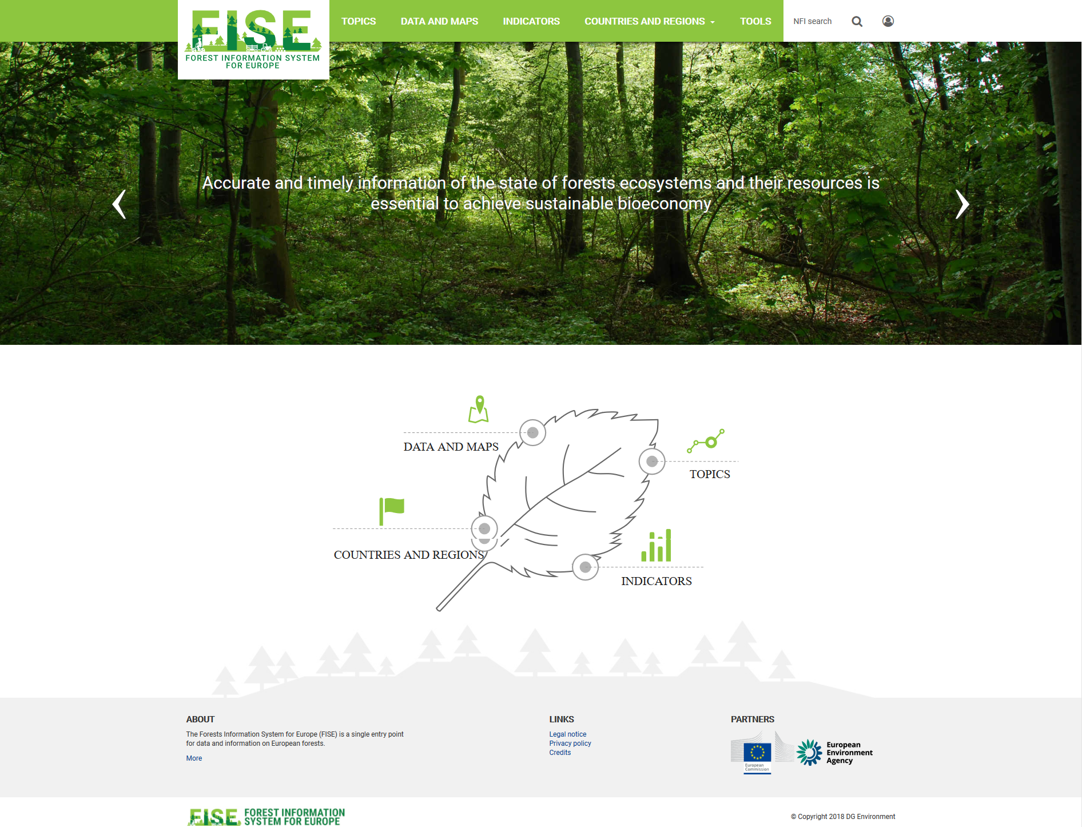
Portal design

Slide 10
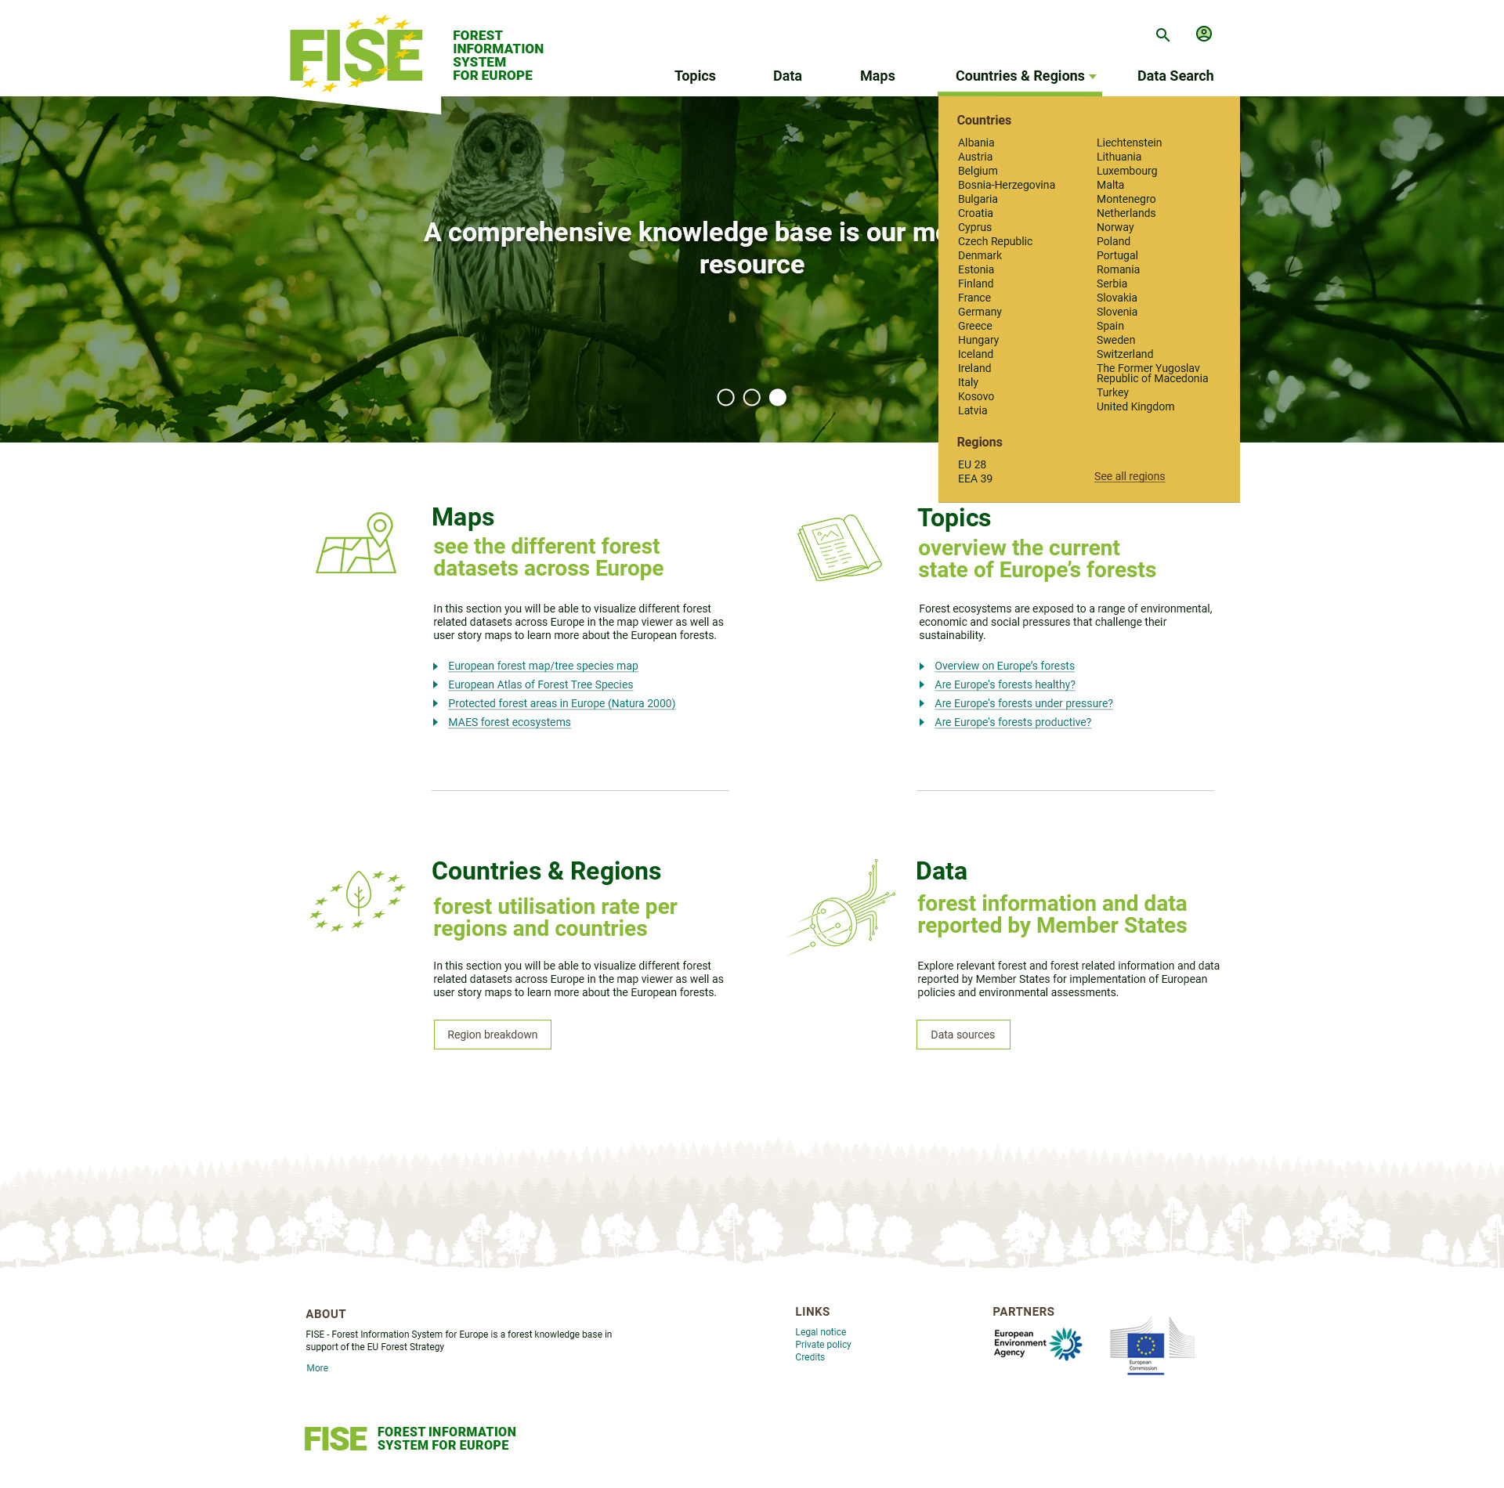
Alternatives

Slide 11
Portal structure
Homepage structure:
Menu area: logo, easy navigation from the portal menu
Rolling banner – presenting short welcome messages for the visitor, announcements, conferences, reporting news
Navigation area, emphasis on main sections
Stories area – to be implemented – will advertise the relevant stories of the moment
Footer area: Contact, About, Partners etc.
Main sections:
Topics
Data and maps
Indicators
Countries and regions
Tools

Slide 12
Portal main sections and pages

Slide 13
Country pages, Indicators?
The country pages will show the information available now:
Art 17 forest data
NFI search per country
LULUCF data
Etc.
Ideally, specific information will be filled in and maintained by countries
Indicators
EEA is compiling forest condition indicators as part of a forest pilot project carried with the Commission
Other indicators, compiled for other processes and related to different policy relevant topics

Slide 14
Search FISE for forest information, including National Forest Inventories
Data has been collected by JRC from NFIs and international organisations:
FAO/FRA, UNECE, Forest Europe, ICP-Forests, EUFORGEN, Global Forest Watch, etc.
Commission Services: JRC, DG ENV, DG AGRI, DG CLIMA, etc.
National Forest Inventories
Copernicus layers (HRL Forests, tree cover density)
Currently more than 3200 resources (datasets, maps, reports, documents etc.) and counting…
The search looks in the resources’ metadata (country/region, resource type, topic, keywords etc. )
Manually associated by the JRC, i.e. common nomenclatures
Meaningful results
Automated import procedure based on the format provided by the JRC
Latest dataset from 30 April 2019 loaded

Slide 15
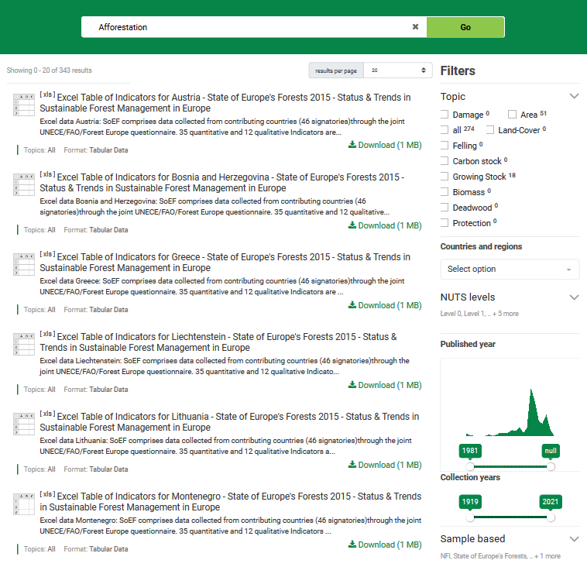
Search (NFI)
Next steps:
Obtain countries’ approval to publish this data and ask for other relevant datasets / information (letter together with the approval for using the ICP data)
Create search by country
Integrate with the global portal search

