Slide 1
Requirements for a regular production of EU ecosystem accounts - the view from Eurostat
Anton Steurer
Eurostat – Unit E2: Environment statistics and accounts; sustainable development
KIP INCA workshop – EEA, Copenhagen 9 March 2018

Slide 2
Objectives
Regular production of environmental accounts at Eurostat – How is it done
Ecosystem accounts– What has to be produced (for discussion)
Towards a regular production of ecosystem accounts - Necessary steps (for discussion)

Slide 3
1. Regular production How is it done

Slide 4
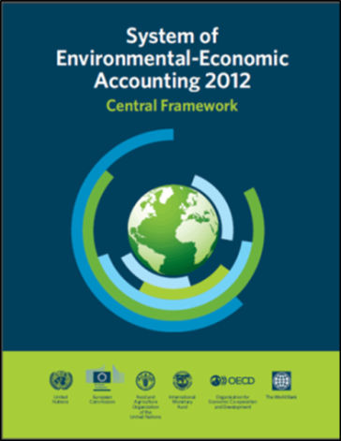
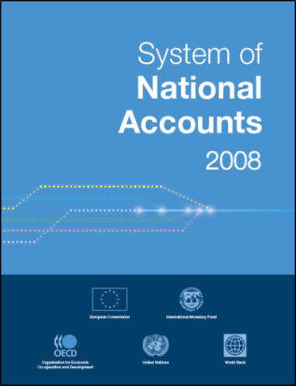
Regular production of environmental accounts is based on:
International accounting standards:
Regulation (EU) 691/2011
Establishes data collections, transmission to Eurostat, quality assessment, etc.
Establishes periodicity, deadlines, tables, variables, breakdowns,…
Debate in working group to resolve problems as they occur

Slide 5
Environmental accounts prepared by Eurostat
Air emission accounts
Material flow accounts
Physical energy flow accounts
Environmental taxes
Environmental goods and services sector accounts
Environmental protection expenditure accounts
Environmental subsidies and other transfers ^{(*)}
European Forest accounts ^{(*)}
^{(*)} Voluntary data collection
Mandatory collections, based on EU Regulation

Slide 6
Production of environmental accounts: (mainly) a decentralised system
Member State
Member State
Member State
Eurostat
Member State
Member State
Member State

Slide 7
Why decentralised system?
EU principles of subsidiarity and proportionality
Better quality of results
Multiple partial sources used for accounts
Member States know better national data sources, national situation, plausibility and interpretation results,…
Member States take ownership of results
Publish nationally, cater national users,…
Eurostat does not have manpower to do everything
(Note deviations: environmental employment estimate, SDG indicators that are not from the statistical system, INCA, LUCAS

Slide 8
Consequences decentralised system
You need data collections in countries
You need questionnaires in agreed format
You need a dedicated working group to discuss
There are data flows which require IT
also metadata flows to explain and assess quality
Data received must be validated
Common methods, definitions, concepts, classifications,…
Countries need support e.g. handbooks
Standards, standards, standards,…

Slide 9
Data handling and processing at Eurostat
Data validation
Completing, gap-filling, early estimates
Calculation of European aggregates
Publication of results

Slide 10
2. What ecosystem accounts to be produced

Slide 11
SEEA ecosystem accounts

Slide 12
For discussion: which accounts
We could start with re-publishing some accounts that are published by a partner
Extent accounts
Later condition accounts
Some services flows (physical units)
Some experimental monetary estimates

Slide 13
3. Necessary steps

Slide 14
Requirements for a regular production of ecosystem accounts
Data quality
Physical data foundation
How to get there (one strategic objective of INCA)?
Regularly produced ecosystem accounts
Regularly produced reference data sets
The aim →
Standardised procedures
Standard valuation methods

Slide 15
Standardised procedures
International guidance (we are working on this and getting there)
Regular data input (is kind of on track for some elements – Copernicus, LUCAS, admin data)
Regular & timely production (needs apparatus at EEA and JRC) and transmission to Eurostat
Handbooks/ established methods for regulating production and data transmission to Eurostat
In the long run integration of MS results

Slide 16
A stable basis
Regular and aligned production of reference data sets
Input data must be delivered in a form that it can be easily integrated
Complementarity between European data collections e.g. Copernicus and LUCAS, and with national ones
Production capacity at EEA and JRC – legal base in the long run?
Resource needs and necessity to balance the needs for information with the associated costs and reliability of the gained data
Strengthening the data foundation – Development of priority data sets under COGI/INSPIRE

