Slide 1
Developing a spatial data platform for KIP INCA - review of state of play and key questions
Conor O’Kane (MRAG) & J-E Petersen (EEA)
9 March 2018

Slide 2
Structure of presentation
1) Context and taking stock
2) Key issues and principles
3) Data platform functionalities – key questions
4) Shared spatial reference data – which and how

Slide 3
Ad 1 ) Overall time line for development & implementation of KIP INCA spatial data platform
Final proposal for technical design of spatial platform by summer 2018
Development and testing of some selected components with support of framework contract by end 2018
Further development and roll-out of agreed elements in 2019
Demonstrate functionality of system during 2020 (on basis of integrating CLC 2018 data set and other refreshed or new data sets).

Slide 5
A shared data platform + information system for KIP INCA
KIP INCA
output
KIP INCA
output
KIP INCA
output
EKC Task force on information platforms
Dissemination of
information
&
knowledge
KIP INCA
output
KIP INCA
output
Data ana-lysis
Data
Integration
&
data analysis
Shared data architecture
Nature data
EKC review of EU Env.
Data Centres
‘Shared
Spatial
Data platform’
Citizen data
Land use data
Data centres
&
data sources
Monitoring data
Statistical data
Copernicus data
Research data outputs

Slide 6
Ad 2) Data foundation for natural capital accounting:
A system of datasets within a common spatial reference framework;
Integration of approaches – assessment of ecosystems, modelling ecosystem services…;
Use of models to transfer data into accounts and fill data gaps
=> requires development of a shared spatial data platform
Improving data foundation – for accounting & assessment
Land
use/cover
data
Ecosystem data
Copernicus Land monitoring
In situ coordination
Natura
2000/CDDA
LUCAS
Forest statistics
Ecosystem mapping (extent)
Environmental reporting
Farm Structure Survey
Ecosystem condition (state)
Biodiversity
assessments (monitoring)

Slide 7
Outline of approach in KIP INCA Phase 1 reporta
Copernicus/
CORINE
Environmental
data and models
LUCAS and ESTAT
data collections
Biodiversity, species,
ecosystem data/MAES
Disaggregation techniques
Web services
Data architecture
Shared pool of ecosystem
reference data
Ecosystem
accounts
Ecosystem
assessment
Policy
evaluation

Slide 8
Key tenets for KIP INCA spatial data platform
Aim is to develop a shared platform that is stable, ‘institutional’ and achieves full integration of systems and sharing data sets (as far as appropriate)
Develop accounts underpinned by harmonised, geo-referenced and QA/QCd datasets
Develop a semantic inventory of spatial datasets placing data in their context.
Serve as common spatial reference framework; with a 1km grid as the core accounting grid
Ensure transparency, traceability and accountability of the datasets and models used to compute the accounts
Facilitate greater efficiency in sharing of spatial data and related joint analysis, thus enabling a pooling of resources between KIP INCA partners and synergies
Achieve this making best use of the present capacity and resources

Slide 9
Ad 2) Key issues and principles:
There are 2 main challenges to tackle:
a) Efficient sharing of existing data sets
b) Development of shared spatial reference data on natural capital
For a) we need to know:
Do we have a problem? If so, how can it be fixed? Within existing tools and set-up or do we need to create a new technical solution?
Also need to consider context: experimentation or regular production?
For b) we need to agree:
Which are the priority reference data sets on natural capital
Can we create them by joining forces? How to set that up?
Are new monitoring or data collection schemes necessary?

Slide 10
Data foundation for experimentation and for regular production
Issue | Experimentation | Regular production
Main objective | Demonstrate feasibility | Efficient & stable production according to agreed methodology
Data source | Grab and use what is available | Go for ‘official’ and regular data
Data integration / alignment (between ecosystem accounts) | Not so important as long as analytical tools can cope | Full alignment supports efficient production, enhances credibility of ecosystem accounting system
Production approach | Tailor to analytical purpose, can be flexible, can be one-off | Requires automated production as much as possible, needs to establish a regular and fully comparable time series
Institutional set-up | As necessary, voluntary arrangement suffices | Formal cooperation required; full compatibility of systems and standards

Slide 11
Ad 3) Data platform functionalities – key questions
Who shares data with whom? Is current set-up efficient for data access?
If there are obstacles what are these? How to solve them?
How do we ensure common geometry and other key data standards for efficient data sharing and integration into different analytical tools.
How to ensure there is one master version which everyone uses, how is that maintained/updated?
Are there output data sets created by JRC/EEA others that are not officially published? How to deal with / efficiently share these?
=> look into set-up of EEA IDP for identifying key principles for creating and maintaining a common pool of data to be used by various partners

Slide 12
Building a shared spatial platform for EU ecosystem accounting system based on EEA IDP ?
Consider link to review of EU Env. data centres – KIP INCA is a ‘use case’ and some of the INCA needs may be resolved via agreements achieved in the EDC review process
The EEA IDP is for the ‘EEA family’ – hence opening it up to INCA partners may be difficult; or at least require substantial investment
An ‘EEA IDP like’ system may not be required for access to, or sharing of, existing official data that all partners push out via EDCs
Nevertheless a shared spatial data platform based on experience gained in the EEA IDP can likely still lead to substantial efficiency gains
Creating shared NCA reference data for KIP INCA requires a system/ approach that ensures are properly maintained, version controlled, and accessible via a ‘one-stop’ system

Slide 13
Ad 4) Shared spatial reference data
Steps to take include:
Identifying priority data sets (current work includes downscaled agricultural land use, ‘integrated biodiversity data’, landscape elements)
Are there any remaining data gaps?
Where we create NCA reference data sets by joining forces: How to set that up? How to achieve regularity and sustainability?
Where existing efforts/creative data combinations still leave gaps: are current EU plans likely to close identified gaps (e.g. via Copernicus) or do we need new monitoring or data collection schemes?
To consider: always need to be able to demonstrate the return on investment for such new or expanded data collection schemes

Slide 14
For breakout session 1 Questions to identify key functionalities
Is the current proposal the best way to address the key issues in slide 8?
If Yes, how does answer the key questions in slide 11?
If no what alternative proposals are there?
For each proposal what are the requirements for their realisation?
What are the constraints on their realisation?
What are the priorities?
Answers ultimately to be represented using Use Case diagrams, and documented in a requirements catalogue that will capture; ownership, priority, how requirements will be verified (e.g. test cases), along with possible resolutions (break out session 2)

Slide 15
Strategic and technical points to discuss
Central platform of decentralised approach?
What are the pre-conditions for either approach ?
Are those fulfilled under current circumstances ?
How compatible are the current systems in reality, e.g. are the metadata catalogues at EEA, JRC and Eurostat really interoperable?
What are key knowledge gains from data architecture test cases?
What kind of governance and management structure does the development and management of a shared KIP INCA spatial data platform require?

Slide 16
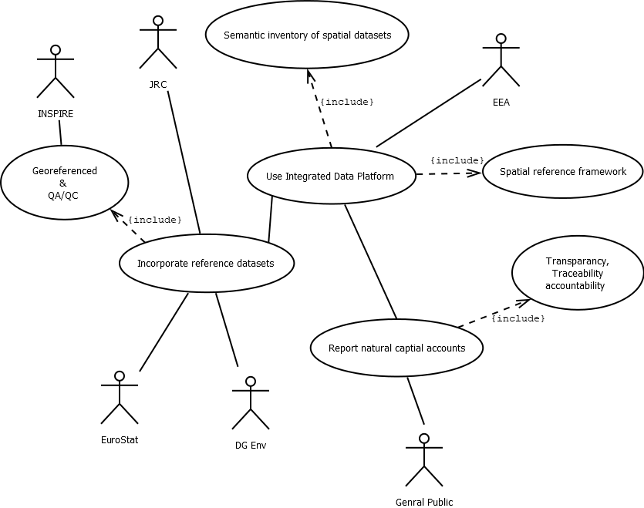
Use case identifying key functionalities

Slide 17
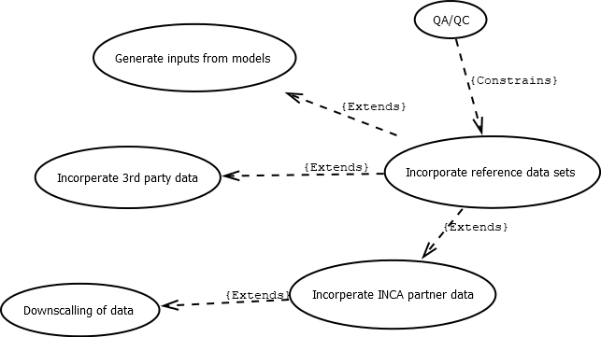
Use case of proposal, Increasing detail

Slide 18
For breakout session 2 Available systems
What are existing platforms and tools that can be used to meet the requirements identified in breakout session 1?
What are the existing data flows, and what changes will be required to meet the functions identified in session 1?
What new interfaces may be required, and what processes will be needed to support those interfaces?
What will be the resource implications of making changes ?
How well can they adapt to change (e.g. new data sets )
Answers to be shown as component and class diagrams describing the interfaces between components, data flows identifying datasets and processes, and described as the resolution in the requirements catalogue

Slide 19
Reserve slides from here below:

Slide 20
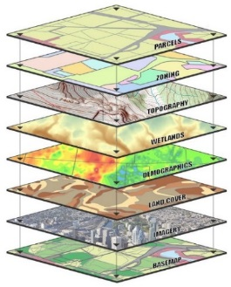
Link between EEA IDP and KIP INCA spatial data platform
Integrated Data Platform
An NSS spatial data architecture and web-map
platform supporting integrated assessments
Reference datasets from, JRC, ESTAT (& ENV), 3rd party
JRC metadata catalogue
Spatial data
management
IDM4
Semantic
Inventory
IDM2
Integrated
analysis
IDM3
Platform for thematic assessments:
KIP INCA,
MAES, GI
Harmonized geospatial data pool
Technical, thematic and contextual inventory
Joint Environmental Data Infrastructure
IDP is for internal use – how to role out to external partners ?!
management, inventory and
integrated analysis of spatial
data
Spatial Data Infrastructure
Spatial data ontology
Web Maps and overlays
Interlinked IT systems
Infographics and query
Integrated
Modelling

Slide 21
INCA
module
1
EEA
data sets
EEA
SDI
Processing
and analysis
Publication of maps,
indicators and accounts
on a landing page
7
INCA
data sets
KIP-INCA
metadata catalogue
& inventory
DOPA
DOPA
JEDI
8
Local PC
2
JRC
data sets
INCA
data sets
JRC
metadata catalogue
?
KIP-INCA metamodel catalogue
ESTAT
data sets
3
ESTAT
data sets
ESTAT
metadata catalogue
INCA
data sets
INCA
data sets
JRC metamodel catalogue
“ESMERALDA” flexible mapping methods
4
other
data sets
INCA
data sets
KIP-INCA
Data
Architecture
JRC ecosystem services model library
other models (e.g., InVest, ARIES)
5
6
0
Geo-referencing of
non-spatial data sets
Representation of current proposal V 0.6

Slide 22
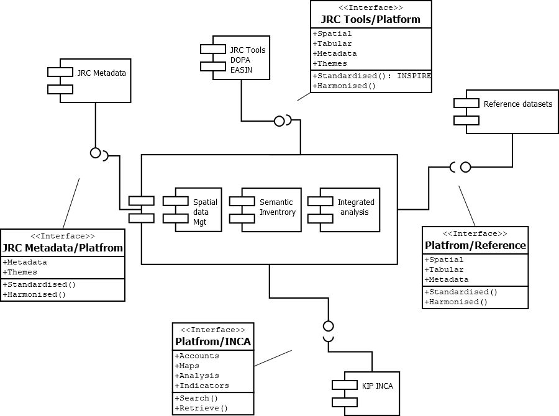
Example Component diagram

Slide 23
Example Dataflow of JRC Pollination

Slide 24
First proposal for functioning of KIP INCA shared spatial data platform
System / tool for spatialisation of non-GIS data
INCA partner
JRC
INCA partner
ESTAT
Provides data for
Provides data for
Generates spatial data
Feeds via web link
Feeds via web link
KIP INCA
web-based data interface
Feeds via web link
Feeds via web link
INCA partner
EEA
INCA partner
ENV
Supplies infrastructure components
EEA ‘s Integrated
Data Platform

Slide 25
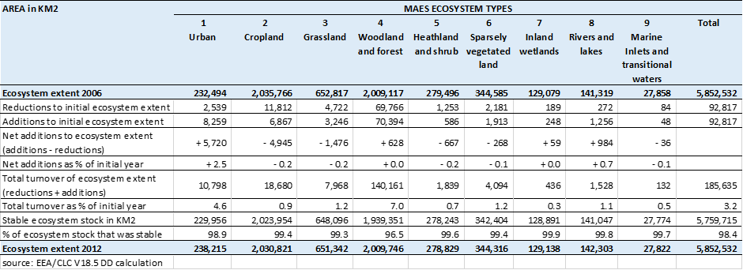
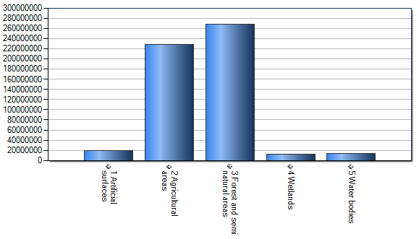
Sharing data in one system
Common
geo-spatial
frame (e.g. 1 km grid)
Different data sets
and data layers
Accounting tables
Combined data sets
Accounting results in charts,
figures, maps etc.

