Slide 1
Methodological choices linked to the 2nd consultation on the EU reference document on natural capital accounting
Expert workshop on Natural Capital Accounting
Dr. Jan Cools and Dr. Roy Haines-Young
(17/9/2014, Brussels)

Slide 2
Discussion questions
Discuss EU reference document on NCA
Added value and target group?
Terminology to use?
Conclusions and next steps

Slide 3
Q1: Added value & Target group
MAIN MESSAGE
EU Reference doc – Agreed concepts & terminology
High-level report on the importance, feasibility & policy use of NCA, including next steps and reccomendations
Overview of experiences – so far limited in doc
ADDED VALUE TO AIM FOR
Guidance to support EU countries to develop or improve their natural capital accounting at national level.

Slide 4
Q2: Terminology
Agree on which terms to use and what they mean:
Natural Capital OR Environmental capital, Ecosystem capital, biotic capital, …
Natural asset
[Natural capital] stock
[Ecosystem services] flow
Ecosystem good
Ecosystem benefit

Slide 5
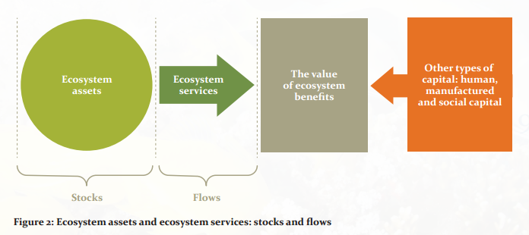
Q2: Terminology
Natural Capital
Source: UNEP (2014) Towards a global map of natural capital: key ecosystem assets.

Slide 6
Q2: Terminology
MAES approach
Natural capital
Abiotic capital:
(Non-living capital)
Biotic / Ecosystem capital:
(Living capital)
Abiotic stocks (assets)
(linked to geo-physical cycles)
Minerals, earth elements,
fossil fuels, gravel , salts etc.
Abiotic service flows
(linked to geo-physical cycles)
Solar, wind, hydro, geo-thermal etc.
Ecosystem stocks (assets):
Ecological structures, and associated processes and functions
Ecosystem service flows:
Provisioning
Regulation & maintenance
Cultural services

Slide 7
Q3: Conclusions and next steps
Final chapter of the EU reference document on NCA
Develop structured data platform
Develop common methodology
Link NCA to ecosystem assessments
Converting data into a common spatial reference frame
Elaborate opportunities for NCA to support decision-making

Slide 8
Discussion questions
Discuss EU reference document on NCA
Added value and target group?
Terminology to use?
Conclusions and next steps

Slide 9
Thank you!!
Questions?
Contact
Jan.cools@milieu.be

