Slide 1
Making natural capital accounts policy relevant – opportunities and challenges
Patrick ten Brink
Senior Fellow and Head of Brussels Office, IEEP
With thanks for permission to build on slides developed in the context of work for the EEA
Expert workshop on key issues in Natural Capital Accounting
19 September 2014, IEEP Brussels office
55 Quai Au Foin / Hooikaai 55, Brussels 1000, Belgium
11 Belgrave Road, London, SW1V 1RB, UK
www.ieep.eu drussi@ieep.eu ptenbrink@ieep.eu
Notes:
- Revise the spelling of Brussels

Slide 2
Policy commitments & accounting related activities
Strategic Plan for Biodiversity 2011-2020: Target 2
Rio+20 Conference: 57 countries – call to strengthen NCA implementation
Global
‘Beyond GDP’ & ‘Stiglitz-Sen-Fitoussi Commission’ & OECD’s Better Life Initiative
UN System of Environmental and Economic Accounting (SEEA)
Global Partnership for Ecosystem Valuation and Wealth Accounting (WAVES)
EU Biod. Strat. : Action 5: promote integration of values in accounting by 2020
EU
Many commitments: opportunities for action
– but added-value results needed to keep commitments alive
7th Environmental Action Programme (7th EAP)
Mapping and Assessment of Ecosystems and their Services (MAES) initiative
EEA Ecosystem Capital Accounts
Regulation on National Environmental Economic Accounts (Regulation (EU) 691/2011)
Practical need for accounts to help implement Water Framework Dir. (2000/60/EC)
NBSAPs – National Biodiversity Strategies and Action Plans
Country
Member States: Range of national commitments and (experimental) accounts
Corporate
Nat. Cap. accounting; EP&L (Puma). Corporate ecosystem valuation (WBCSD)

Slide 3
Accounting tools – what do they focus on?
Asset accounts (SEEA Vol.1) (biophysical and, where possible, monetary indicators)
e.g. minerals, energy, land, soil, timber, other biological resources and aquatic resources
Environment
Physical flow accounts (SEEA Vol. 1)
(in physical terms)
e.g. energy, water, material flows, air emissions, waste water and solid waste
Pollution, Waste
Society
The Economy
Economic Sectors
(examples)
- Agriculture, hunting, forestry & fishing
- Oil and gas; mining & quarrying
- Wood and wood products
- Food products, beverages & tobacco
- Textiles, textile products & leather
- Pulp, paper & paper products
- Rubber & plastics products
- Research & development
Outputs from one sector can be intermediate inputs to another
System of National Accounts (SNA )
Abiotic subsoil assets
Exports
Abiotic resources
e.g. mineral, fossil fuels, construction materials
€
€
Public Sector
Many types of accounts linked to natural capital – asset accounts, ecosystem service accounts – in biophysical and monetary form
– different actual potential and practical added value to policies
Abiotic flows
€
Outputs:
Products & services
e.g. solar energy, wind
Inputs from Human and Social Capital
Labour, institutions
Inputs from Natural Capital
Natural resources and ecosystem services
Private Sector
e.g. water
Direct benefit from Nature - inc. ecosystem services
Other Resource flows
e.g. provisioning, cultural, & regulating services
House-holds
Ecosystem services
€
€
Monetary accounts (SEEA Vol.1)
(in monetary terms)
e.g. Environmental Protection Expenditures; environmental taxes; environmental subsidies
Biodiversity (Ecosystems, Species, Genes)
Man-made capital
(inc. financial capital)
Ecosystem Capital asset accounts (SEEA Vol.2; EEA’s ECA) (biophysical and, where possible, monetary indicators) e.g. ecosystem accounts: spatially detailed accounts for particular ecosystems (e.g. building on habitat classes) & cross-cutting carbon, water, biodiversity accounts
Ecosystem service accounts (SEEA Vol.2; EEA’s ECA)
(biophysical and, where possible, monetary indicators) Provisioning, regulating, cultural ES

Slide 4
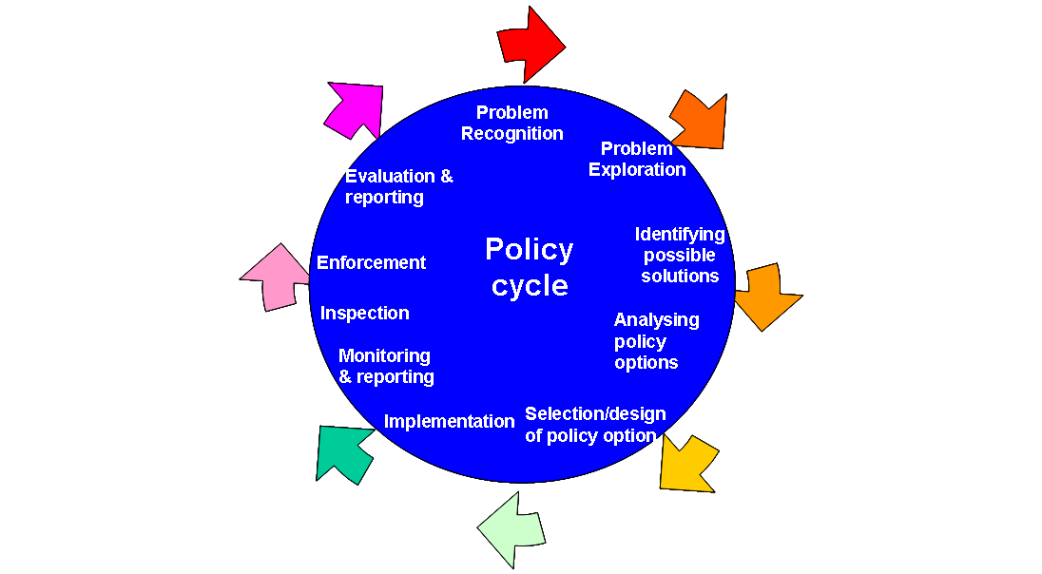
What problem / needs can NCAs address?
Policy Areas
Points in policy Cycle
Biodiversity
Water
Climate mitigation & adaptation
Cohesion policy
Agriculture
Forestry
Fisheries
Energy
Resource efficiency
Green economy
Yes
?
?
?
Yes
?
?
?
Accounts can (in principle) be of use to many policy areas and across the policy cycle Added value depends on quality of data, maturity of accounts and alternative info sources

Slide 5
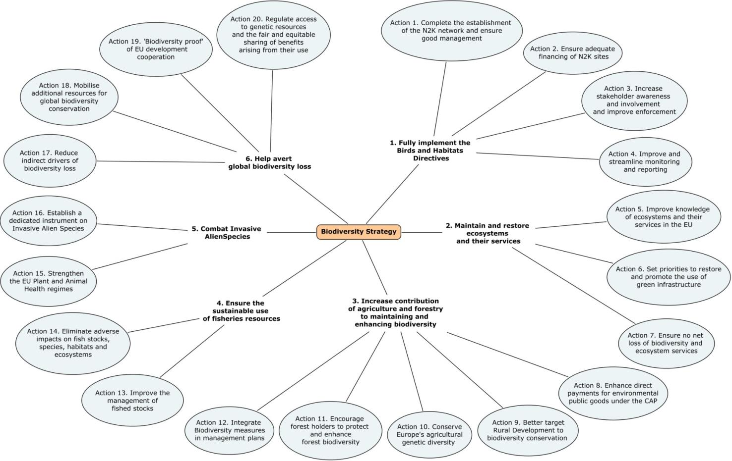
Policy Commitments: EU Biodiversity Strategy
Biodiversity Strategy to 2020: Target 2, Action 5 & commitment to accounting. Supporting a range of other targets, inc. restoration & halting biodiversity loss.
Collecting information on the state of ecosystem capital stocks and flows and providing information on the pressures on ecosystems and ecosystem services – e.g. fragmentation and degradation
Providing complementary information for the development of biodiversity policies (e.g. on key pressures)
NCA can help track progress regarding the degradation and restoration objectives (not on the local scale, but as regards broad objectives at a larger scale). Complementing Natura 2000 reporting.
Identifying scale of risk in forests (Ag or marine) from IAS
Accounts use across the policy cycle
Yes
Added
value?
Yes
Too
approx.?
Yes
Accounts
Precise enough?
?
?
Others?
Source: Tucker, G M, McConville, A J and Newman, S (2013) An EU Biodiversity Policy Map. An IEEP Paper for JNCC, IEEP, London.

Slide 6
Water Policy
Water: Policy opportunities for accounts Water Framework Directive (WFD): Good status for groundwater and good ecological status/potential for surface waters (2027) Floods Directive (FD): Flood risk areas (2015)
WFD: Synthesising information on water intake, water availability and water quality and exploring the links between water use and land cover. This will help to identify areas of water surplus & stress. FD: Where ECA is linked to demographic data: Identifying which areas are at risk from flooding (2015), e.g. linking water surpluses and proximity to population centres.
Helping support the 2nd river basin management plans, RBMP (2015). Ecosystem capital accounts, where sufficiently detailed, may help with WFD legal requirements re detailed ecological flow objectives (by 2020), as they may help identify limits of abstraction that are consistent with the objectives.
Accounts (where available) could contribute to the review of the WFD (2018).
Challenges include:
Developing integrated land-biomass-water accounts to provide (real world) indicators for the inter-linkages and hence prove added-value beyond existing indicator sets
Finding resources for river basin management accounts and buy-in for these to become part of river basin management plans that integrate natural assets and ecosystem services
Others?
Target:
Achieve good groundwater status by 2010
Target:
Achieve good surface water status by 2015 / start of the 2nd management cycle
Target:
Good ecological status of all water bodies by 2027 (quantity and quality).
Maintain good ecological status and promoting water related ecosystem services provision ?
2007
2008
2009
2010
2012
2015
2021
2027
2050
COM on water scarcity & drought
Not to scale !
Start of the 3rd management cycle
Final river basin management plans (RBMP)
WFD programme of measures operational
Final deadline for meeting objectives
Check that RBMP are in place
2nd RMBP & Review of WFD & 1st FRMP
Source: own creation, building on A Farmer, M Pallemaerts, S Withana, D Russi and P ten Brink, acknowledge revision supported by EEA contract

Slide 7
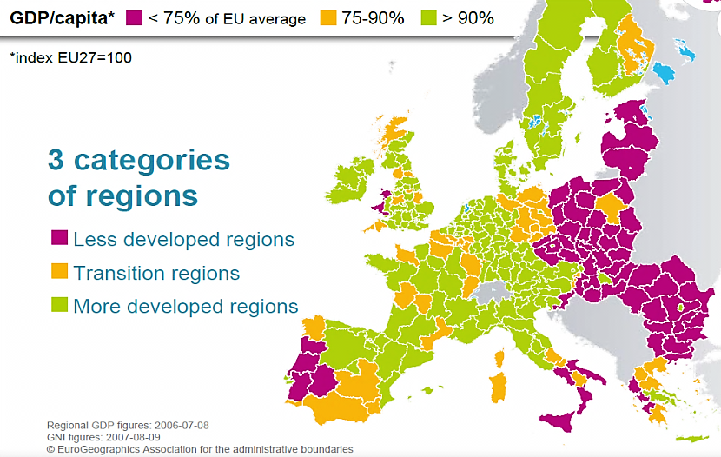
Cohesion Policy - Thematic objectives related to: low-carbon economy; climate change adaptation, env. protection, promotion of resource efficiency.
Helping to select policies, set regional strategies and objectives, and allocate funds across different cohesion policies priorities.
Regional programmes’ effects on biomass carbon and carbon neutrality commitments can be monitored. Ecosystem capital accounts could also highlight trade-offs and synergies between different developments paths.
Yes
Likely
Yes
For
issues
Helping set programme priorities (at least at regional level), and possibly informing project prioritisation (pending sufficient quality data),
Yes
For certain
issues
?
For certain
project types
Potential for accounts:
Ecosystem/habitat accounts to assess baseline of a region’s natural assets/wealth and changes over time.
Carbon biomass accounts for commitments on GHG mitigation;
Land & water accounts: areas at risk from climate change - water scarcity, flooding et al.;
Regional accounts: carbon intensity, resource efficiency, regional planning and assessments;
Local accounting for decision making regarding investments - e.g. for restoration.
Challenges: Need experimentation, improved data & capacity building + longevity of accounts (time series important).
Others?
Source: own creation, building on K Medarova and P ten Brink; adapted from slide developed in context of work for EEA

Slide 8
Summary
Range of potential benefits across policy areas and policy cycle steps
Actual added value will depend on the indicators that come out of accounts (type, granularity, robustness, real world-or modelled), how they fit the policy (cycle) needs and what other evidence bases are available (e.g. long time series indicators) – need advice from statisticians / accountants
The proof of utility likely to be demonstrated in areas where there is:
High policy need - e.g. peatlands degradation/restoration and regional carbon balances - link to BD/carbon/CP
Implementation needs – e.g. river basin management plans and ecological flow objectives for WFD
(c) Economic benefits of the evidence base - e.g. using accounts to identify forest values at risk from IAS; flood risk areas,
(d) Fewer competing info sources, so that experimental accounts have a chance of real added value - Marine areas.
Where something offers added value will be country and region specific.
Policy benefits will grow as accounts mature and policy makers’ awareness of the instrument grows – further application, method advances and investment needed
Challenges remain : data, ground-truthing, funding, capacity building, methodologies (e.g. valuation), and interpretation of meaning (e.g. meaning of “value”, and what is included/not and hence what do numbers mean, defining ‘fit-for-purpose’)
Some major issues remain: e.g. monetisation and integration of biodiversity
The Way forward will be defined by targeted experimentation/application to demonstrate added value and keep commitments to the instrument real.

