Slide 1
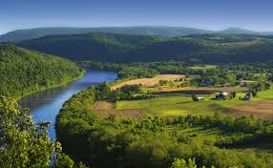
EEA land accounts – discussion
Main outcomes and open question

Slide 2
Outcomes
Policy and analytical uses of land accounts:
comparison of different land covers between member states – benchmarking between countries
land cover changes in the different member states can be pictured, providing useful information for policies on European level now and in the future – e.g. Cohesion and CAP
Thematic and spatial scale to coarse to provide input into local policies – MS to establish their own accounts, compatible with EU accounts

Slide 3
Outcomes II
Needs to be addressed:
User perspective to be included into development of accounts – need for test users
Land use accounts as the basis for other accounts – need of consistency with other accounts
Mainly land cover is accounted for so far- need to cover land use
Data quality and reliability

Slide 4
Outcomes III
Key design elements:
Uncertainty in data has to be documented
Scope and scale have to be aligned
Validation of local data

Slide 5
Open questions
How to approach lack of coordination between different EU institutions when it comes to data sharing?
Do the different institution have different aims for integrated natural capital accounts?

