Slide 1
Land accounts in Europe – current state and outlook
Land accounts
01/10/2015
Daniel Desaulty daniel.desaulty@eea.europa.eu

Slide 2
Analytical purpose of land accounts
To provide an overview of the different land cover types across Europe
To analyse their changes over time in a systematic way (e.g. through Land-TAKE indicator (CSIO14))
To identify key patterns and trends, e.g urbanisation, forest loss, etc.
Land accounts are supporting other component accounts, e.g. carbon accounts

Slide 3
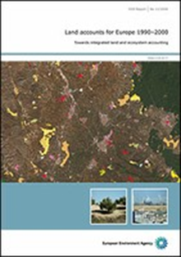
EEA land accounts are soon established:
Land Account methodology exists
EEA report 11//2006: Land accounts for Europe
1990-2000
Data are available and accessible
Data 1990 – 2000 – 2006
http://www.eea.europa.eu/data-and-maps/data/data-viewers/
land-accounts
Complete Corine Land Cover 2012 is coming soon

Slide 4
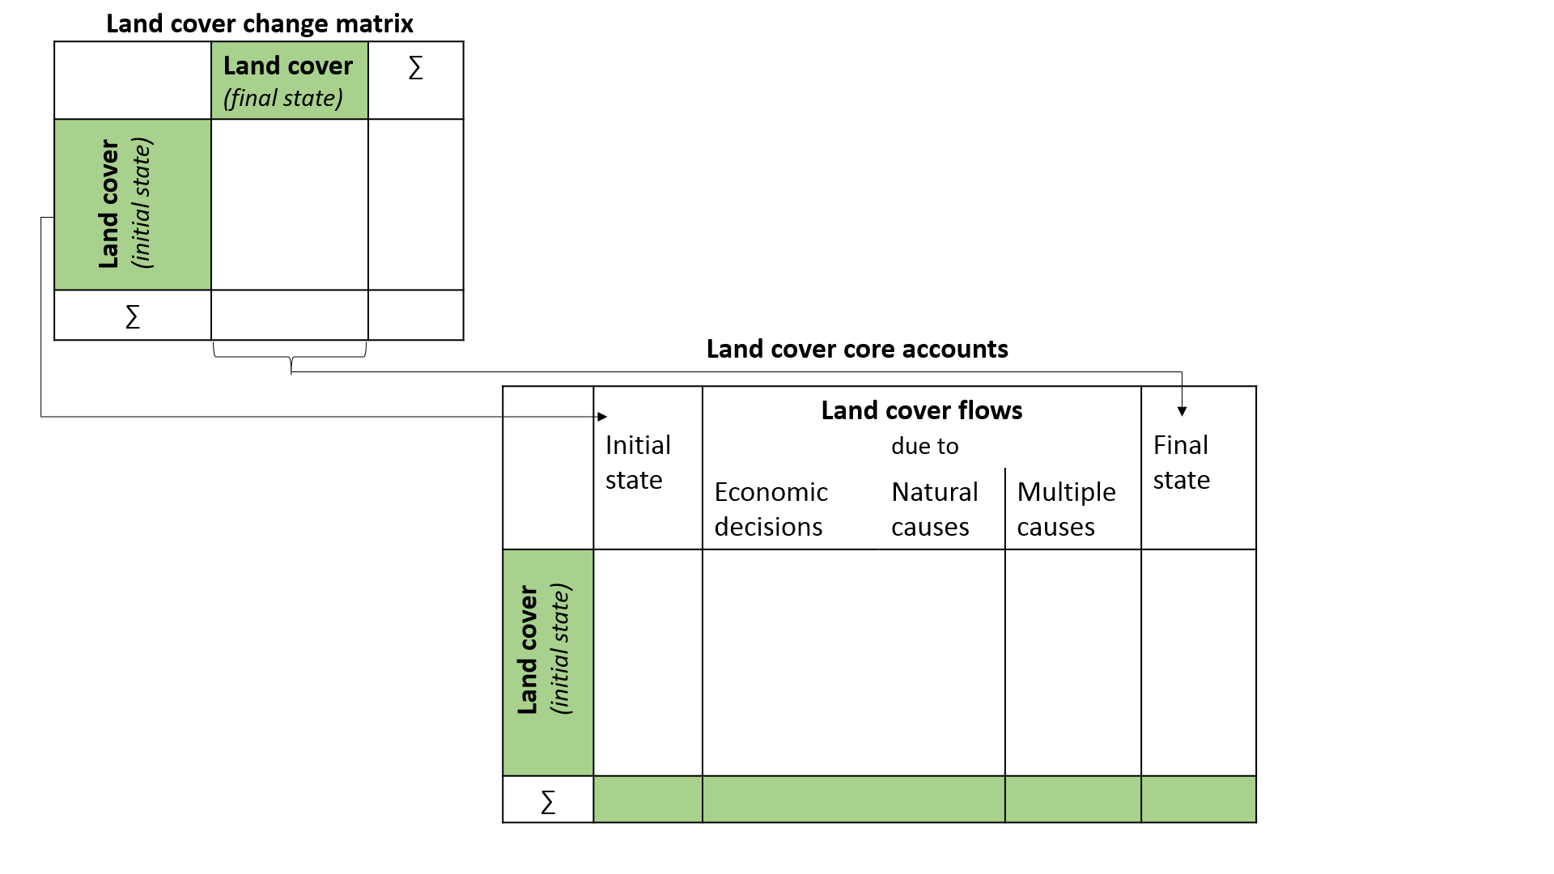
The structure of land cover accounts

Slide 5
Accounting table for land cover and flows

Slide 6
Data organization
To produce land accounts we need to define:
Statistical unit or basic unit:
Nomenclature or classification: to classify the basic unit
Analytical and reporting unit : country, NUTS, River basin, …

Slide 7
Statistical unit and spatial data requirements
The statistical unit has been defined as a basic spatial area: it is a cell of 1 km²
All information must be compiled (and stored) at this level
Information must exist for all of the cells
The population is derived from Corine Land Cover rasterized at 100 m and aggregated at 1 km²; this makes a cell of 1km² a composite cell
Need for a “reference” mask for ecosystem accounting
Based on Corine Land Cover
Need for process to fit the input data into the ecosystem accounting grid, in particular estimation of missing cells
Storage of all output data (variables and time series) in the same format (same grid and same extent)
Need for geo referencing of all reporting and analytical units – All the cells must be matched. In particular when the source needs to be rasterized
Units have to be updated regularly

Slide 8
Towards an integrated LCEU classification
One cell of 1km² is a composite unit
There is the need to define a Land Cover Ecosystem Unit
Different classification exist for classifying LCEU: LEAC, UN-SEEA, MAES
There is the need to adapt the LCEU classification to the new “norms”
Proposal to use a classification and a method which could be aggregated both in MAES and in UN-SEEA

Slide 9
SECA-LCEU Classification

Slide 10
Analytical and reporting units
Even if the data are calculated and stored at cell level, we know the precision of CLC, of statistics disaggregation and geographical estimation
The accounts are not intended to be produced at 1km² level but for zones or units and for analysis or reporting
Analytical and reporting units:
Administrative units (countries, NUTS1, NUTS2, NUTS3, …)
Geographic regions or zonings
River basins
Coastal zones
Mountain areas
Elevation breakdown
Bio-geographical regions
Low or high intensity agriculture
..

Slide 11
Towards ecosystem land accounts - next steps
The current land accounts provide a platform for further development towards ecosystem land accounts
Future activities:
Ecosystem accounting units will have to be defined further
Ecosystem reporting units will have to be developed fully for analytical use of land accounts
Relationships between land cover and land use will have to be explored further
A common reference grid for has to be developed

