Slide 1
A statistical perspective on developing an ecosystem accounting system
1-2 Oct 2015
Anton Steurer, Eurostat Unit E2

Slide 2
Overview of presentation
Basic idea of environmental accounting
Key aspects of SEEA CF and EEA
Core ecosystem accounting model
Data integration (KIP INCA) as practical realisation

Slide 3
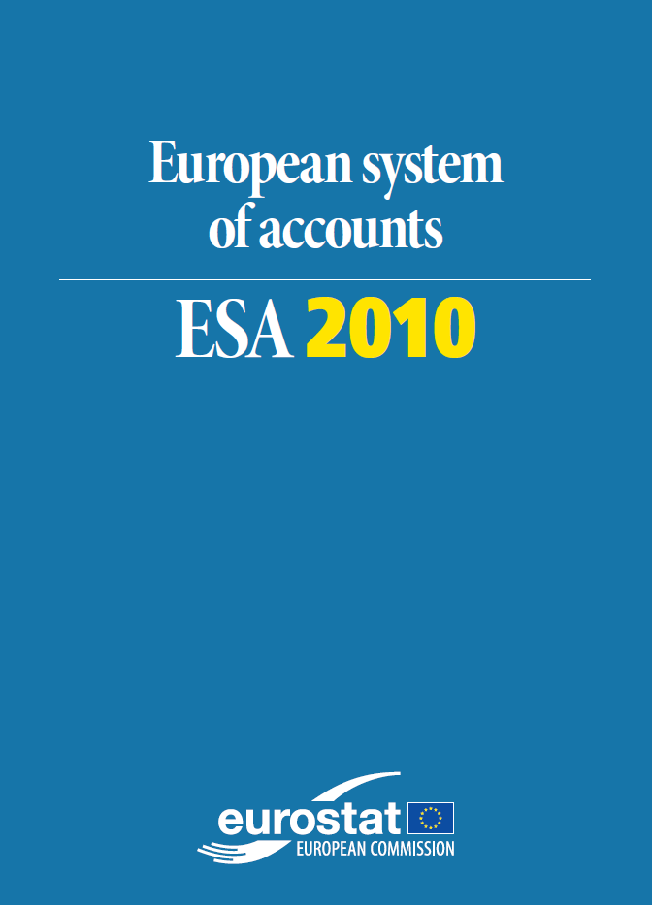
What is environmental accounting
Presents environmental information in a way that is compatible with national accounts using the same concepts (not territory but residence principle which fits to gross domestic product) and classifications
Integrates existing data into a coherent system
Allows analysis and modelling of environmental effects of economic activities and of policy measures
Basic frameworks supply-use tables (=what goes in comes out) and balance sheets (=opening stock plus changes gives closing stock)
Main areas:
Physical flow accounts (air emission, energy…)
Monetary environmental accounts (taxes, outlays…)
Asset accounts (physical and monetary)
Recently research in ecosystem accounting

Slide 4
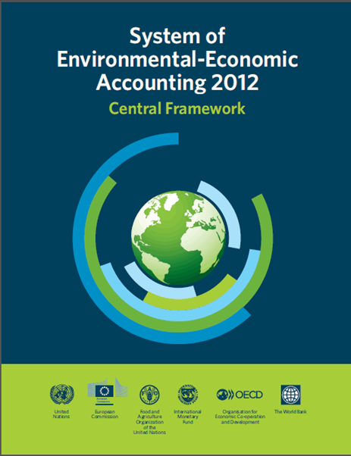
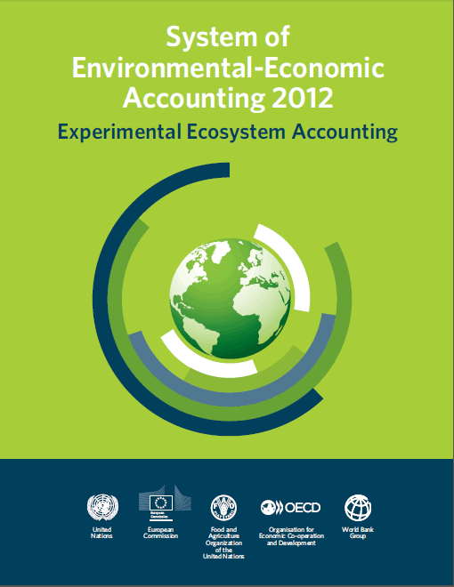
International & EU guidance documents
United Nations, European Commission, FAO, IMF, OECD and World Bank (2013): System of Environmental-Economic Accounting 2012 – Central Framework. (International Statistical Standard)
United Nations, European Commission, FAO, OECD and World Bank (2014): System of Environmental-Economic Accounting 2012 - Experimental Ecosystem Accounting. http://unstats.un.org/unsd/envaccounting/seeaRev/eea_final_en.pdf
European Commission (2013): Mapping and Assessment of Ecosystems and their services http://ec.europa.eu/environment/nature/knowledge/ecosystem_assessment/pdf/MAESWorkingPaper2013.pdf

Slide 5
Key aspects of SEEA CF and EEA
SEEA CF: component accounts (land, water, timber, fish….)
SEEA EEA: ecosystems based. Ecosystem = spatial area combining biotic and non-biotic components functioning together
Ecosystems have an extent (=size) and a condition (=state or quality)
They produce a bundle of ecosystem services (= contributions to human benefits and well-being – excludes flows that benefit nobody or only other ecosystems)
They also have a potential (= ability to produce more ecosystem services than are demanded, or produce a different basket = can be converted within limits)

Slide 6
Key aspects of SEEA EEA cont.
Key concepts (ecosystem, ecosystem service, extent, condition…..)
Key classifications (= lists of ES and ESS, the latter = CICES)
Basic spatial units (=small unit, e.g. 1km2 grid cells)
Land cover/ecosystem functional units (= ecosystems basically)
Accounting units (= e.g. administrative regions)

Slide 7
What’s included in natural capital?
Definition and scope can vary (not in SEEA)
What is natural?
Biotic resources only or also abiotic?
Treatment of oceans and the atmosphere (global commons)
Only assets generating an income stream?
Only assets or also flows -> a system of natural capital accounts
SEEA defines environmental assets to include
natural and cultivated assets
all bio-physical – biotic and abiotic
limited inclusion of oceans and atmosphere
no requirement for income stream

Slide 8
Core Ecosystem Accounting Model
ECOSYSTEM ASSET
(e.g. forest, wetland, agricultural area, marine environment, or combinations in a region or landscape)

Slide 9
Core Ecosystem Accounting Model
Other ecosystems
Ecosystem structure, function & processes
ECOSYSTEM ASSET

Slide 10
Core Ecosystem Accounting Model
Ecosystem services
- Provisioning
- Regulating
- Cultural
Other ecosystems
Ecosystem structure, function & processes
ECOSYSTEM ASSET

Slide 11
Core Ecosystem Accounting Model
Benefits :
Material & non-material
Ecosystem services
Human inputs (e.g. labour, produced assets)
Other ecosystems
Ecosystem structure, function & processes
ECOSYSTEM ASSET

Slide 12
Core Ecosystem Accounting Model
Individual & societal well-being
Benefits : material & non-material; SNA and non-SNA
Ecosystem services
Human inputs (e.g. labour, produced assets)
Other ecosystems
Ecosystem structure, function & processes
ECOSYSTEM ASSET

Slide 13
Role of the SNA production boundary
There are SNA benefits and non-SNA benefits
SNA benefits = recorded in national accounts as produced by an economic unit (e.g. potatoes are produced by farmers, ecosystem service in this view = contribution to making of potatoes; but clean air is produced by nature).
Production boundary defines scope of activity (and income and consumption) from the use of assets
Includes market and non-market activity (e.g. govt. health, education, defense, owner-occupied dwellings…)
Includes subsistence agriculture and fishing but excludes natural processes
Implications for environmental assets
SNA value only covers contribution to current measures of output – i.e. essentially income from extraction or harvest, and implicitly some priced parts of ecosystem services ("the nice view"…)
Cost of capital relates to loss of future extraction income

Slide 14
Changing the Production Boundary
Benefits :
SNA & non-SNA
Extended production boundary
Ecosystem services
ECOSYSTEM ASSET
e.g. forest, wetland, coastal area, agricultural land

Slide 15
What do we need for accounting for ecosystems (at EU level)?
We need biophysical accounts first
for direct use
as a basis for valuation studies, upscaling
We need an EU data layer of accounts as a
frame for countries and for responding to EU policies
foundation for building input data layers and the capacity to analyse accounting results
We need accounting experiments & demonstrations
We need stepwise standards & recommendations
We need a community that works on this and advances the area (i.e. we need also funding)

Slide 16
What is the challenge? Many different & separate & expensive data gathering exercises but not really tailored towards measuring ecosystems
LUCAS (ground observation)
Biodiversity monitoring
COPERNICUS (satellite images)
Corine Land Cover
Forest statistics
Water FD reporting
Farm Structure Survey (agricultural census)
Natura 2000 data
Et cetera

Slide 17
What is the potential solution ?
Goal: nested and connected data sets in a common frame: the foundation for an Integrated system for Natural Capital and ecosystem services Accounting - based on statistical and geospatial information
Land
use/cover
data
Ecosystem data
Land use data
Natura
2000/CDDA
FSS
Bio-energy
Forest stats
LUCAS
Copernicus Land monitoring
In situ coordination
Ecosystem mapping (extent)
Ecosystem condition (state)
Biodiversity
assessments (monitoring)

Slide 18
Summing up
SEEA provides a basic frame for thinking about ecosystems and a world-wide community.
A key idea is data integration which allows making use of existing data, exploiting the strengths of each approach.
Capitalise on expertise and data available, incl. accounting, monitoring, analysis and modelling
Shared roles and cooperation of partners decisive
Strategic component: gradually, different approaches (such as LUCAS) can be tailored towards better contributing to ecosystem accounting
EU level data sets integrated by EU level bodies – no extra work for MS but opportunity to plug in
Organise a system (a machine) that generates the data – this is a long-term effort that requires perseverance, funding and clever people.

