Slide 1

Session 3: Copernicus High Resolution Layers (HRLs) profiles in current HNV ‘map‘
Review of satellite data opportunities
19/10/2018 | Revising the JRC/EEA EU-level HNV Farmland methodology - Expert workshop to review potential improvements of the JRC/EEA HNV farmland methodology, UBA, Vienna
Tomas Bartalos, Tomas Soukup, Miroslav Kopecky (GISAT)
ETC ULS

Slide 2
Contents
Background
Current HNV ‘map’ improvement concept using HRLs
HRLs 2015 at a glance (what is in/what is out)
HRLs profiles in current HNV ‘map’
Copernicus (and EO data) potential for improvement
Conclusions - next steps

Slide 3
Background
Work done under ETC ULS AP2018 assignment
Task 1.8.1.3 ‘Integration of Copernicus land monitoring products’ with focus on HRL Grassland
HNV identified as candidate for added-value potential using HRL Grassland
Current analysis done as support to task 1.8.4.2 ‘HNV farmland updated’

Slide 4
HNV ‘map’ improvement concept using HRLs
    Rationale
    CLC is currently starting point for HNV ‘map’.
    HRLs data are more detailed then CLC for covered land elements.
    Is there potential for HNV ‘map’ improvement (with special focus on HRL Grassland)?
    Theoretical concept based on
      substraction (-) - some areas are excluded from current HNV ‘map’ based on HRLs (correcting commissions)
      addition (+) - some areas are added to current HNV ‘map’ based on HRLs (correcting omissions)

Slide 5
HNV ‘map’ improvement concept using HRLs
    Substraction (-) candidates
      HRL Forest, HRL Imperviousness - removing non-agriculture areas in mixed classes or due to CLC MMU
      HRL Water & Wetness - removing non-agriculture areas in mixed classes or due to CLC MMU
    Addition (+) candidates
      HRL Grassland - adding missing grassland areas due to CLC MMU

Slide 6
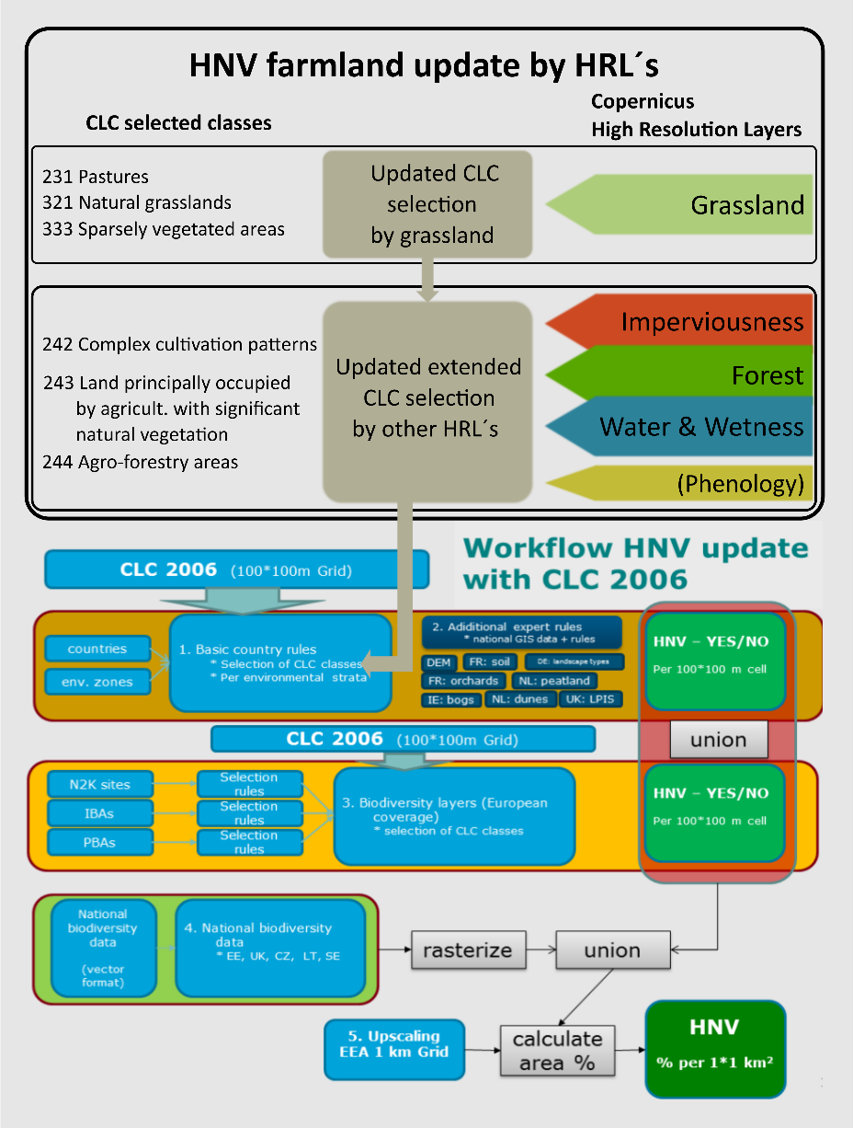
HNV ‘map’ improvement concept using HRLs
Raster based spatial overlay of HNV and HRLs
HNV/HRLs strata definition
Detailed LC cover composition calculated (based on CORINE LC)
HNV update
  Negative (excluding from HNV)
  Positive (extending HNV)
Thematic vs. geometric improvement
100m resolution

Slide 7
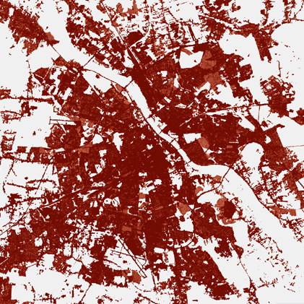
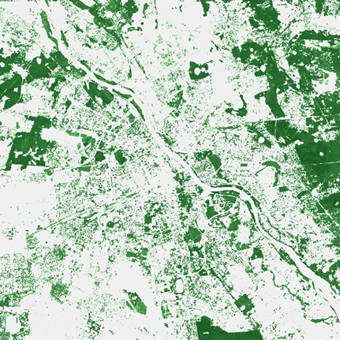
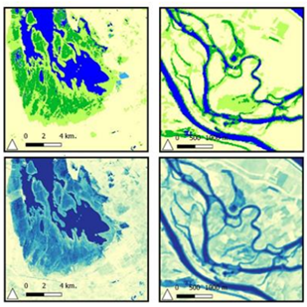
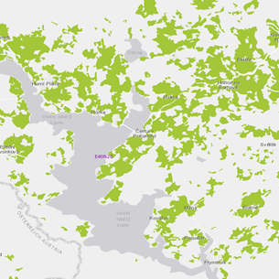
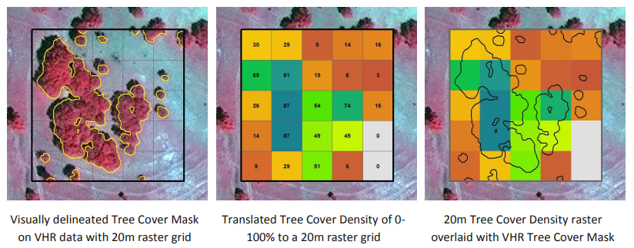
HRLs 2015 at a glance
In order to evaluate individual HRL potential for HNV ‘map’ improvement, understanding of HRL 2015 products contents relevant to HNV ‘map’ is essential
Europe-wide (EEA39) data, 100m (20m)
  HRL Imperviousness (Soil Sealing) products: capture the percentage of soil sealing
  HLR Forest: capture the percentage of the canopy coverage of trees (forests)
  HRL Water and Wetness: product showing the occurrence of water and wet surfaces over the period from 2009 to 2015
  HRL Grassland: the main product is a binary grassland/non-grassland mask that is supposed to include the full spectrum of grassland use intensity (from natural to managed grasslands)

Slide 8
HRLs 2015 at a glance
Lot | Topic | Products | Input imagery
1 | Imperviousness | Imperviousness density (IMD) Imperviousness density change (IMC) Imperviousness density change classified (IMCC) | Multi-temporal HR and VHR for calibration
2 | Forest | Tree Cover Density (TCD) Dominant Leaf Type (DLT) Forest type (FTY) Tree Cover density change (TCDC) Leaf Type change (DLTC) – Experimental Product | Multi-temporal HR and VHR for calibration
3 | Grassland | Grassland (GRA) Grassland Vegetation Probability Index (GRAVPI) - Expert Product Ploughing Indicator (PLOUGH) – Expert Product | Multi-temporal HR and VHR for calibration + SAR (S1)
4 | Wetness and Water | Wetness and water (WAW) in 4 classes: permanent water temporary water permanent wet temporary wet Water & Wetness Probability Index (WWPI)– Expert Product | Multi-temporal HR and VHR for calibration + SAR
5 | Small Woody Features (SWF) | Small woody features SWF (vector, 5m and 100m raster) | VHR IMAGE 2015

Slide 9
HRLs 2015 at a glance
Lot | Topic | Products | Input imagery
1 | Imperviousness | Imperviousness density (IMD) Imperviousness density change (IMC) Imperviousness density change classified (IMCC) | Multi-temporal HR and VHR for calibration
2 | Forest | Tree Cover Density (TCD) Dominant Leaf Type (DLT) Forest type (FTY) Tree Cover density change (TCDC) Leaf Type change (DLTC) – Experimental Product | Multi-temporal HR and VHR for calibration
3 | Grassland | Grassland (GRA) Grassland Vegetation Probability Index (GRAVPI) - Expert Product Ploughing Indicator (PLOUGH) – Expert Product | Multi-temporal HR and VHR for calibration + SAR (S1)
4 | Wetness and Water | Wetness and water (WAW) in 4 classes: permanent water temporary water permanent wet temporary wet Water & Wetness Probability Index (WWPI)– Expert Product | Multi-temporal HR and VHR for calibration + SAR
5 | Small Woody Features (SWF) | Small woody features SWF (vector, 5m and 100m raster) | VHR IMAGE 2015
Considered Layers
HRL types
Continuous data (IMP, TCD)
Binary data (GRA)
Multi-class data (WAW)
(Expert layers)
Other
Sequenced elimination
Threshold assignment

Slide 10
HRLs profiles in current HNV ‘map’
Analysis to show actual presence of HRLs in/out of HNV ‘map’
Does it match with our theoretical concept?
What needs to be considered in addition for particular HRL use?
Test sites: Czech Republic, Austria, Bulgaria, Denmark, Croatia, Netherlands, Portugal, Schleswig-Holstein

Slide 11
HRLs profiles in current HNV ‘map’
 | Relative share (%)
 | on total area (%) |  | of HRL on HNV (%) |  |  |  |  | of overlap (HRL&HNV)
region | HNV | other | IMP | WAW | TCD | GRA |  | HRL* (excl) | HNV (noHRL)
CZ | 16.33 | 83.67 | 0.41 | 1.72 | 51.26 | 32.00 |  | 53.39 | 14.60
AT | 23.64 | 76.36 | 0.60 | 1.00 | 41.91 | 35.25 |  | 43.51 | 21.24
BG | 23.72 | 76.28 | 0.09 | 0.59 | 62.34 | 17.41 |  | 63.02 | 19.57
DK | 4.55 | 95.45 | 0.14 | 37.02 | 15.83 | 23.54 |  | 52.99 | 23.47
HR | 52.59 | 47.41 | 0.30 | 2.00 | 53.04 | 11.39 |  | 55.35 | 33.26
NL | 11.08 | 88.92 | 0.80 | 14.64 | 19.84 | 48.25 |  | 35.28 | 16.47
PT | 33.13 | 66.87 | 0.46 | 1.50 | 36.16 | 13.40 |  | 38.12 | 48.47
SchHol | 7.27 | 92.73 | 0.52 | 16.40 | 21.16 | 49.54 |  | 38.08 | 12.38
HRL(excl) * - is the sum of HRL shares to be potentially excluded (IMP+WAW+TCD)

Slide 12
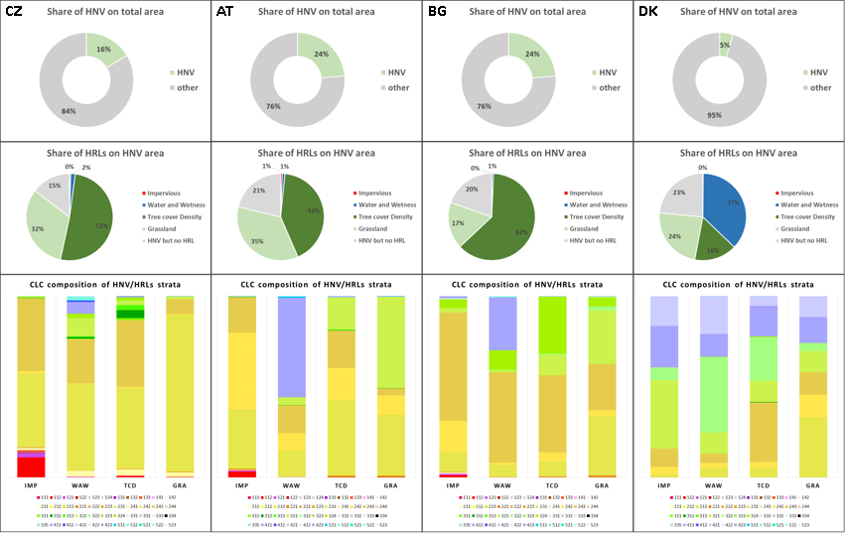
HRLs profiles in current HNV ‘map’
Additional composition of overlapping areas was calculated, to target the LC structure within each strata (HNV/HRLs), utilizing the CORINE LC database. (The shares of CORINE Level 3 classes are used)
The LC composition may indicate relevancy of each HRL strata
The structure can be used for further stratification (to include or exclude appropriate areas)
Roughly describes wider context (pure class as Forest or mixed class as Complex cultivation pattern)

Slide 13
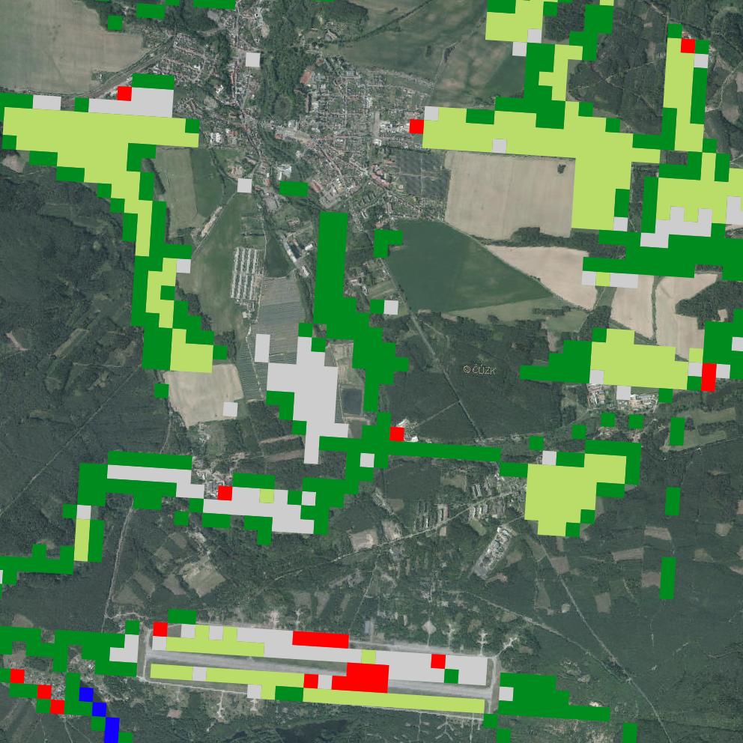
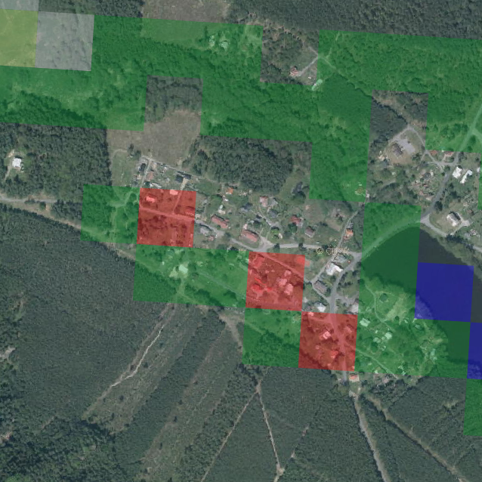
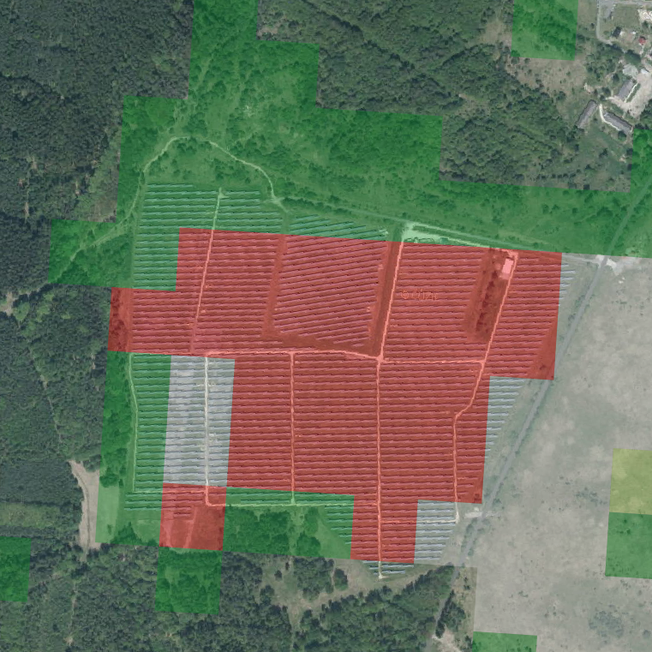
HRLs profiles in current HNV ‘map’
HRL Imperviousness 2015
HRL Imperviousness
Generally low share on total HNV (< 1%)
Represents small residuals and patches of bulit-up/sealed areas
Considering the nature and high reliability of bulit-up area classification, thematically can be considered as „no farmland“ area => candidate for exclusion
(Applied sealing degree threshold is 30%)

Slide 14
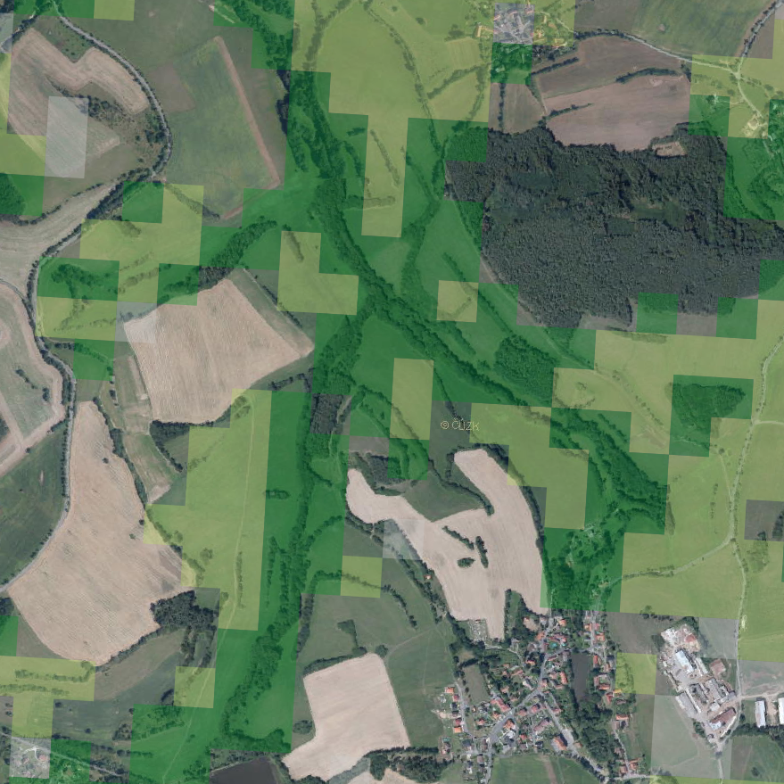
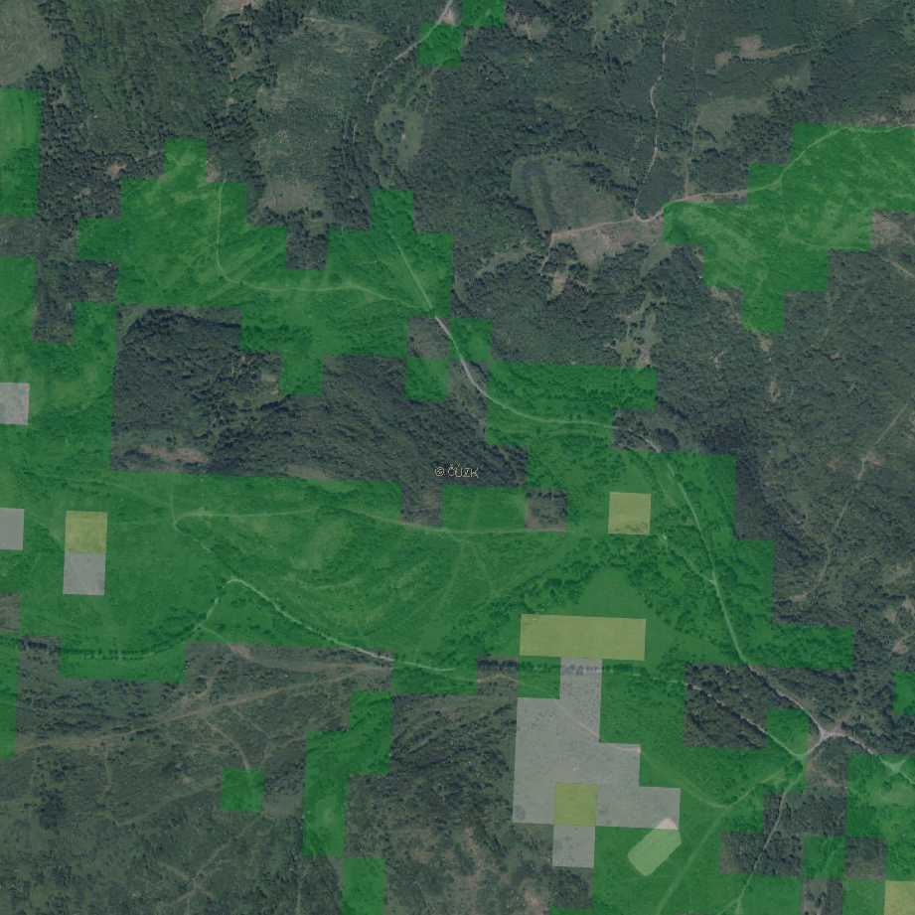
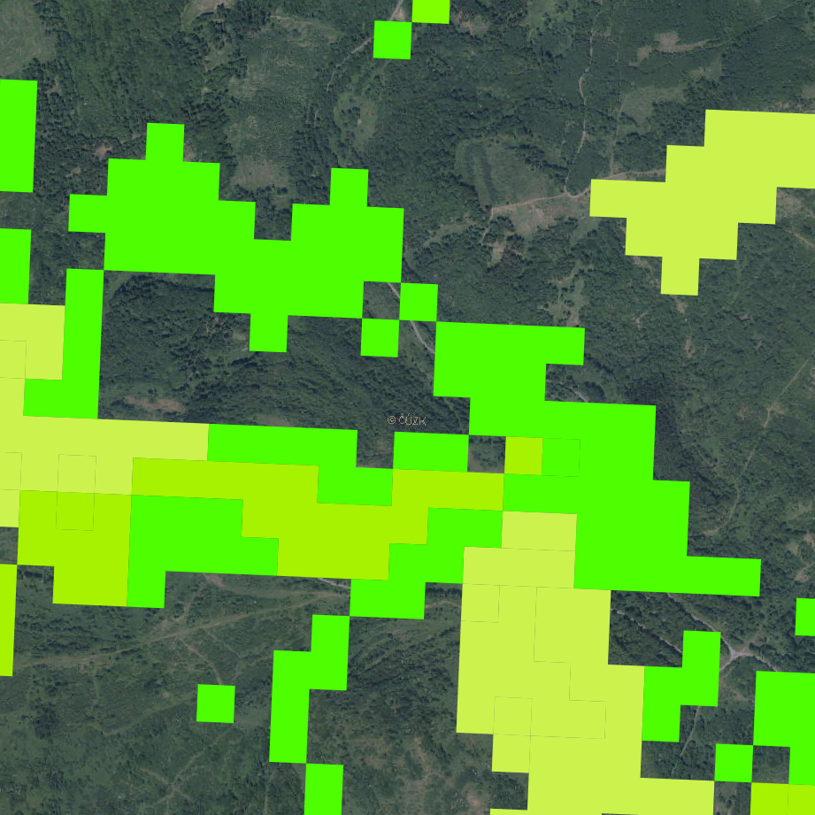
HRLs profiles in current HNV ‘map’
HRL Forest (Tree cover density)
Generally high share on total HNV (15-60%)
The overall share does not indicate the nature of Forest/Tree cover
If dens, closed continuous tree cover and high CLC related share of Forest classes - anticipates Forest => candidate for exclusion (no farmland)
Potential tree cover scattered trees may be of interest for HNV (should be not excluded (inside HNV) or can be , but further spatial metrics is needed to differentiate
(Applied tree cover density threshold is 30%)

Slide 15
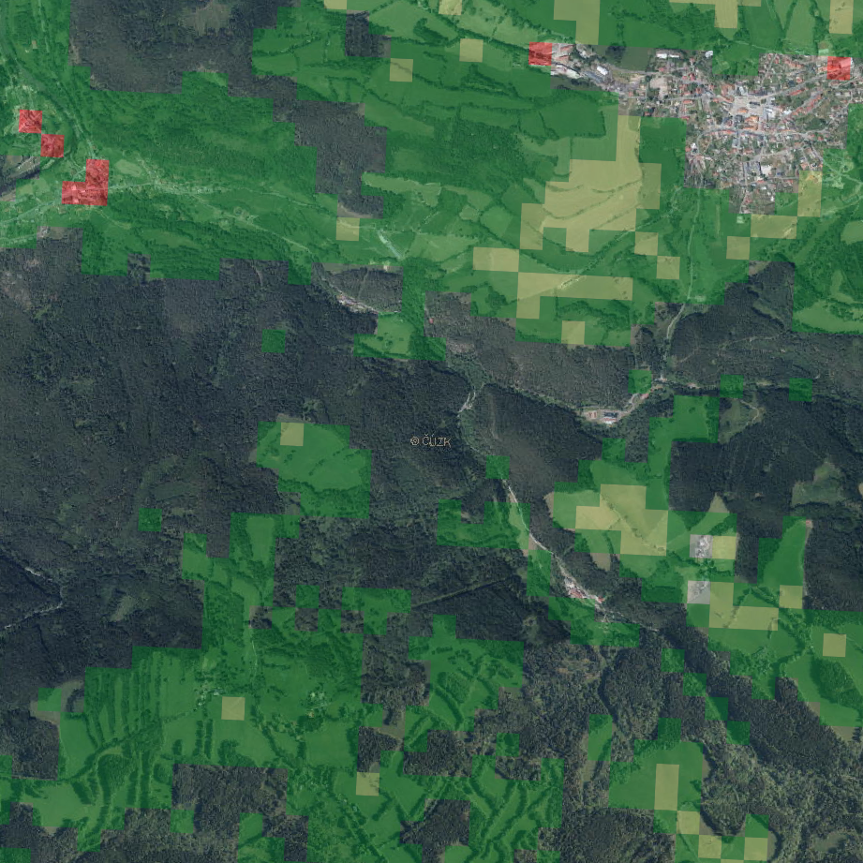
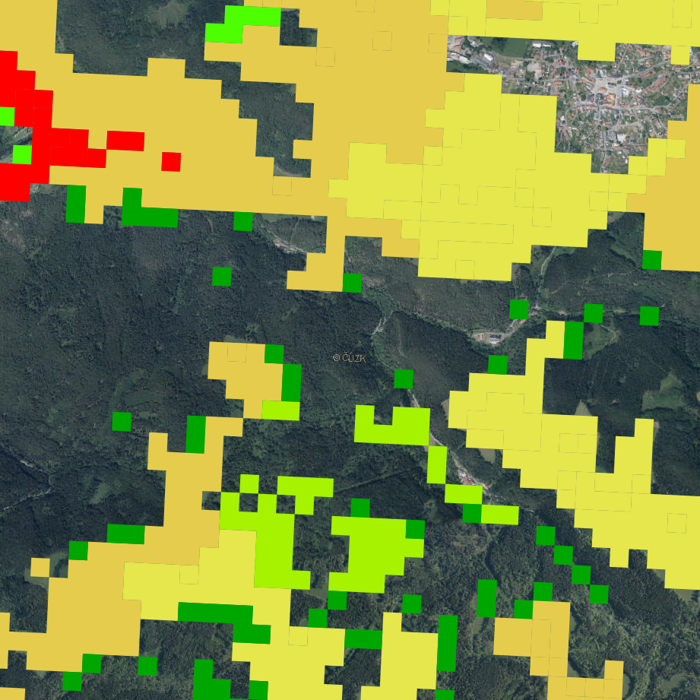
HRL Forest example

Slide 16
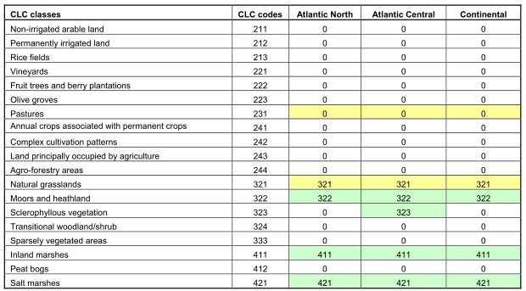
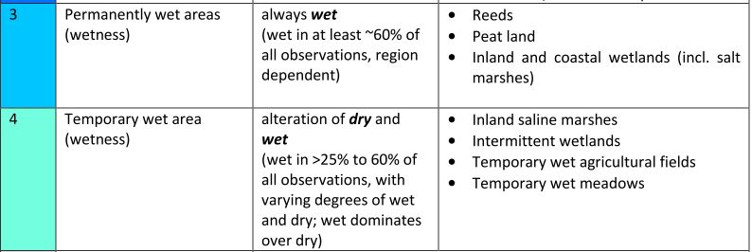
HRLs profiles in current HNV ‘map’
HRL Water & Wetness
Categorical HRL (4 classes)
Varies heavily within selected countries based on geographical conditions (inland < 1%, some countries with see up to 40%)
The categories included in WAW HRL follow different pattern than CLC categories considered by HNV definition
  Water categories are candidates for exclusion (both permanent and temporary)
  Wet areas are ambivalent (example of NL)

Slide 17
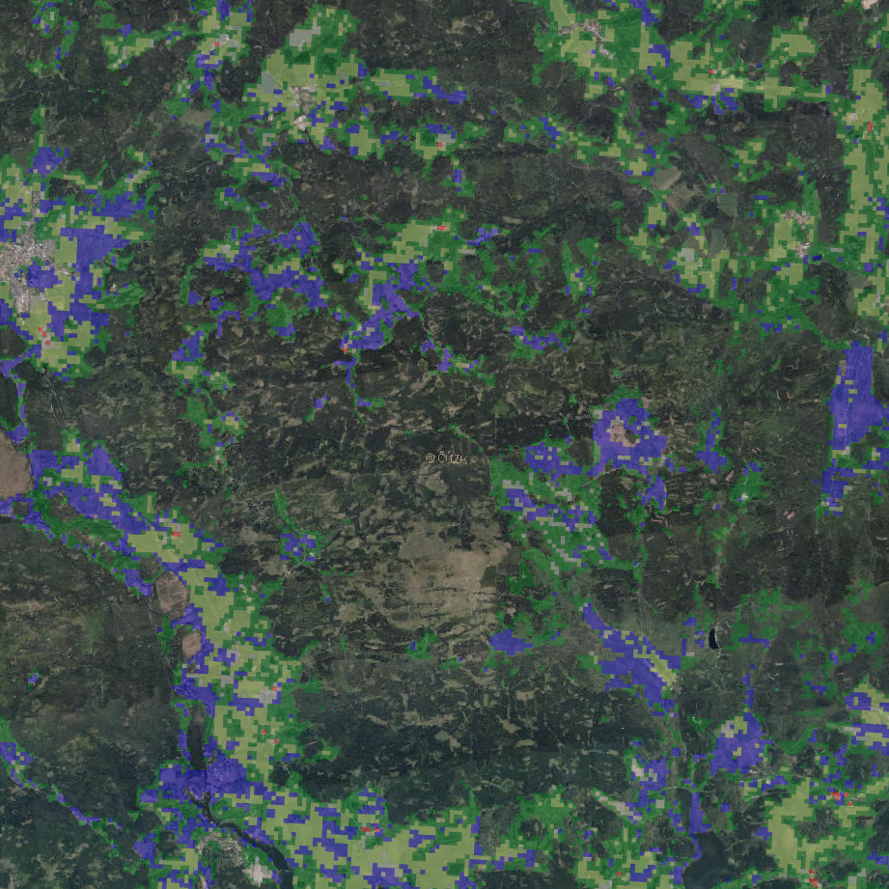
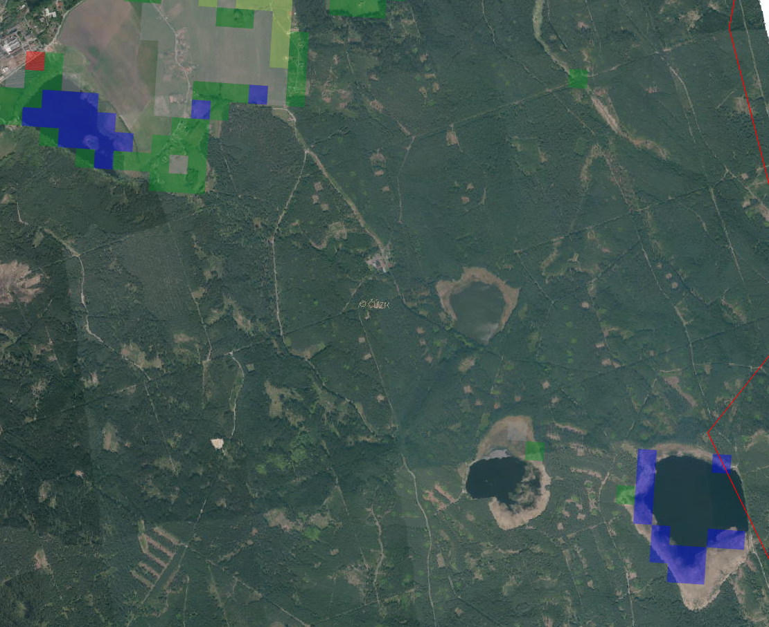
HRL Water & Wetness example

Slide 18
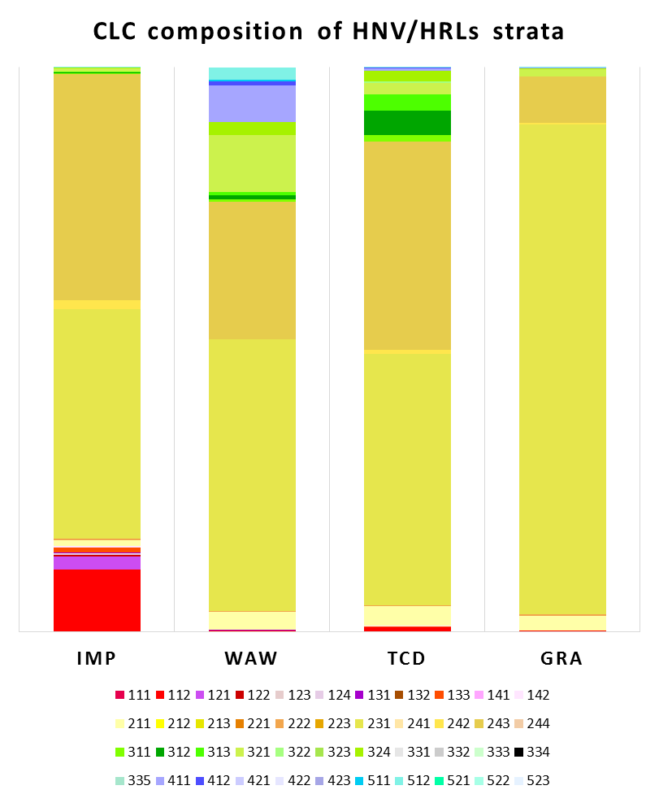
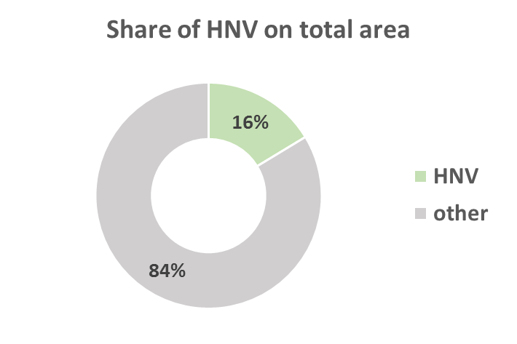
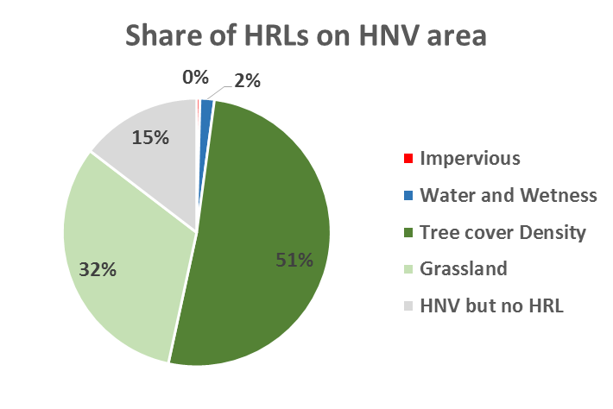
HRLs profiles in current HNV ‘map’ - CZ
 | %
CLC class | IMP | WAW | TCD | GRA
111 | 0.00 | 0.00 | 0.00 | 0.00
112 | 11.03 | 0.20 | 0.83 | 0.21
121 | 2.35 | 0.09 | 0.05 | 0.01
122 | 0.28 | 0.00 | 0.01 | 0.00
123 | 0.00 | 0.00 | 0.00 | 0.00
124 | 0.28 | 0.00 | 0.00 | 0.01
131 | 0.08 | 0.05 | 0.01 | 0.00
132 | 0.00 | 0.01 | 0.00 | 0.00
133 | 0.87 | 0.00 | 0.02 | 0.01
141 | 0.04 | 0.02 | 0.02 | 0.00
142 | 0.27 | 0.08 | 0.12 | 0.06
211 | 1.04 | 3.10 | 3.48 | 2.48
212 | 0.00 | 0.00 | 0.00 | 0.00
213 | 0.00 | 0.00 | 0.00 | 0.00
221 | 0.06 | 0.00 | 0.03 | 0.10
222 | 0.28 | 0.19 | 0.20 | 0.24
223 | 0.00 | 0.00 | 0.00 | 0.00
231 | 40.61 | 48.03 | 44.54 | 86.72
241 | 0.00 | 0.00 | 0.00 | 0.00
242 | 1.52 | 0.13 | 0.60 | 0.37
243 | 40.15 | 24.35 | 36.91 | 8.12
244 | 0.00 | 0.00 | 0.00 | 0.00
311 | 0.08 | 0.33 | 1.16 | 0.02
312 | 0.13 | 0.83 | 4.37 | 0.04
313 | 0.13 | 0.45 | 2.82 | 0.03
321 | 0.68 | 10.11 | 2.12 | 1.30
322 | 0.00 | 0.00 | 0.27 | 0.00
323 | 0.00 | 0.00 | 0.00 | 0.00
324 | 0.02 | 2.34 | 1.81 | 0.13
331 | 0.00 | 0.00 | 0.00 | 0.00
332 | 0.00 | 0.00 | 0.00 | 0.00
333 | 0.00 | 0.00 | 0.00 | 0.00
334 | 0.00 | 0.00 | 0.00 | 0.00
335 | 0.00 | 0.00 | 0.00 | 0.00
411 | 0.04 | 6.53 | 0.50 | 0.12
412 | 0.00 | 0.73 | 0.04 | 0.01
421 | 0.00 | 0.00 | 0.00 | 0.00
422 | 0.00 | 0.00 | 0.00 | 0.00
423 | 0.00 | 0.00 | 0.00 | 0.00
511 | 0.04 | 0.21 | 0.01 | 0.00
512 | 0.02 | 2.22 | 0.08 | 0.00
521 | 0.00 | 0.00 | 0.00 | 0.00
522 | 0.00 | 0.00 | 0.00 | 0.00
523 | 0.00 | 0.00 | 0.00 | 0.00

Slide 19
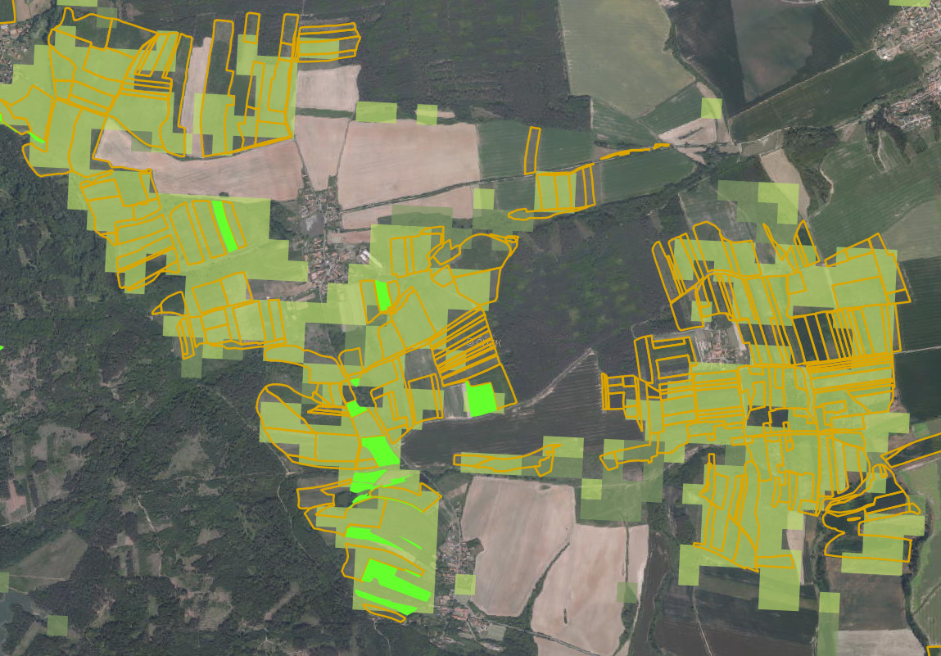
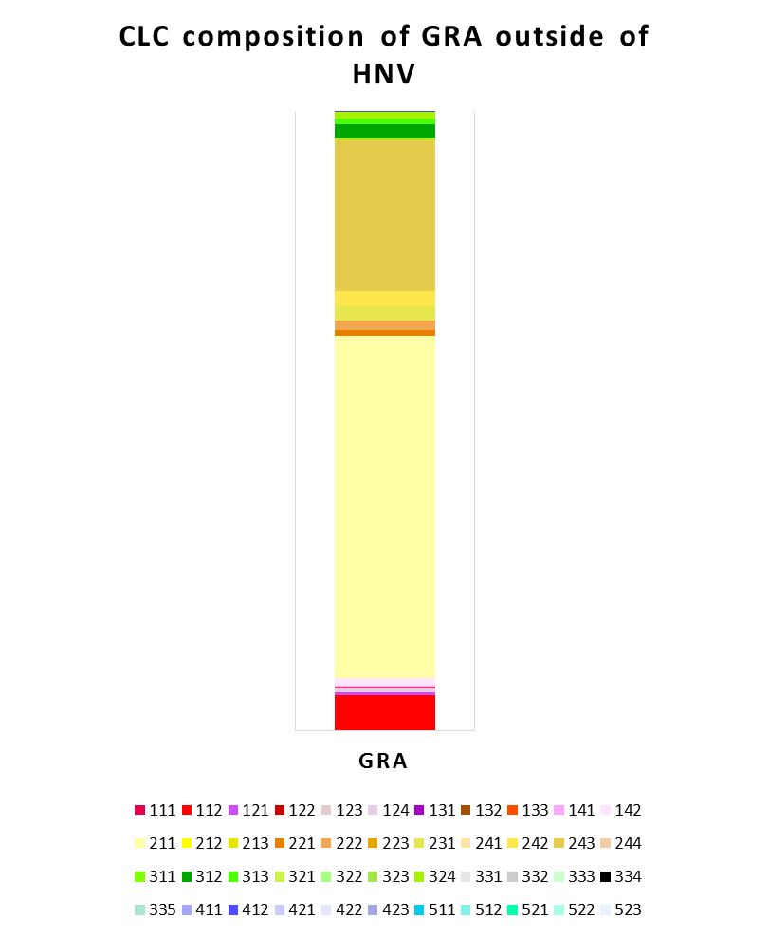
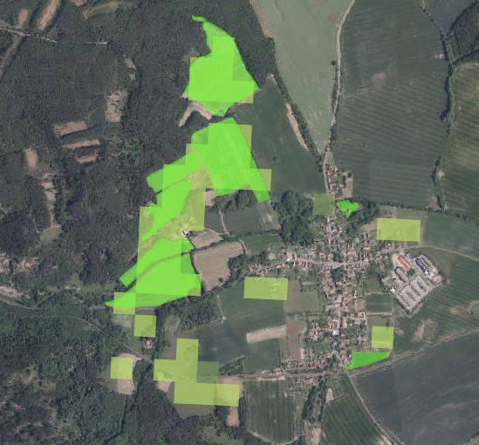
HRL Grassland (outside HNV, CZ only)
 | Area (km²)
HNV | 12 877.4
HRL GRA (outs. HNV) | 3 166.5
CLC class | GRA
111 | 0.00
112 | 5.76
121 | 0.44
122 | 0.04
123 | 0.00
124 | 0.60
131 | 0.06
132 | 0.09
133 | 0.12
141 | 0.08
142 | 1.36
211 | 55.18
212 | 0.00
213 | 0.00
221 | 0.85
222 | 1.63
223 | 0.00
231 | 2.27
241 | 0.00
242 | 2.52
243 | 24.39
244 | 0.00
311 | 0.38
312 | 2.03
313 | 1.00
321 | 0.01
322 | 0.00
323 | 0.00
324 | 1.13
331 | 0.00
332 | 0.00
333 | 0.00
334 | 0.00
335 | 0.00
411 | 0.00
412 | 0.02
421 | 0.00
422 | 0.00
423 | 0.00
511 | 0.00
512 | 0.05
521 | 0.00
522 | 0.00
523 | 0.00
Grassland HRL outside HNV ‘map’
Large proportion of:
  Arable land (211)
  Land principally occupied by agriculture… (243)
Complex pattern when compared with reference data (LPIS)

Slide 20
HRL Grassland (outside HNV, CZ only) example

Slide 21
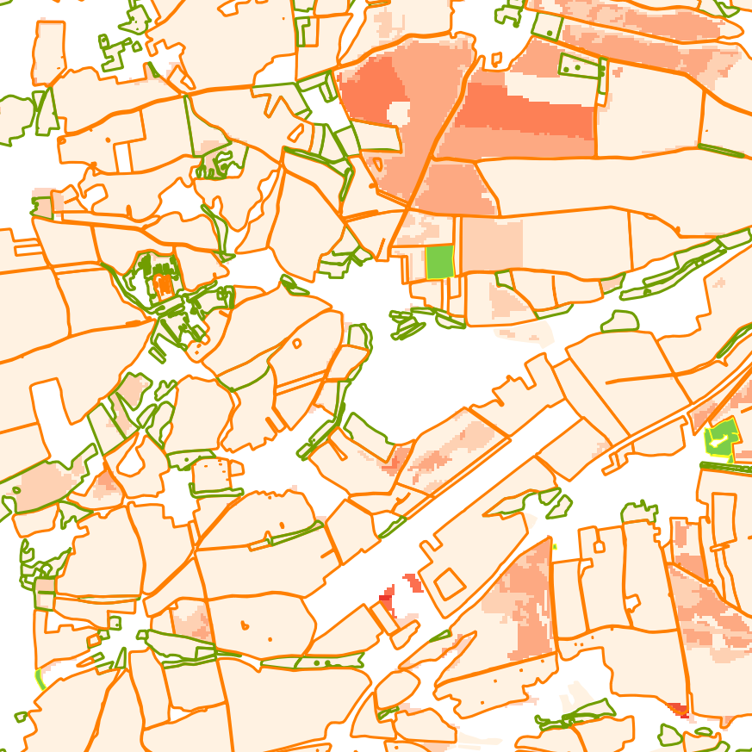
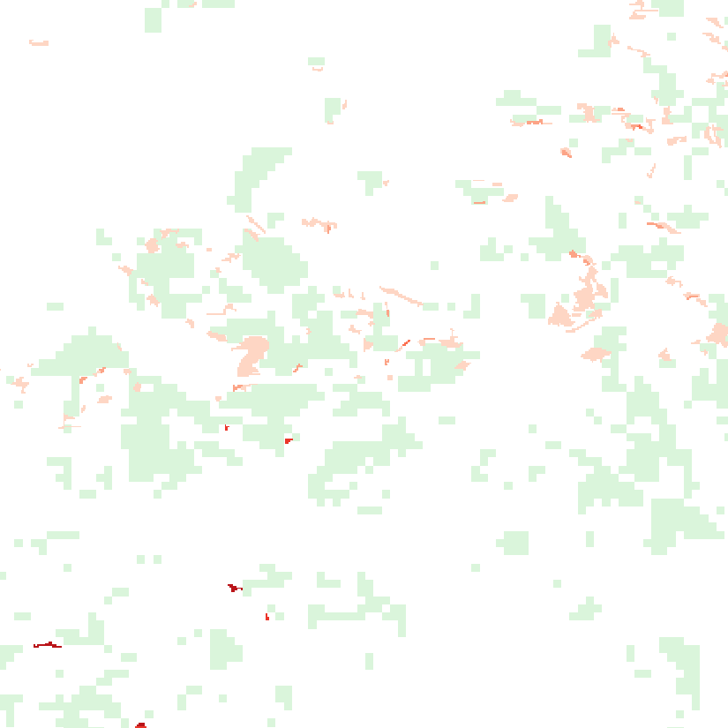
HRL Grassland - Ploughing Indicator - example

Slide 22
HRL Grassland - Ploughing Indicator - example

Slide 23
Copernicus (and EO data) potential for improvement
Current Copernicus HRLs
Relatively high overlap of HRL and HNV
Spatial resolution has to be considered (CLC class, HRL 100m/20m)
In general influence of Imperviousness is low, but thematically consistent => candidate for exclusion
Water and Wetness – geographically dependent, multi-class issue – detailed HRL – CLC stratification needed, Permanent Water candidate for exclusion, other classes has to be evaluated in detail
Forest (tree cover density) – high share on HNV (density threshold dependent), partly potential for exclusion, but combination of CLC class and additional spatial metrics should be applied to differentiate continuous forests and scattered trees
Grassland (within HNV) – suitable for geometric enhancement but detailed LC class evaluation is needed, (and MMU difference has to be considered)
Grassland (outside HNV) – example in CZ (rather complex – HNV-HRL-LC relation is essential)

Slide 24
Copernicus (and EO data) potential for improvement
Current Copernicus HRLs - other considerations
Threshold vs. range definition for continuous HRLs (10-30%, 30-60%, etc.)
Utilization for other expert layers (as Ploughing indicator of Grassland HRL)
Use of additional layers for stratification e.g. elevation (DEM), eco-biogeographical zones

Slide 25
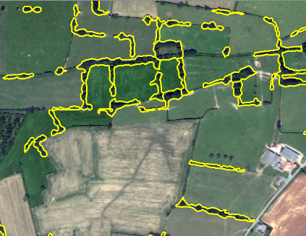
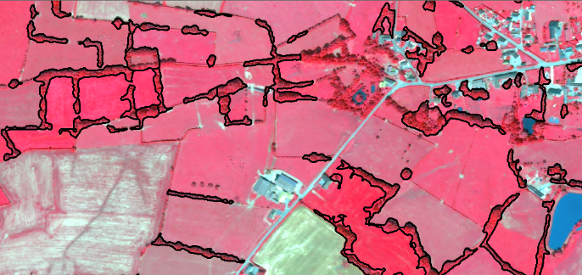
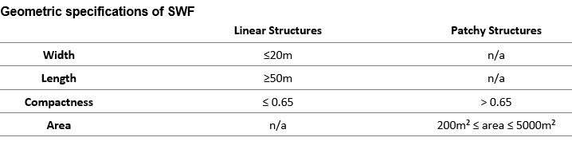
Upcoming Copernicus products
Small Woody Features (SWF 2015)
  Product includes
    Linear hedgerows and scrubs
    Tree rows
    Isolated patches of trees
  Elements to be excluded
    Stone walls
    Drainages ditches
    Grass margins, field boundaries without trees or hedges
    “Grey infrastructure”
    Artificial tree rows like olive tree plantations

Slide 26
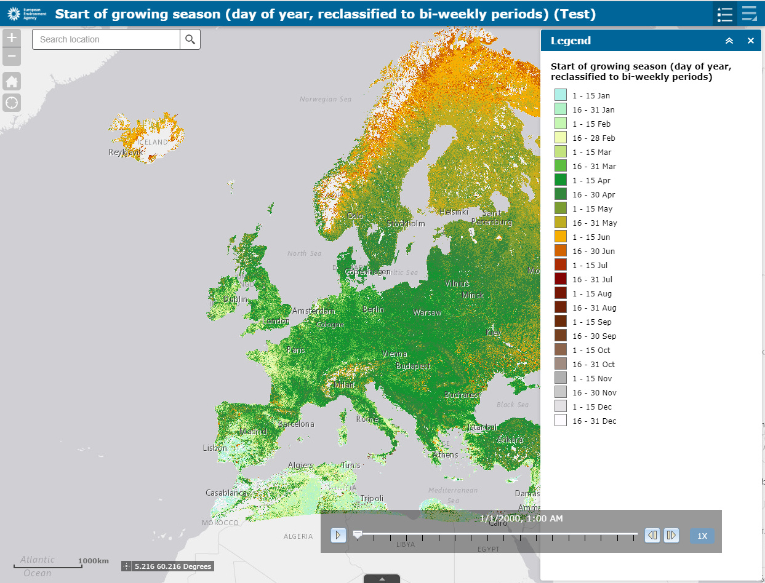
Upcoming Copernicus products
    HR Phenology (resp. HRL Grassland + HR Phenology)
    ETCULS Task 1812 Phenology indicator (pre-cursor)
Annual Start of Season (2000 - 2016)
Start of Season trend (2000 - 2016)
Annual Length of Season (2000 - 2016)
Length of Season trend (2000 - 2016)
Annual Productivity (2000 - 2016)
Productivity trend (2000 - 2016)
Based on MODIS / TIMESAT PPI
Available as Web Service

Slide 27
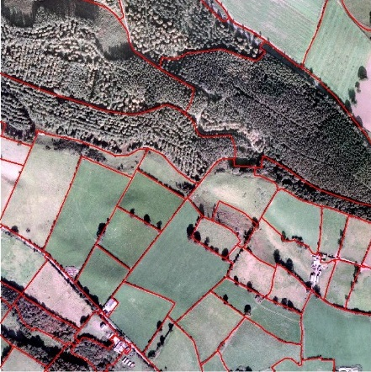
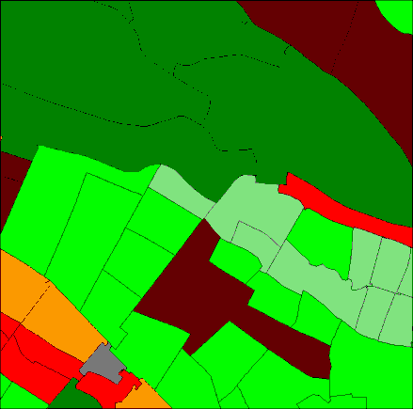
Upcoming Copernicus products
    CLC+ Backbone (in the context of LULCF ‘carbon’)
    High resolution next generation land cover vector database
    MMU 0.5ha
Tentative specification only Implementation 2019
1 | Built-up
2 | Needle-leaved Woodland
3 | Broad-leaved Woodland
4 | Shrubland
5 | Permanent herbaceous land
6 | Periodically herbaceous land (i.e. arable land)
7 | Lichens and mosses land
8 | Partly vegetated land
9 | Non-vegetated land
10 | Water
11 | Snow and Ice

Slide 28
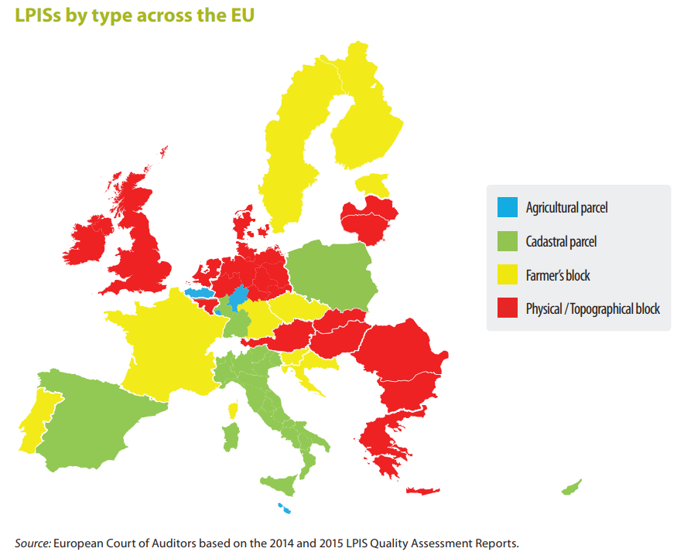
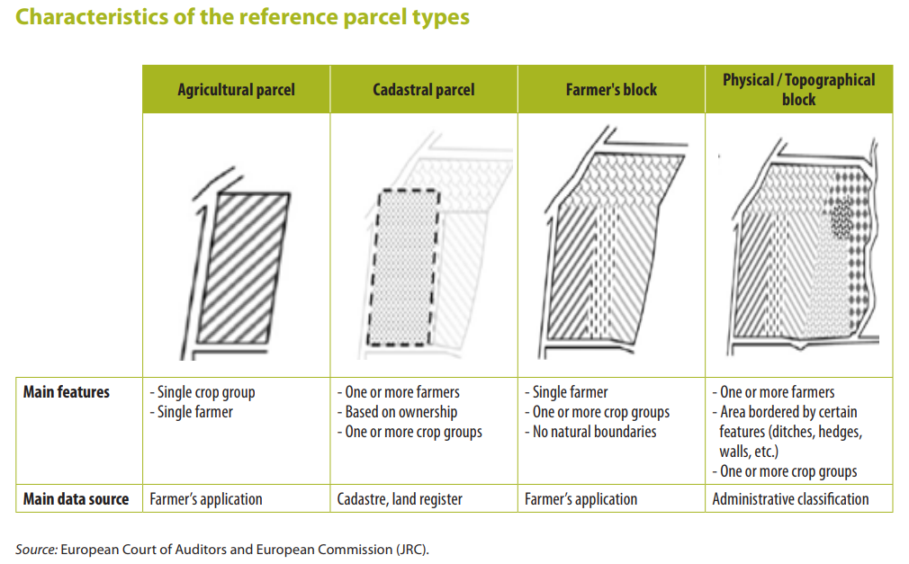
Other datasets
LPIS
Discussed for ‘decades’, but LPIS data becomes more and more open.
Coordinated effort shall help to achieve availability of open-part for all EU28.
Although not fully harmonized, some common denominator could be found on the level of physical blocks and basic categories: arable, permanent grassland, other…

Slide 29

Other “datasets”
Sentinel based CAP support (Sentinel1 & Sentinel2)
Crop type maps
Grassland cutting, grazing http://esa-sen4cap.org/
Agriculture practices (harvest monitoring,…)
SEN4CAP (but also SEN4AGRI, CzechAGRI) developed methodologies
Objectives: Demonstrate potential of S1 & S2 to improve the efficiency & traceability of the IACS and in particular for the greening measures of the CAP
Support to the CAP2020 reform process in respect of the potential of the Sentinels

Slide 30


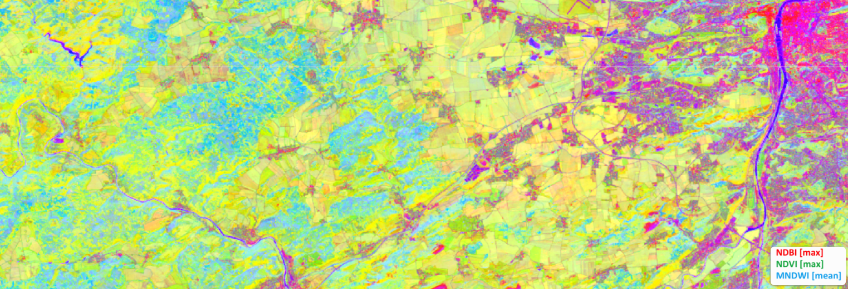
Other datasets
European products – TimeScan, S2GLC
TimeScan Landsat 2015
Harmonized spectral and temporal properties of the land surface (6 indices x 5 statistics)
Notes:
The TimeScan Sentinel-1 product is derived from more than 1500 scans by Sentinel-1 between May 2014 and July 2016. The product is provided in form of a false-colour image showing the temporal average, minimal and difference between mean-min backscattering for every pixel in the red, green and blue bands. The information is resampled to a final spatial resolution of 100m. Urban conglomerations, for example, reflect strongly and appear as prominent, bright areas. Water bodies deflect a large proportion of the oblique synthetic aperture radar beams from the satellite and are therefore dark. Vegetated regions are distinguished by comparatively high minimal backscatter, which causes forests and meadows to appear in green tones. Temporally dynamic land cover types, such as crop acreage, have changed considerably during the acquisition period and appear lilac in the data product.
The TimeScan-Sentinel2 layer
is a convenience product providing a harmonized representation of the spectral and temporal properties of the land surface. The TimeScan-Sentinel2 dataset is from Sentinel-2 images acquired between mid 2015 and November 2016. The product condenses the information content of the original images to a small percentage of their original size. The TimeScan-Sentinel2 layer can be analysed in the form of a single, cloud-free dataset based on statistical ranges of 6 indices (NDBI, NDVI, MNDWI, ND-B8A/B12, ND-B4/B2, ND-B4/B3, ND-B8/B4) for such aspects as the state of vegetation, water cover, or bare ground (e.g., built-up, rock, soil). For each of the indices temporal statistics are determined based on the entire period, including the maximal, minimal, mean, and stdev values. The TimeScan-Sentinel2 layer is composed of 29 bands - 28 bands related to the indices statistics (7 indices x 4 statistics) plus one band providing the number of valid input acquisitions per pixel.
The TimeScan-Landsat-2015 layer
is a higher-processing level baseline product providing a harmonized representation of the spectral and temporal properties of the land surface. The TimeScan-Landsat-2015 dataset was derived for selected cities from Landsat images collected from 2015. The product condenses the information content of the original images to a 20th of their original size. The TimeScan-Landsat-2015 layer can be analysed in the form of a single, global, cloud-free dataset based on statistical ranges of 6 indices (NDBI, MNDWI, NDVI, ND-b5/b7, ND-b4/b2, ND-b3/b2) for such aspects as the state of vegetation, water cover, or bare ground (e.g., built-up, rock, soil). For each of the indices temporal statistics are determined based on the entire period from 1989 to 1991, including the maximal, minimal, mean, stdev and mean slope values. The TimeScan-Landsat-2015 layer is composed of 31 bands - 30 bands related to the indices statistics (6 indices x 5 statistics) plus one band providing the number of valid input acquisitions per pixel.

Slide 31
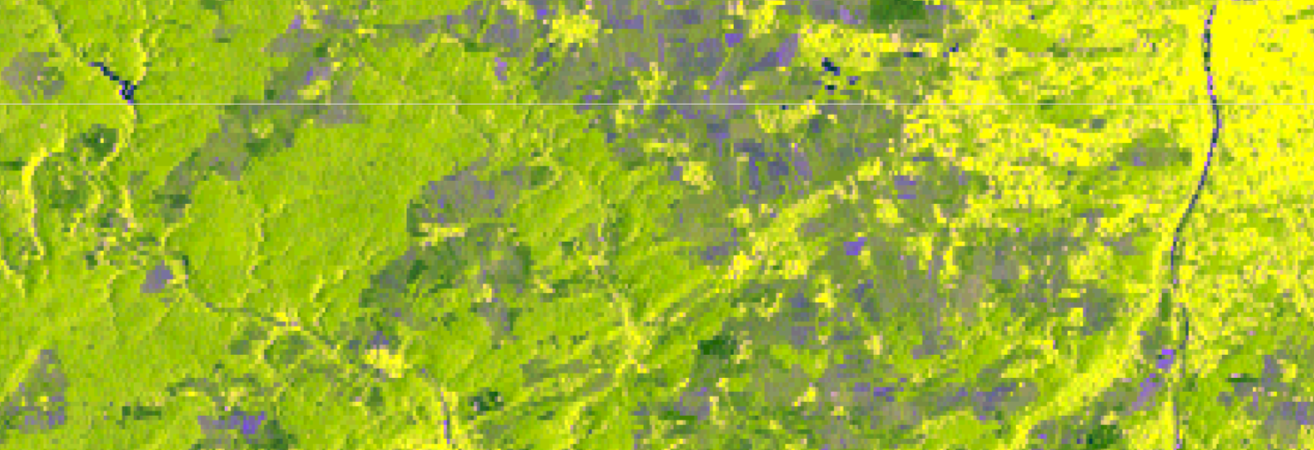
Other datasets
Global/European products - TimeScan
TimeScan Sentinel1
Harmonised backscatter properties of the land surface
Notes:
The TimeScan Sentinel-1 product is derived from more than 1500 scans by Sentinel-1 between May 2014 and July 2016. The product is provided in form of a false-colour image showing the temporal average, minimal and difference between mean-min backscattering for every pixel in the red, green and blue bands. The information is resampled to a final spatial resolution of 100m. Urban conglomerations, for example, reflect strongly and appear as prominent, bright areas. Water bodies deflect a large proportion of the oblique synthetic aperture radar beams from the satellite and are therefore dark. Vegetated regions are distinguished by comparatively high minimal backscatter, which causes forests and meadows to appear in green tones. Temporally dynamic land cover types, such as crop acreage, have changed considerably during the acquisition period and appear lilac in the data product.
The TimeScan-Sentinel2 layer
is a convenience product providing a harmonized representation of the spectral and temporal properties of the land surface. The TimeScan-Sentinel2 dataset is from Sentinel-2 images acquired between mid 2015 and November 2016. The product condenses the information content of the original images to a small percentage of their original size. The TimeScan-Sentinel2 layer can be analysed in the form of a single, cloud-free dataset based on statistical ranges of 6 indices (NDBI, NDVI, MNDWI, ND-B8A/B12, ND-B4/B2, ND-B4/B3, ND-B8/B4) for such aspects as the state of vegetation, water cover, or bare ground (e.g., built-up, rock, soil). For each of the indices temporal statistics are determined based on the entire period, including the maximal, minimal, mean, and stdev values. The TimeScan-Sentinel2 layer is composed of 29 bands - 28 bands related to the indices statistics (7 indices x 4 statistics) plus one band providing the number of valid input acquisitions per pixel.
The TimeScan-Landsat-2015 layer
is a higher-processing level baseline product providing a harmonized representation of the spectral and temporal properties of the land surface. The TimeScan-Landsat-2015 dataset was derived for selected cities from Landsat images collected from 2015. The product condenses the information content of the original images to a 20th of their original size. The TimeScan-Landsat-2015 layer can be analysed in the form of a single, global, cloud-free dataset based on statistical ranges of 6 indices (NDBI, MNDWI, NDVI, ND-b5/b7, ND-b4/b2, ND-b3/b2) for such aspects as the state of vegetation, water cover, or bare ground (e.g., built-up, rock, soil). For each of the indices temporal statistics are determined based on the entire period from 1989 to 1991, including the maximal, minimal, mean, stdev and mean slope values. The TimeScan-Landsat-2015 layer is composed of 31 bands - 30 bands related to the indices statistics (6 indices x 5 statistics) plus one band providing the number of valid input acquisitions per pixel.

Slide 32
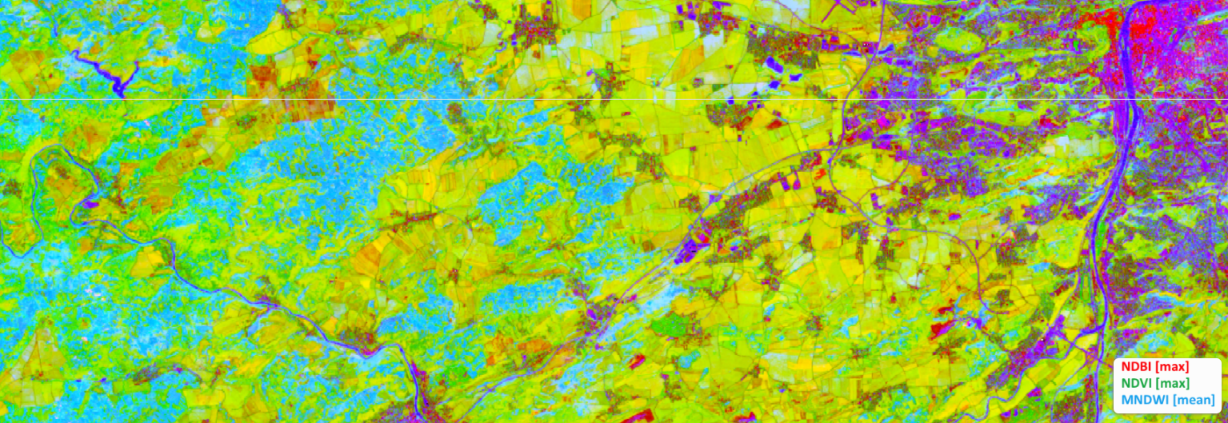
Other datasets
Global/European products - TimeScan
TimeScan Sentinel2
Harmonized spectral and temporal properties of the land surface
Notes:
The TimeScan Sentinel-1 product is derived from more than 1500 scans by Sentinel-1 between May 2014 and July 2016. The product is provided in form of a false-colour image showing the temporal average, minimal and difference between mean-min backscattering for every pixel in the red, green and blue bands. The information is resampled to a final spatial resolution of 100m. Urban conglomerations, for example, reflect strongly and appear as prominent, bright areas. Water bodies deflect a large proportion of the oblique synthetic aperture radar beams from the satellite and are therefore dark. Vegetated regions are distinguished by comparatively high minimal backscatter, which causes forests and meadows to appear in green tones. Temporally dynamic land cover types, such as crop acreage, have changed considerably during the acquisition period and appear lilac in the data product.
The TimeScan-Sentinel2 layer
is a convenience product providing a harmonized representation of the spectral and temporal properties of the land surface. The TimeScan-Sentinel2 dataset is from Sentinel-2 images acquired between mid 2015 and November 2016. The product condenses the information content of the original images to a small percentage of their original size. The TimeScan-Sentinel2 layer can be analysed in the form of a single, cloud-free dataset based on statistical ranges of 6 indices (NDBI, NDVI, MNDWI, ND-B8A/B12, ND-B4/B2, ND-B4/B3, ND-B8/B4) for such aspects as the state of vegetation, water cover, or bare ground (e.g., built-up, rock, soil). For each of the indices temporal statistics are determined based on the entire period, including the maximal, minimal, mean, and stdev values. The TimeScan-Sentinel2 layer is composed of 29 bands - 28 bands related to the indices statistics (7 indices x 4 statistics) plus one band providing the number of valid input acquisitions per pixel.
The TimeScan-Landsat-2015 layer
is a higher-processing level baseline product providing a harmonized representation of the spectral and temporal properties of the land surface. The TimeScan-Landsat-2015 dataset was derived for selected cities from Landsat images collected from 2015. The product condenses the information content of the original images to a 20th of their original size. The TimeScan-Landsat-2015 layer can be analysed in the form of a single, global, cloud-free dataset based on statistical ranges of 6 indices (NDBI, MNDWI, NDVI, ND-b5/b7, ND-b4/b2, ND-b3/b2) for such aspects as the state of vegetation, water cover, or bare ground (e.g., built-up, rock, soil). For each of the indices temporal statistics are determined based on the entire period from 1989 to 1991, including the maximal, minimal, mean, stdev and mean slope values. The TimeScan-Landsat-2015 layer is composed of 31 bands - 30 bands related to the indices statistics (6 indices x 5 statistics) plus one band providing the number of valid input acquisitions per pixel.

Slide 33
Conclusion - next steps
Way-forward proposal
The HRLs provide valuable information useful for HNV ‘map’ update
Direct extraction of HRLs from HNV is possible only for Imperviousness and Permanent Water
For other HRLs no simple extraction/supplement can be carried out (more complex description needed with regard to Land Cover class, HRLs characteristics (degree, categories) and HNV specific conditions (relevant LC classes, stratification according eco-biogeographical conditions etc.)
Complex rule based description to be developed
  Use of additional/ancillary layers may refine the selection for possible update of HNV ‘map’
  Quantitative comparison with reference data

Slide 34
Session 3: Copernicus High Resolution Layers (HRLs) profiles in current HNV ‘map‘
Review of satellite data opportunities
19/10/2018 | Revising the JRC/EEA EU-level HNV Farmland methodology - Expert workshop to review potential improvements of the JRC/EEA HNV farmland methodology, UBA, Vienna
Contacts:
Tomas Bartalos <tomas.bartalos@gisat.cz>
Tomas Soukup <tomas.soukup@gisat.cz>
Miroslav Kopecky <miroslav.kopecky@gisat.cz>

