Slide 1
Doris Marquardt, 19. October 2018
Expert Workshop
Revising the HNV Farmland methodology –
Comparison of analysis of
HRL data with current HNV ‘map‘
Discussion

Slide 2
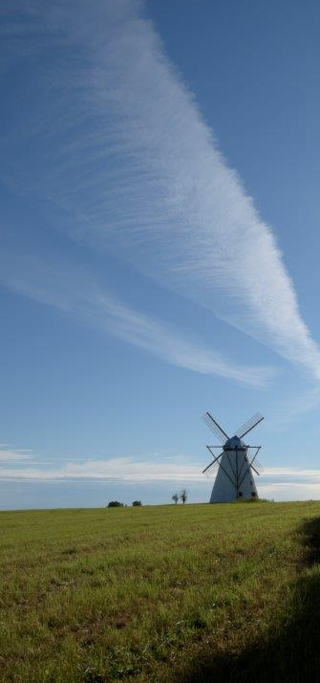
Technical questions
What is covered by the HR grassland layer? / What is the difference to the natural grassland layer?
Which time series of the HRL are and will be available?
Why are the classes of the Wetness layer regarded as exclusive criteria?
Where has QA been dine that HRL are “better” than CLC been undertaken?

Slide 3
Reflections I - HRL Imperviousness
Exclusion sufficient? | Clear – no significant impact
Implications of overlap | xx
Strengths for HNV assessment | Time series available
Weaknesses for HNV assessment | xx
Open questions | Rules for vegetation pixels within HNV f? Are rocky areas covered? How far? Threshold necessary? If so which?

Slide 4
Reflections II - HLR Forest
Inclusion/Exclusion sufficient? | 100% for exclusion
Implications of overlap | xx
Strengths for HNV assessment | xx
Weaknesses for HNV assessment | xx
Open questions | What is if it lays in mixed areas? HNV forest or exclusion

Slide 5
Reflections III - HRL Water and Wetness
Exclusion sufficient? | xx
Implications of overlap | xx
Strengths for HNV assessment | xx
Weaknesses for HNV assessment | xx
Open questions | xx

Slide 6
Reflections IV - HRL Grassland
Inclusion sufficient? | Need for further discussion about relation to different CLC classes
Implications of overlap | To be discussed with HNV experts Mask in relation with certain CLC classes
Strengths for HNV assessment | Better assessment of mixed classes Potentially spatial fine-tuning
Weaknesses for HNV assessment | Time series backwards not available
Open questions | Can the 20m layer be used? → Implications to be discussed Can it be overlapped with WET? Link to LUCAS

Slide 7
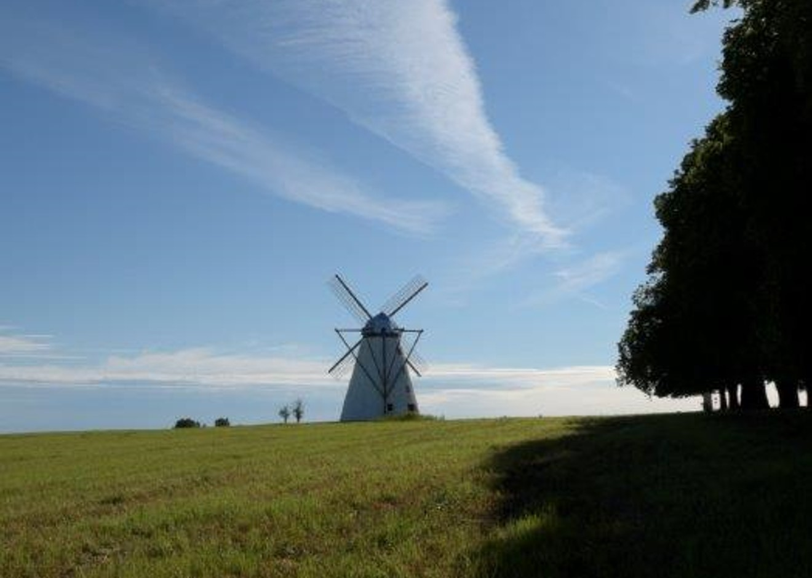
Coffee Break
Contact details:
Dr Doris Marquardt
Project Manager Agriculture & Agro-ecosystems
E-mail: doris.marquardt@eea.Europa.eu

