Slide 1
Expert workshop on components of EEA Ecosystem Capital Accounts (ECA)
Focus on biomass carbon and biodiversity data
24/03/2015

Slide 2
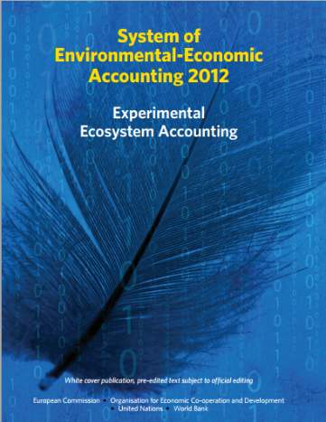
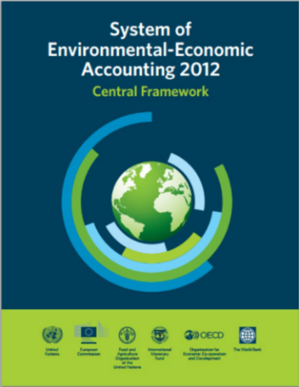
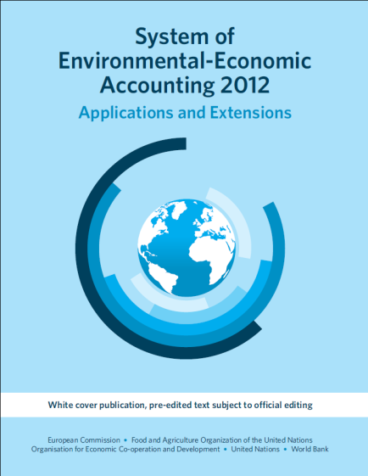
An experimental methodological framework
The System of Economic and Environmental Accounts (SEEA) adopted by the United Nations Statistical Commission in 2013 was completed by a volume on experimental ecosystem accounts

Slide 3
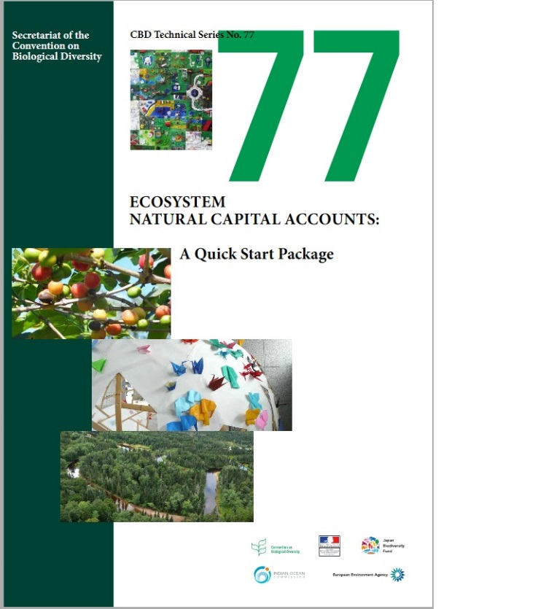
An experimental methodological framework
A comprehensive manual on Ecosystem Natural Capital Accounts called "Quick Start Package" (ENCA-QSP) presenting the accounting frameworks, possible data sources and methods

Slide 4
Ecosystems Capital Accounts Approach
An accounting approach
Ecosystem accounting aims to provide an overall measure of trends in ecosystem assets as well as the associated services they provide
In this way we could track the capacity of ecosystems to deliver services in a sustainable way and to report their degradation and enhancement
Accounting is a coherent, consistent and integrated approach based on a set of concepts, definitions, classifications & accounting rules and conventions.
Accounts must promote the integration of statistical and scientific data in a system to allow a comparative analysis on national and international level.

Slide 5
EEA Ecosystem Capital Accounts
Simplified Ecosystems Capital Accounts (SECA):
The tables will be developed progressively
In basic tables, only the most important items will be estimated
We develop a simple methodology, for comparability in space and time.

Slide 6
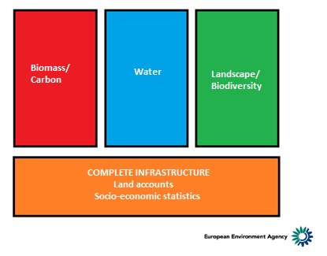
Original simplified framework of SECA

Slide 7
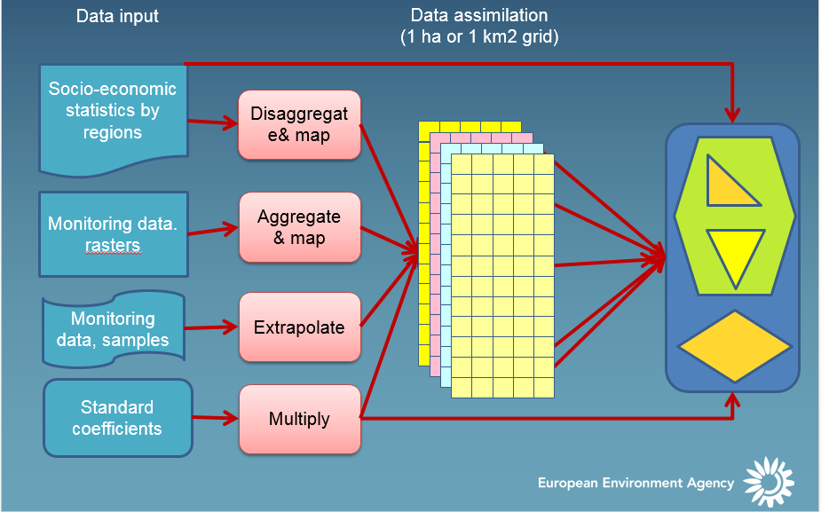
Calculation principle for accounts

Slide 8
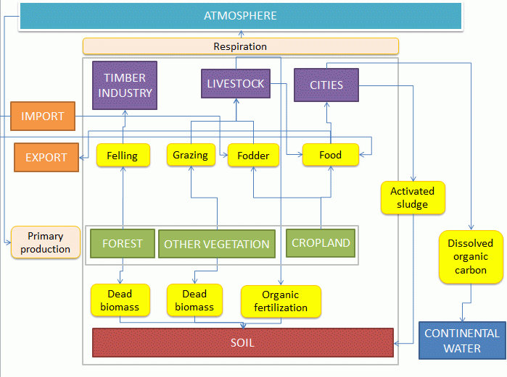
The Ecosystem Carbon Account
Diagram and simplified structure of the accounts
Stocks / Flows account
Opening stocks
Flows / Input (+) whose: NPP (Net Primary Production) NEP = NPP – heterotrophic respiration Carbon imports (seed, manure)
Flows / Output (-) whose: Wood removals Agriculture crops Animal products
Net Ecosystem Carbon Balance 1 (NECB 1)
Changes in Stocks whose: Net Forest growth Changes in land cover
Net Ecosystem Carbon Balance 2 (NECB 2)
Adjustment = NECB 2 – NECB 1
Closing Stocks

Slide 9
The Ecosystem Carbon Account
List of calculated variables
Organic Carbon Content Stock - Forest
Organic Carbon Content Stock - Harvested crops
Organic Carbon Content Stock - Soil
Organic Carbon Content Stock - Other Natural Vegetation (total)
Organic Carbon Content Stock - Other Natural Vegetation (by class)
Organic Carbon Content Flow - Forest Growth
Organic Carbon Content Flow - Forest Growth
Organic Carbon Content Flow - Forest Harvest
Organic Carbon Content Flow - Harvested Crops
Organic Carbon Content Flow - Grazed biomass
Organic Carbon Content Flow - Sludge Application
Organic Carbon Content Flow: manure application
Organic Carbon Content Flow: manure deposition
Organic Carbon Content Flow: Net Primary Production
Organic Carbon Content Flow: Deadwood
Organic Carbon Content Flow: Litter

Slide 10
The Ecosystem Carbon Account
Example of methodology used to develop carbon accounts :
Forest aboveground biomass
European forest data is disaggregated using 1km reference grid creating forest downscaled information. Disaggregation of the regional statistics is based on the CORILIS and NDVI average between 1999 and 2010. Afterwards, this new generated data is converted into carbon content per 1km² using carbon conversion factors derived from literature.
Forest statistics were collected from the three sources EFISCEN, National Forest Inventories (FI) and EFIMED expressing biomass stock and increment in m3. The geographic level is at best NUTS 2 , at worst NUTS 0.
The areas of forest are CORILIS-0 forest areas calculated by aggregating the three types of forest: Broadleaved, Coniferous & Mixed areas. CORILIS-0 is Corrine land cover rasterized at 100 m and aggregated in a 1 km² grid.
Forest Stock for year 2001 (to 2010) = Forest Stock Volume year 2000 (n -1) + Growing Stock (n) + Leftovers (n) – Felling (n)

Slide 11
The Ecosystem Carbon Account
Example of methodology used to develop carbon accounts :
Carbon stock in soil
For 2000 the approach used to calculate the soil carbon stocks consist to multiply the total carbon content of organic C to a depth of soil by the bulk density and taking into account the stony or content of coarse soil elements.
Carbon stocks are calculated according to the following and general formula: C (g/cm2) = %C *(Bulk Density) *(100 -% stone) * e.
For the other year (2001 to 2010), we calculate the new stock estimating the yearly variation by the “measurable” elements of stocks variation (Application of dry sludge in agricultural fields, Application of manure in agricultural fields and productive grassland, Manure from ruminants in the field, urbanization, intensive agriculture, soil respiration

Slide 12
The Ecosystem Carbon Account
We will provide time series of Ecosystem Carbon Accounts but:
Are the results sufficiently robust to report the evolution of carbon stock (evolution is more important than stock)
How use the account (in evolution) ? Which level ? Which ecosystem ?
Which relevant indicator can be used at this stage ?

