Slide 1

CLC+ components conceptual work
Service Contract 59142

Slide 2
Agenda
Time | Agenda item | Who
14:00 – 14:15 | Welcome & objectives of the meeting | EEA & Stefan
14:15 – 14:30 | Task 1A EAGLE matrix Task 1B UML model Task 1C CLC+ Core Guidelines | Stephan Christoph Perger Stefan
14:30 – 14:40 | Task 2 EAGLE web site | Emanuele
14:40 – 15:00 | Task 3 Barcoding review and QA approach | Stephan
15:00 – 15:20 | Task 4 Change mapping | Geoff
15:20 – 15:40 | Task 6 AI/ML based analytics | Marian
15:40 – 15:45 | Task 7 ISO | Julian
15:45 – 15:50 | Task 5 Meeting support | Stefan
15:50 – 16:00 | AOB

Slide 3

Task 1A: Update of EAGLE matrix & related documentation
Achievements / progress
  Deliverable D1-1a: Updated EAGLE Matrix version 3.2 -> FINISHED
  now available on new EAGLE webpage
  Deliverable D1-1b: CSV file for Upload of new EAGLE ontology version 3.2
  in EIONET Data Dictionary -> FINISHED
  Deliverable D1-3: Updated Explanatory Documentation of the EAGLE Concept version 3.2
  (HTML and PDF format). -> FINISHED
  now available on new EAGLE webpage
  Deliverable D1-4: ChangeLogFile (Mapping table) from old to new matrix version,
  (Elements that have been newly added / changed in Name/Code, replaced) -> FINISHED
  Bar Code Transfer protocol from old to new version, internal file for cloudflight,
  for already existing ingestions -> FINISHED
Next steps / open issues
  Task completed
  Online publication of changeLogFile on new EAGLE webpage, if needed

Slide 4
Task 1B – Update of the EAGLE UML model
Expected Output:
  Updated EAGLE UML model in Enterprise Architect & PDF format
Milestones
  15.12.2022
  Align the EAGLE data model structure and terminology with the latest EAGLE matrix version (last update of the data model was 2015) -> FINISHED
  04.10.2023
  Then incorporate the latest matrix updates / input for UML model -> FINISHED
Progress & Achievements
  Update information on the required UML model changes, based on the EAGLE Matrix 3.2_20230829 (latest)
  Use of code lists for all lookup attributes linked to the matrix data dictionary
  Potential harmonization steps between the UML model and the matrix have been proposed
  Drafted a potential UML model extension to integration the land use aspect into the data model
  Drafted a concept to close the “missing link” between the matrix and the model

Slide 5
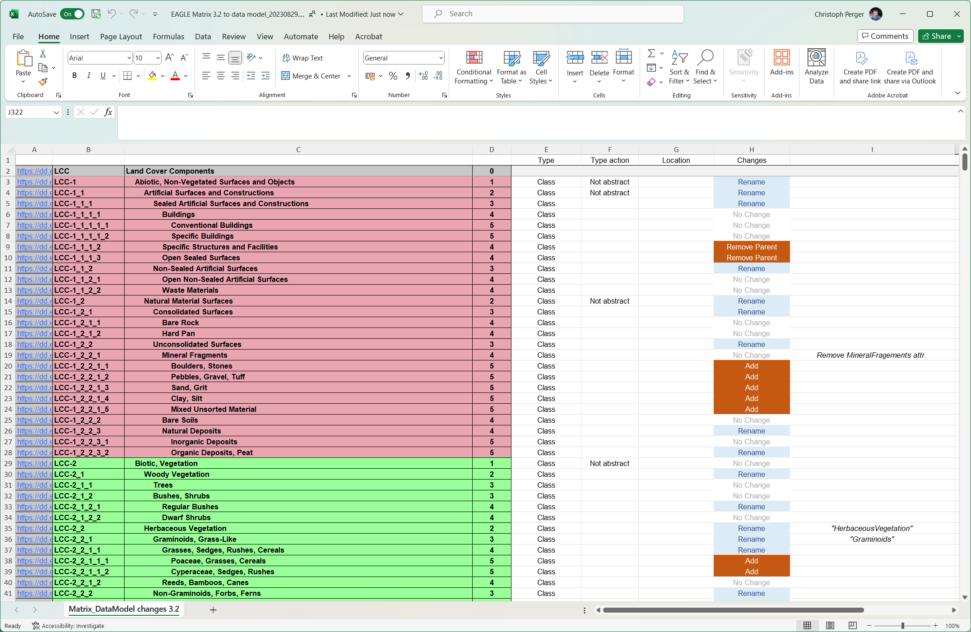
Example - Required UML model changes

Slide 6
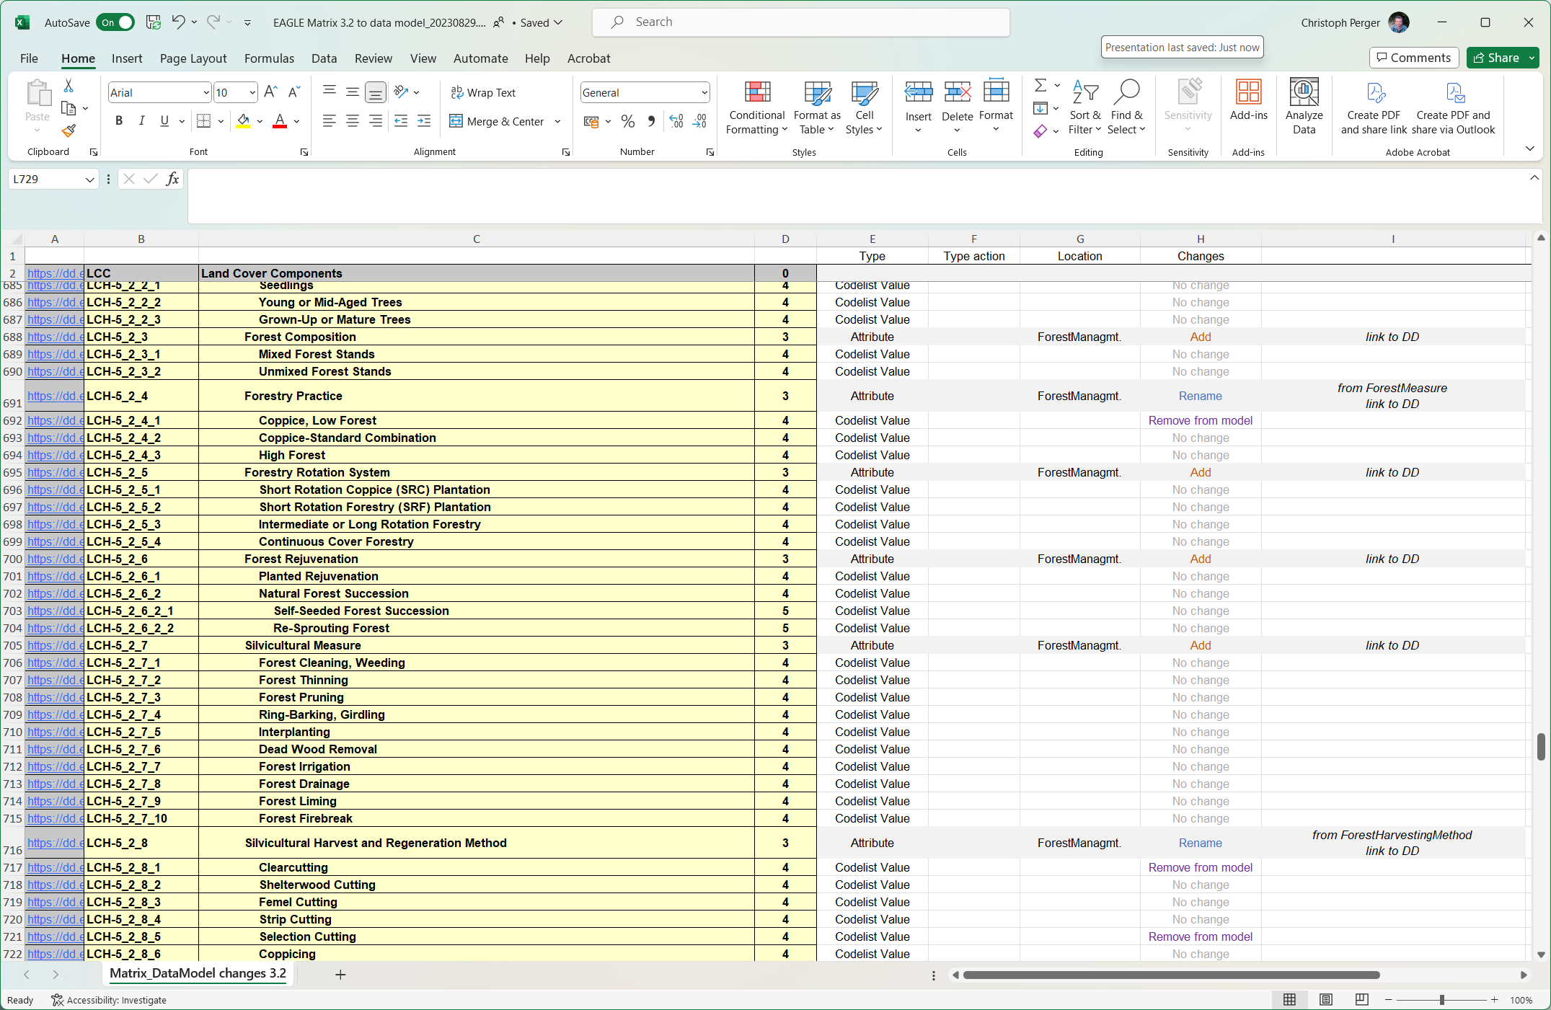
Example - Required UML model changes

Slide 7
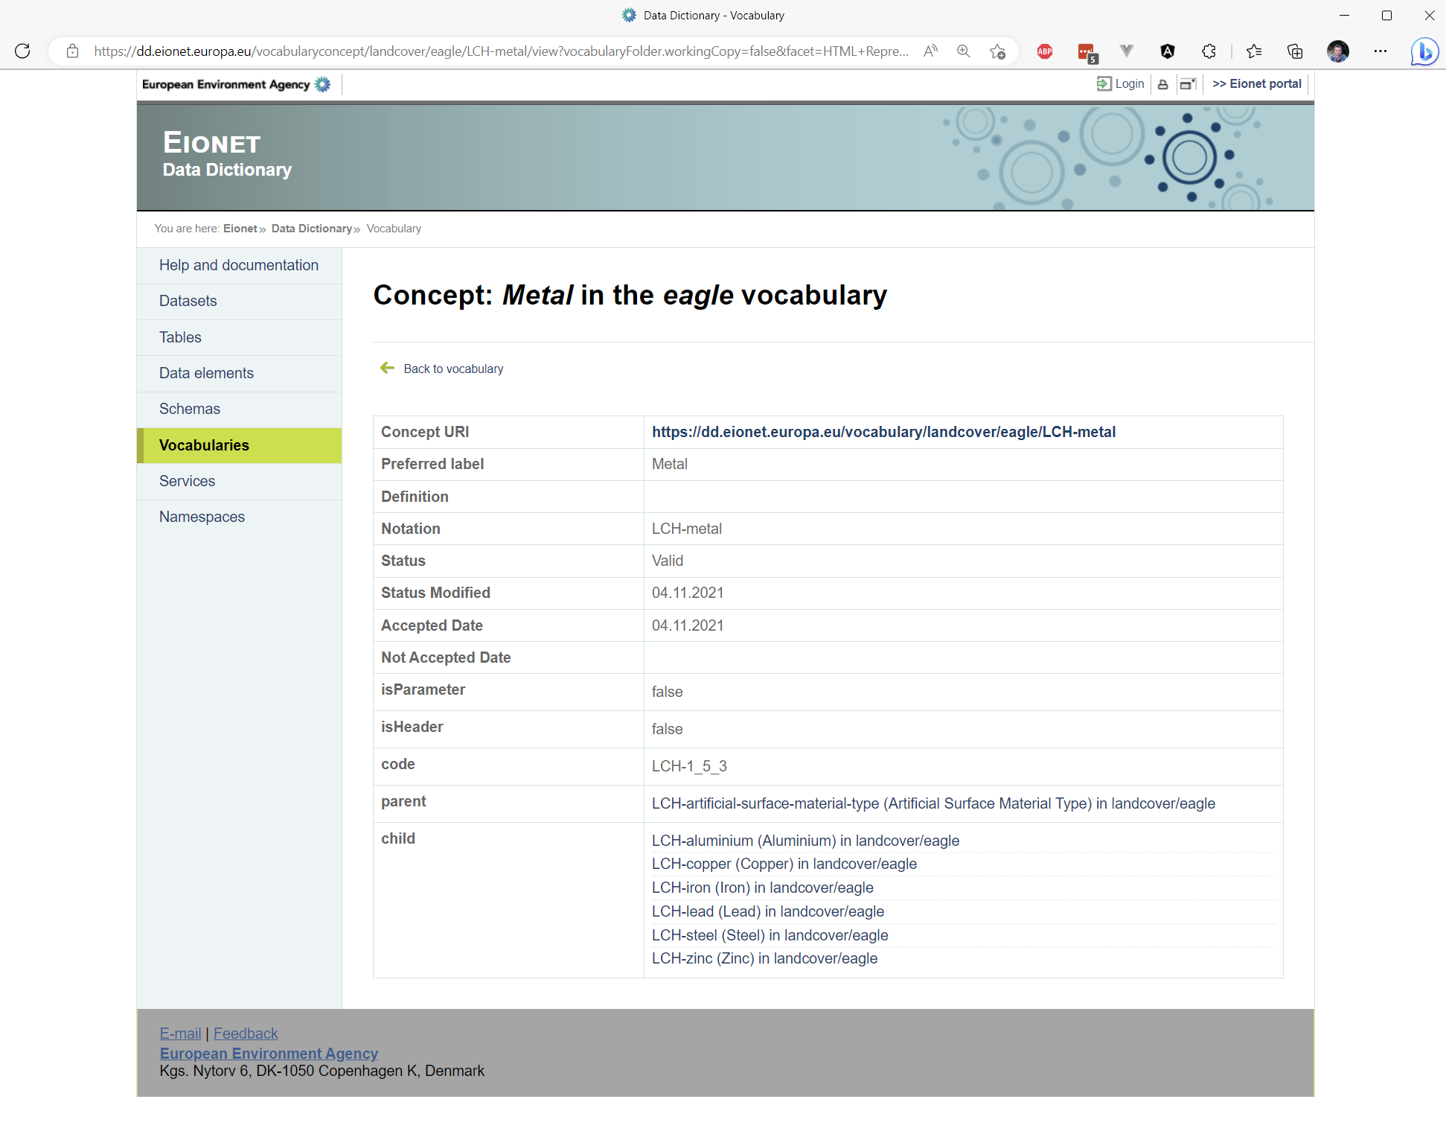
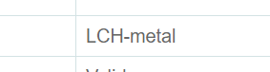
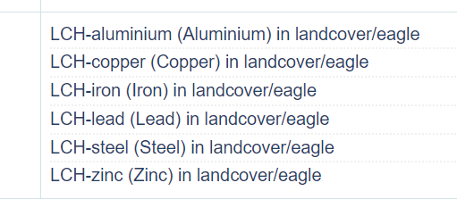
Example – Using code lists from dd.eionet.europa.eu

Slide 8
Task 1B – Update of the EAGLE UML model
Conclusions and next steps:
  Incorporate the required changes in Enterprise Architect / PDF
  Structural changes to harmonize matrix and model can be tackled in a follow-up project
  The drafts and concepts to improve the data model cannot be pursued with the available resources. Nonetheless they represent preparations for future implementations

Slide 9
Task 1C – CLC+ Core Guidelines
Achievements / progress
  Task closed
  Final report submitted on 11/04/2023
Next steps / open issues
  Not applicable

Slide 10
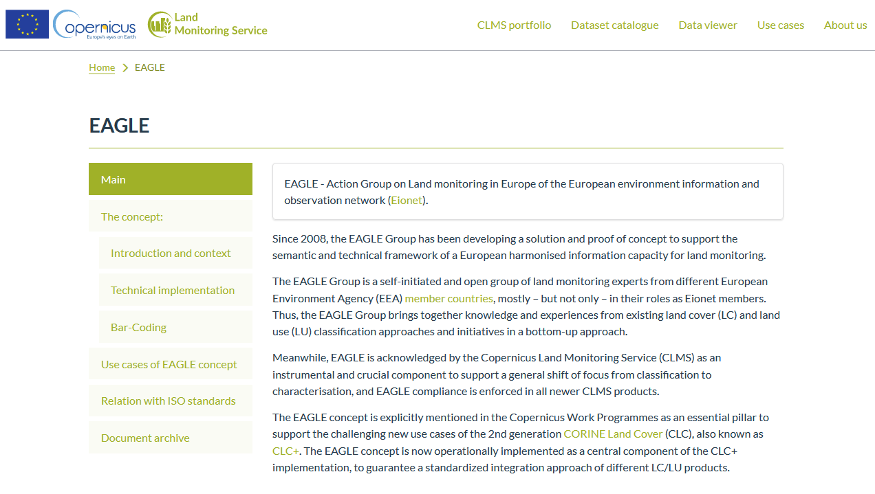
Task 2 – EAGLE web site update
Partners: UMA, Stephan A., Geoff S., s4e
After several rounds of comments /reviews
Status:
1rst Draft on-line
Current content – on review
Web site look and functionalities - on review
https://clms-prod.eea.europa.eu/en/eagle
→ first comments to EEA

Slide 11
Task 2 – EAGLE web site update
Pending tasks:
To support the finalization of content correctness and web site features,
To provide last version of some documents (i.e., barcoding manual),
Upload the archived documents downloaded from the former web site into the eionet EAGLE folder (translation of web site file into folder structure)

Slide 12

Task 3: EAGLE Bar Coding Review
Achievements / progress
  Deliverable D3-1a: Bar Code Manual revised draft
  draft delivered
  Deliverable D3-1b: Thematic content guidance document for EAGLE Matrix Bar Coding
  -> FINISHED
  Deliverable D3-2: Concept for a bar coding review and acceptance process,
  draft delivered
  Reviewed Bar Coding results (from CLC+ Core ingestions) for
  CLC2018, HRL IMP, HRL Grassland, HRL Forest, HRL SWF
  -> FINISHED
Next steps / open issues
  Consolidation of Bar Code Manual (final version)
  Agreement between EEA & EAGLE on scaling, organize & manage bar code review process
  Summary of Comments on reviewed ingested bar code results

Slide 13
Task 4 Develop a change mapping concept
Change mapping is important for reporting
Consistent multi-purpose mapping is challenging
EAGLE was designed as a way of recording status
“Kicking the can down the road”
Scale and complexity of challenge is requiring deep conceptual thinking

Slide 14
Task 4 Develop a change mapping concept
Three potential approaches to capture and generate “change” information:
  Input oriented - ingestion of existing change data sets into the EAGLE data model.
  Internal oriented - addressing issues of spatial, thematic, and temporal consistency.
  Output oriented - CLC+ Instances create and capture meaningful changes
Provide a road map for the implementation of best practice examples and recommendations.
D4-1 Report of Task 4: Develop a change mapping concept for CLC+ Due 30.11.2023

Slide 15
Task 4: Ingestion of existing change data sets
Achievements / progress
  Reviewed existing change layers
  Assessed approaches to production and recording of change
  CLC+ Core can’t ingest changes at the moment
  Evaluated two options for ingestion
    Expand EAGLE data model to include change elements
    Use two ingestions per change layer
Next steps / open issues
  Change layers have baked in characteristics
  Prepare a list of new elements required for the second option above against the latest EAGLE model
  Future of change layers within CLMS
    Should change layers only be delivered by CLC+ Core extractions?

Slide 16
Task 4: Internal consistency
Achievements / progress
  Reviewing existing approaches to internal consistency
    Reprocessing of collections
    Inter-calibrations of data sets
    Accounting layers
  Opportunities within CLC+ Core
    Easy access to time series
    Ancillary data to support calibration
  Challenges
    Building rulesets
    Storage of results
Next steps / open issues
  Rulesets
    System errors
  Impacts on CLC+ Core
    Deployment of methods
    Multiple versions of the same dataset
    Cataloguing of revised layers

Slide 17
Task 4: Output CLC+ changes
Achievements / progress
  Extraction of information is the most powerful capability of CLC+ Core
  In principle straightforward
  Practical implementation more challenging
  Complexity of changes required
  Specification alignment of inputs
  Spatio-temporal consistency of inputs
Next steps / open issues
  Conceptual issues
    Change information that remain consistent with status layers
    Changes prompt update of status layer
    Role of national data in changes
    Documentation to build change rulesets
  Develop example rulesets
    A range of complexities – access to all inputs of status layers
    Dynamic rulesets – specification and availability of inputs
    Focus on reporting requirements

Slide 18
Task 5 – Meeting and other support to EEA
Achievements / progress
  Permanently open task
Next steps / open issues
  Provision of a timeline of EAGLE history
  Start already with OODM WG?

Slide 19
Task 6: Use of AI/ML EO-based analytics products for filling gaps in CLC+ instances
Summary
This task will assess the use of advanced technologies (like artificial intelligence / machine learning) and / or recent EO-based products that are being provided by the service industry to support the closing of current data and information gaps.
Selection of specific CLC + classes suitable for gap filling
Evaluations of suitability of AI/ML methods for gap filling – which approach to use to fill the gaps
Test specific methodologies in case study areas for certain gaps
Review the usefulness of commercially available analytics layers to support gap filling

Slide 20
Task 6: Use of AI/ML EO-based analytics products for filling gaps in CLC+ instances
Selection of CLC classes
Reasoning
  Outcome of Task 16 & 17
    European data were only possible to derive up to Level 3
    National data can’t define all Level 3 classes
    OSM data can not deliver data to fill all data gaps (Task 17)
  Availability of training data
    Classes should be covered by UA or CZ
Selected CLC classes
  1.2.1 Industrial or commercial units
  1.2.3 Port areas
  1.4.1 Green urban areas
  3.2.4 Transitional woodland-shrub
  4.2.3 Intertidal flats

Slide 21
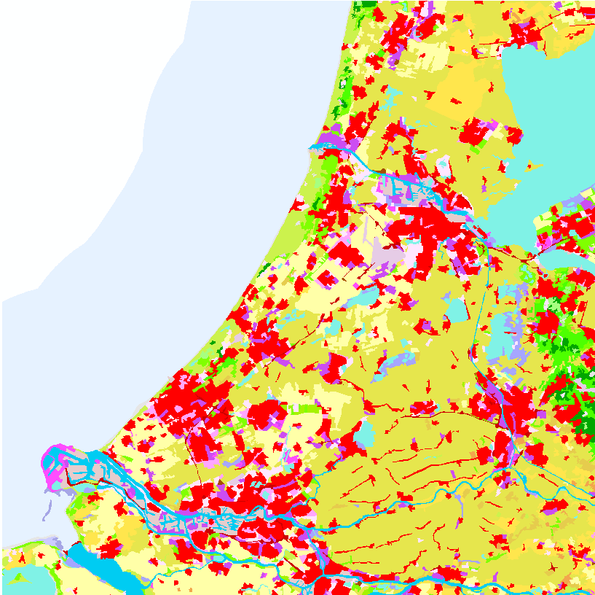
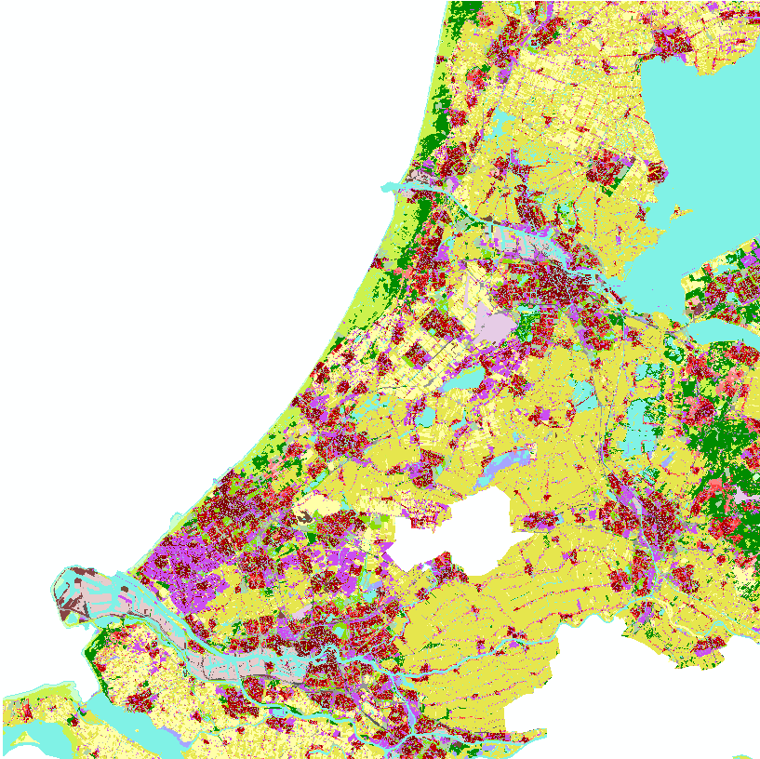
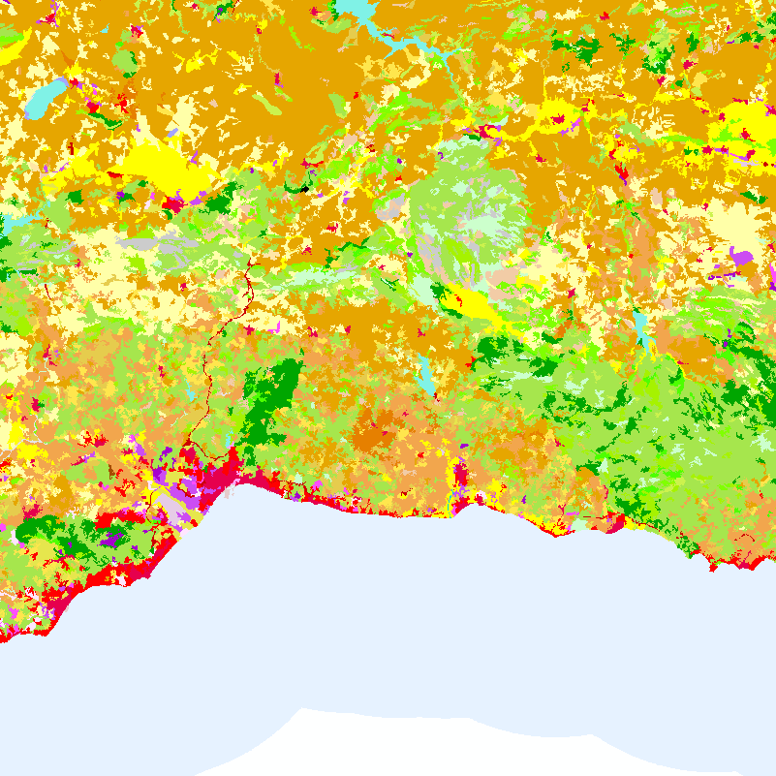
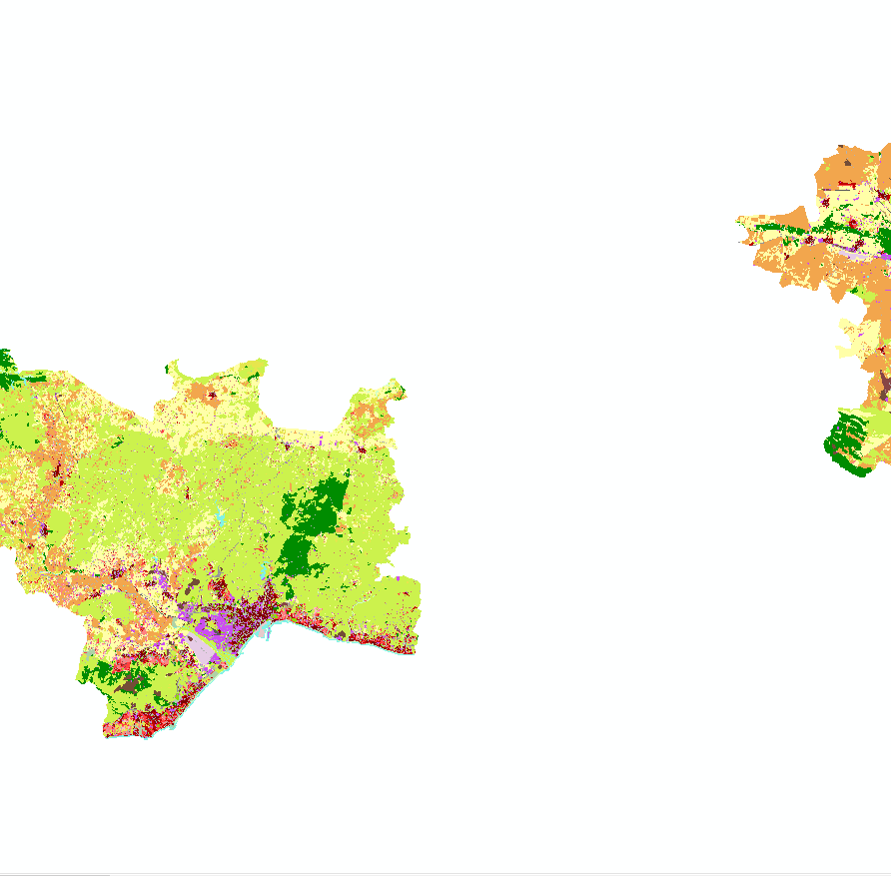
Task 6: Use of AI/ML EO-based analytics products for filling gaps in CLC+ instances
CLC
UA
Study area – EEA grid 100x100km
Reasoning
  Test for different climate, environment, landscape
  Presence of selected classes / data gaps
  Different availability (coverage) of training data
Netherlands E37 N32
Spain E30 N16

Slide 22
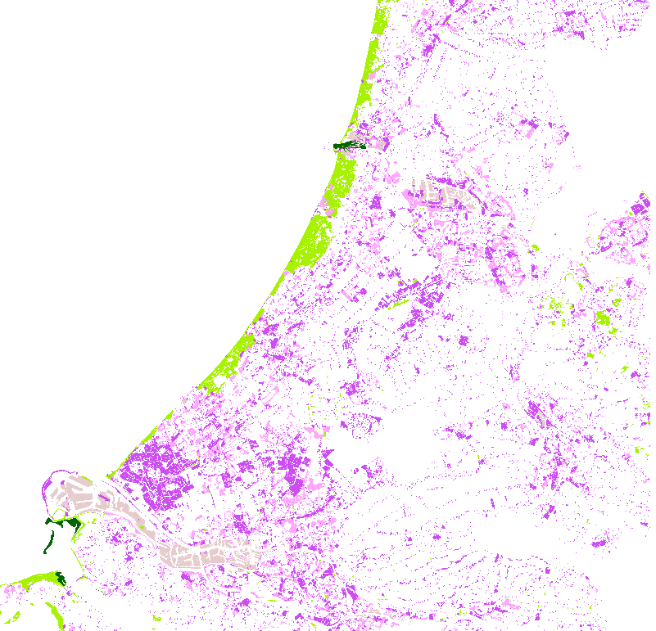
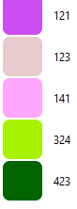
Task 6: Use of AI/ML EO-based analytics products for filling gaps in CLC+ instances
Data
Year 2018
Urban Atlas
  12100 Industrial, commercial, public, military and private units -> 121
  12300 Port areas -> 123
  14100 Green urban areas -> 141
  32000 Herbaceous vegetation associations -> 324
Coastal zones (level 2/3)
  112 Industrial, commercial, public and military units -> 121
  123 Port areas and associated land -> 123
  14 Green urban, sports and leisure facilities -> 141
  34 Transitional woodland and scrub -> 324
  723 Intertidal flats -> 423
Sentinel 2 satellite images (16)
  4 bands (10m)
  4 seasons
Map of UA and CZ merged and translated to CLC classes
  Union
  UA has priority over CZ

Slide 23
Task 6: Use of AI/ML EO-based analytics products for filling gaps in CLC+ instances
Methods
Random forest – pixel based decision trees ML method
  Used in several LULC applications
  Highly accurate
  Suitable for non urban classes
Neural networks – DL method – taking into account context
  Suitable for urban classes
  Shapes of objects
Generative modelling (not priority for LULC mapping)

Slide 24
Task 6: Use of AI/ML EO-based analytics products for filling gaps in CLC+ instances
Achievements / progress
  Data gap review
  Data gap and datasets selection – CLC + Legacy classes
  Selection of study areas and data collection
  Building and application of ML model (Random Forest)
Next steps / open issues
  Tuning parameters of RF model to improve accuracy
  RF for Spain
  DL modeling – 2nd method for both areas
  Evaluation of both methods (accuracy assessment)
  Reporting and consultation with partners

Slide 25
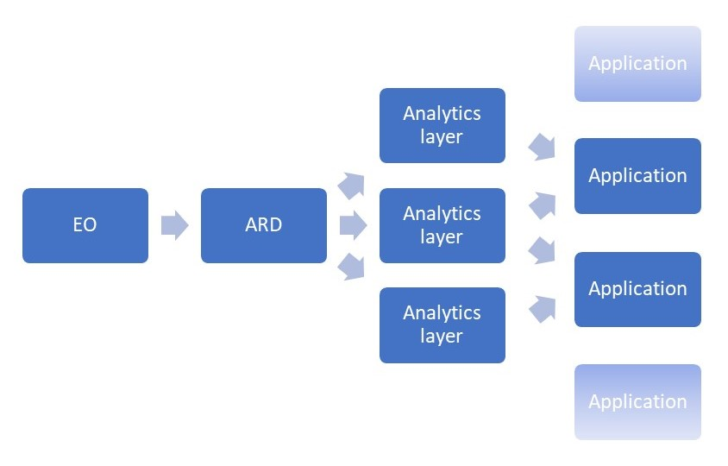
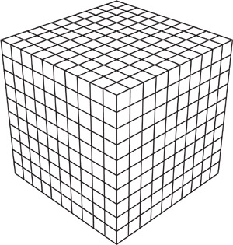
Task 6 – Analytics layers
Spatial domain
EAGLE
Data
Model
CLC+ Core

Slide 26
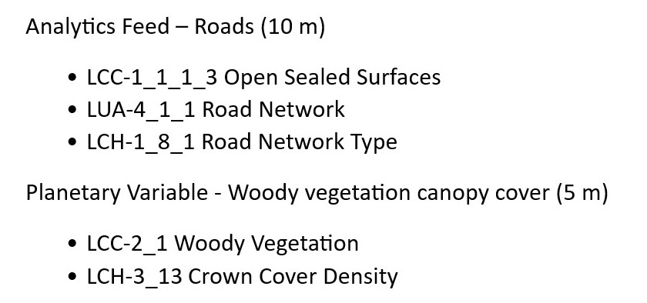
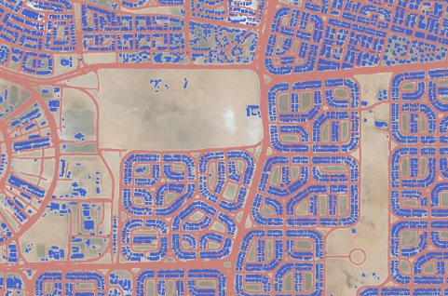
Task 6 – Analytics layers
Achievements / progress
  Reviewed potential analytics layers
  Outlined criteria for inclusion in CLC+ Core
  Selected those suitable for CLC+ Core
  ‘Bar coded’ some examples
  Initiated development of use cases
Next steps / open issues
  Test upload of one or more layers
  More work on use cases, role in CLC+ Legacy
  Derived elements from analytics layers
  Operational integration with CLC+ Core
  Licencing options

Slide 27
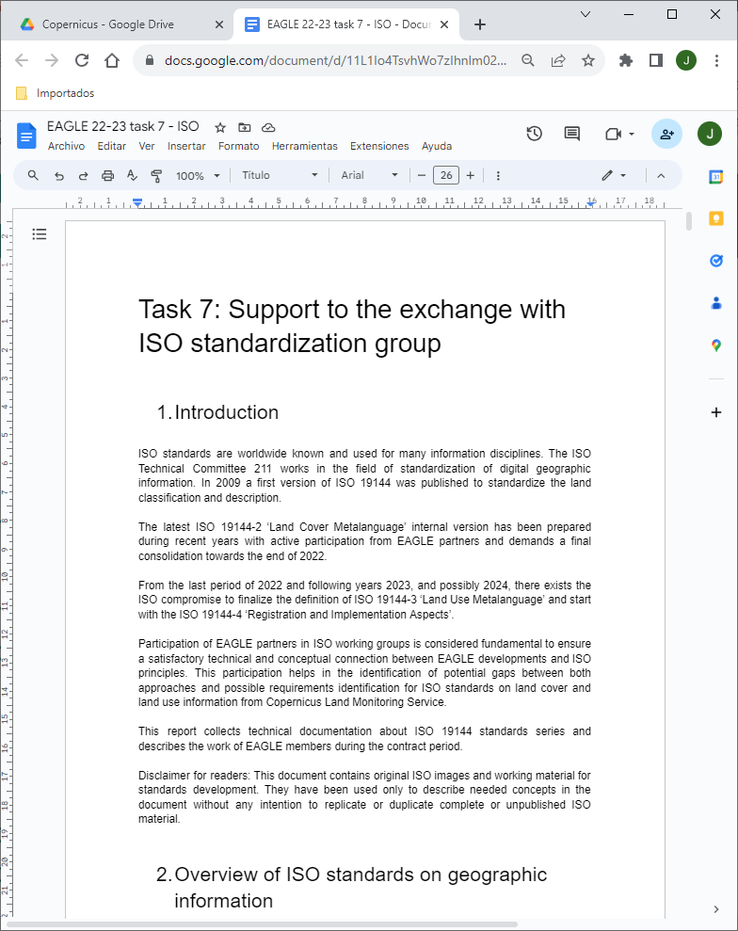
Task 7: Support to the exchange with ISO standardization group
Milestones: Not applicable
Deliverables
  D7-1 (30.11.2023): Report of Task 7 - Support to the exchange with ISO standardisation group (LIVE DOCUMENT→)
  Technical (draft o final) documentation generated in ISO 19144 standards series to be easily accessible for EEA → under precise ISO permissions
Partners
  EAGLE members who are not part of the ETC DI (CNIG, Specto Natura, Stephan Arnold)

Slide 28
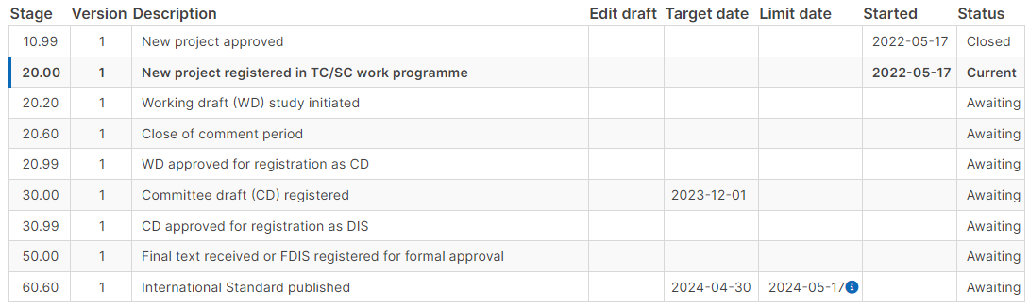
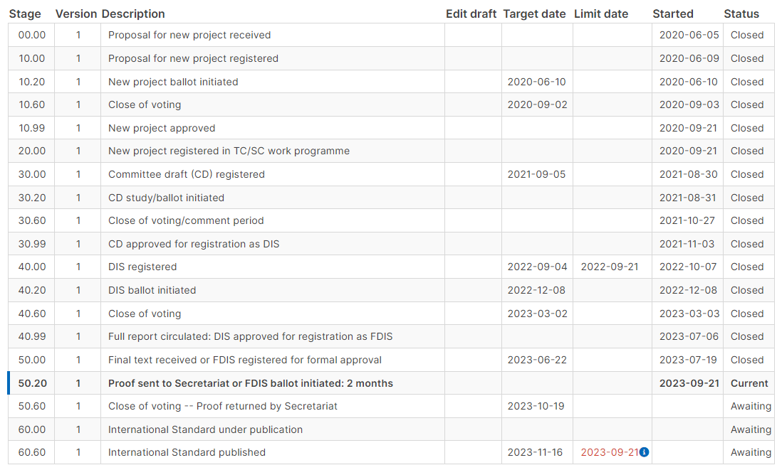
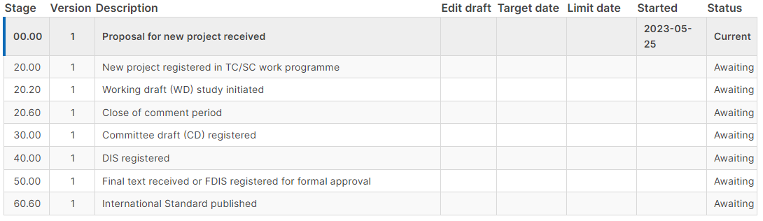
Task 7: Support to the exchange with ISO standardization group
ISO 19144 Calendar
19144-3 LUML (needs completion by registries)
19144-2 LCML
(draft TS by 30 November)
(As technical specifications)
19144-4 Registration (Preliminary working item PWI in 2023-2024. Material for registry needs to be included)
(draft TS by 30 November)
EEA & EAGLE interest to continue participating along 2024?
(As technical specifications)

