Slide 1
Christoph Perger, Stephan Arnold I EAGLE Kick-off meeting
EAGLE kick-off meeting (SC 59142)
24.10.2022
Task 1 – EAGLE concept update
Subtask 1A – Documentation & Matrix
Subtask 1B – UML Model
Subtask 1C – CLC+ Core User Guidelines

Slide 2
Stephan Arnold I EAGLE Kick-off meeting
EAGLE kick-off meeting (SC 59142)
24.10.2022
Task 1A – Documentation and Matrix Update

Slide 3
Task 1A – Documentation and Matrix Update
Expected output:
Updated version and documentation of the EALE concept, according to user requirements regarding implementation for CLC+ Core System and other recent use cases like e.g. CLMS HRL VLCC or LULUCF, to be able to compose and decompose Land Units / Land classifications of Earth´s surface.
See also Deliverables
Actions
Task 1 Workshop to capture workload, discuss solutions/revise items
Re-assure pending items to be considered into matrix / model (from EEA side, user community, encountered use case scenarios)
Revision / Confirmation of the Matrix content elements (LCC, LUA, LCH), check against recent user requirements, clarify left over issues.

Slide 4
Task 1A – Documentation and Matrix Update
Milestones
M1 – Update of EAGLE matrix / input for UML model (15.12.2022)
Deliverables
D1-1 Updated EAGLE matrix (ready for upload in EIONET Data Dictionary)
D1-3 Updated Explanatory Documentation of the EAGLE Concept (HTML and PDF format, including the definitions of the matrix / model elements)
D1-4 Mapping table between old and updated EAGLE matrix versions
Partners
Stephan Arnold, Spatial Focus, Lechner, s4e, Specto Natura, UMA, Cloudflight, CNIG

Slide 5
First results (to be filled after the KOM)
Action | Symbol | Remark
Content agreed
Subtasks agreed
Milestones agreed
Deliverable agreed
AOB

Slide 6
Short summary for next steps, meetings or other relevant issues
Find date and place for Task 1 Workshop, in November 2022 (?), possibly back-to-back with anyway-meeting (piggy back)
Be aware of consequences of matrix/model changes for CLC+ Core systematics

Slide 7
Christoph Perger I EAGLE Kick-off meeting
EAGLE kick-off meeting (SC 59142)
24.10.2022
Task 1B - UML model update

Slide 8
Task 1B - UML model update
Expected output:
Updated EAGLE UML model in Enterprise Architect & PDF format
Actions
(Task 1) Workshop to scope the task’s outline
Identification of potential structural modifications necessary, overarching elements (LC-DataSet, LCU, AbstractLCC), land use architecture *), etc.
LCC review and update of the data model classes
LCH review and update of the attributes, enumerations and code lists
Fine-tuning after M1 (result of task 1A)
Generation of a user-friendly 1-pager

Slide 9
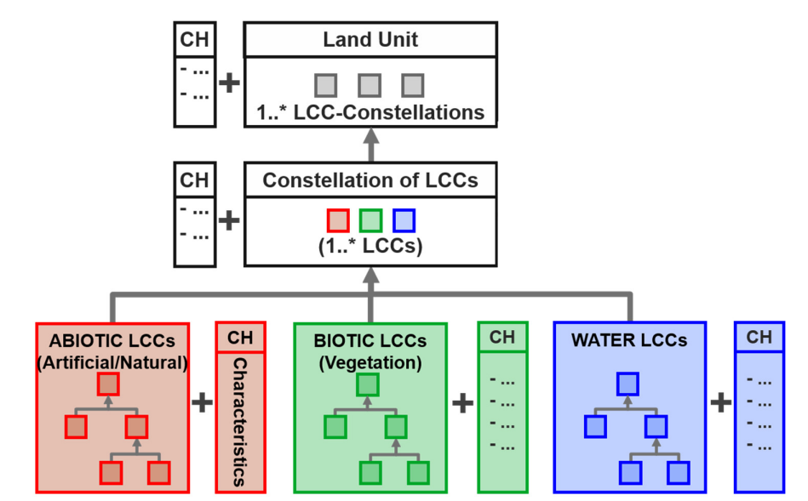
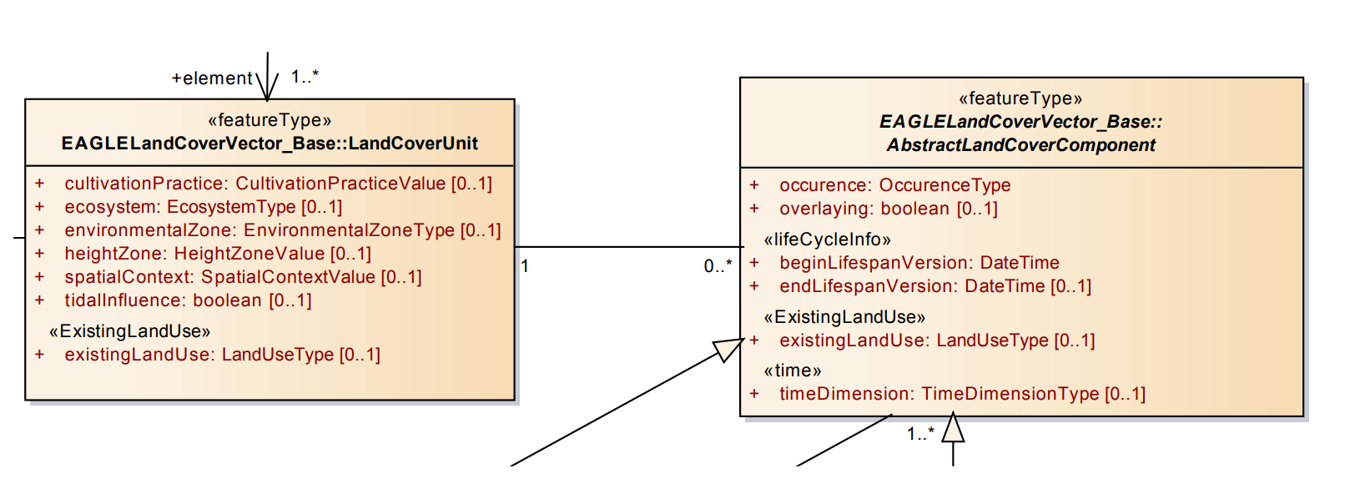
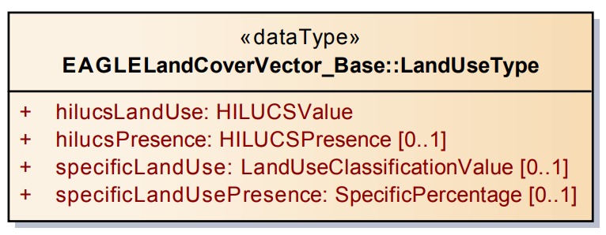
*) Land use architecture - Details

Slide 10
Task 1B - UML model update
Milestones
15.12.2022 Align the EAGLE data model structure and terminology with the latest EAGLE matrix version (last update of the data model was 2015) until M1
31.01.2023 Then incorporate the latest matrix updates / input for UML model
Deliverables
D1-2 UML data model in Enterprise Architect (poss. incl. online version)
D1-2 “Human-readable” PDF version (A0 poster)
Partners
Cloudflight, Spatial Focus, Stephan Arnold, CNIG, UBA-V

Slide 11
First results (to be filled after the KOM)
Action | Symbol | Remark
Content agreed
Subtasks agreed
Milestones agreed
Deliverable agreed
AOB

Slide 12
Short summary for next steps, meetings or other relevant issues
Be in close connection with Task 2 Online EAGLE Webpage, have it up-to-date

Slide 13
Stefan Kleeschulte I EAGLE Kick-off meeting
EAGLE kick-off meeting (SC 59142)
24.10.2022
Task 1C. & CLC+ Core user guidelines update

Slide 14
1C – CLC+ User guidelines
Expected output:
D1.5 Update of the CLC+ Core user guidelines (30.09.2022)
Actions
Get CLC+ Core user guidelines from SP consortium
Integrate lessons learnt from Copernicus task 22 (LULUCF) on Core data ingestions and extraction
Integrate results from EAGLE task 3 (bar coding review): CLMS examples (15.03.2023)
Creation of a living document (on-line version?) to allow updates / extensions with new lessons learnt

Slide 15
1C – CLC+ User guidelines
Planning:
Review CLC+ Core user guidelines prepared by SP (31.10.2022)
Collect comments for improvement made during first Core training (31.10.2022)
Collect comments for improvement made during second Core training (30.11.2022)
Collect lessons learnt from LULUCF task 22 (30.11.2022)
First updated version of user guidelines (31.12.2022)
Second updated version of user guidelines (30.05.2023)
Partners:
s4e (10), Lechner (5), Specto Natura (2)

Slide 16
First results (to be filled after the KOM)
Action | Symbol | Remark
Content agreed
Subtasks agreed
Milestones agreed
Deliverable agreed |  | Change of deadline for D1-5 agreed.
AOB

Slide 17
Overall planning of activities & dependencies
Deliverable No | Deliverables | Estimated deadline
D1-1 | Updated EAGLE matrix | 31.12.2022
D1-2 | Updated EAGLE UML model | 31.01.2023
D1-3 | Updated Content Explanatory Documentation of the EAGLE Concept | 31.12.2022
D1-4 | Mapping table between old and updated EAGLE matrix versions | 31.12.2022
D1-5 | Update of the CLC+ Core User Guidelines | 31.12.2022
D2-1 | Updated website material. | 31.12.2022
D2-2 | Promotional material | 31.12.2022
D3-1 | Report of Task 3 - Standardised bar coding for CLMS products | 31.01.2023
D3-2 | Report of Task 3 - Concept for a bar coding review and acceptance process | 30.06.2023
D4-1 | Report of Task 4: Develop a change mapping concept for CLC+ | 30.11.2023
D5-1 | Collection of PowerPoint presentations | 30.11.2023
D5-2 | Report of Task 5 – Summary of tasks undertaken | 30.11.2023
D6-1 | Report of Task 6 - Use of AI/ML and other (commercial) EO-based analytics for filling gaps in CLC+ instances | 30.11.2023
D7-1 | Report of Task 7: Support to the exchange with ISO | 30.09.2023
IR | Interim report | 31.03.2023
FR | Final report | 31.10.2023

