Slide 1
D2-2 pictures and infographics for new EAGLE web site content (2023)

Slide 2
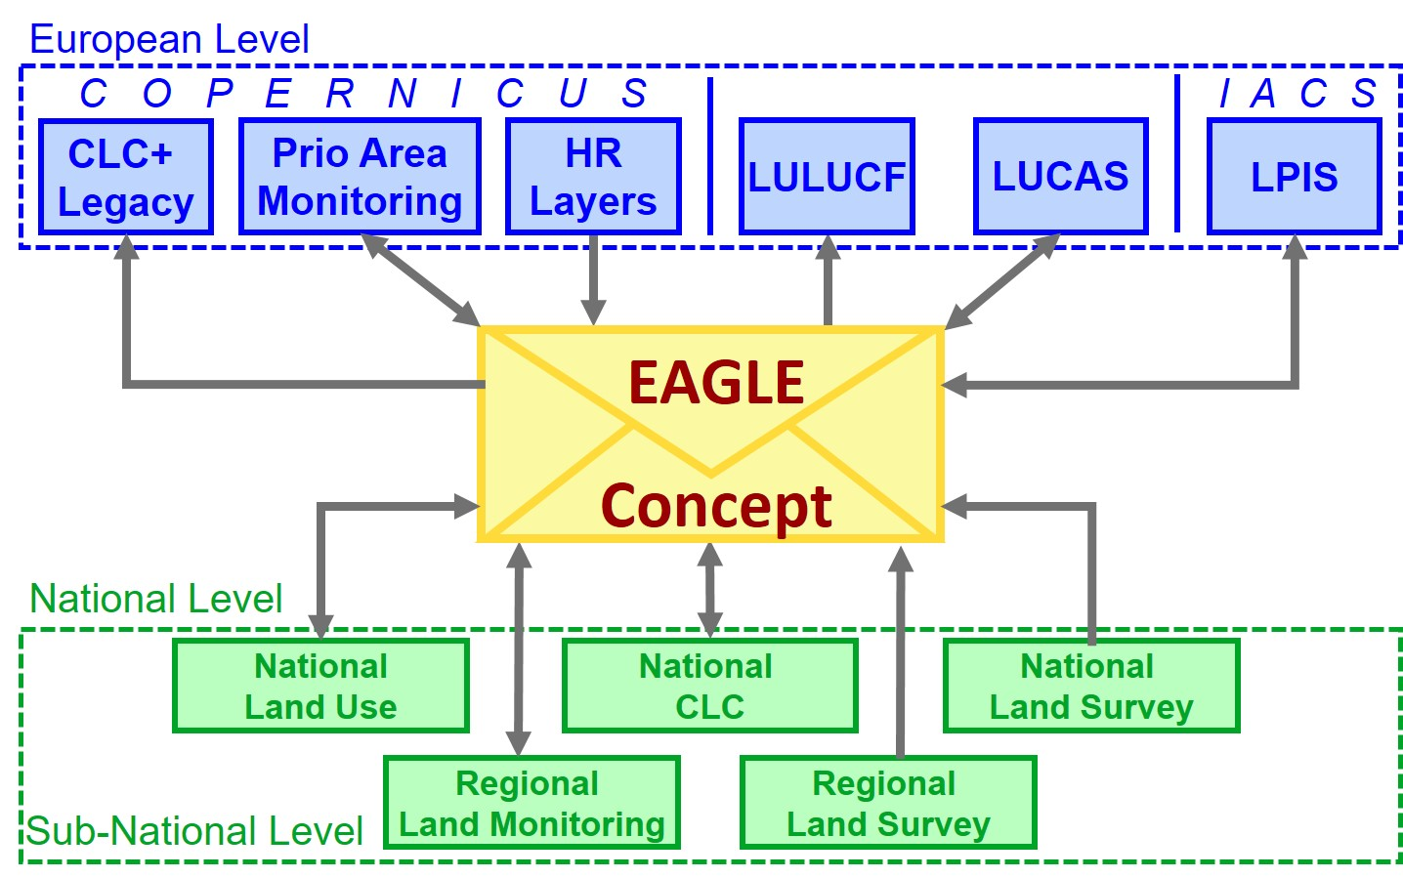
Figure 1 EAGLE concept as a semantic centrepiece and vehicle to allow comparisons and translations between different nomenclatures.

Slide 3
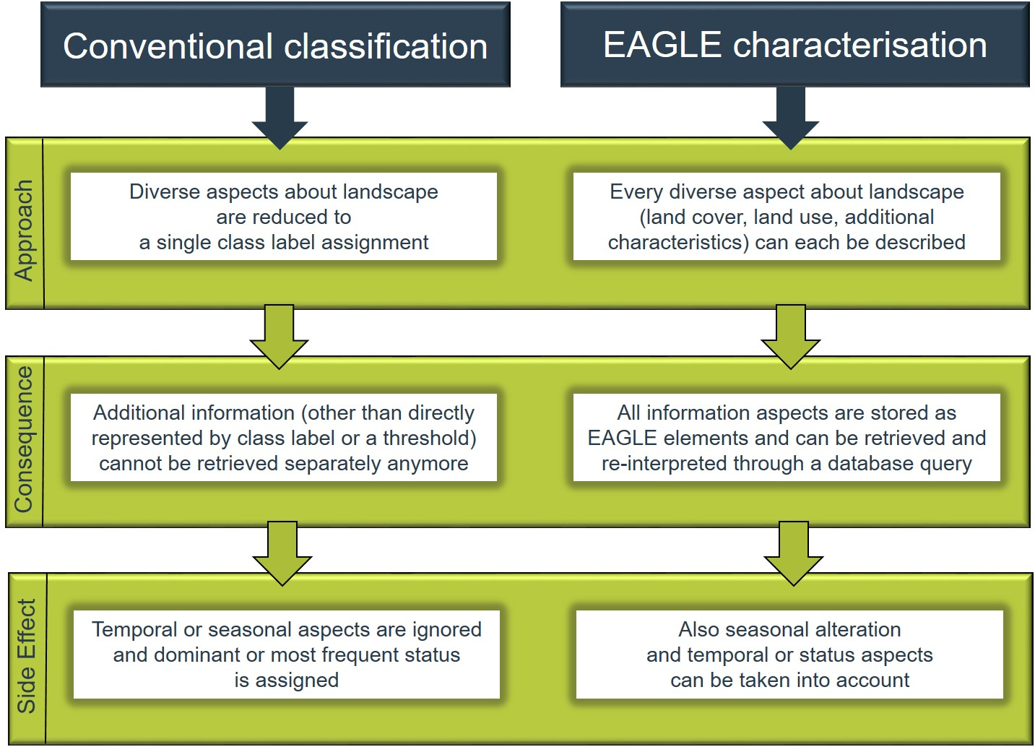
Figure 2: Different approaches of conventional classification (left) and object-oriented characterization (right) of landscapes and their consequences regarding information capture and storage.

Slide 4
Conventional classification
EAGLE characterisation
All available information is reduced to a single class assignment
All known land cover, land use and additional characteristics can be captured and described
Approach
Additional information, even if defined within the class description, can not be retrieved anymore
All information are saved as EAGLE elements and can be easily retrieved if requested
Consequence
Semi-natural grassland
LC Biotic: grasses, trees; Water: inland water; LU crop production, fishing
pasture, …
Results

Slide 5
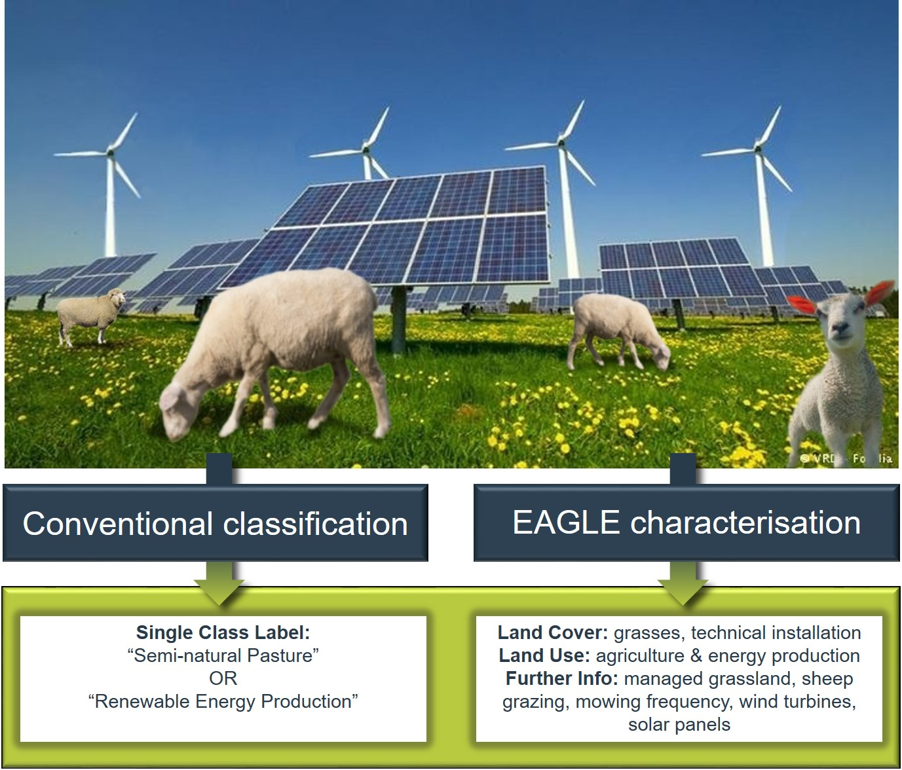
Figure 3: Example 1 for different information content between conventional classification approach versus object-oriented EAGLE characterisation.

Slide 6
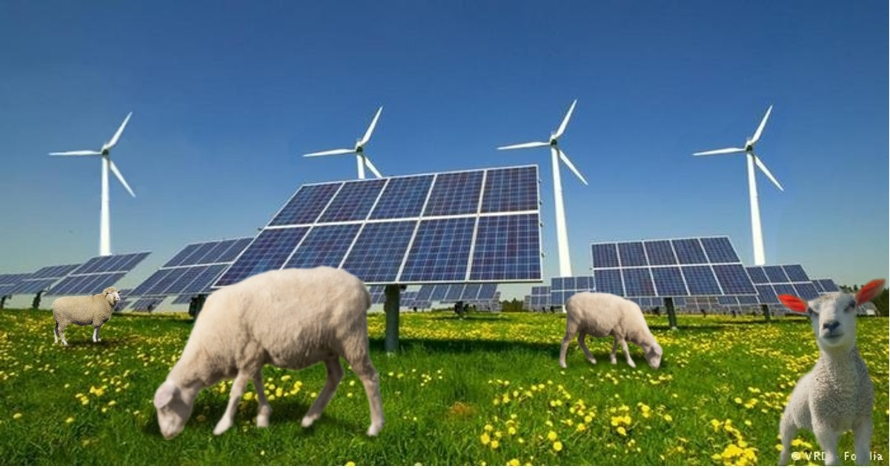

Slide 7
Foto: © Oberstdorf · Kleinwalsertal Bergbahnen
Figure 4: Example 2 for different information content between conventional classification approach versus object-oriented EAGLE characterisation.
.

Slide 8
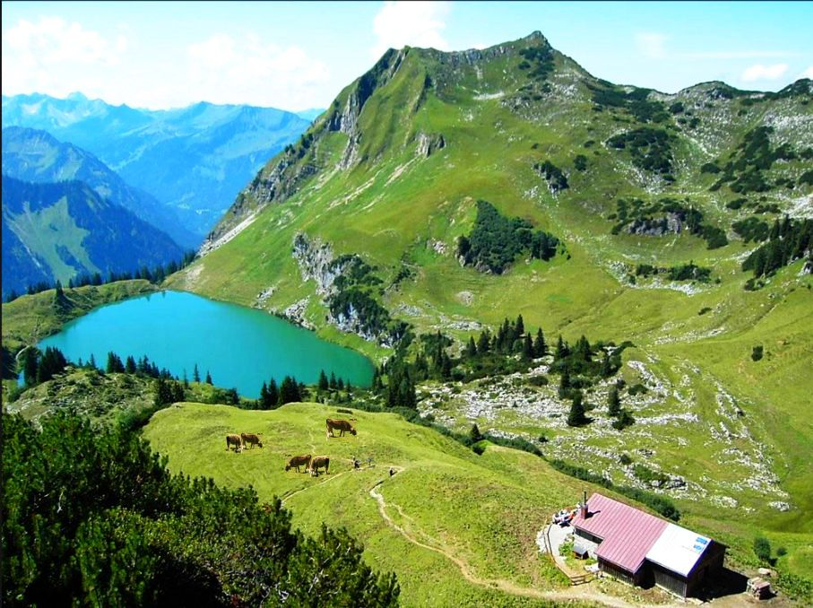
Foto: © Oberstdorf · Kleinwalsertal Bergbahnen

Slide 9
Figure 5 Example of semantic analysis of class definition through decomposition, highlighting landscape elements by their componential type: Land Cover (LC), Land Use (LU), Characteristics and Parameters (CH).

Slide 10
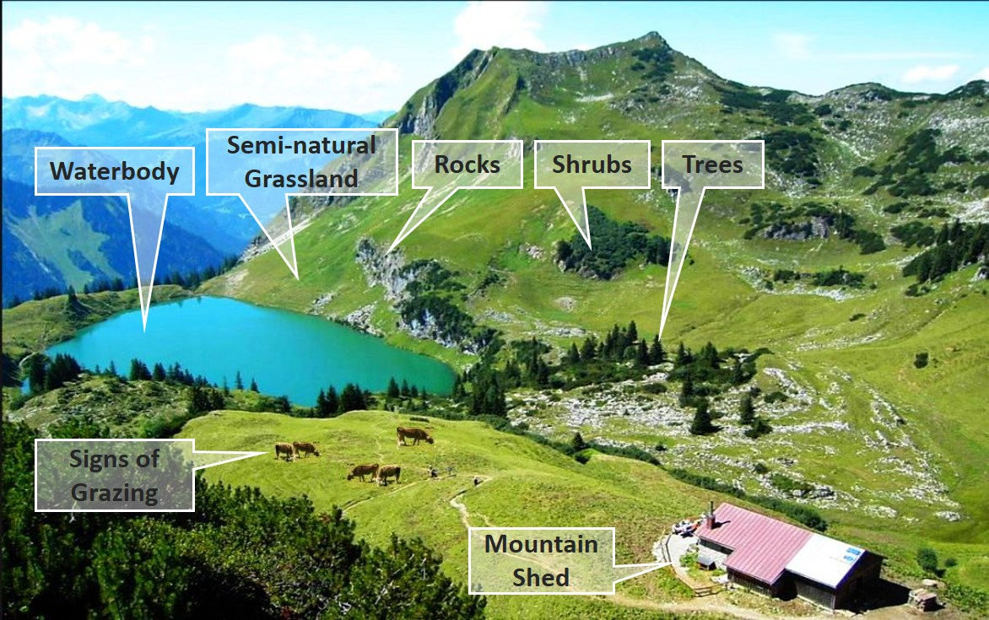
Figure 6 Decomposition of complex real world landscape situation which can be captured with EAGLE concept as a mapping tool (adapted from © Oberstdorf – Kleinwalsertal Bergbahnen).

Slide 11
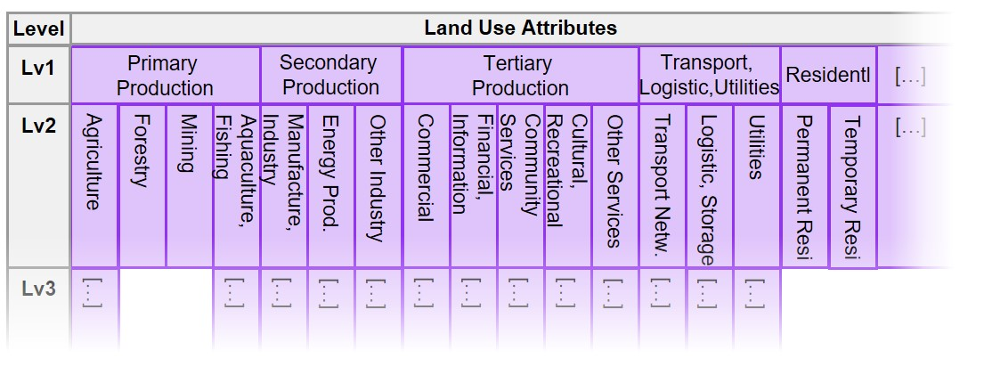
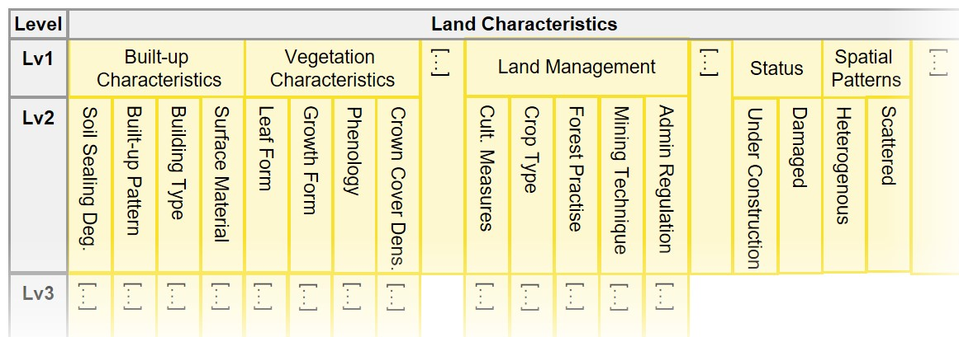

Slide 12
Figure 7 The EAGLE Matrix in horizontal form with the three blocks LCC, LUA, LCH. All three blocks are shown here for illustration reasons below each other, but normally are arranged sideways next to each other.

Slide 13
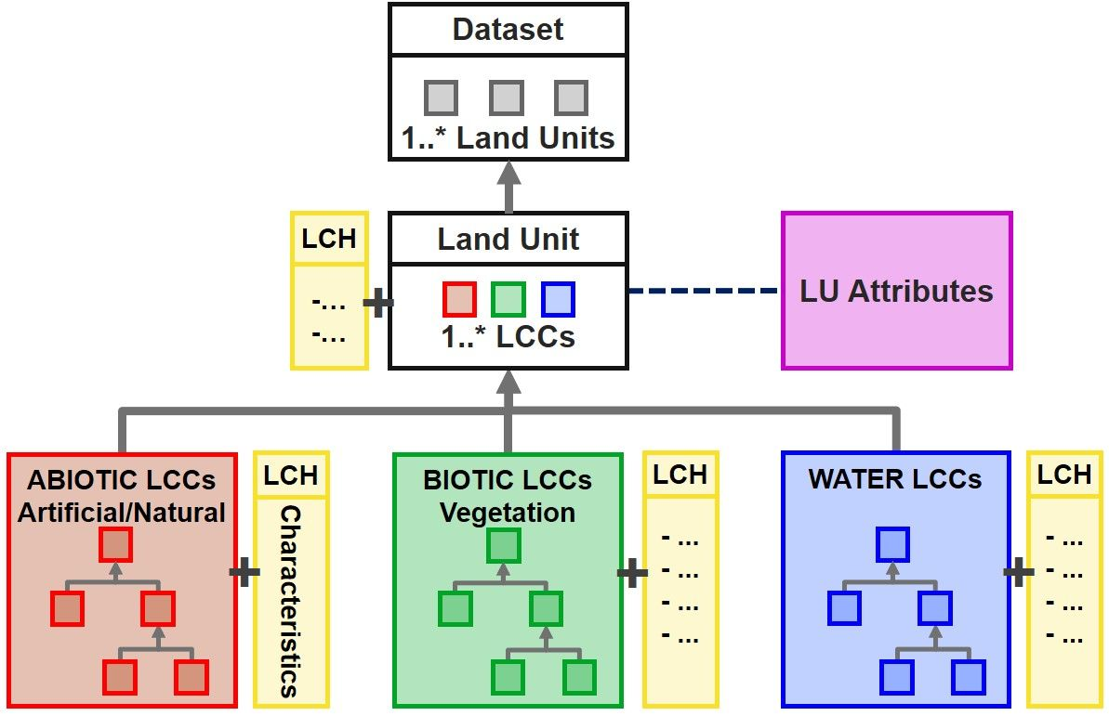
Figure 8 Simplified structure of the EAGLE UML data model, with a Land Unit as a geometric instance of a “Dataset”, being composed of “Land Cover Components”, enriched by “Land Use Attributes”, and further described by “Land Characteristics”.

Slide 14
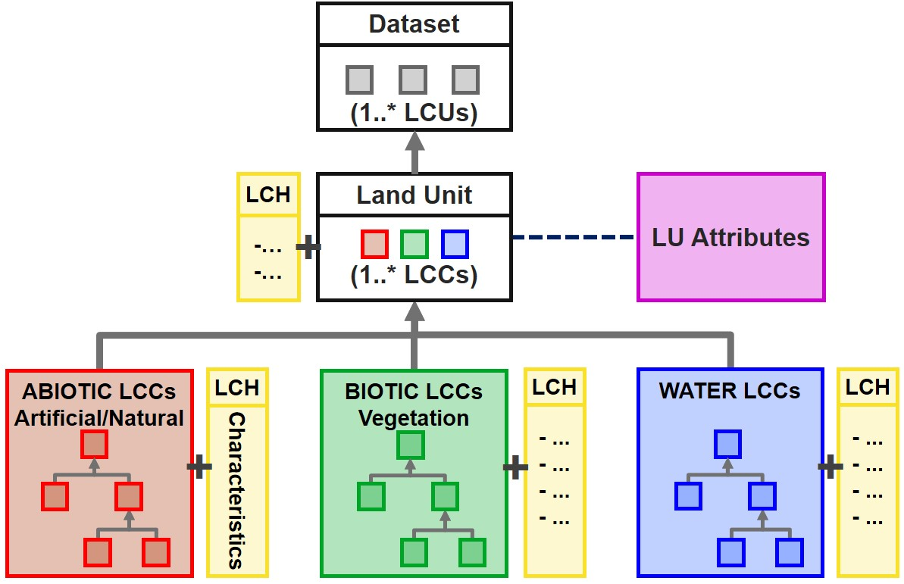

Slide 15
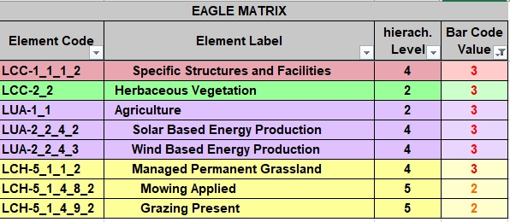
Figure 9 Example of how to decompose and bar-code a complex landscape situation: Pasture grassland combined with Renewable Energy Production. All elements assigned code “3” are mandatory all together; elements coded with "2" are selective mandatory, meaning at least one or more of them must be present.

Slide 16
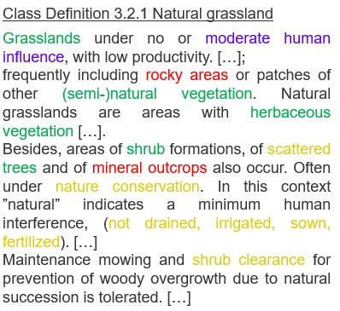
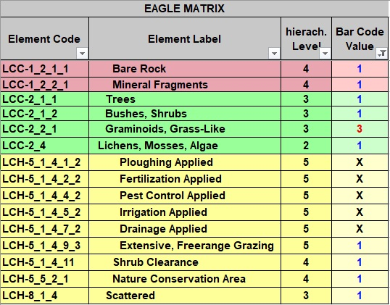
Figure 10 Example of bar-coding decomposition of the textual CLC class definition “Natural Grassland”. Mandatory elements are coded with “3” and must be present all together, optional elements which frequently or typically (but not necessarily) can occur are coded with “1”, and elements excluded by definition are coded “X”.

Slide 17
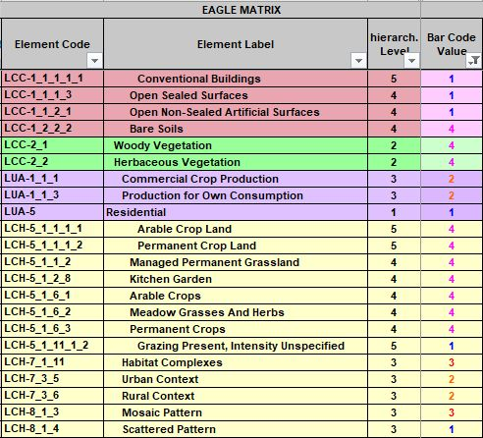
Class definition CLC 2.4.2 Complex cultivation patterns
Mosaic of agricultural land parcels of at least two of the following three cultivation types: arable crop land, pasture [herbaceous vegetation] and permanent crop land [woody vegetation];
Mosaic of parcels of permanent crops (fruit trees, berry plantations, vineyards and olive groves);
Agricultural mosaics with scattered houses, or garden huts, situated in proximity of rural or urban settlements and used for growing agricultural crops, fruit, and vegetable for own consumption;
Hobby/city/kitchen gardens primarily for agricultural production use;
Vineyards, intermixed with other cultivation types in mosaic pattern.
Figure 11 Example of bar-coding decomposition of the textual CLC class definition “Complex Cultivation Pattern”. Selective mandatory elements are coded with “2” and at least one of them must be present, optional elements which occasionally can occur are coded with “1”, paired mandatory elements where at least two of them must be present in any combination are coded “4”.

Slide 18
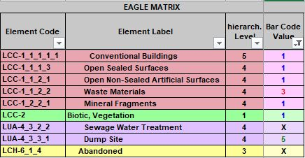
Class definition CLC 1.3.2 Dump site
dump sites of public, industrial, communal waste; waste rock after processing of various raw materials; waste sewage sludge; pools of liquid waste from chemical processes;
associated land of mines where barren materials are dumped (coal tips, slag dumps).
Includes: line vegetation belts, part of buffering zones around dump sites; buildings, transport networks including parking lots [open non-sealed areas] associated with dump site;
non-vegetated slag heaps.
Excludes: abandoned, reclaimed or reconverted former dump sites.
Not applicable for: water treatment plants
Figure 12 Example of bar-coding decomposition of the textual CLC class definition “Dump site”. Cumulative mandatory element is coded with “3” and must be present, optional elements which occasionally can occur are coded with “1”, exclusive mandatory is LUA “dump site” which is coded with BCV “5”, Land use type water sewage plant and abandoned status are excluded by definition.

Slide 19
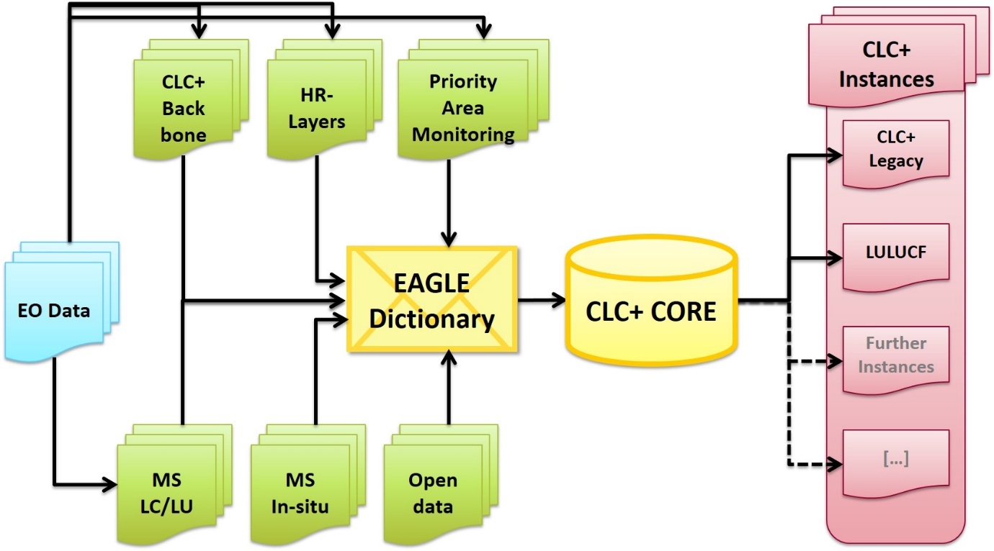
Figure 14: Connections between EAGLE UML data model and INSPIRE data specifications for Land Cover (left side) and Land Use (right side) which make the EAGLE model INSPIRE-compliant.

Slide 20
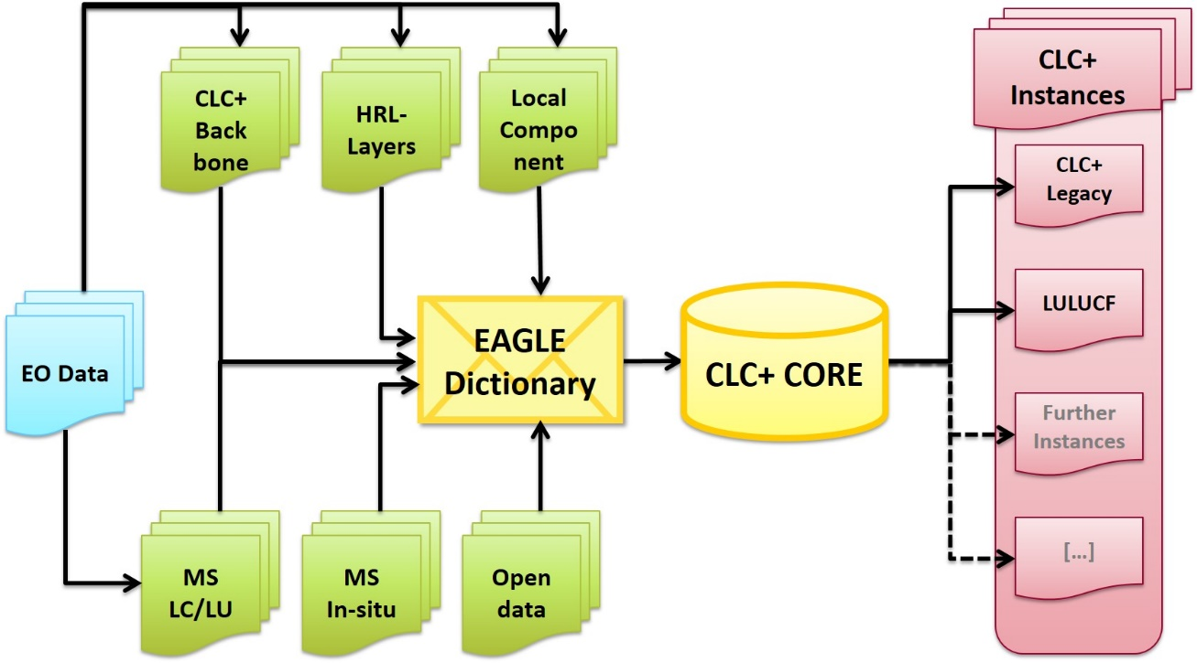

Slide 21
Figure 3: Example 1 for different information content between conventional classification approach versus object-oriented EAGLE characterisation.

