Slide 1
D2-2 pictures and infographics

Slide 2
Conventional classification
EAGLE characterisation
All available information is reduced to a single class assignment
All known land cover, land use and additional characteristics can be captured and described
Approach
Additional information, even if defined within the class description, can not be retrieved anymore
All information are saved as EAGLE elements and can be easily retrieved if requested
Consequence
Semi-natural grassland
LC Biotic: grasses, trees; Water: inland water; LU crop production, fishing
pasture, …
Results

Slide 3
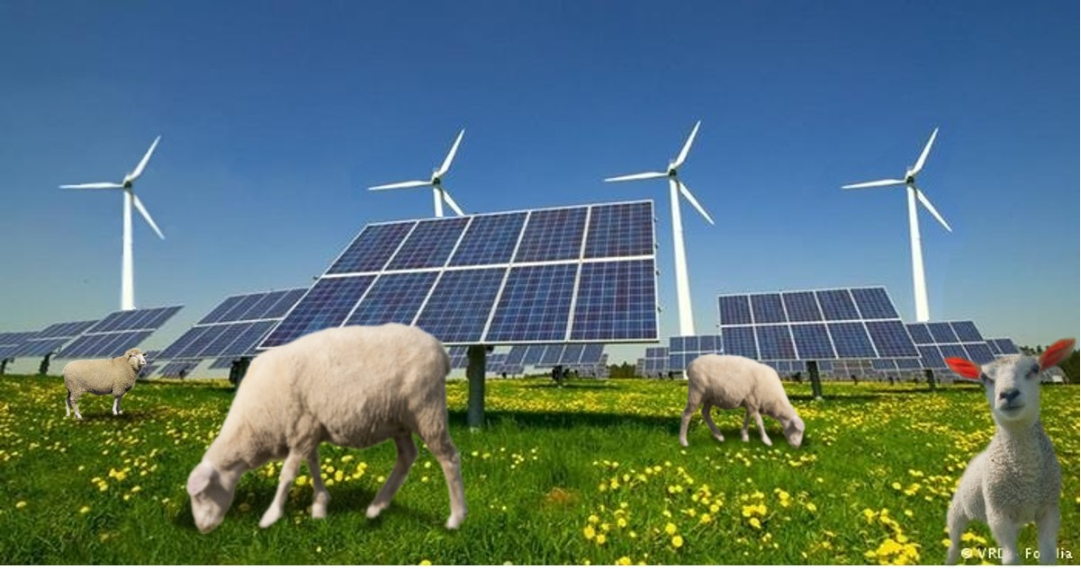

Slide 4
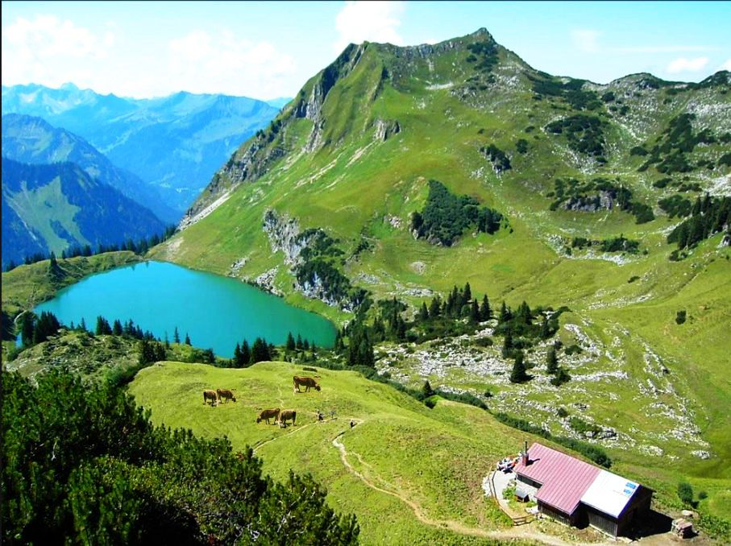
Foto: © Oberstdorf · Kleinwalsertal Bergbahnen

Slide 5
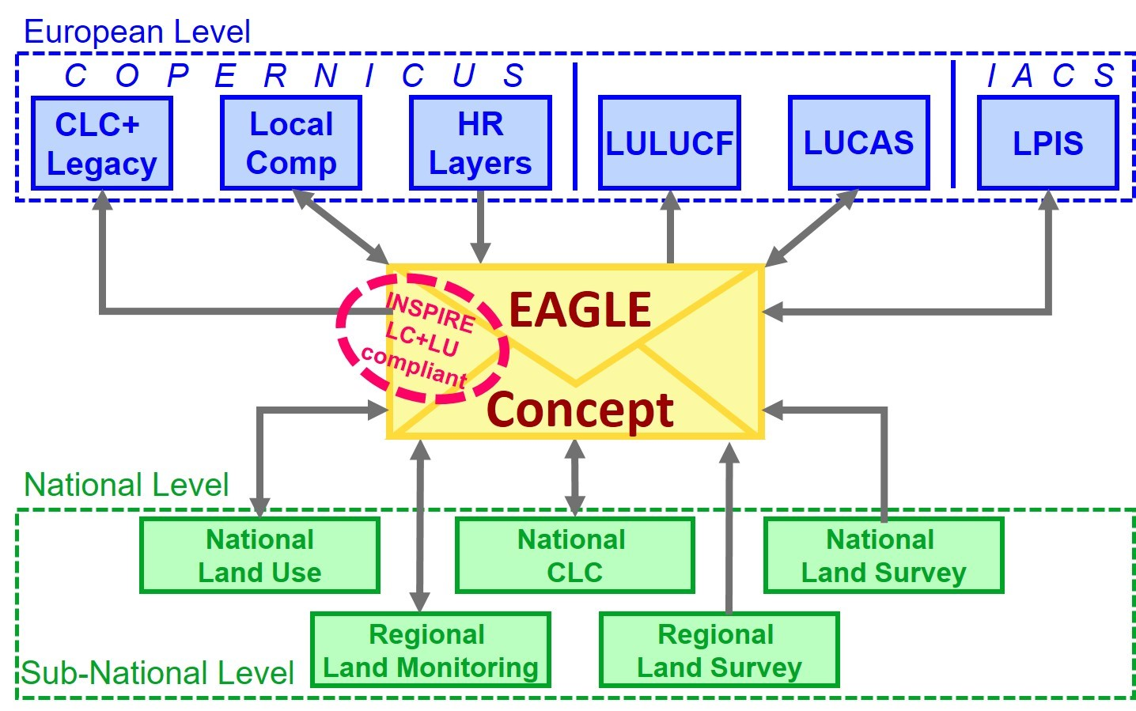

Slide 6
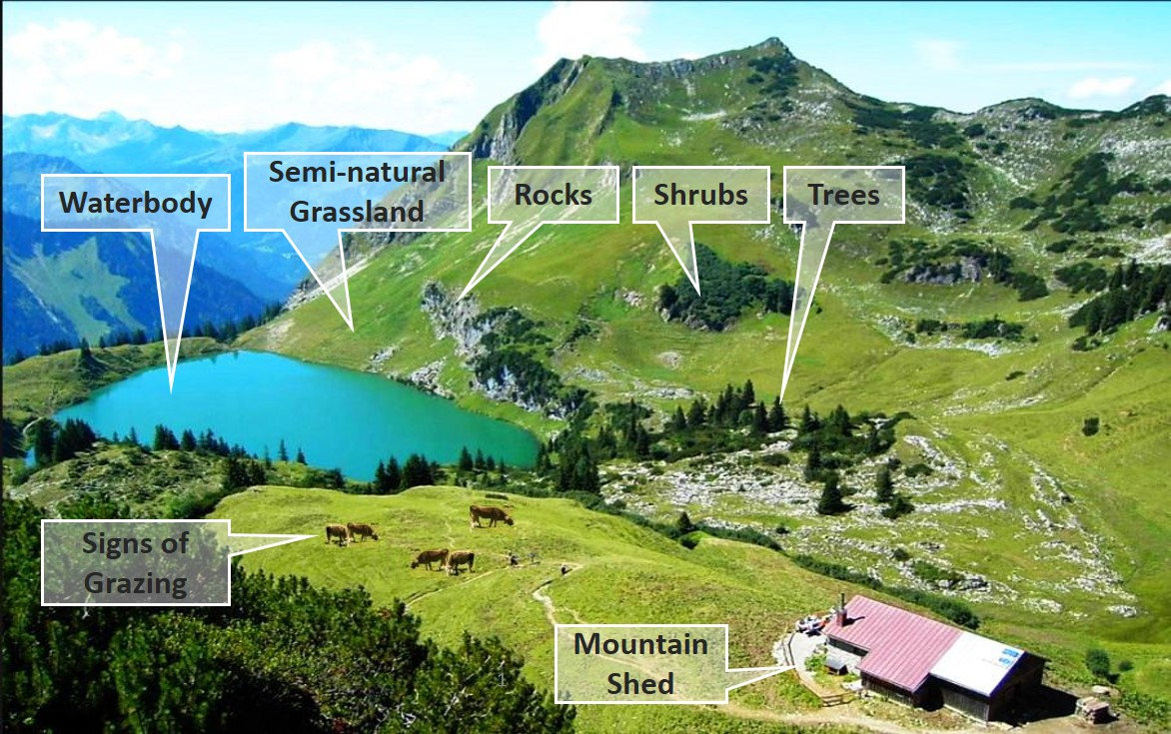
decomposition elements from a complex landscape (adapted from © Oberstdorf – Kleinwalsertal Bergbahnen)

Slide 7
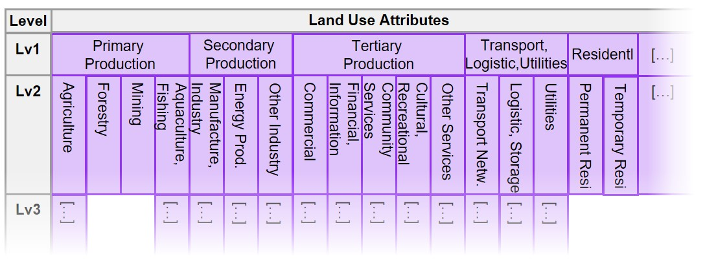
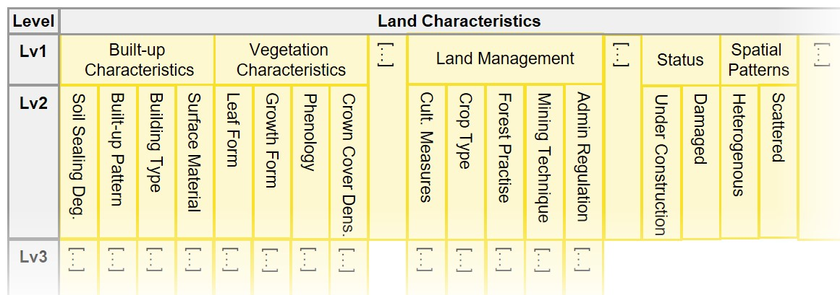

Slide 8
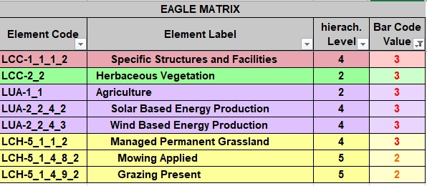

Slide 9
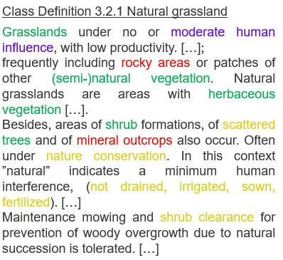
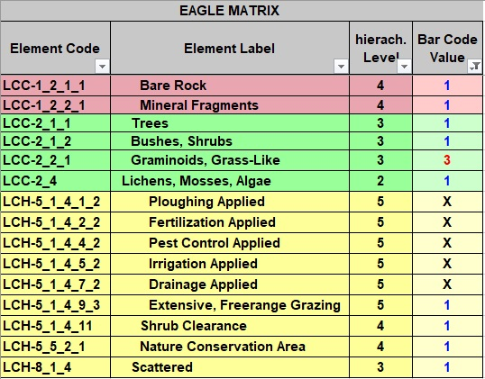

Slide 10
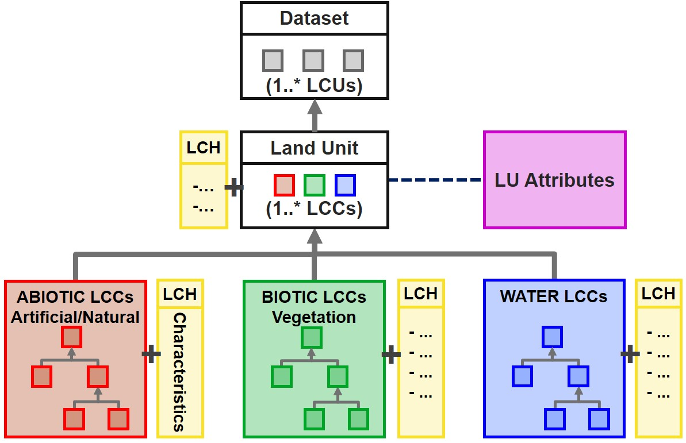

Slide 11
