Slide 1
MSFD TG-DATA D5 and D8 workshop(s) 29-30 April, Copenhagen
Discussion Session: drafted templates for workflows information

Slide 2
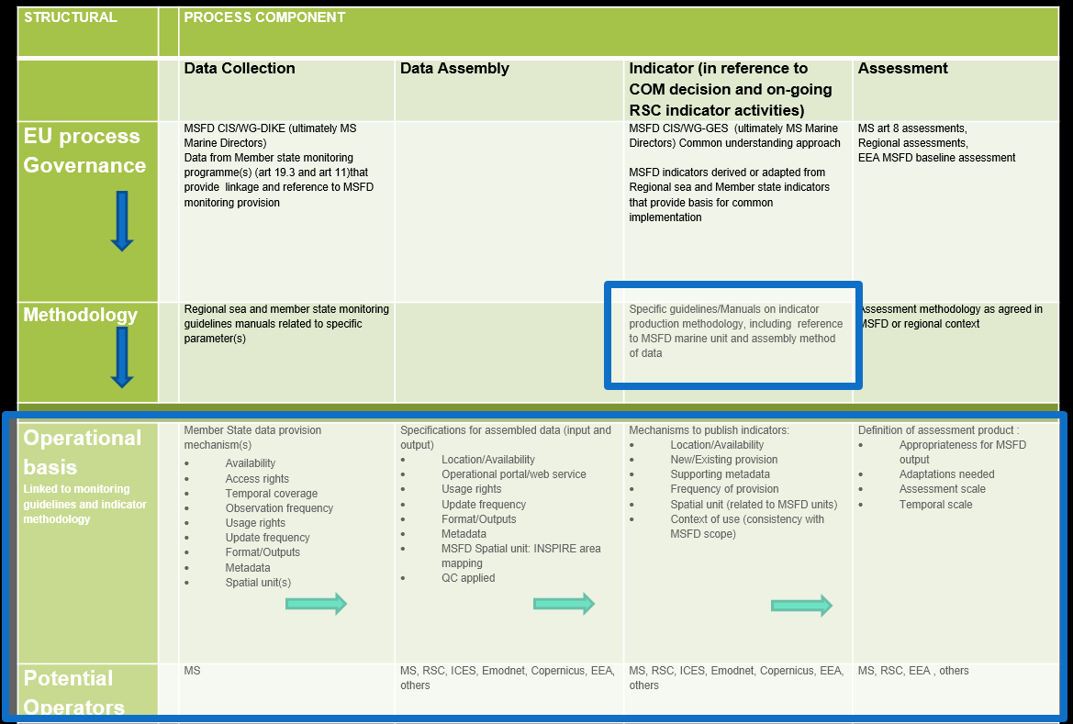

Slide 3
MSFD DATA FLOWS: SCHEMAS
Information about EXISTING workflows:
Are any clarifications needed?
Is there missing and/or erroneous information?
MS perspective
RSC/Regional perspective
Does this represent an accurate ‘ground truth’ of the situation as is (in 2014)?

Slide 4
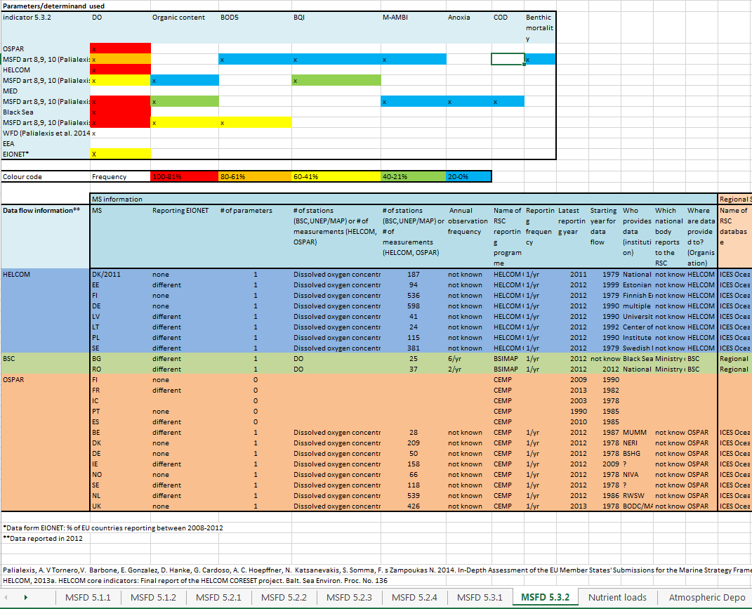
MSFD DATA FLOWS: SCHEMAS
Information about EXISTING workflows:
To what extent would you consider each component (MSFD indicators) an MS/regional operational system
MS perspective
RSC/Regional perspective

Slide 5
MSFD DATA FLOWS: SCHEMAS
Information about EXISTING workflows:
What are the major gaps in making
it operational?
Access and Usage rights (at MS/Regional level)
QC procedures (at MS/Regional level)
Formats and outputs?
Metadata (to link to MSFD)

Slide 6
MSFD DATA FLOWS: SCHEMAS
Information about PROPOSED or NEW workflows:
Which of these workflows will be developed/change/is planned to change?
By what means will it change?
RSC coordinated
MS lead
Regional/European Infrastructure project
3) Is there a timeline for these changes?

Slide 7
MSFD DATA FLOWS: SCHEMAS
Information about PROPOSED or NEW workflows:
4) What will be the major gaps in making it operational?
Access and Usage rights (at MS/Regional level)
QC procedures (at MS/Regional level)
Formats and outputs?
Metadata (to link to MSFD)

