Slide 1
Integrating biodiversity measurements, assessments and policy responses in an ecosystem capital accounting framework.
J-L Weber, R. Spyropoulou, A.T. Peterson
Notes:
The presentation discusses possible ways in which biodiversity values can be incorporated into ecosystem capital accounting frameworks to help reach the global Aichi Target 2 (CBD,2010). requires assessing where progress is being made, or where negatives outweigh positives. Although several indicators of biodiversity loss have been proposed (cf. e.g. Butchart et al. 2004, 2005; Loh et al. 2005, EEA 2009. 2010), they have not been tested as applicable to ecosystem capital accounting, meaning that they are scalable and accessible to countries outside of Western Europe and North America.

Slide 2
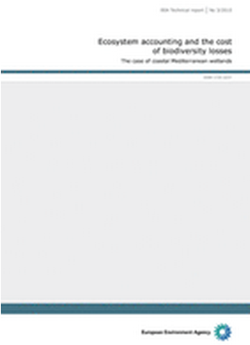
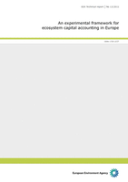
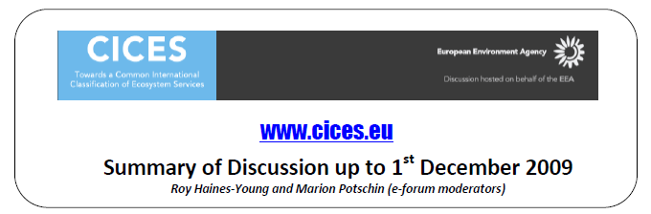
An experimental framework for ecosystem capital accounting in Europe
EEA Technical report
No 13/2011
EEA’s involvement in ecosystem accounting
Activities within SEEA revision context
Land cover accounts for Europe 1990-2000 (26 countries), 2006
Updated for year 2006 (34 countries), next update: for year 2012
Fast Track implementation of ecosystem capital accounts,
2010-2012 (with Eurostat)
Ecosystem accounting and the cost of biodiversity losses — the case of coastal Mediterranean wetlands, 2010, a report for TEEB
http://www.eea.europa.eu/publications/an-experimental-framework-for-ecosystem

Slide 3
The background of Ecosystem Capital Accounts:
➔ Ecosystem capital potential (& degradation) can be measured by combining measurements of 3 ecosystem services:
biomass/carbon, freshwater and systemic services
carbon
there is little or no compensation or tradeoff between them; the use of one should not reduce the use of the others
biomass/carbon, freshwater are based on conventional balances
systemic services (regulating, socio-cultural…) are measured indirectly in relation to ecosystem integrity.
systemic services
water
➔The simplified ecosystem capital accounting circuit
Ecosystem capital
depreciation
Ecological debts
Calculating economic aggregate
Healthy ecosystem
benefit
^{Adapted from}
^{Aoyama Yukiko,} Oguro Michio, and Yano Tohru,
^{Tohoku University, Sendai,} ^{Japan, November 2011}
Ecosystem degradation
Notes:
Third point is that, as a capital, ecosystems produce 3 broad types of services between which there is no compensation or trade-off. The 3 services are carbon, freshwater and systemic services. Ecosystem capital potential and degradation can be measured by combining measurements of these 3 broad services.
Fourth, the simplified ecosystem capital accounting circuit is proposed. So far, economic aggregations such as GDP or National Income were calculated from benefits based on ecological services on the assumption that the ecosystem is healthy. But actually, exploitation of ecological resources results in degradation of ecosystem itself. The degradation of ecosystem should be included the calculations of economic aggregations.
3

Slide 4

What do ecosystem capital accounts tell? an ultra-short story
6
5
Carbon
surplus
10
8
“+”
2
4
Water surplus
4
3
“+”
4
1
Landscape integrity, biodiversity
6
4
Land cover, landscape units, 1km² grids and calculation of ecosystem capital
Notes:
Finally, he presented Experimental implementation of ecosystem accounts in Europe.
First, define 1 square km grids and assign land cover class for each grid.
Then calculate total capital of each grid maybe by adding each component of ecosystem services such as accessible water surplus and carbon surplus and systemic services.
4

Slide 5
3.15
Land cover, landscape units, 1km² grids and calculation of ecosystem capital
6
5
Carbon
surplus
10
8
“+”
2
4
Water surplus
4
3
“+”
4
1
Landscape integrity, biodiversity
6
4
12
10
“=”
20
15
12
10
Total ecosystem capital potential (or capacity)
20
15
Notes:
Finally, he presented Experimental implementation of ecosystem accounts in Europe.
First, define 1 square km grids and assign land cover class for each grid.
Then calculate total capital of each grid maybe by adding each component of ecosystem services such as accessible water surplus and carbon surplus and systemic services.
5

Slide 6
Capital1
Capital2
Improvement
12
10
9
11
-3
+1
_
=
20
15
12
12
-8
-3
Time 1
Time 2
Degradation
Capital1 – Capital2 = Change in capital
^{Adapted from}
^{Aoyama Yukiko,} ^{Oguro Michio, and Yano Tohru}
^{Tohoku University, Sendai,} ^{Japan, November 2011}
Notes:
Then using the total capitals, we can detect the degradation of ecosystem capitals.
If the total capital of this area change along the time, we can calculate the change by subtracting the capital 2 from the capital 1, and we can detect degradation and improvement of ecosystem capitals.
6

Slide 7
The making of the biodiversity/species index for LEAC/Ecosystem capital accounts in Europe,
J.-L. Weber*, E. Ivanov⁺, R. Spyropoulou*, O.Gomez*
* European Environment Agency
⁺ University of Nottingham

Slide 8
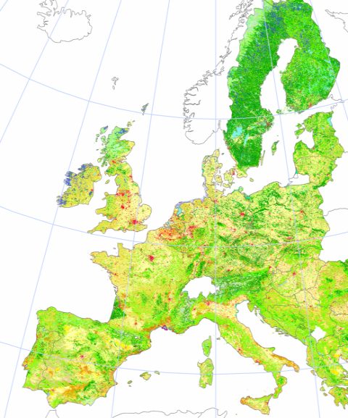
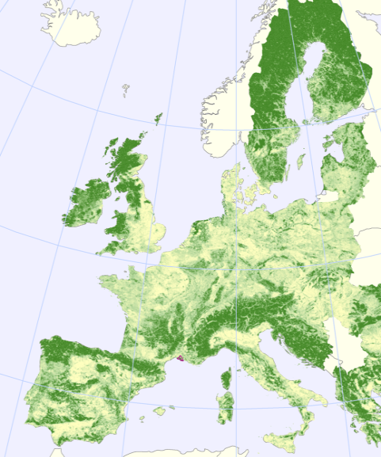
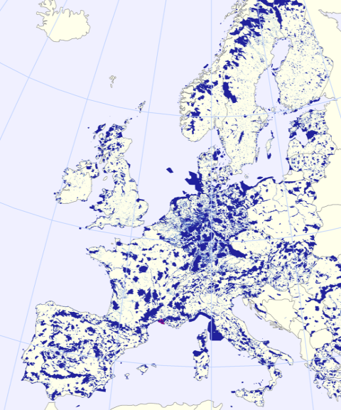
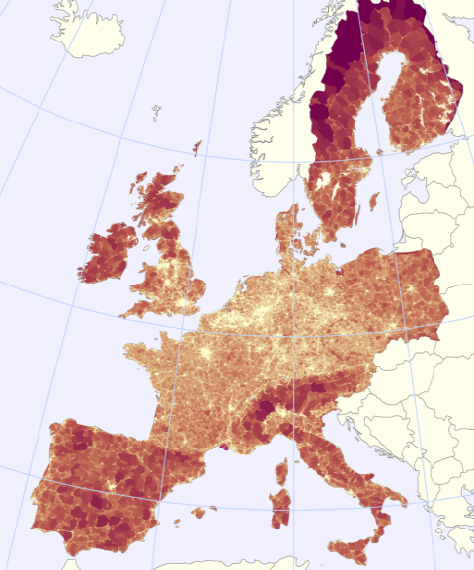

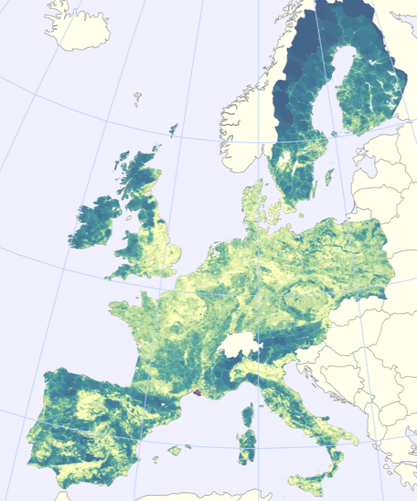
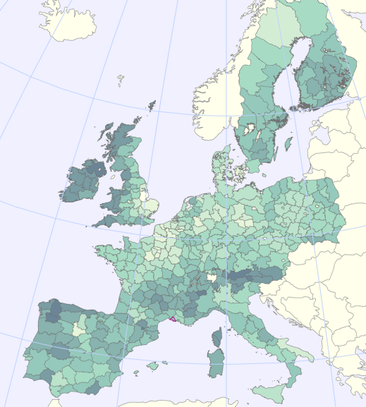
Net Landscape Ecological Potential of Europe
3.39
Corine land cover map (CLC is derived from satellite images)
Green Landscape Index (derived from CLC)
Nature Value (Naturilis, derived from Natura2000 and other designated areas)
Fragmentation (Effective Mesh Size (MEFF) derived from TeleAtlas Roads and CLC)
➔
and
Landscape Ecological Potential (LEP) 2000, by 1km² grid cell
LEP 2000 by NUTS 2/3

Slide 9
Main questions before
Why to put species there anyway?
What to expect from species indices ? (measuring stock impossible) What about changes e.g trends of population or trends in the number of species present?
What to expect from full ecosystem capital accounts e.g. to explain trends, to identify policies, to measure progress?
What kind of data on species could be used for testing our approach?

Slide 10
More than 1000 species protected in the EU
Distribution maps (2006)
Attributing species into their most preferred habitat / Ecosystem (one specie can belong to more than one group): Forest, Agriculture, Grassland, Shrubland, Forest, Wetlands and water, Coasts
Population trends 2000-2006 ( Increasing, Stable, Decreasing)
Index T1: no of species Increasing + Stable – Decreasing
Future prospects as seen in 2006 (good, poor, bad)
Index T2: no of species with good- poor- bad future prospects

Slide 11
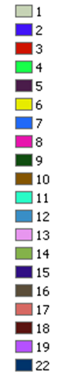


Input 1: Number of forest species reported with « future = bad or poor» Note that several « forest » species can be found in other ecosystems as well.

Slide 12

Input 2: Forest Dominant Landscape Type 34 (more than 1/3…)

Slide 13

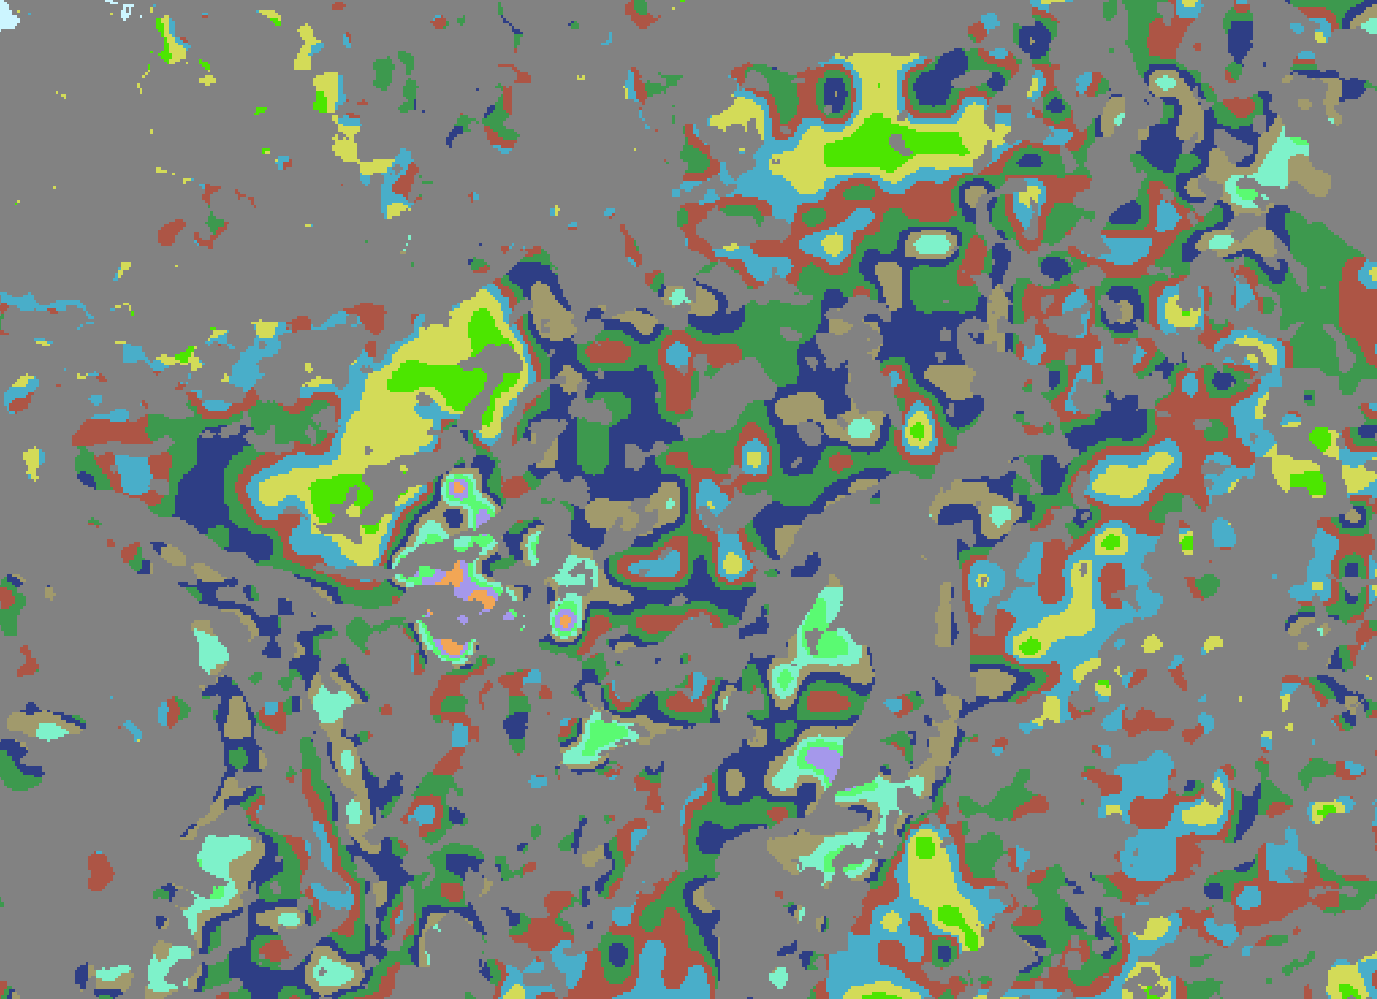
Filtering of resampled data with the map of Forest Dominant Landscape Type 34 (1 km x 1 km)

Slide 14

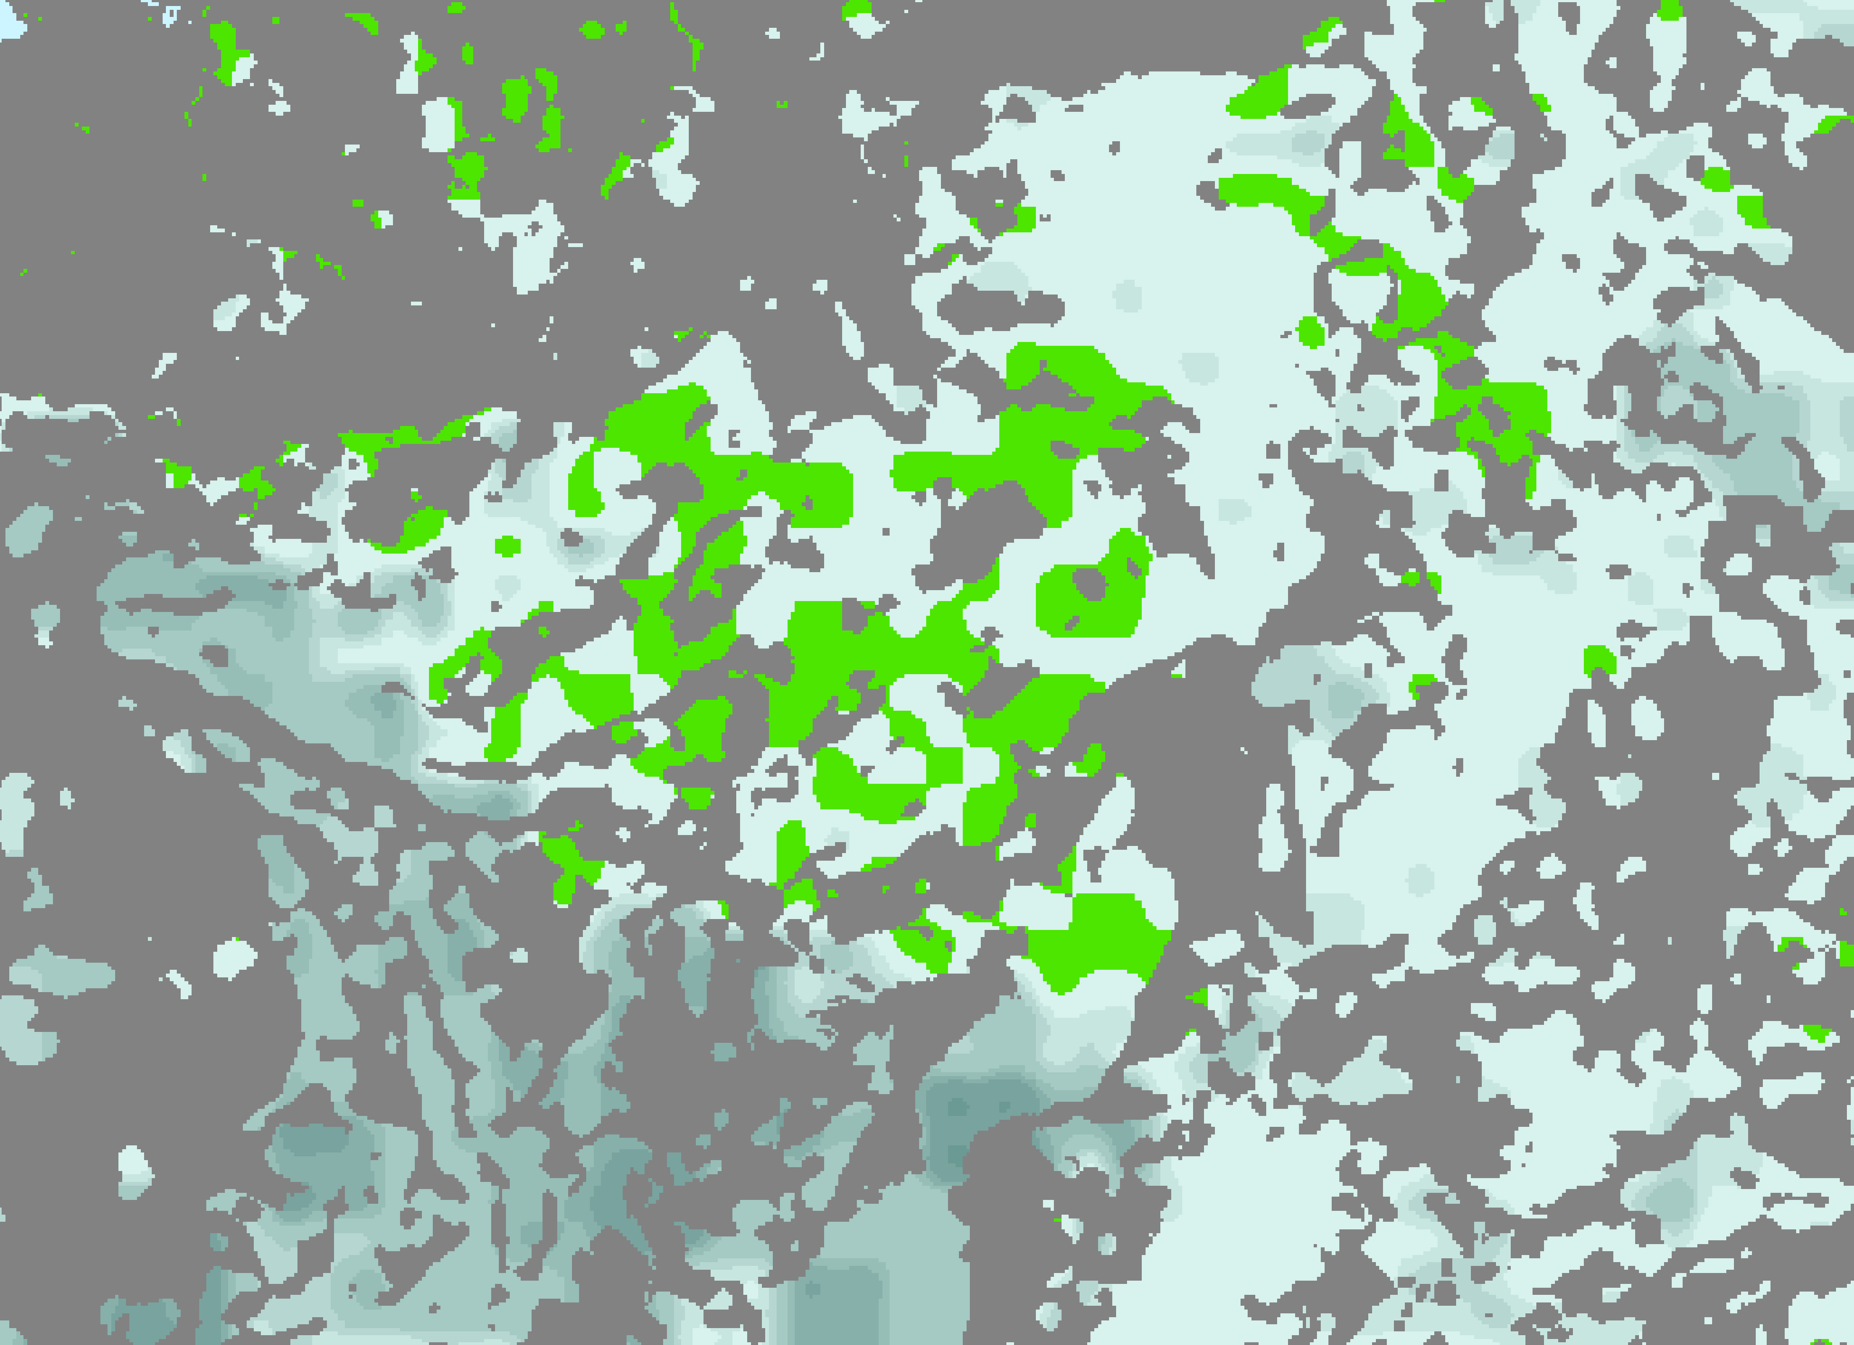
Similarly processed data for Forest: number of species with « future = good »

Slide 15

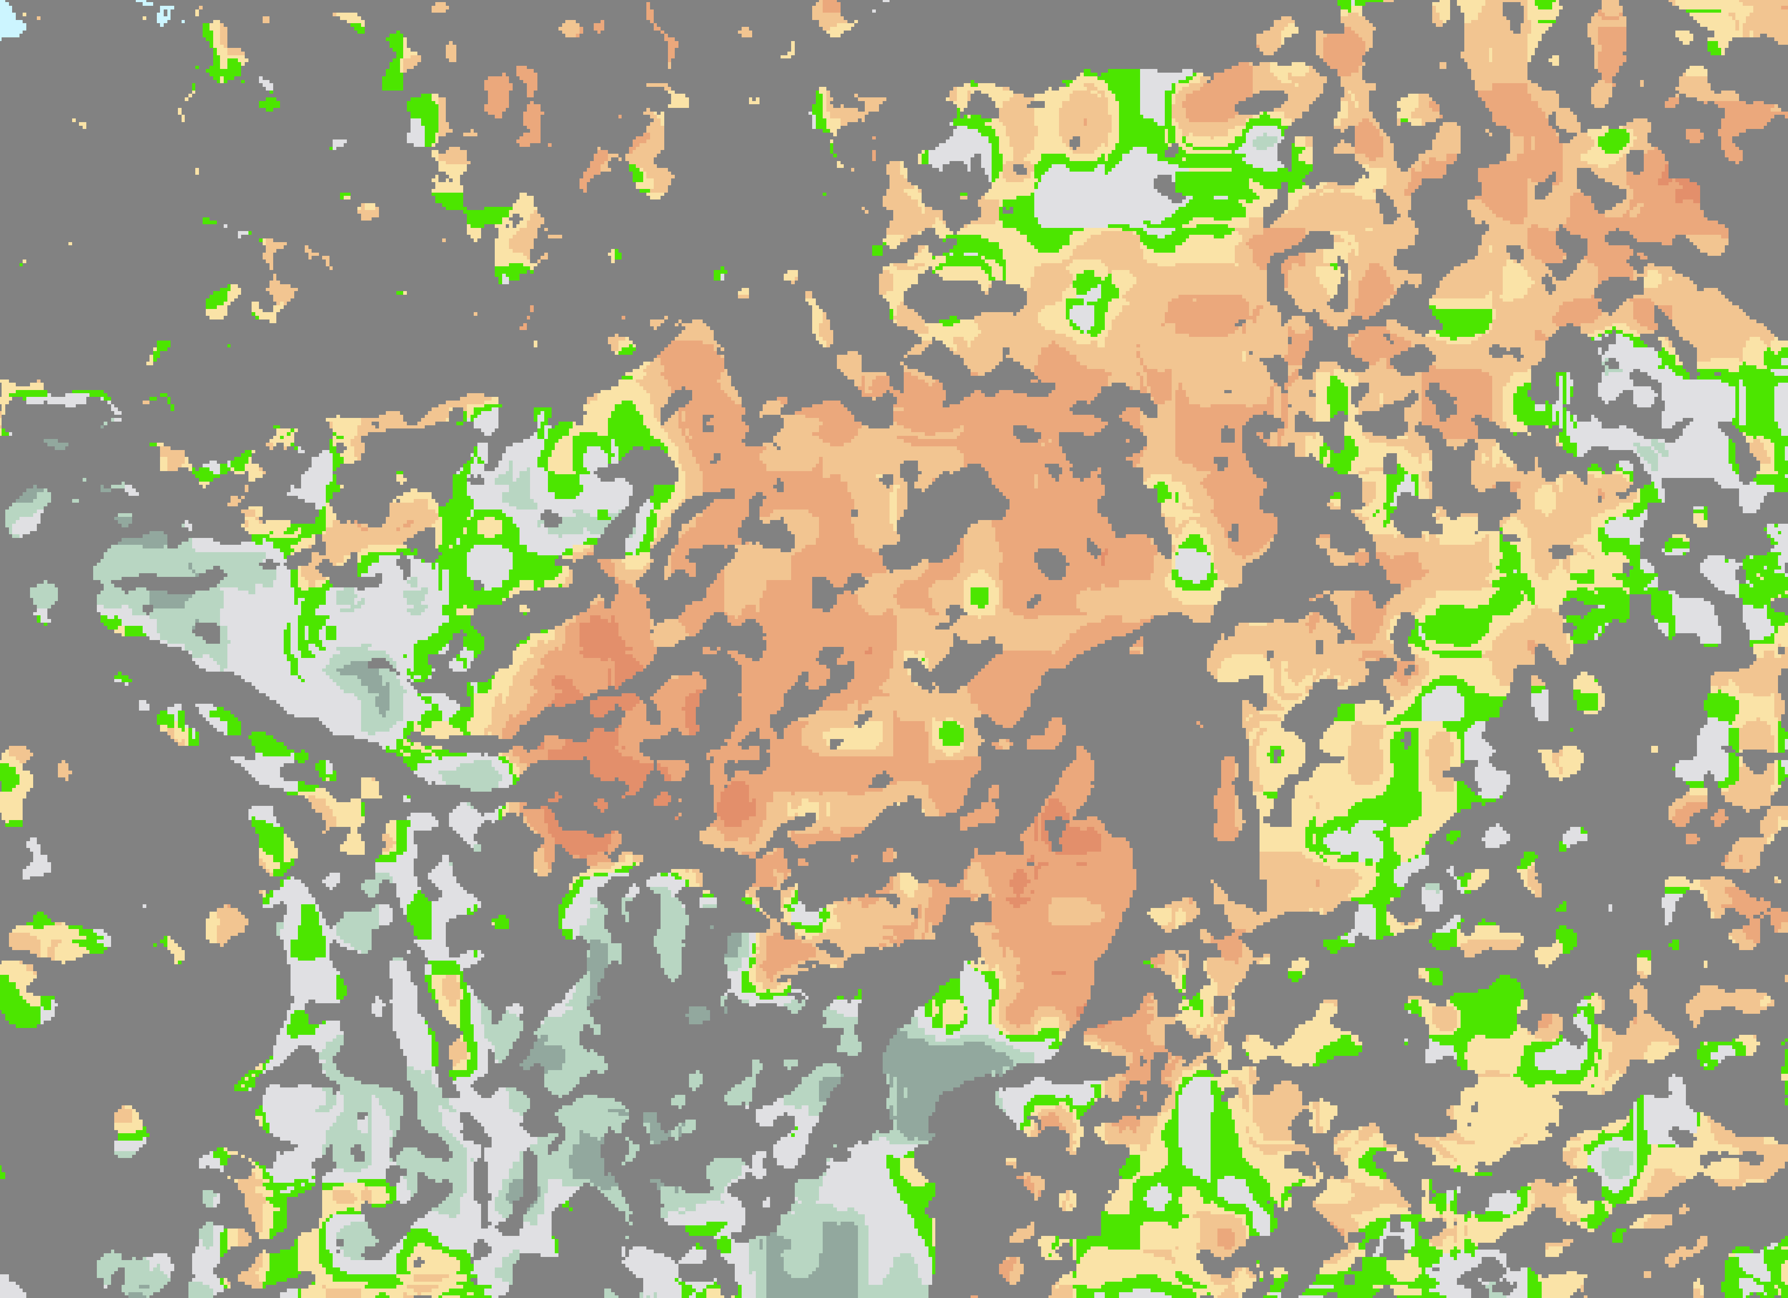
Forest : future prospects index : Number of species with « future good minus future bad+poor »

Slide 16
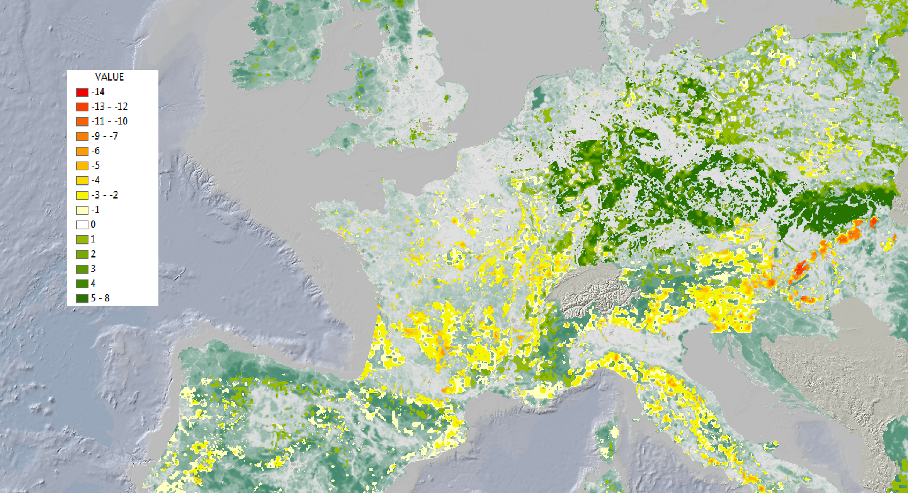
Forest species population index : No of species with population increase and stable minus no of species with decrease

Slide 17
REsults

Slide 18
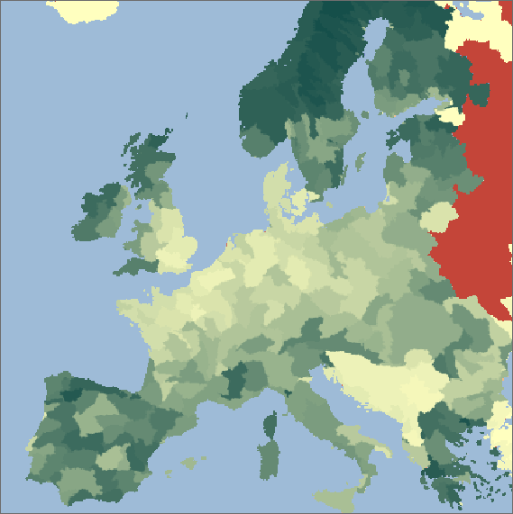
Net landscape ecological potential, nlep 2000 (observed)
+90
+1

Slide 19

Net landscape ecological potential, nlep 2010 (nowcast)
+90
+1

Slide 20
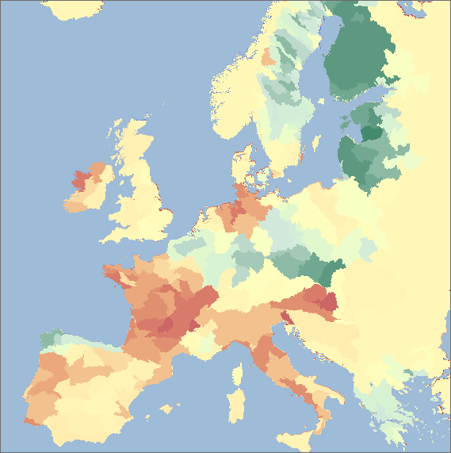
T1 Species “Populations trend” index, by sub-basins

Slide 21
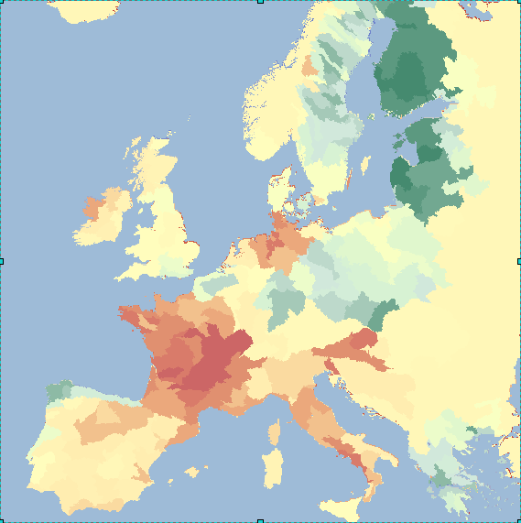
T2 Species “Future prospect” index, by sub-basins

Slide 22
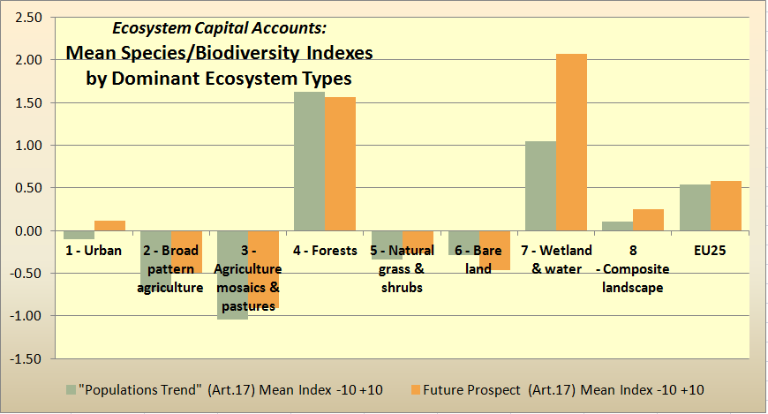
Ecosystem Capital Accounts: Landscape/Biodiversity Capacity Account
Species change mean indexes pre- and post 2006, by ecosystems

Slide 23
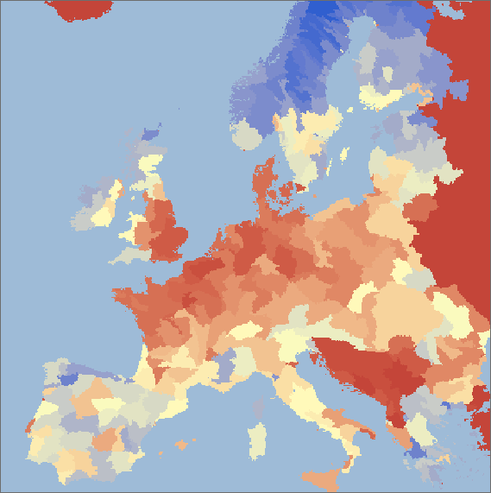
Landscape/species capacity 2000 by sub-basins
+100
+1

Slide 24
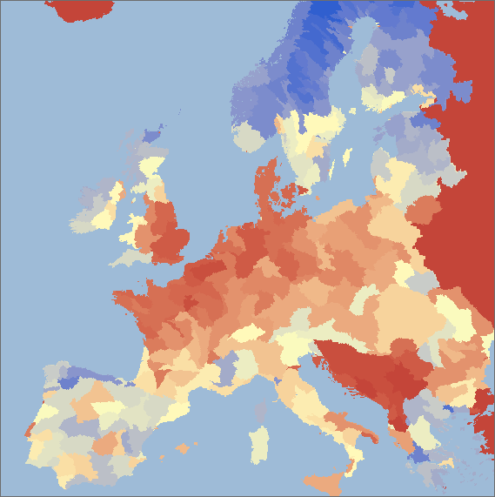
Landscape/species capacity 2006 by sub-basins
+100
+1

Slide 25

Landscape/species capacity 2010 by sub-basins
+100
+1

Slide 26
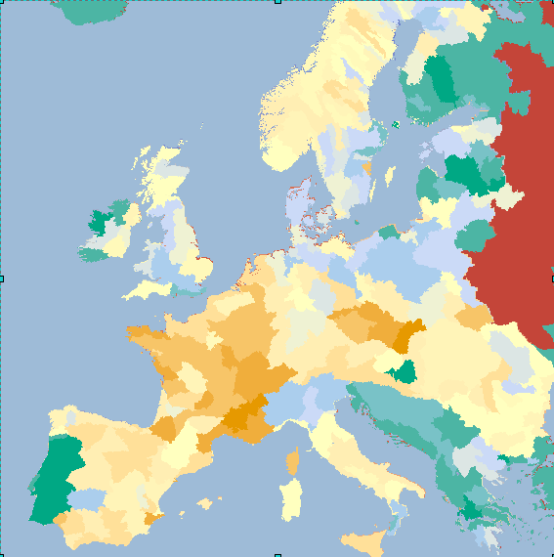
Change in landscape/species capacity 2000-2006, by sub-basins

Slide 27
More questions after
How to represent the unequal distribution of species across countries?
How to define the starting Time of these landscape/ species indices?
How to go on linking ecosystem capital accounts with ecosystem services and human wellbeing?
More species categories, more data needed…. Will there be more monitoring?
Can this methodology be implemented at the global scale, ie, within global ecosystem capital accounts?

