Slide 1
Experimental Ecosystems/Natural Capital Accounts for Mauritius, 2000 – 2010 Collection of maps
Jean-Louis Weber, Nov. 2013

Slide 2
Statistical Units

Slide 3
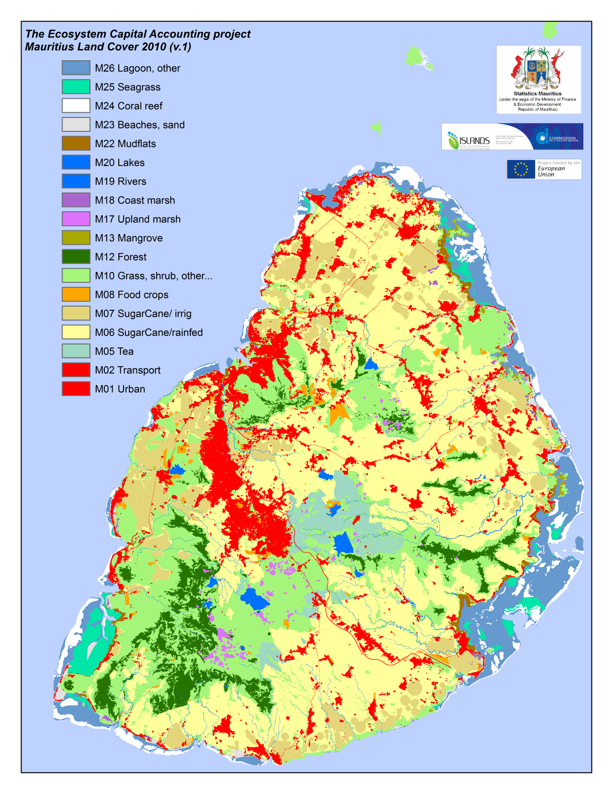
LCEFU: Land Cover Ecosystem Functionnal Units The SEEA-ENCA Land Cover map v.1 2010 of Mauritius

Slide 4
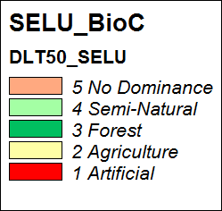
Dominant Land Cover types (neighbourhood value more than 50%)

Slide 5
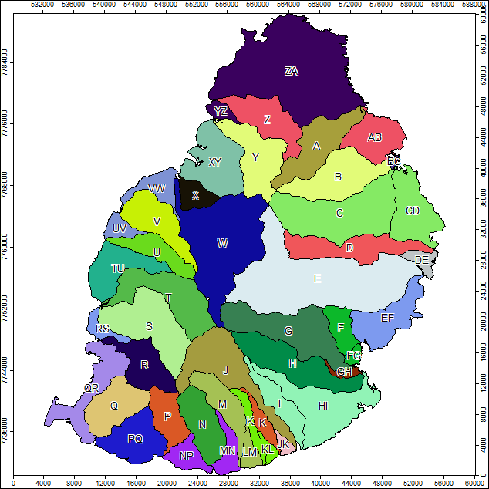
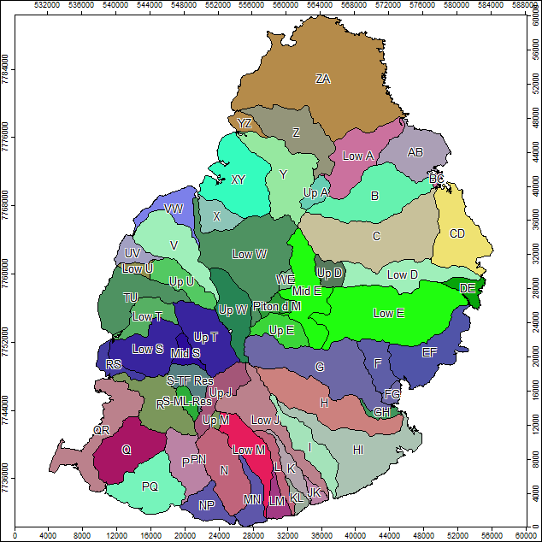
Mauritius’ river catchments and sub-catchments used for ECA

Slide 6
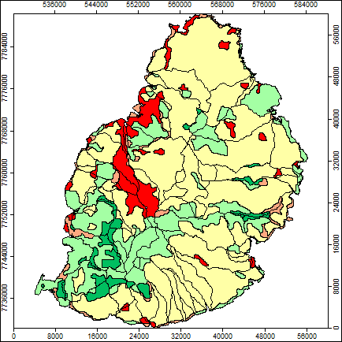
SELU: Socio-Ecological Landscape Units (DLT50 x Sub-catchments)

Slide 7
Each SELU has a SELU_ID which reads: DLT50_SubCatchment_ID

Slide 8
SECU: Sea Ecosystem Coastal Units

Slide 9
The Biomass-Carbon account

Slide 10
SELU: Woody biomass 2000
Source: Emil D. Ivanov from FAO FRA2010 and MODIS EVI
Map: Jean-Louis Weber

Slide 11
SELU: Woody biomass 2010
Source: Emil D. Ivanov from FAO FRA2010 and MODIS EVI
Map: Jean-Louis Weber

Slide 12
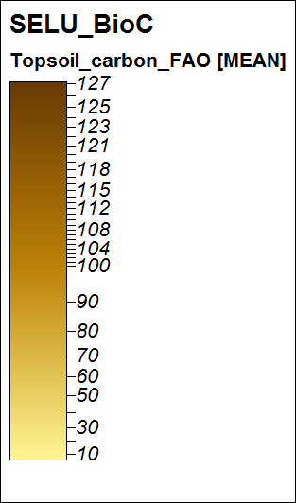
SELU: Topsoil carbon
Source: Emil D. Ivanov & Jean-Louis Weber
from FAO and ORSTOM84
Map: Jean-Louis Weber

Slide 13
SELU: NPP 2000
Source: Emil D. Ivanov
from MODIS NPP and EVI
Map: Jean-Louis Weber

Slide 14
SELU: NPP 2010
Source: Emil D. Ivanov
from MODIS NPP and EVI
Map: Jean-Louis Weber

Slide 15
SELU: NPP change 2000-2010
Source: Emil D. Ivanov
from MODIS NPP and EVI
Map: Jean-Louis Weber

Slide 16
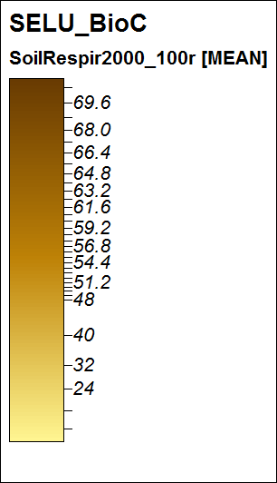
SELU: Estimation of heterotrophic respiration(soil, decomposers…) 2000
Source: Emil D. Ivanov
Map: Jean-Louis Weber

Slide 17
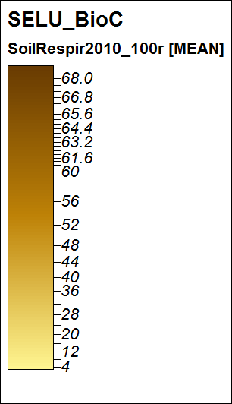
SELU: Estimation of heterotrophic respiration (soil, decomposers…) 2010
Source: Emil D. Ivanov
Map: Jean-Louis Weber

Slide 18
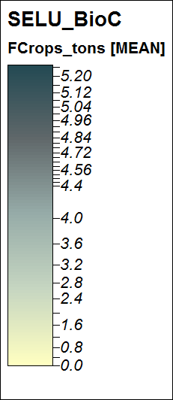
SELU: Total food harvest 2010 (incl. family gardens & cane fields secondary crops), (tons)
Source: Statistics
Estimation & map:
Jean-Louis Weber

Slide 19
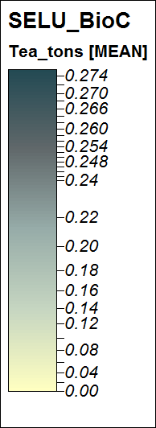
SELU: Tea harvest 2010 (tons)
Source: Statistics
Estimation & map:
Jean-Louis Weber

Slide 20
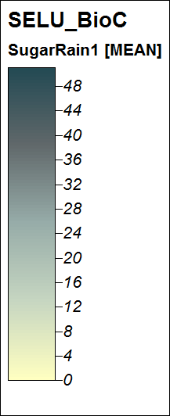
SELU: Sugarcane harvest, rainfed crops, 2010 (tons)
Source: Statistics
Estimation & map:
Jean-Louis Weber

Slide 21
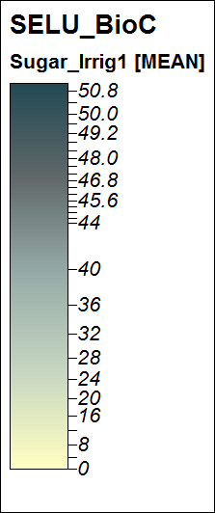
SELU: Sugarcane harvest, irrigated crops, 2010 (tons)
Source: Statistics
Estimation & map:
Jean-Louis Weber

Slide 22
SELU: Sugarcane total harvest, 2010 (tons)
Source: Statistics
Estimation & map:
Jean-Louis Weber

Slide 23
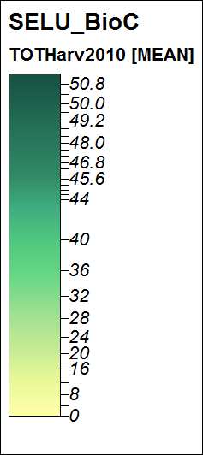
SELU: Total agriculture harvest, 2010 (tons)
Source: Statistics
Estimation & map:
Jean-Louis Weber

Slide 24
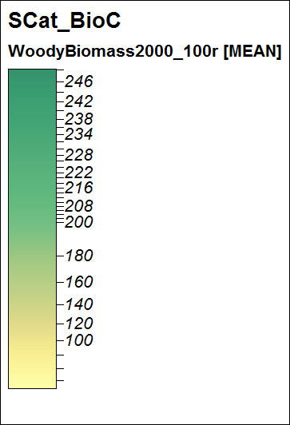
ECA Sub-Catchments: Woody biomass 2000
Source: Emil D. Ivanov from FAO FRA2010 and MODIS EVI
Map: Jean-Louis Weber

Slide 25
ECA Sub-Catchments: Woody biomass 2010
2010
Source: Emil D. Ivanov from FAO FRA2010 and MODIS EVI
Map: Jean-Louis Weber

Slide 26
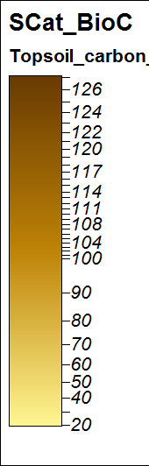
ECA Sub-Catchments: Topsoil carbon
Source: Emil D. Ivanov & Jean-Louis Weber
from FAO and ORSTOM84
Map: Jean-Louis Weber

Slide 27
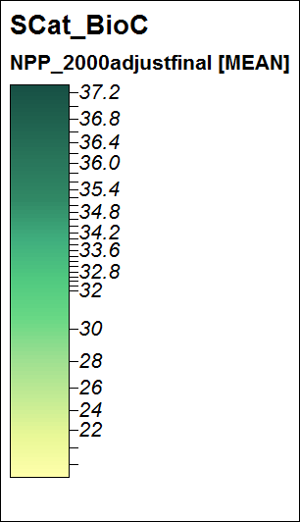
ECA Sub-Catchments: NPP 2000
Source: Emil D. Ivanov
from MODIS NPP and EVI
Map: Jean-Louis Weber

Slide 28
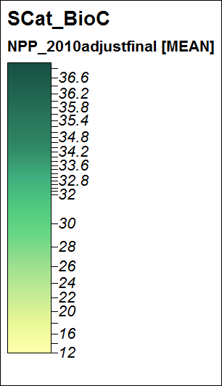
ECA Sub-Catchments: NPP 2010
Source: Emil D. Ivanov
from MODIS NPP and EVI
Map: Jean-Louis Weber

Slide 29
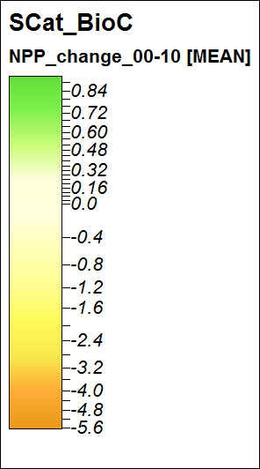
ECA Sub-Catchments: NPP change 2000-2010
Source: Emil D. Ivanov
from MODIS NPP and EVI
Map: Jean-Louis Weber

Slide 30
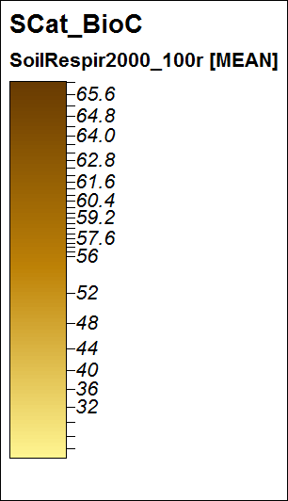
ECA Sub-Catchments: Estimation of heterotrophic respiration(soil, decomposers…) 2000
Source: Emil D. Ivanov
Map: Jean-Louis Weber

Slide 31
ECA Sub-Catchments: Estimation of heterotrophic respiration (soil, decomposers…) 2010
Source: Emil D. Ivanov
Map: Jean-Louis Weber

Slide 32
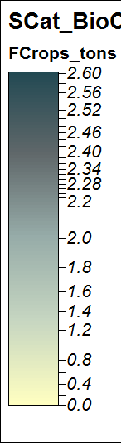
ECA Sub-Catchments: Total food harvest 2010 (incl. family gardens & cane fields secondary crops), (tons)
Source: Statistics
Estimation & map:
Jean-Louis Weber

Slide 33
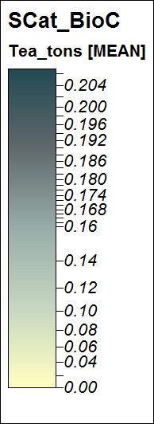
ECA Sub-Catchments: Tea harvest 2010 (tons)
Source: Statistics
Estimation & map:
Jean-Louis Weber

Slide 34
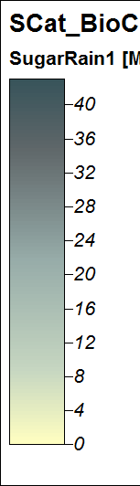
ECA Sub-Catchments: Sugarcane harvest, rainfed crops, 2010 (tons)
Source: Statistics
Estimation & map:
Jean-Louis Weber

Slide 35
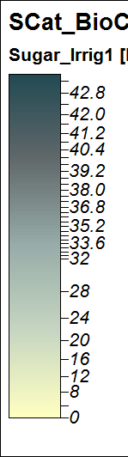
SELU: Sugarcane harvest, irrigated crops, 2010 (tons)
Source: Statistics
Estimation & map:
Jean-Louis Weber

Slide 36
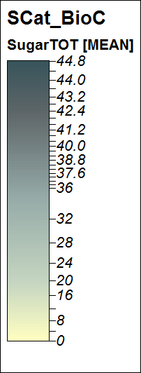
SELU: Sugarcane total harvest, 2010 (tons)
Source: Statistics
Estimation & map:
Jean-Louis Weber

Slide 37
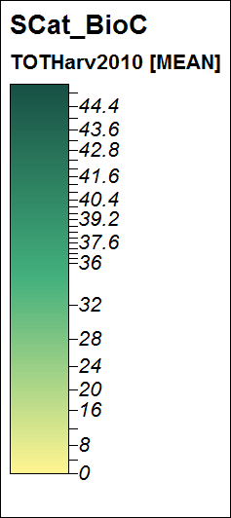
ECA Sub-Catchments: Total agriculture harvest, 2010 (tons)
Source: Statistics
Estimation & map:
Jean-Louis Weber

Slide 38
The green infrastructure/ biodiversity account

Slide 39
GBLI: the Green Background Landscape Index

Slide 40
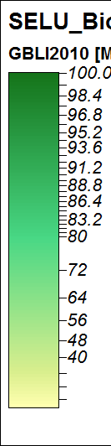
GBLI: the Green Background Landscape Index by SELU
2010

Slide 41
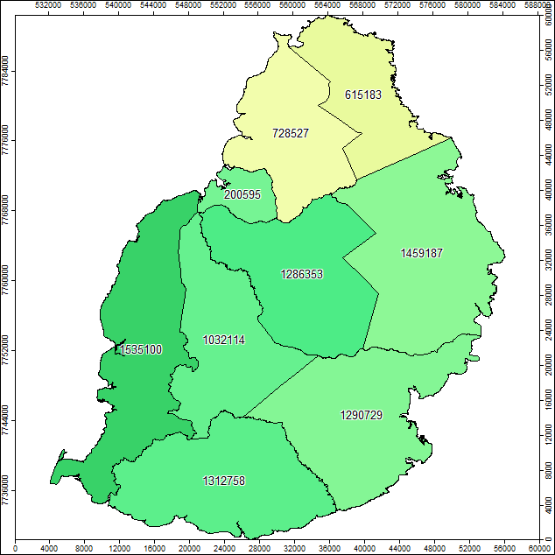
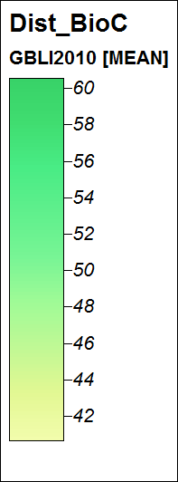
GBLI: the Green Background Landscape Index by Districts (GBLI-weighted ha)

Slide 42
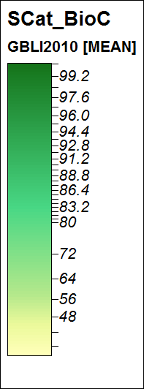
GBLI: the Green Background Landscape Index by SubCatchments (GBLI-weighted ha)

Slide 43
GBLI: the Green Background Landscape Index by SubCatchments (GBLI-weighted ha)

Slide 45
Fragmentation of SELUs by main roads (barrier effect)

Slide 46
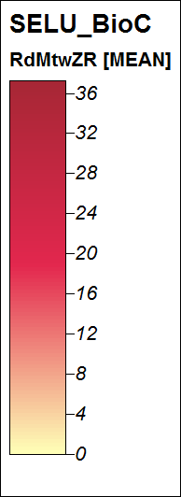
SELU Fragmentation index 0-100 as % road corridors (100m pixels)

Slide 47
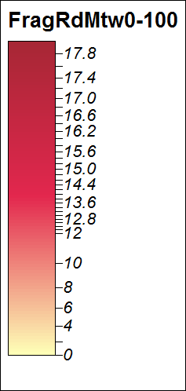
SELU Fragmentation index 0-100 as % road corridors (100m pixels)

Slide 48
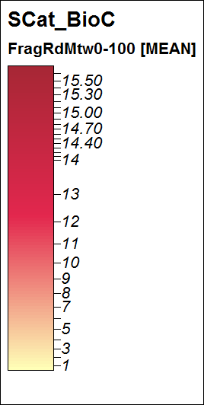
Fragmentation index 0-100 as % road corridors (100m pixels) by Sub-Catchments

Slide 49
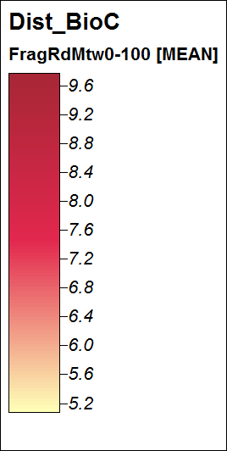
Fragmentation index 0-100 as % road corridors (100m pixels) by Sub-Catchments

Slide 51
NLEP, the Net Landscape Ecosystem Potential 2010

Slide 52
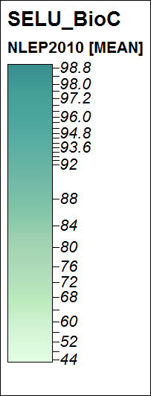
NLEP, the Net Landscape Ecosystem Potential 2010 by SELU

Slide 53
NLEP, the Net Landscape Ecosystem Potential 2010 by SELU (values = weighted ha)
2010

Slide 54
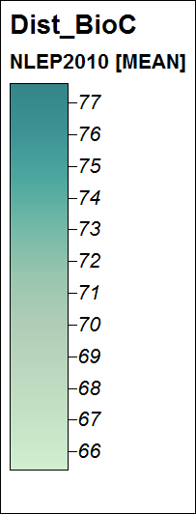
NLEP, the Net Landscape Ecosystem Potential 2010 by Districts (values = weighted ha)

Slide 55
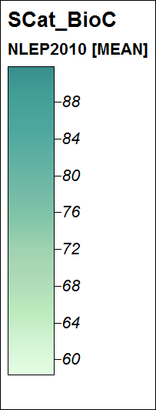
NLEP, the Net Landscape Ecosystem Potential 2010 by Sub-Catchments (values = weighted ha)

Slide 56
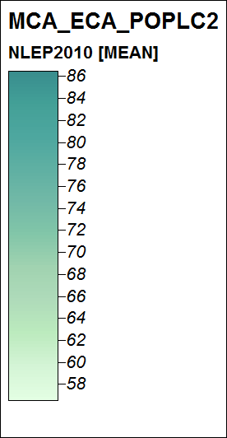
NLEP, the Net Landscape Ecosystem Potential 2010 by MCA-ECA (values = weighted ha)

Slide 57
NLEP, the Net Landscape Ecosystem Potential 2010 by MCA-ECA (values = weighted ha)

Slide 58
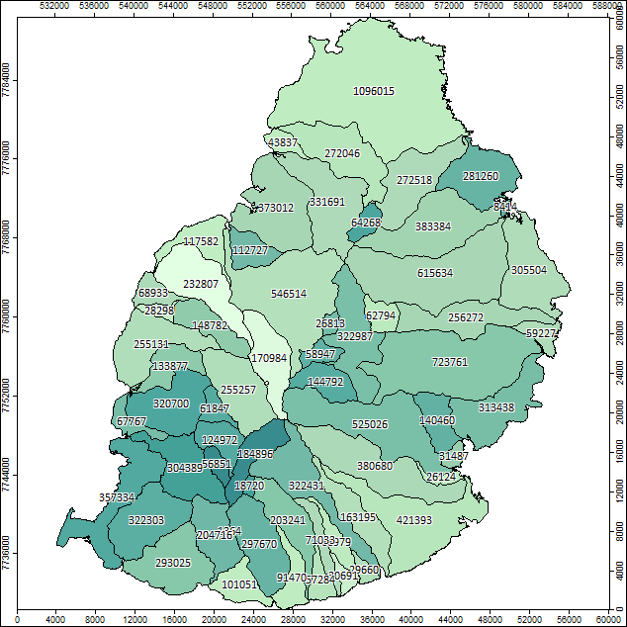
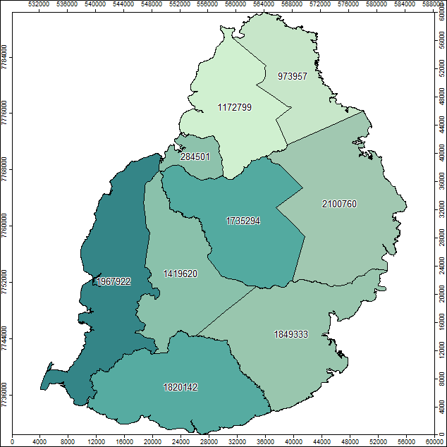
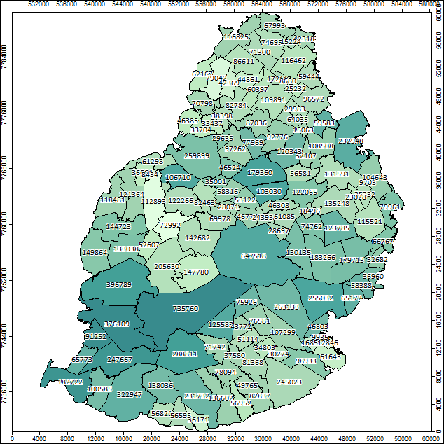

Slide 60
GBLI1010

Slide 61
Water ecosystem accounts

Slide 62
Isohyets merged to match the Meteo simplified statistics

Slide 63
Rainfall by isohyets according to data from representative stations
NB: the sample is very small which results in anomalies; in addition, isohyets create artifical boundaries. The data need to be smoothed to correspond better to the real world.

Slide 64
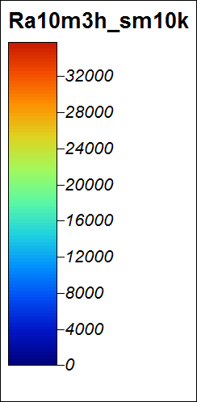
Rainfall, m3/ha, final smoothing
The input grid of rainfall is resampled to 1km2. It is then smoothed with a radius of10. Then, it is resampled back to 100m and cropped with the island coastline.

Slide 65
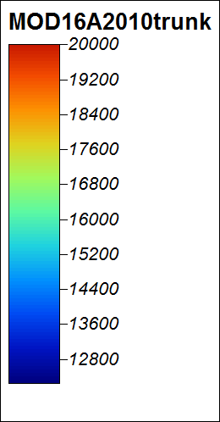
Evapo-Transpiration: MODIS16A3 product reprojected from sinusoidal to UTM and truncated at 20000 (ET values are in 0.1mm, the cells of 1km2)
NB:
0.1 mm is equivalent to 1m3/ha

Slide 66
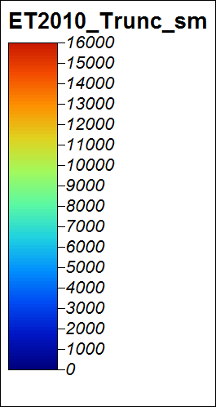
Evapo-Transpiration: from the MODIS16A3 product to the ETP map
The MODIS16A3 product contains ET values in 0.1mm, the cells being of 1km2. It is reprojected from sinusoidal to UTM, then resampled to 100 and truncated at 16000 to eliminate artefacts due to the clipping out of sea and artificial surfaces in the algorithm. A second adjustment for artificial areas is done (ET/(M01/10). The result is then smoothed (Gaussian filter, radius 10).

Slide 67
ET maps from MODIS16A
2000
2010

Slide 68
Manual allocation to sub-catchments of representative (downstream) river gauging stations using the Hydrology Databook.

Slide 69
Visual allocation to sub-catchments of representative (downstream) river gauging stations using the Hydrology Databook.

Slide 70
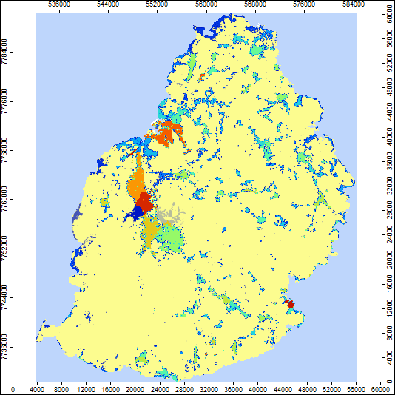
Population 2010 resampled to M01-Urban land cover/ 1 ha

Slide 71
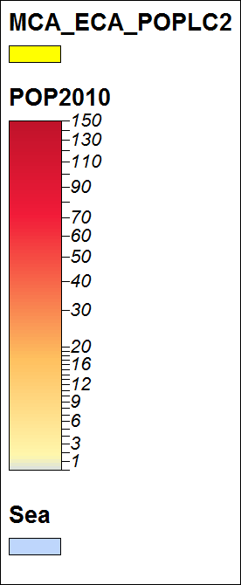
Population 2010 resampled to M01-Urban land cover (persons by 1 ha cells)

Slide 72
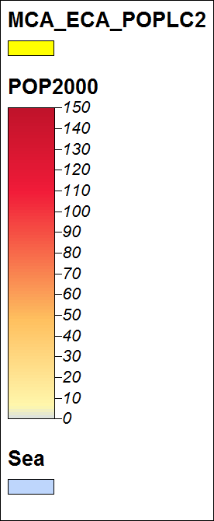
Population 2000 resampled to M01-Urban land cover/ 1ha

Slide 73
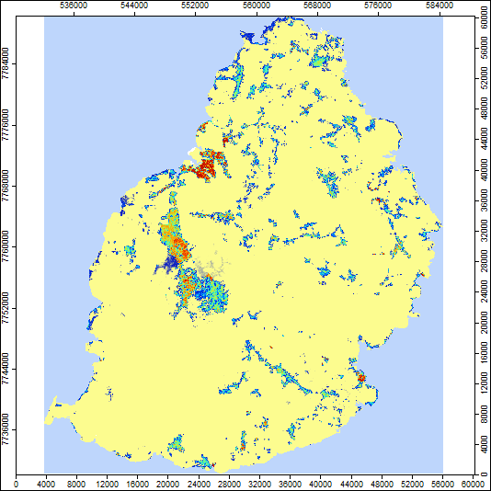
Population 2000 resampled to M01-Urban land cover/ 1ha

Slide 74
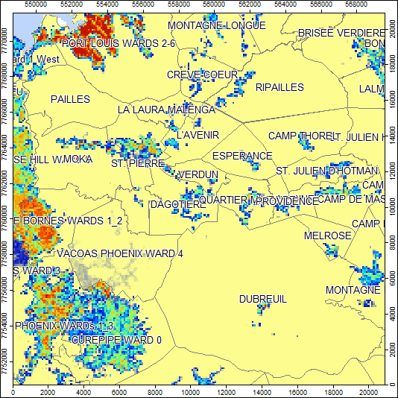
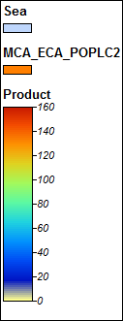
Population 2000 resampled to M01-Urban land cover/ 1ha

Slide 75
First estimation of the water consumption by households/municipalities (in m3/person/year, from the MWA)
2000:
155 m3/p/Year

Slide 76
First estimation of the water consumption by households/municipalities (in m3/person/year, from the MWA)
2010
2010:
165 m3/person/Year

Slide 77
Water intensity of use, 1st decile, 2010

Slide 78
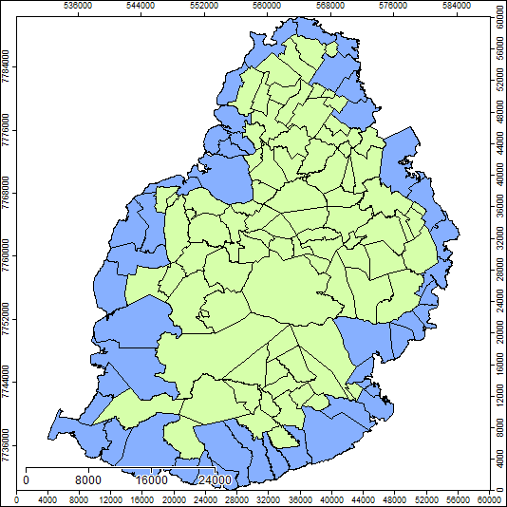
Coastal municipalities

Slide 79
Rivers gauging stations used for accounting

Slide 80
Flows of gauged rivers, 2000 and 2010 in Mm3
2000
2010

Slide 81
River Catchments/Sub-Catchments andLakes (in yellow)

Slide 82
Boreholes and estimation of groundwater abstraction by subcatchments (Mm3)
Mean abstraction 2010 by borehole: 0.139 Mm3

Slide 83
Accessible water
Accessible water, total by Sub-Catchment, Mm3
Accessible water, mean by ha, 10^3 m3
2010

Slide 84
Water Intensity of Use
2010
The Water Intensity of Use Index is the ratio between Accessible Resource and Total Abstraction of Water.
These results are experimental and request further validation and completion as well as clarification regarding dams.
The map reads that values below 100 reflect a structural deficit (which is clearly the case in the northern catchment for the need of which has been created the Midlands reservoir.
Values between 100 and 120 seem reflecting some vulnerability to climate variations and / or a dependency from external supply.
Catchments beyond 150 are in excedent.

Slide 85
2010 – Urban temperature on the coastal ecotone

Slide 86
2000
2010

Slide 87
2010 – Urban temperature on the coastal ecotone
2010

Slide 88
2000 – Urban temperature on the coastal ecotone

Slide 89
Increase of urban temperature on the coastal ecotone , 2000 to 2010

Slide 90
Mean increase of urban temperature on the coastal ecotone , 2000 to 2010, in points per ha on a scale from 0 to 100

Slide 91
Increase of urban temperature on the coastal ecotone , 2000 to 2010, mean increase as % of the lagoon area

Slide 92
The coral reefs state index derived from the ESA assessment

Slide 93
The coral reefs state index derived from the ESA assessment

Slide 95
First account of biodiversity status for Sea Ecosystem Coastal Units (based on the coral reefs index, mean values)

Slide 96
Sea Ecosystem Coastal Units

Slide 97
Ecosystem Capital Capability (inland): ECU mean prices by Districts, 2000

Slide 98
Ecosystem Capital Capability: ECU mean prices by Districts, 2010

Slide 99
Ecosystem Capital Capability (inland): ECU mean prices by Districts, 2000 & 2010
2000
2010

Slide 100
Ecosystem Capital Capability (inland): ECU Value by Districts, 2000

Slide 101
Ecosystem Capital Capability (inland): ECU Value by Districts, 2010

Slide 102
Ecosystem Capital Capability (inland): ECU Value by Districts, 2000 & 2010
2000
2010

Slide 103
Ecosystem Capital Capability (inland): Change in ECU Value by Districts, 2000-2010

Slide 104
Ecosystem Capital Capability (inland): Change in ECU Value, % by Districts, 2000-2010

Slide 105
Ecosystem Capital Capability (inland): Change in ECU Value (left) and % (right) by Districts, 2000-2010

